Slide 1
International Operations
Overview
February 2023

Slide 2
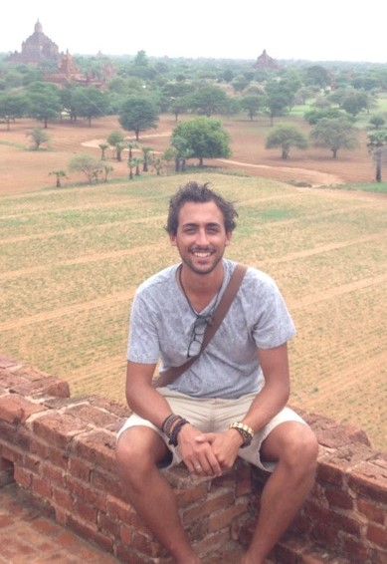
International Travel
Dan Fabbro
International Travel Specialist
Experience in international development and international security.
Lived, worked and traveled extensively in Europe and Southeast Asia
Watch the Global Hub Town Hall- available online at UMB’s YouTube page!

Slide 3
International Operations & the Global Hub
Ensure support of UMB's global activities
Provide specialized support to UMB units in procurement, finance, human resources, compliance, International Travel, and Safety and Security
Facilitates and promotes robust risk management across all international operations.
For more information: Global Hub - Welcome to the Global Hub (umaryland.edu)

Slide 4
International Operations Team
Anna Schowengerdt
US
Assistant VP, UMB International Operations
VP, MGIC Policy and Administration
Danielle Hill
US
Dept. Coordinator
Atiqul Abbast
US
Manager, Int’l Finance & Procurement
Mwanaisha Rashid
Kenya
Sr. Manager,
Int’l HR
Isabel Nshimbi
Zambia
Manager,
Int’l IT
Herty Cortez Diaz
US
Director, Int’l Risk Management
David Ng’onamo
Malawi
Sr. Specialist,
Int’l Procurement
Richard Tassani
Tanzania
Sr. Specialist, Int’l Accounting
VACANT
US
Lead Specialist, Int’l Legal Compliance
Ken Nisbet
US
Manager, Int’l
Safety & Security
Dan Fabbro
US
Specialist,
Int’l Travel

Slide 5
International Travel and Security
International challenges and travel security
Empower personnel
Safety and security as enabler of UMB International Research and Programs

Slide 6
International Travel for Faculty and Staff
Global Hub: International Travel (umaryland.edu)
STEP 1: Take Personal Safety and Security Training
STEP 2: Check destination country security ratings
STEP 3: Sign International Traveler Attestation Form
STEP 4: Request Travel Authorization in Concur
STEP 5: Book your Travel with Travel Leaders
STEP 6: Download International SOS’ Assistance app
International Travel (umaryland.edu)

Slide 7
International Safety and Security
Ken Nisbet
International Safety and Security Manager
12+ years experience in international security risk management
Lived, worked and traveled extensively in Sub-Saharan Africa and the Middle East

Slide 8
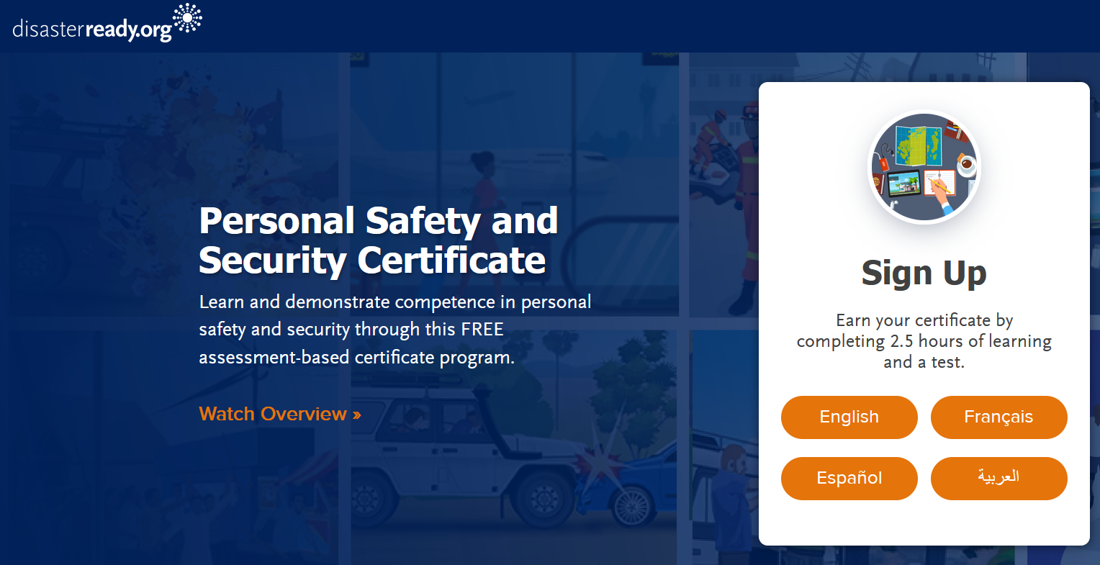
How International Operations supports you
Before You Go
Learn at your own pace with recommended travel security courses via DisasterReady.org

Slide 9
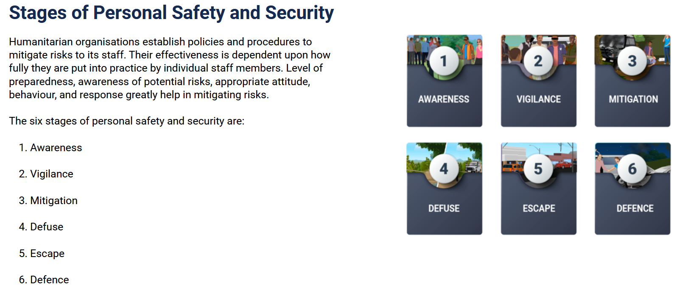
How International Operations supports you
Before You Go
Learn at your own pace with recommended travel security courses via DisasterReady.org
Personal safety and security awareness module

Slide 10
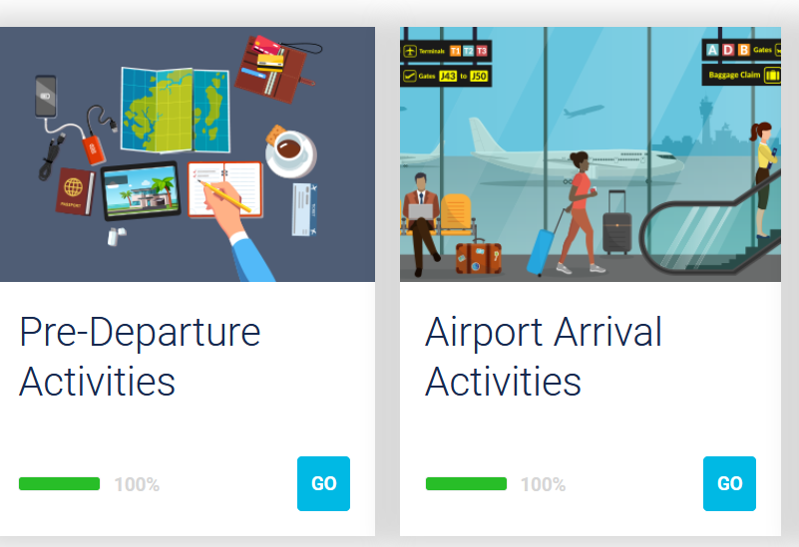
How International Operations supports you
Before You Go
Learn at your own pace with recommended travel security courses via DisasterReady.org
Pre-travel considerations

Slide 11
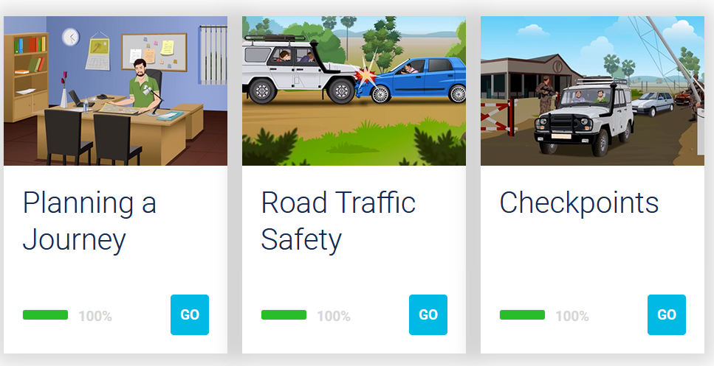
How International Operations supports you
Before You Go
Learn at your own pace with recommended travel security courses via DisasterReady.org
Vehicle travel and road safety

Slide 12
How International Operations supports you
International SOS:
Available to all traveling on UMB’s behalf – now including nonemployees
Can register with personal email and Membership ID
Security and medical support, ranging from routine queries to evacuation
Sophisticated itinerary tracking system allows for IO to determine who is in the affected area of an incident
Working on expanding access to International SOS’s online trainings to all UMB travelers
UMB’s 24/7 International Incident Reporting line
Connect with IO’s Duty Officer for support and guidance as necessary

Slide 13
How International Operations supports you
Learn at your own pace with recommended travel security courses via DisasterReady.org
Pre-departure safety and security briefings/meetings

Slide 14
How International Operations supports you
Before You Go
Learn at your own pace with recommended travel security courses via DisasterReady.org
Pre-departure security briefings
Always available to discuss safety and security considerations for your international trips and projects overseas

