Slide 1
Rapid Improvement Events (RIE) Report Out Presentations
October 15th, 2026

Slide 2
What is UMB Elevate
University-wide Continuous Improvement (CI) initiative focused on empowering employees to improve the way we work, learn, serve, and collaborate.
CI is built on the belief that the people closest to the work are best positioned to improve it.
CI is not about doing more with less, it's about working better with what we have.
Long-term commitment to building a culture where CI becomes part of everyday work.
Help advance UMB's mission while strengthening organizational excellence across the university.

Slide 3
UMB Elevate Roadmap
01. Readiness Assessment Complete
02. Employee Green Belt Training (4 Cohorts – Total 64 employees) In Progress
03. Rapid Improvement Events (Demonstration Projects) In Progress
04. Communications & Engagement Plan Coming soon
05. Establish Steering Committee Coming soon
06. Employee Learning & Development (White Belt Program) Coming soon
07. Smart Goals & Metrics Coming soon
08. Advisory Group Coming soon

Slide 4
PCard Purchase Contract Review
Rapid Improvement Event

Slide 5
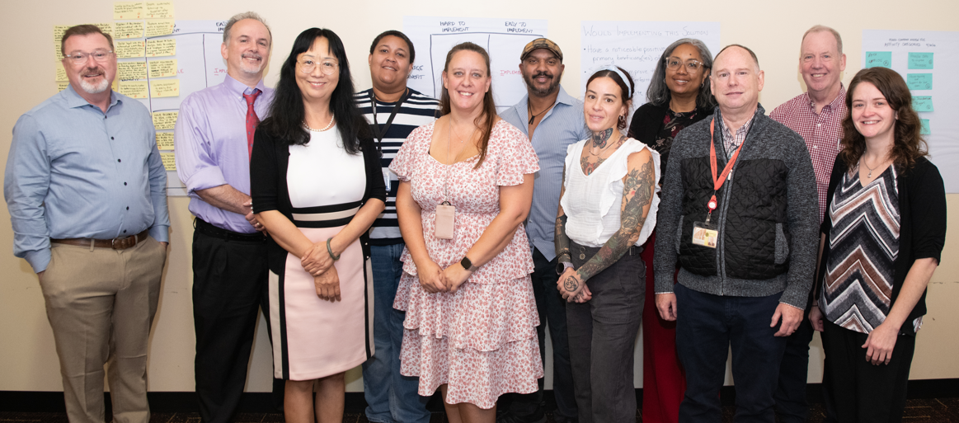
Team Picture

Slide 6
Team: Leaders, Members & Facilitator​s
External Facilitator:
Bill Balzer
RIE Team Leaders:
Keith Gagnon
​
Facilitators in Training (FIT)​
Jana Goodwin, SON
Reese Spindle, F&O
RIE Team Members​:
Richard Elliott, SSAS
Stephen Giermek, CITS
Justin Hanna, School of Social Work
Tina McFarland, School of Pharmacy
Heather McKlveen, School of Law
Vanessa Perrigo, SSAS
Kristin Kearney, Provost Office

Slide 7
Background
PCard holders may make individual purchases of less than $5,000
PCard holders cannot sign contracts or other purchasing agreements.
Agreements requiring signature must go through the appropriate procurement authority for review and signature before purchase.
Contract-signing authority rests with professional procurement staff in:
  SSAS for general goods and services purchases.
  CFSA for construction and facilities purchases.

Slide 8
Current State
PCard users and Departments are submitting contracts multiple ways
  Direct buyer
  SASS contract email
  Other email such as PCard administration or legal
Duplicate submissions are occurring
Contracts are not being submitted with all pertinent information
No visible tracking system

Slide 9
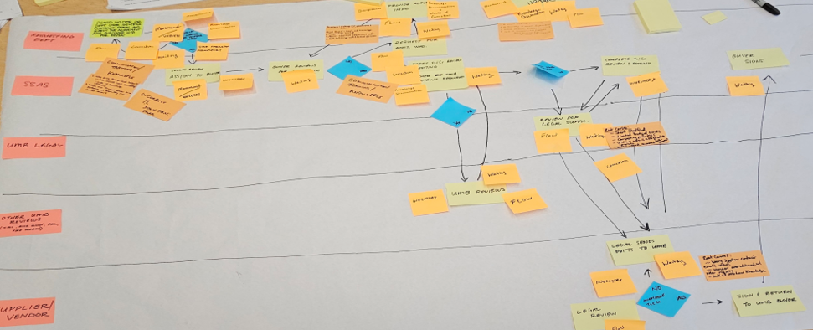
Current State Process Map

Slide 10
Current State - Analysis
Identify Waste – correction, flow, inventory, overprocessing, overproduction, waiting
Analysis – Root Causes via Five Whys
Common causes – bad expectations, incorrect knowledge, poor communications
Solutions
  Simple – improved training, communications, expectations, standards
  Complex – automated, improved systems
Notes:
Current State – Stephen Giermek
Lots of waste identified in current workflow. Wastes of:
Correction – activity or steps are repeated to correct mistakes or resolve problems
Flow – extra resources are needed to respond to uneven demand or fluctuating schedules
Inventory – resources or output stockpiled because they are not yet needed
Overprocessing – unnecessary time & energy is consumed with no value add
Overproduction – steps or products completed before they can be used, or output exceeds what is immediately needed
Waiting – process is halted or slowed waiting for people, info, actions, resources
Analysis of Root Causes
Five Whys
Cause & Effect / Fishbone diagram
Solutions
Simple
Common trends
Training
Communications
Web pages
Setting expectations
Standards
Standard operating procedures
Templates
More complex
Excel, MS Forms, Automate
Explore
CITS developed app, similar to or expansion of existing IT-PCS form
Requires discovery and human resources
3rd part solutions – Veoci, etc.
Requires discovery and financial resources

Slide 11
Metrics & Targets for Improvement
SCORECARD METRIC | CURRENT | FUTURE TARGET | CHANGE
Quality: duplicate submissions / duplicate handling | 62% of buyers receive duplicate submissions at least occasionally 25% frequently | Reduce to 0 | Complete reduction
Quality: requests with complete required information | 25% of buyers report that requests almost never or only some of the time contain all information | At least 90% complete at intake | Baseline dependent
Operational Delivery: end-to-end turnaround time | Average 5.9 days* | Reduce median time by at least 25% | ≥25% reduction
Operational Delivery: requests with visible owner and status | 50% of Buyers report Frequent bypassing of intake mailbox No consistent systemwide view or status tracking | 100% in tracking mechanism | To 100%
Business Performance: records searchable and audit-ready | Fragmented mailbox / files | 100% completed records retained with audit trail | To 100%

Slide 12
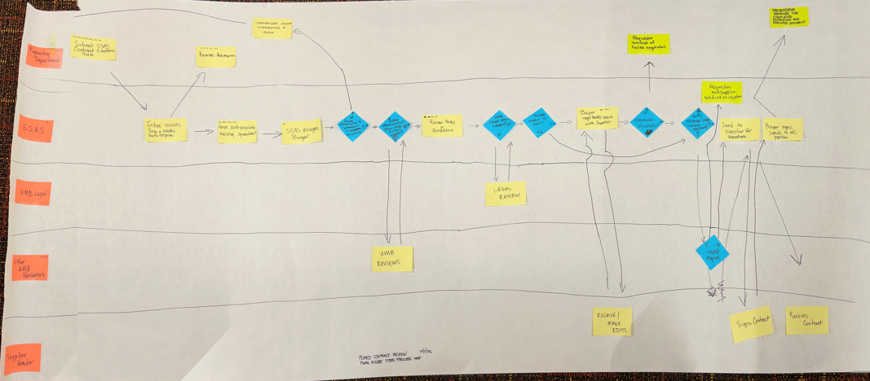
Proposed Future State

Slide 13
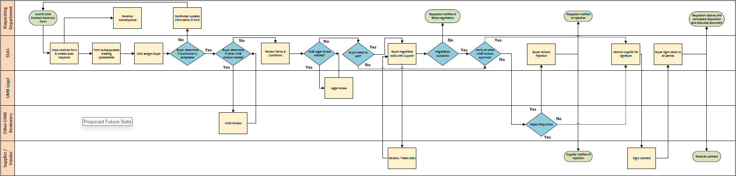
Proposed Future State

Slide 14
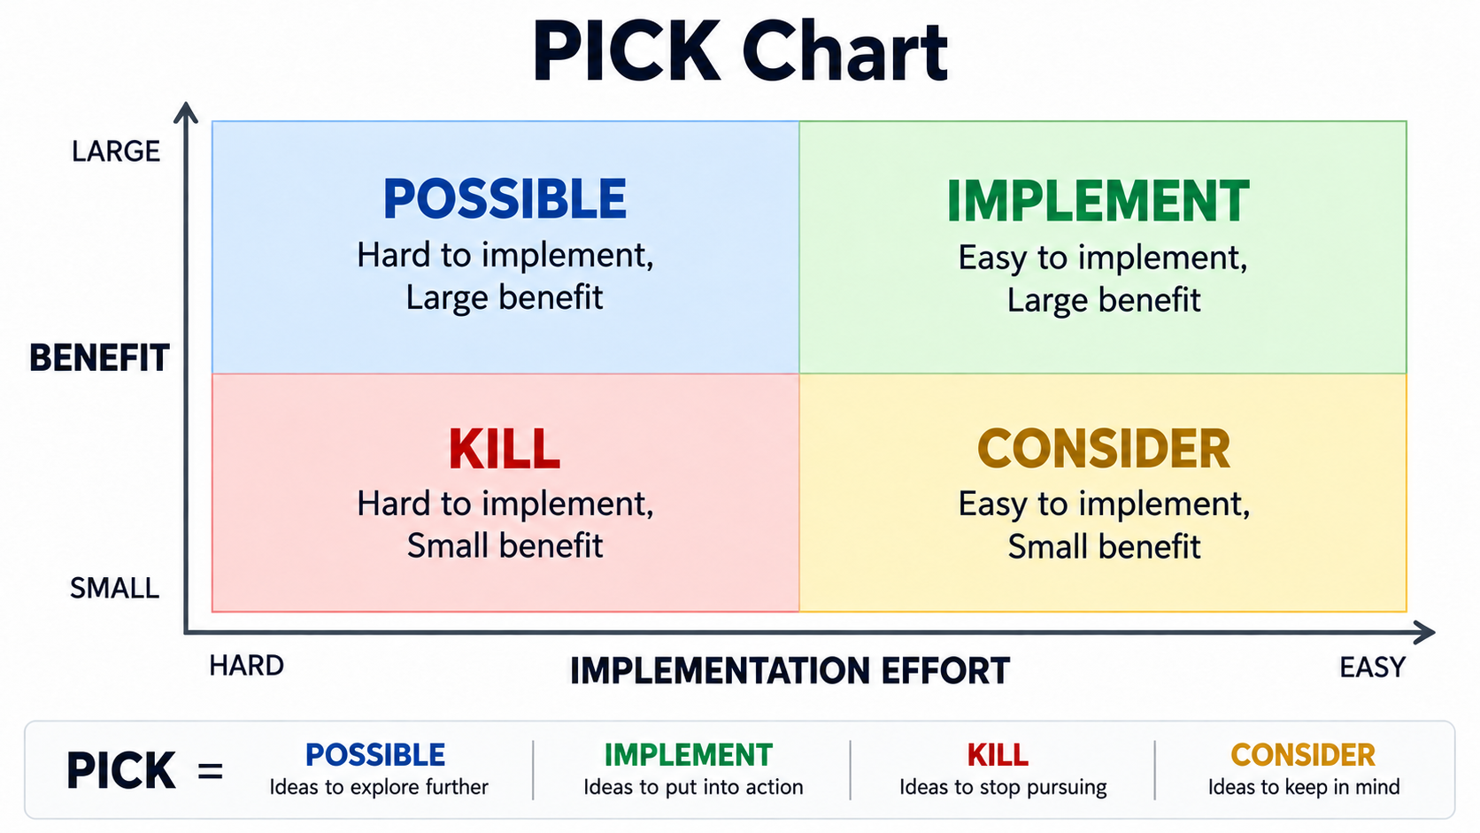
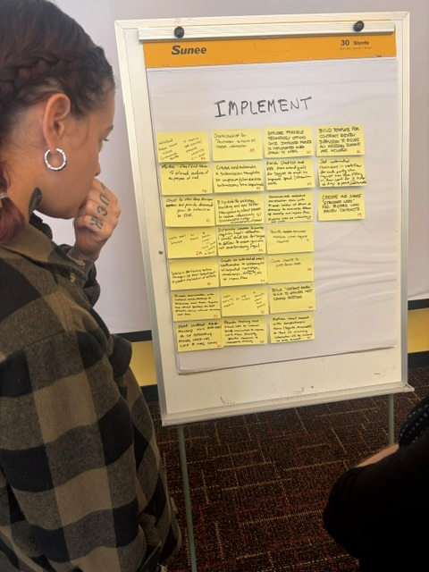
Implementation Plan
70+ proposed solutions grouped into 9 categories
24 solutions selected for implementation, spanning 8 of the 9 categories

Slide 15
Implementation Plan
Selected Solution Categories:
Data Catalog
Manual Process Tracking
Automated Process Tracking
Improved Intake System
Buyer Standardization
Data Analysis to Improve Processes
End User Training & Support
Automated Communications
Next Steps:
Post RIE: SSAS is developing email templates and buyer checklists, defining intake and reporting requirements, and meeting with key stakeholders.
October 2026 | SSAS will review the Microsoft Forms + Lists draft with RIE technology advisor to confirm that it meets the team’s goals.
February 2027 | Target Implementation, with website updates completed, and end-user training available in Percipio before launch.

Slide 16
Impact
End User:
  Consistent repeatable process
    Reduces submissions via an incorrect method
    Reduces duplicate submissions
  Reduction of Knowledge Deficit
    Improved Training
    Defines complete submission requirements
SSAS:
  Process standardization
    Improved submission intake
    Process tracking
    Reduces information requests
  Reduces turnaround time
UMB
  Increased efficiency
  Creates audit trail
  Demonstrates a stronger commitment to Service Excellence and customer satisfaction
  Zero cost; existing resources

Slide 17
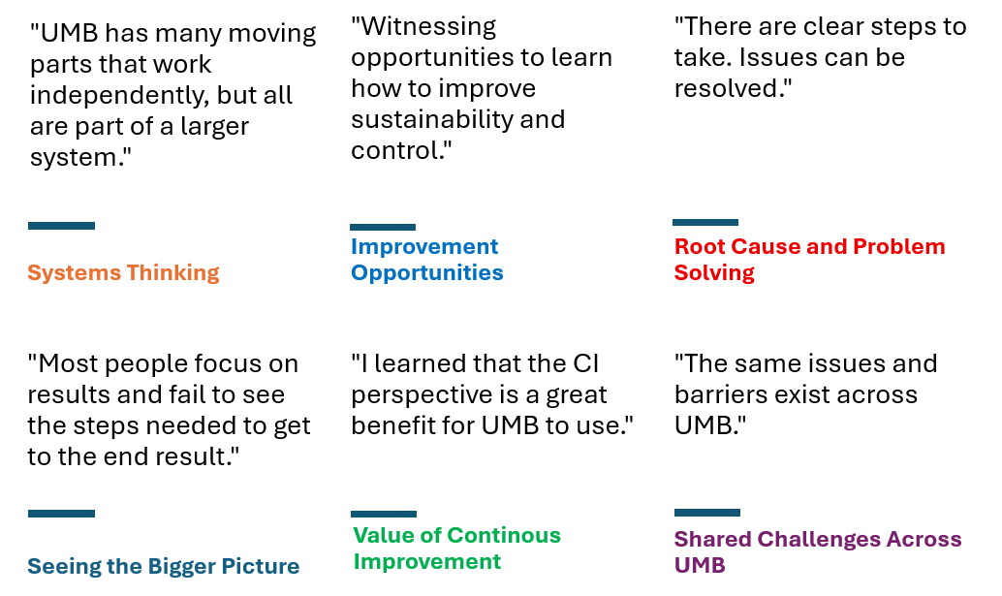
RIE Team Insights
Keep the momentum
Notes:
The Green belt training and active participation in this event demonstrates the collective willingness for change. We were asked to share our insights of this event. Six themes described our new gained thinking.

Slide 18


