Slide 1
Town Hall
April 29, 2021
Dr. Judy L. Postmus
Dean & Professor, School of Social Work
Dr. Roger J. Ward
Provost & EVP (Interim)
Dean, Graduate School

Slide 2
Strategic Planning Timeline
January – March
Review Core Values
Develop strategic plan themes and high-level strategic outcomes informed by:
Mission, Vision, Core Values
President’s goals; USM goals; current strategic planning goals, MHEC, Other (?) …
Involves deans, VPs, shared governance councils, others (?)
April – May
University-wide feedback/input sessions on themes and outcomes
Revise and refine themes and outcomes
Draft plan
Mid-May – June
Finalize and adopt plan
Design implementation plan

Slide 3
Core Values

Slide 4
Core Values Evolution
Civility/Accountability Respect and Integrity
New Well-Being and Sustainability
Diversity Equity and Justice
Excellence/Knowledge/Collaboration Innovation and Discovery

Slide 5
Summarized Town Hall Comments
  Over 200 individuals joined the Town Hall
  Take-away ideas / discussion included:
    Compassion – where does it fit?
    Anti-racist – Do we need to call it out or strive for the outcomes of equity & justice?
    Courage – where does it fit?
    Opportunity? Perhaps linked to growth & success (as a theme?)
    Leadership? How to incorporate?
    How to ensure that Core Values are embedded into our every day lives at UMB? How will they be measured and evaluated?

Slide 6
Town Hall Survey
  Town Hall participants and the general UMB community were urged to complete a Core Values Survey between April 5 – 12, 2021
  Survey combined quantitative and open-ended questions for each proposed core value, along with an opportunity for feedback about core values overall
  About 200 responses were received for the survey:
    Students – 9% Faculty – 26% Staff – 65%

Slide 7
Town Hall Survey
  All schools were represented: Greatest participation from University Administration (34%); School of Medicine (23%); School of Nursing (15%); and School of Social Work (9%)
  Within University Administration: Greatest participation from Administration & Finance (62%); Academic and Student Affairs (13%); and Office of Research & Development (10%)

Slide 8
Town Hall Survey Questions
  The same questions were asked for all four proposed core values using a 5 – Point Likert scale:
    How well does the proposed core value align with your personal and professional values?
    In your opinion, how well does the proposed core value align with current values of UMB faculty, staff, and students?
    In your opinion, how well does the proposed core value reflect UMB?
    How strongly do you feel that the proposed core value should be adopted as a UMB core value?

Slide 9
Town Hall Survey Results
    Question 1: How well does the proposed core value align with your personal and professional values?

Slide 10
Town Hall Survey Results
    Question 2: In your opinion, how well does the proposed core value align with current values of UMB faculty, staff, and students?

Slide 11
Town Hall Survey Results
    Question 3: In your opinion, how well does the proposed core value reflect UMB?

Slide 12
Town Hall Survey Results
    Question 4: How strongly do you feel that the proposed core value should be adopted as a UMB core value?

Slide 13
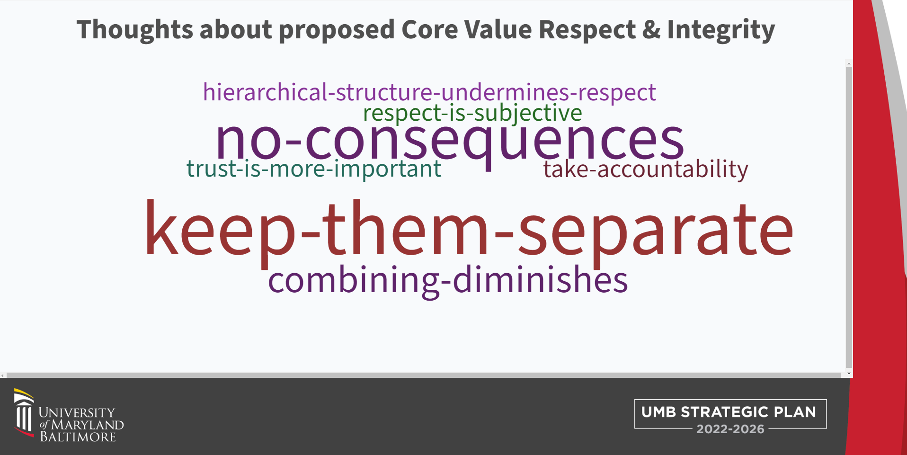

Slide 14
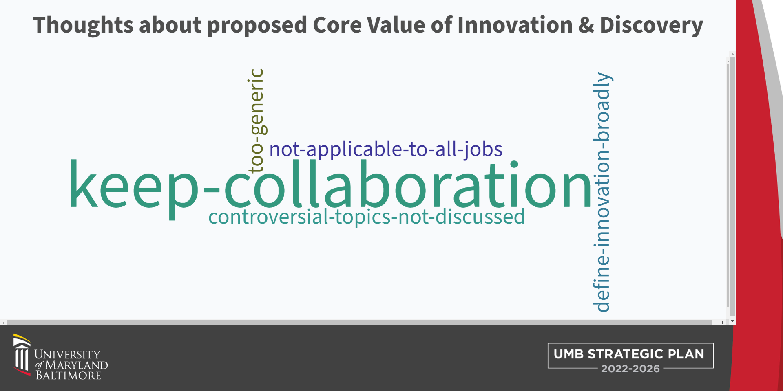

Slide 15
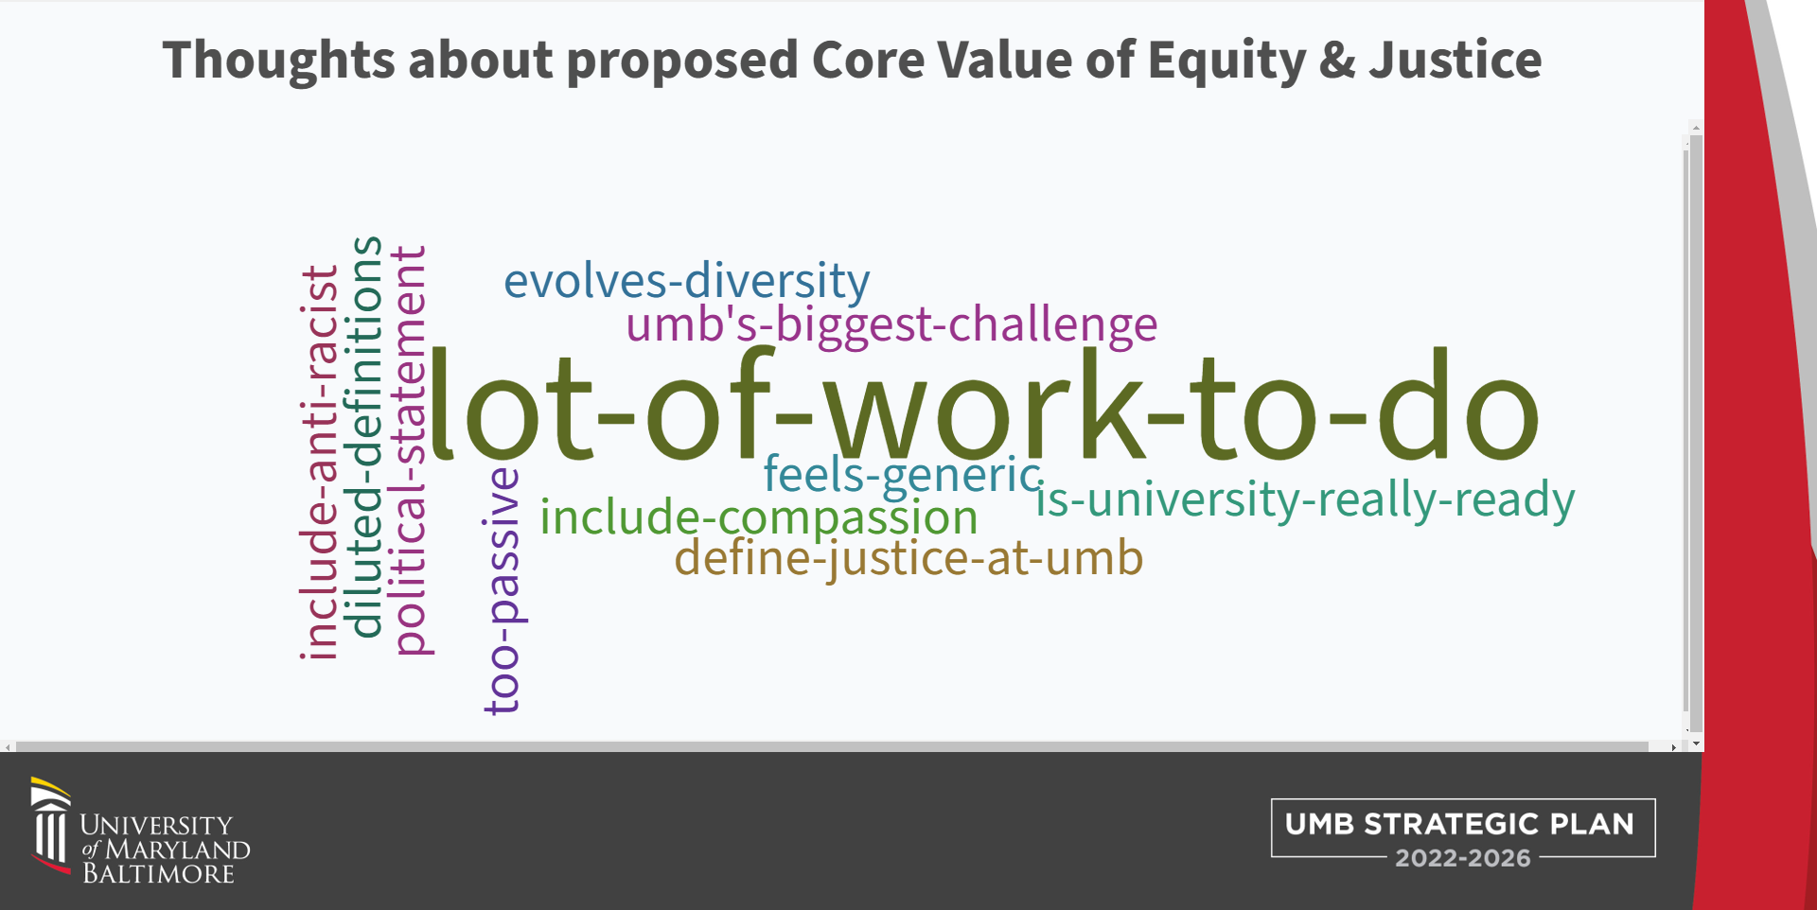

Slide 16
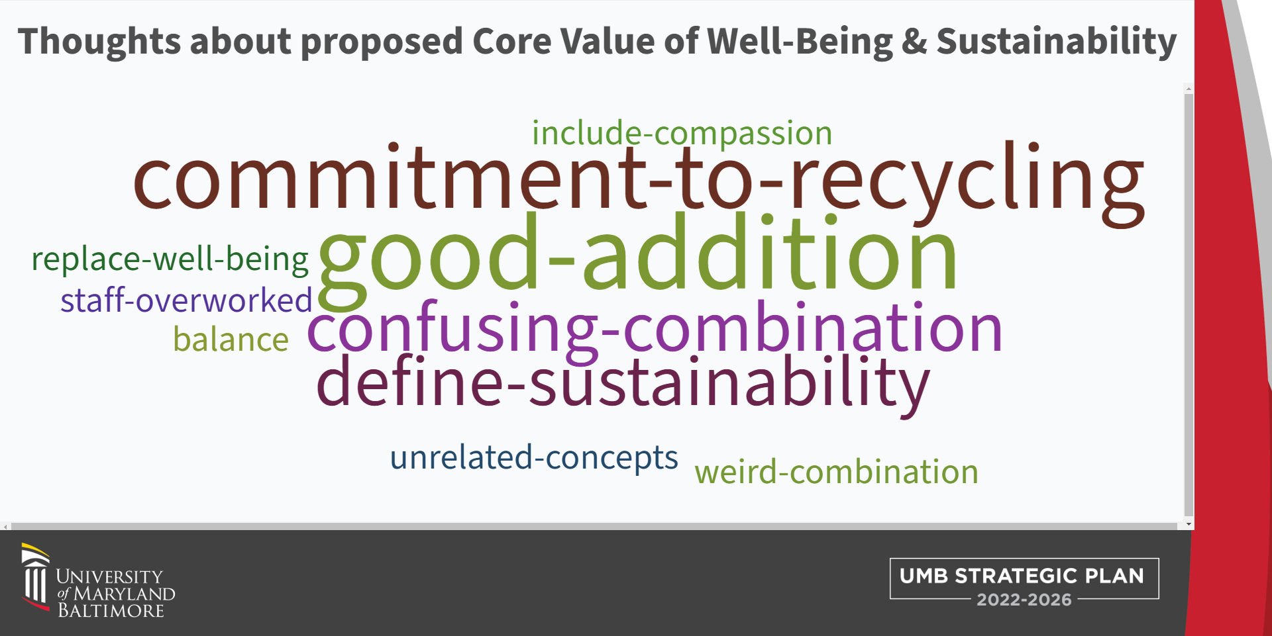

Slide 17
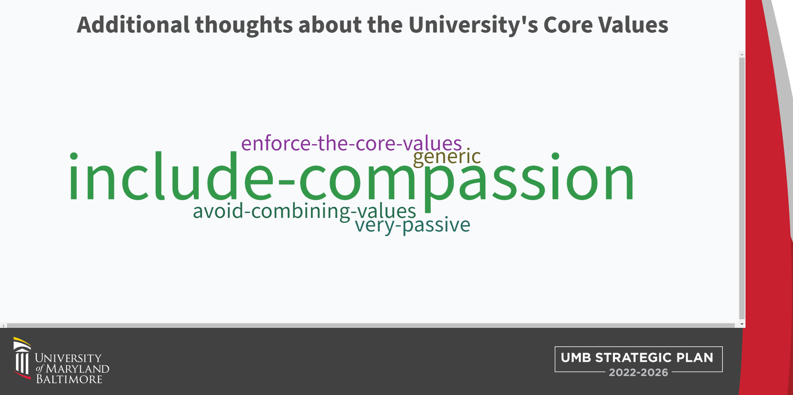

Slide 18

RESPECT and INTEGRITY
Civility/Accountability
WHAT IT MEANS
We value each other and hold ourselves accountable
for acting ethically and transparently using compassion and empathy.
SYNONYMS/IDEAS TO CAPTURE IN THE FULLER NARRATIVE
Civility | Accountability | Transparency | Ethics – Compassion - Empathy

Slide 19
New
WELL-BEING and SUSTAINABILITY
WHAT IT MEANS
We care about the welfare our people, planet,
communities, and university.
SYNONYMS/IDEAS TO CAPTURE IN THE FULLER NARRATIVE
Work & Academic Life Balance | Environmentally Friendly
Responsible Stewardship of Resources| Family Friendly| Mindfulness

Slide 20
Diversity
EQUITY and JUSTICE
WHAT IT MEANS
We embrace and are committed to diversity and value inclusive and
just communities. We oppose racism and oppression in all its forms.
SYNONYMS/IDEAS TO CAPTURE IN THE FULLER NARRATIVE
Diversity | Inclusion | Social Justice | Anti-racist

Slide 21
INNOVATION and DISCOVERY
Excellence/Knowledge/Collaboration
WHAT IT MEANS
We imagine and explore new and improved ways to accomplish our mission of research, education, and service.
SYNONYMS/IDEAS TO CAPTURE IN THE FULLER NARRATIVE
Creativity | Discovery | Agility | Novel Thinking | Teamwork | Partnership | Taking Risks | Learn from mistakes | Explore new opportunities | Embrace Optimism | Be Influential | Develop Leaders | Be Agile

Slide 22
Leadership
RESPECT and INTEGRITY
WELL-BEING and SUSTAINABILITY
EQUITY and JUSTICE
INNOVATION and DISCOVERY

Slide 23
Strategic Themes

Slide 24
Themes & Strategic Outcomes
STRATEGIC OUTCOMES - The results the University expects to realize if it is successful in pursuing the strategic objectives.
--Developed at the University Level--
GOALS (SMART) – Strategies, approaches, milestones, or actions developed in plans by schools and administrative units to achieve the objective and outcomes
--Developed at the School/Unit Levels--
THEME – A major area of focus for the University influenced by our mission, vision, and core values.
--Developed at the University Level--
STRATEGIC OBJECTIVE – A long-term organizational goal that puts a theme into context and brings it into sharper focus
--Developed at the University Level--

Slide 25
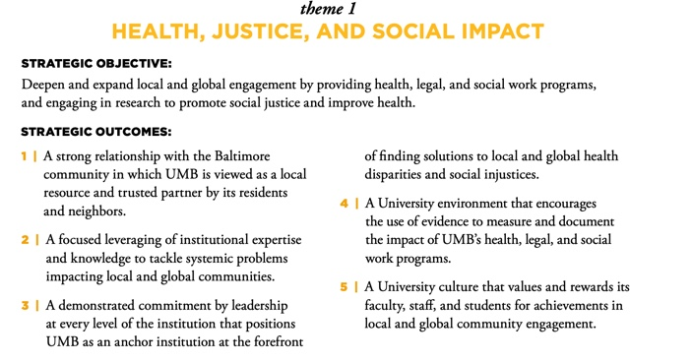
Themes & Strategic Outcomes

Slide 26
Strategic Plan 2016 Themes
6 Themes
  Health, Justice, and Social Impact
  Research and Scholarship
  Student Success
  Inclusive Excellence
  Partnership and Collaboration
  Efficiency, Effectiveness, and Assessment
  SP 2016 Plan:
  https://www.umaryland.edu/about-umb/strategic-plan/themes/

Slide 27
Proposed Strategic Themes
  Community Partnership and Collaboration
  University Culture, Engagement and Belonging
  Student Growth and Success
  Innovation and Reimagination
  Global Health and Education
  Core Values Integration and Accountability

Slide 28
Proposed Strategic Theme
  Community Partnership and Collaboration
What we aspire to:
UMB fully embraces its status as an “Anchor Institution” and engages in earnest and respectful partnerships and collaborations with our neighbors and community organizations to realize mutually beneficial goals that have measurable and sustainable impact.

Slide 29
Proposed Strategic Theme
  University Culture, Engagement and Belonging
  What we aspire to:
  Members of the UMB community feel comfortable and valued at work, including being treated fairly and respected by their colleagues; are connected to the people they work with and the teams they are part of; and contribute to meaningful work outcomes—understanding how their unique strengths are helping their teams and the institution achieve shared goals.

Slide 30
Proposed Strategic Theme
  Student Growth and Success
  What we aspire to:
  UMB aspires to a holistic and student-centered strategy across all dimensions of the student experience, inside and outside of the classrooms, clinics, and laboratories. We strive to adapt to the evolving needs of our diverse and changing student population by providing flexible and responsive support services and innovative instruction modalities to promote success and to prepare our graduates to be exemplary professionals and leaders in society.

Slide 31
Proposed Strategic Theme
  Innovation and Reimagination
  What we aspire to:
  UMB aspires to leverage the intellectual curiosity and creativity of our faculty, staff, and students to cultivate a transformative mindset that embraces new ideas, flexibility, and agility – learning from failures along the way – to successfully imagine new and improved ways to get things done.

Slide 32
Proposed Strategic Theme
  Global Health and Education
  What we aspire to:
  UMB seeks to enhance its status and reputation as a globally-engaged research institution committed to improving the human condition beyond the borders of the United States. Together with our international partners and collaborators, we will support innovative learning, teaching, and dialogue in pursuit of multidisciplinary solutions to global challenges.

Slide 33
Proposed Strategic Theme
  Core Values Integration and Accountability
  What we aspire to:
  UMB aspires to create a community in which each of us fully embraces our Core Values and lives them in our words and actions. We seek to empower, encourage, and expect each faculty, staff, and student member of our community to take accountability for their actions and for cultivating a working and learning environment that promotes respect, tolerance, understanding, and fairness.

Slide 34
Next Steps
  Develop 6 groups (one per theme): that is co-chaired by 2 steering committee members
    Identify others from UMB community vested in helping draft strategic objectives & outcomes for a particular theme
    Present draft ideas at next SC meeting (May 5, 2021); finalize feedback by May 15
  Strategic Objectives: long term organizational goals that put each theme into context and bring it in to sharper focus.
  Strategic Outcomes: the results UMB expects to realize if we are successful in pursuing the Strategic Objectives.
  Collect feedback and ideas: from UMB community via survey

Slide 35
Sub-Committees for Themes
Community Partnership and Collaboration - Ashley Valis & Wendy Shaia with John McKee from Committee and Tricia O’Neill from the Logistics team
University Culture, Engagement and Belonging - Christina Fenwick & Stephanie Suerth with Josh Abzug from Committee and Cherita Adams from the Logistics team
Student Growth and Success - Niv Hegdekar & Donna Parker with Bim Akintade and Emily Smith from Committee and Karen Matthews from the Logistics team
Innovation and Reimagination - Mark Macek & Peter Murray with MJ Tooey & Lisa Lebovitz from Committee and Michael Brown from the Logistics team
Global Health and Education - Dennis Paffrath & Flavius Lilly with Peter Danchin from Committee and Tricia O’Neill from the Logistics team
Core Values Integration and Accountability - Dawn Rhodes & Jon Kucskar with Laura Kozak & Terry Rogers from Committee and Greg Spengler & Danielle Brown from the Logistics team

Slide 36
The End
Go in Peace and Spread Love

