Slide 1
Library Research Support
Emilie Ludeman, MSLIS
Head of Research and Education Services
eludeman@hshsl.umaryland.edu
Amy Yarnell, MLS
Head of Data and Bioinformation Services
ayarnell@hshsl.umaryland.edu

Slide 2
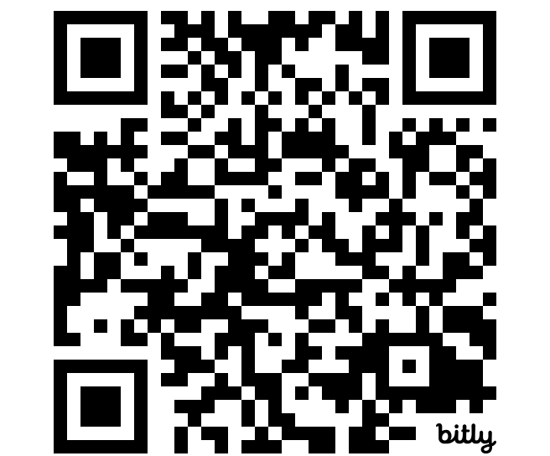
Research and Education Services
Meet your School's librarian
https://bit.ly/HSL-RES

Slide 3
Librarians can assist with
Literature searches
Evidence synthesis projects (e.g., systematic and scoping reviews)
Reference management tools such as Zotero
Publication strategies (e.g., selecting a journal for publication)
Research impact assessment

Slide 4
Data and Bioinformation Services
Find out more:
https://bit.ly/HSHSL-DABS

Slide 5
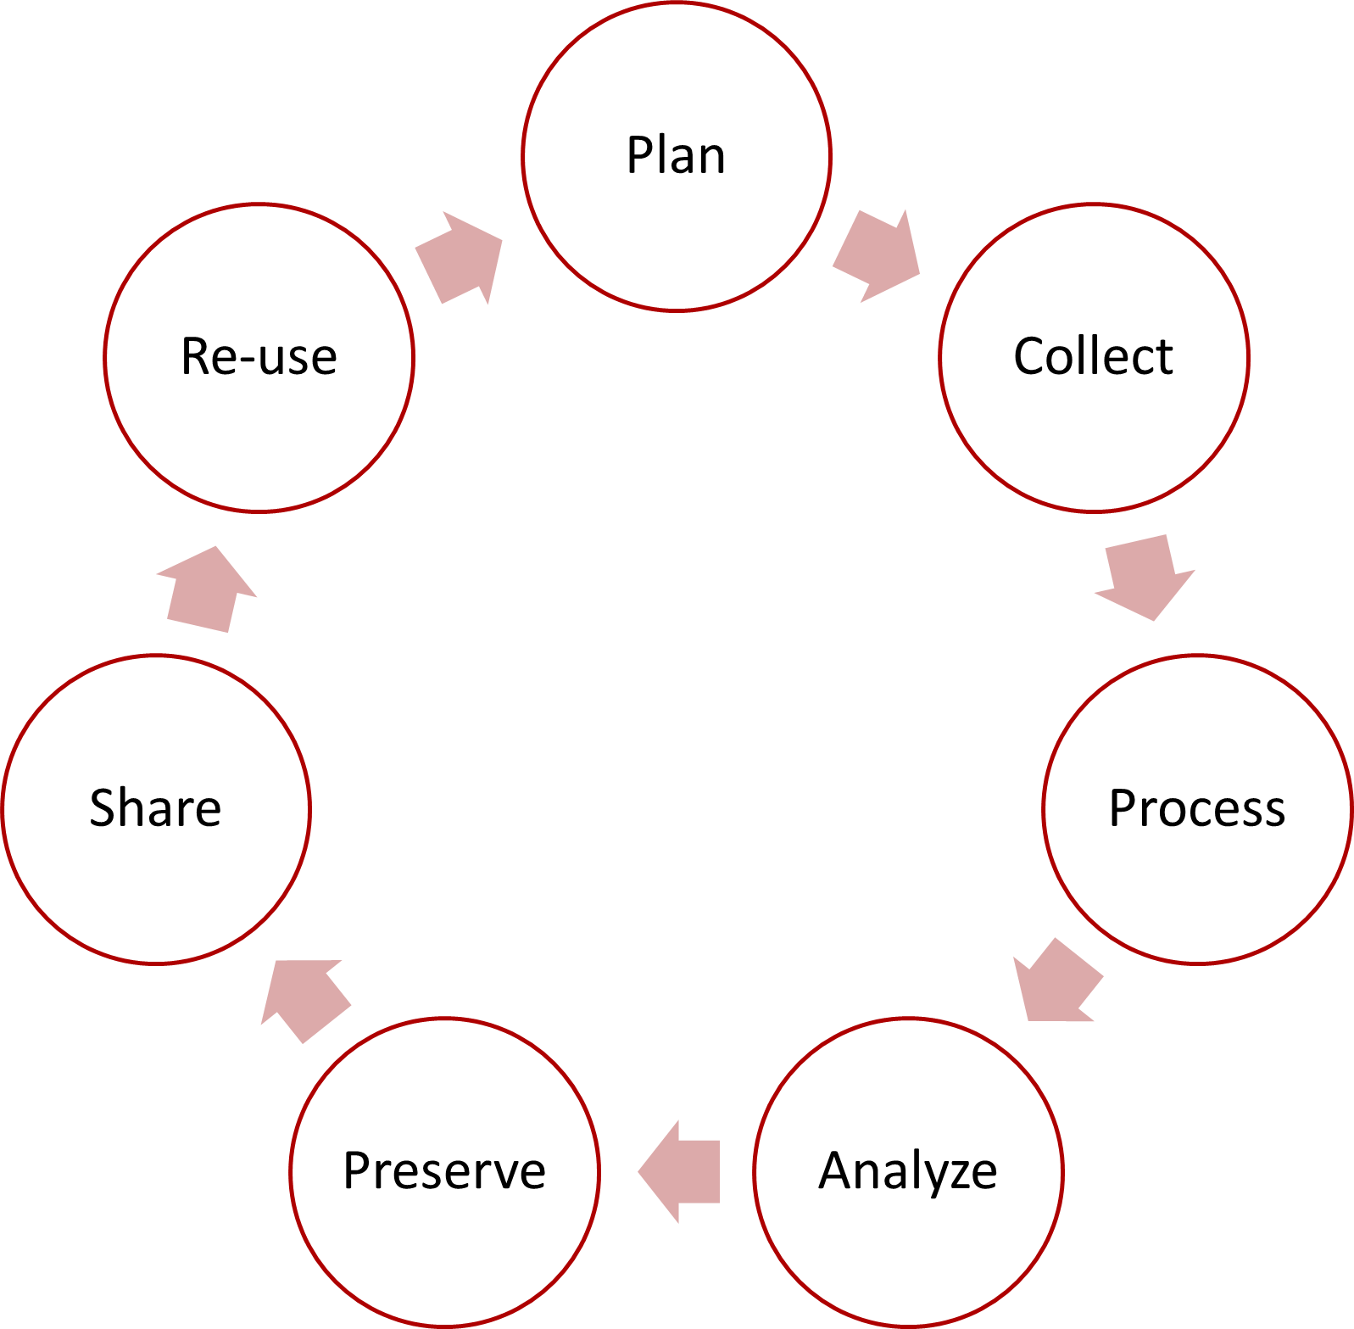
What we do
Support all stages of the research data lifecycle
Projects
Workshops
Guides and Tutorials
Consultations
From general guidance to
customized project collaboration

Slide 6
Librarians can assist with
Writing data management plans
Finding data for secondary research
Developing questionnaires in REDCap or Qualtrics
Choosing tools for data analysis and visualization
Following reproducible and open research practices
Meeting data sharing requirements

Slide 7
Questions?

