Slide 1
SPA/SPAC Updates Quarter 1, 2020
September 26, 2019
2:30 – 4:00 pm

Slide 2
SPA Agenda
Carry forward Form
Kuali Research - Routing/process
DOD again
Training
Reminders

Slide 3
New Team Members
Please join with us in welcoming Odessa to the Team White Proposal Team

Slide 4
Carryforward Form
New form
Submit to SPA FIRST!!!!
SPA must review each award
SPA teams will assist with obtaining prior approval if necessary
Remember to include Supporting Documentation/Prior Approval with the form
SPA will forward the carryforward to SPAC for processing

Slide 5
Kuali Research
Routing of Proposals in Kuali Research
In consultation with the SOM Dean’s office (only school really affected by this change), we will be changing how routing occurs.
Combining with College Park resulted in all key persons named in the proposal to be included in the routing, which caused delay and confusion.
Sometime after October 5, 2019, new routing agendas will be put into place.
Notes:
Proposals created the same day will not show on SPA’s deadline report (internal)

Slide 6
Routing Process
New Routing Process
There will be no change if a department/division creates a proposal for their faculty.
If a center/institute creates a proposal, it will automatically pull in the center/institute as the lead unit into the Person details within the Key Persons tab. (This controls the routing of the proposal)

Slide 7
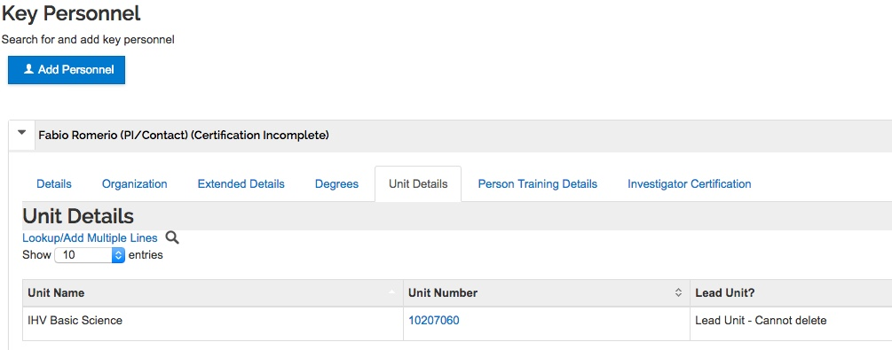
New Routing Process
Under Key Person tab – Under Personnel you will add your Principal Investigator and any other key person.
Open Details – under Unit Details, add the academic unit
Click here to add academic unit

Slide 8
New Routing Process
Add Academic Unit number (you must have this in the proposal, or it will be rejected back to you for correction)

Slide 9
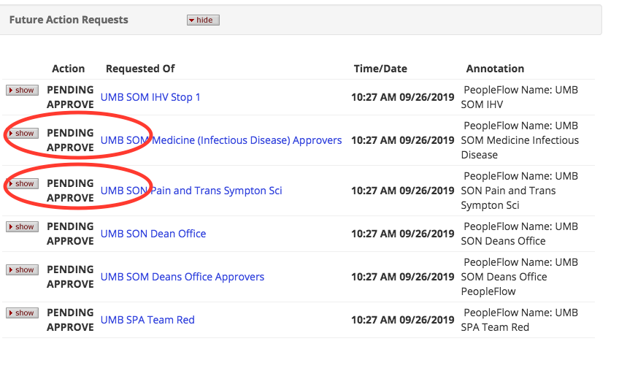
Old vs New Routing
These will be listed as FYI instead of Pending Approval

Slide 10
Kuali Research & Proposals
Oct 5th and 16th deadlines
Remember get your proposals in early! Specially since we are heading into the Holiday Season soon
Remember to follow SOM, SOD and SOP routing deadlines
Proposal triaging occurs 24 hrs. AFTER proposal creation!

Slide 11
DOD Proposals/Pre-Proposals
You must select the Sr. Administrator as the Business Official during the Pre-Proposal phase
Team Red: Marie Coolahan
Team White: Christine To’alepai
The order for the attachments in the attachment section is very important in DOD submissions

Slide 12
SAVE THE DATE!!!
NCURA Region II PDC – Internal Control
November 7, 2019 – 9:00 AM to 4:00 PM
Location – UMB Biopark

Slide 13
Kuali Research Reminders…
Info & Guides on SPA website
http://www.umaryland.edu/kualicoeus/user-resources-and-help/
Navigating and searching in KR
PI certification and approval
KR New User Training Dates (CITS enrollment database)
10/2/2019 10:00AM-12:30PM
New email for KR “Report a Problem”
DLKualiResearchHelp@umaryland.edu

Slide 14
KR Proposal Reminders
Subrecipient Commitment Form is still a requirement at the time of proposal
PI’s must certify the proposal – This hold true for copied proposals as well
Do not use old proposals!
Proposals with human subjects
Instructions for NIH proposals with human subjects http://www.umaryland.edu/kualicoeus/user-resources-and-help/nih-human-subjects-forms/

Slide 15
Reminders
Please use the team emails when communicating with SPA, this allows us to triage the action. Then you will receive an email from the SPA person who is working on that action. This is true unless you are already working with a SPA individual then communicate directly with them.
Remember SPA response time to e-mails generally takes 24 hours unless an email is marked as URGENT!!
Ask your general questions at Research Matters http://researchmatters.umaryland.edu
If you change the deadline date, please update your team or the person working on your proposal immediately!
Please give SPA adequate time to review your proposal.

Slide 17
Cost Agenda
SPAC-Costing and Compliance
Extension of Budget Retro (BR) Cut Off
Direct Retro (DR) Form Changes
New SOAPF Accounts and Post Docs on Training Grants
Service Center Rate Proposals
093019 Initiation

Slide 18
Extension of BR Cutoff date – Overriding 90day BR rule
With Quantum going live on 10/02/19
BR cutoff date PP20-07 (Check date 10/04/19) has been extended
Initially Tuesday 10/01/19 was the last day to process EFPs for 07/01/19
Extended to PP20-10 (Check Date 11/15/19)
Tuesday 11/12/19: last day to process EFPS for 07/01/19
Must be approved by 8pm on 11/12/19
Wednesday 11/13/19 start processing EFPs with begin date 08/18/19

Slide 19
DR Form Update
Form will be updated for new Quantum Chart string
Available on SPAC-Cost web page prior to Quantum Go-Live on 10/02/19
https://www.umaryland.edu/cost/direct-retro-forms/
Development for New Online Form completed after Go-Live

Slide 20
New Quantum SOAPF Accounts
To adjust fringe benefits and fund health benefits for post docs on training grants
If the Project/Purpose used to charge these expenses have changed, please send notification with old and new chart string to effort@umaryland.edu
Adjustments for September 2019 will not show up on e-UMB Financials
They will be posted to Quantum Financials in the calendar month October 2019
Cumulative balance will be accurate

Slide 21
Service Center Proposals
Rate letters will be sent out by next Monday, 10/01/2019
Completed Proposals need to be returned to Ron Powell and Tom McHugh by 11/01/2019
Please Attach Narration sheet with rate proposal

Slide 22
Effort Reminders
June Effort forms were due 09/10/19
Total delinquent forms in ERS: 452
The new 093019 period is being initiated
Will be available next Monday 09/30/19
Check PCA Balances!
No Fixed EFPS at year end to allocate retropays processed in FY20, but related to FY19
These FY19 retro pays are falling to the PCA and need DRs to move to correct projects

Slide 23
Questions

Slide 24
SPAC AGENDA
Staffing Upates
Preparing for Quantum
Preparing for Go Live
Development
Reminders!

Slide 25
SPAC Staffing Updates
OPEN POSITIONS
NOT A ONE!
Welcome Intern
Nicolette McGhee

Slide 26
Preparing for Quantum
Everything prior to 7/1/2014 is closed or being closed (few stragglers)
25,124 projects 21,095 closed
1,501 expired (GT 7/1/14) and 2,528 open
We are only able to use Raven until after Oct 1
Still have FFR’s out there with only 2 BD’S

Slide 27
Preparing for After Go-Live
First 2 weeks will be spent setting up awards
The entire team will be setting up and modifying awards
Then we move onto billing
Have notified sponsors that we may be late
DIRRF’s are input directly by departments

Slide 28
Development
NIH – Federal Salary Cap Policy update
SCCU policy update
Training Grants Training
Relinquishment Guidance
Closure Process update

Slide 29
Reminders
SCR Reporting
Due by October 11th
For Federal Service Contracts Only
Esther Ndiangui from our office will notify you with your list
Remember, if you have a service contract, you need to have your subs track their hours for invoices posted in our system 10/1/18-9/15/19

Slide 30
Questions

Slide 31
QUANTUM Updates
Quantum Financials – Lynn McGinley
Revenue Recognition
Cost Sharing
Data Analytics Demo

