Slide 1
SPA/SPAC UPDATE MEETING
November 10, 2016
2:00 – 3:30 pm
Pharmacy Hall: N103 Lecture Hall

Slide 2
TODAY’S AGENDA
MAS Update
  Audit findings regarding state agreements
SPA Updates
  Personnel
  KC Updates
  FDP Clearinghouse
SPAC Updates and Reminders
  Update on VA IPA
  Proposed changes to the Uniform Guidance
FLSA and Sponsored Projects
Financial Systems Update
  Role Validation
  Update on Financial System Project

Slide 3
SPA Updates
4th Quarter 2016
November 10, 2016

Slide 4
SPA Personnel
One open position for Analyst, SPA
  This is an entry level position within SPA
  He/she will work on the contract team processing outgoing subs
  Currently interviewing

Slide 5
SPA New Staff
Stephen Peterson, Manager
  Manages the contract team within SPA and responsible for all incoming contracts/agreements and outgoing subawards
Emmanuel Shodeinde, Administrator
  Contract team
Mike Starace
  Moving to proposal team white
William (Bill) Hugo, Analyst
  Outgoing subawards

Slide 6
SPA Teams
Team Red—Proposals
  Managed by Greg Sorensen
  Processes all proposals
    Marie Coolahan (lead)
    Towanda Gilliam
    Mike Starace
Team White—Proposals
  Managed by Greg Sorensen
  Processes all proposals
    Debbie Griffith (lead)
    Christine Toalepai
    Suzanne Hollis

Slide 7
SPA Teams
Team Red—Contracts
  Managed by Stephen Peterson
  Processes all contracts
    Stacey Boyd (lead)
    TBN
  Process all subawards
    Venzula Harris
Team White—Contracts
  Managed by Stephen Peterson
  Processes all contracts
    Denise Meyer (lead)
    Emmanuel Shodeinde
  Process all subawards
    William Hugo

Slide 8
SPA Teams
Contact your SPA team red or white for any questions unless you have been triaged to a specific person in SPA.
Use the SPA team email addresses
  Team-white@ordmail.umaryland.edu
  Team-red@ordmail.umaryland.edu

Slide 9
KC Update
Kuali Research
SPA needs department representation to assist with the KC testing
Expect to begin testing early Jan/Feb 2017
Go Live 7/1/17

Slide 10
Federal Demonstration Partnership
FDP Clearing House
Reduce administrative burden in creating subs
UMB is a part of a pilot with FDP
Any school participating in this pilot will receive the one page subrecipient commitment form
The organization tab in KC will identify which schools are participating in this pilot.
  If FDP Address is Yes, 1 page form
  IF FDP Address is blank, 3 page form

Slide 11
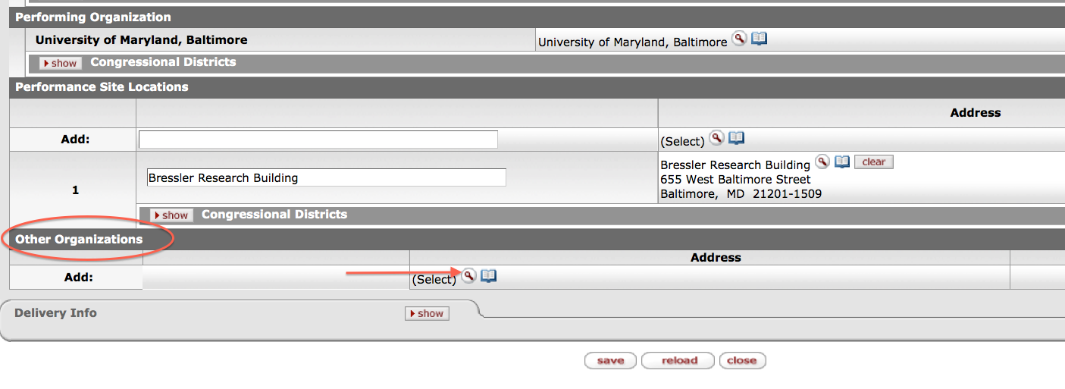
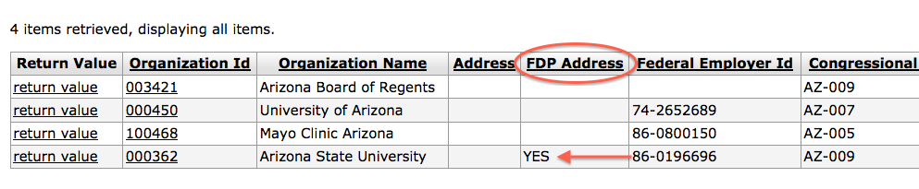

Slide 12
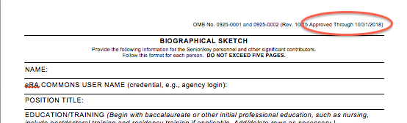
Kuali Coeus
NIH Forms D are now in KC
For Adobe packages with subs, use the sub form associated with that Adobe package
Use most recent forms
  Ex. Biosketch approved through 10/31/2018

Slide 13
NIH Notice for Font Guidelines
Characters Per Inch (CPI)—NIH guideline is 15 CPI (per NOT-OD-16-009, Oct.13, 2015)
Recommending that faculty use 12 pt. regardless of which type of font used
99% of any font used at 12pt. will meet NIH guideline of 15 CPI.
Use the Adobe measuring tool to be sure.
Use a monospace font.

Slide 14
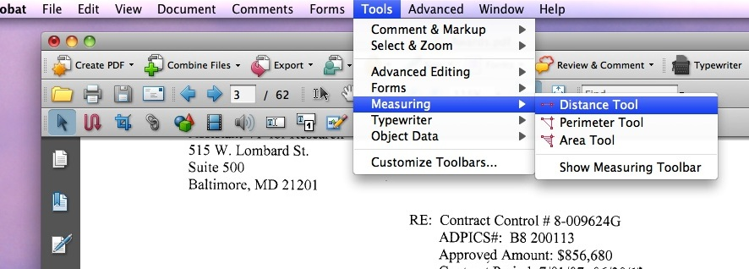
Adobe Measuring Tool
To access the Adobe Measuring Tool
  Tools>Measuring>Distance Tool
  Draw to one inch

Slide 15
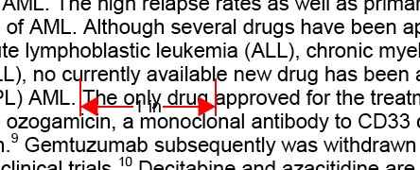
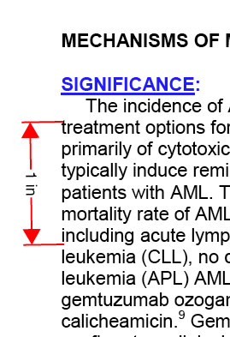
Within the 1”space, count the Characters.
Should be 15 CPI or less
No more than 6 lines of text per vertical 1 in.

Slide 16
Increase for Postdoc and Trainee
Stipend Levels
NOT-OD-17-002 announced the process for how training grants and fellowships will process the stipend level increase
Effective 12/1/2016
Based on levels of experience 0, 1, 2 years
Training grant and individual fellowship awards supporting currently active postdocs trainees and fellows at levels 0, 1, & 2, ending 12/31/16 may apply for one-time supplement funding.
Use the Parent Announcement to Existing NIH Grants, PA-16-287

Slide 17
For Training Grants
Application submitted must be based on the number of appointees at levels 0, 1, & 2.
Applicants may NOT increase the number of appointees under the current award.
Applications must remain consistent with the current experience level of each postdoc.
Only request funds to cover increases in stipends from 12/1/16 up to the end date of the current period of appointment.
For periods less than a whole month (i.e. days and weeks) stipends should be prorated appropriately.
New stipend levels will be reflected in xTrain as of 12/1/16.

Slide 18
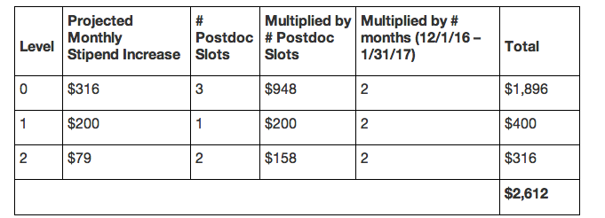
Training Grants
Example:
Institution A has 3 postdocs at Level 0, 1 at Level 1, and 2 at Level 2 with periods of appointment ending on January 31, 2017. Its supplemental funding request would be:

Slide 19
Postdoc Fellowships
Submit applications to cover projected stipend increases for individual postdoc fellows at levels 0, 1 & 2.
Funds requested should only be for the period 12/1/16 up to the end date of the current budget year.
Subsequent NOAs will reflect the FY 2017 stipend levels

Slide 20
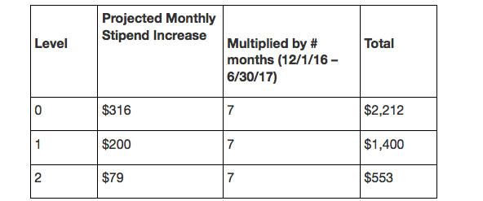
Postdoc Fellowship
Example:
Individual fellowship budget year ends June 30, 2017. Supplemental funding requests for fellows at career levels 0, 1 or 2 would be as follows:

Slide 21
Reminders
When routing proposals that have corporate sponsors, there are only four choices for activity type
  Corporate Research - CME Corporate
  Corporate Clinical Trial -Corporate Other Activities
All MTAs (Material Transfer Agreements) are reviewed and negotiated by CCT.
Unfunded corporate agreements with a federal pass through will be reviewed and negotiated by SPA. Please send these agreements to your SPA team via email.
  DUA’s
  CDA’s
SPA does NOT use UMBiz!

Slide 22
Reminders
Please, please use the team emails when communicating with SPA, unless an action has been triaged and you know who the SPA person that is working on that action.
You must use the Subrecipient Commitment Form if you have a subrecipient within your proposal. SPA staff have been instructions to hold your proposal until the form is in KC.
IPA temp accounts MUST have the Dean’s office signature before SPA or SPAC will process. The new form is on the SPA website.
IPA Fully executed agreements MUST have the VA PO# in order for SPAC to finalize the PID!

Slide 23
Reminders
DOD: Make sure your faculty are affiliated with the correct UMB (Maryland, University of, Baltimore)
Inclusion Enrollment Form
PHS Assignment Form
SPA will only bypass on the deadline day.
Getting your Proposals in early
And remember… Research Matters!

Slide 24
SPAC Updates
4th Quarter 2016
November 10, 2016

Slide 25
SPAC New Staff
Karen Barnes – Sr. Manager
Interns
  Hamid (Central)
  Nicole (11/28 to replace Romel) (Central)
  Cassandra (Teams)

Slide 26
SPAC New Staff
David Addy, Accountant I Team Red
Krissy Long - Accountant I Team White
Tammira Barnes – Accountant I Team Central
Ajesh (AJ) Singh – Accountant I Team Central
Moreen Barker – FA Team Central
Damita Brown – Admin/Cost

Slide 27
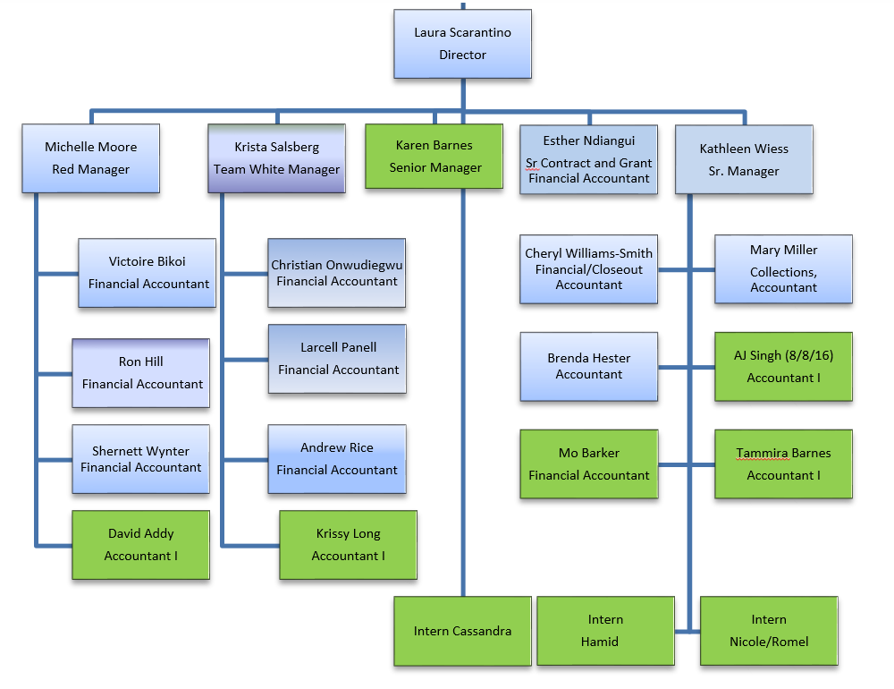
SPAC ORGANIZATION CHART
Effective 11/1/16

Slide 28
Federal Financial Reporting Deadline
Moved up internally due to the holidays
November FFR’s should be in SPAC by 11/20
December FFR’s should be in SPAC by 12/12
Your DR deadline for any grants that require a financial report is December 13th
The deadline for JE’s is 12/21/16, however they must be approved and posted in order to be included on the expenses for the FFR
Questioning large credit entries

Slide 29
Federal Financial Reporting Deadline
Can’t meet reporting deadline?
  Ask for extensions prior to exp. of award
This requirement flows down to us as a sub of federal Prime funds
Emails from SPAC will be more descriptive with deadlines for posting
We can no longer draw money after the required reporting date
We miss the deadline, the sponsor does not have to honor our invoice

Slide 30


Check Your Budgets
Did you request your OTC cost share during KC input before you routed?
Will be sending more descriptive emails upon setup
Please check your emails for accuracy

Slide 31
VA IPA
The VA is seeing an increasing number of modifications coming through that are extensions.
Cannot extend an IPA using modification to avoid the 60 days notice policy.
You must have a NEW fully signed agreement before work starts.
For Example:
Cannot put in a modification for an IPA that has ended to increase effort AND extend the dates. That is considered late.
A modification can be done ONLY until the expiration date.
And a new IPA dated at least 60 days out of now must be done

Slide 32
VA IPA
Any packet received marked as a modification which includes extending IPA dates which have already occurred (delinquent/late), will be returned to the service to do two separate packets and have corrections made to dates to ensure the IPA is not working prior to having a fully signed agreement

Slide 33
VA IPA Training Day
The VA will be holding another IPA training day
Since they continue to have be major problems with IPA packets being done correctly, they are requiring that all staff who work on the IPA packets, including Investigators, attend one of these sessions:
Tuesday 11/29/16
VA 2nd Floor Auditorium.
Session A: 10 am - Noon
Session B: 1 pm – 3:00 pm
This is going to be hands-on step-by-step training – so bring your notepad and something to write with.

Slide 34
Effort Reminders
September effort forms are due Tuesday, November 22nd
Check your PCA balances!
  No longer use fixed EFPs to allocate retropays that were processed in FY 17, but were related to FY 16
  These FY 16 retro pays are falling to the PCA and DRs are needed

Slide 35
Proposed changes to the Uniform Guidance
Federal Register item was expected October 28th
  Now expected November 11th
Expected to delay the implementation of the procurement regulations changes (again) until July 1, 2018
USM rules now do not require competition for purchases under $25,000

Slide 36
FLSA and Sponsored Agreements

Slide 37
Implementation of FLSA at UMB
UMB implementation date is November 27th to coincide with the beginning of a pay period
Several jobs, some primarily charged to grants, were made non-exempt
  Clinical Research Assistant
  Laboratory Research Assistant
  Laboratory Animal Research Assistant
  Research Analyst
  Research Project Coordinator
  Counseling Associate
  Events Coordinator
  Coordinator
These jobs will now be eligible for overtime

Slide 38
Allowability of Overtime Premiums on Sponsored Agreements
Generally allowable if paid according to University policy
Allowable does not mean funds are available
Know your terms and conditions
  Some may require overtime to have prior approval
  If the overtime premium causes rebudgeting, the rebudgeting may require prior approval

Slide 39
Reminder of Overtime Policy
Overtime will be paid at an overtime premium rate of one and a half times the employee’s regular pay for all hours worked over 40 hours per pay week
Holidays, unscheduled closings, annual, personal and sick leaves count as time worked
A department may require employees to work overtime
Should be limited to unusual, essential, or emergency situations, and when practical should be fairly distributed.
Requires advanced approval from the employee’s department head
  Employees must be paid for overtime even if they did not receive approval in advance
Employees should not be pressured to record anything other than the time worked on their timesheets

Slide 40
Consequences for Violating FLSA Rules
  Progressive discipline for managers/employees
  Violations may result in civil or criminal action.
  Employers may be assessed civil penalties of up to $1,100 for each willful or repeated violation of the overtime pay provisions of the law Employers who have willfully violated the law may be subject to criminal penalties, including fines and imprisonment.
  Employers who have willfully violated the law may be subject to criminal penalties, including fines and imprisonment.

Slide 41
Consequences for Violating FLSA Rules
The US Department of Labor is committed to stepped up enforcement
  Audit and payment of violations from previous years.
  Further audit of all timekeeping records and additional penalties/fines.
  Fines, interest and possible criminal sanctions.
  Possible loss of all federal contracts

Slide 42
Allocating Overtime
Department must decide whether the overtime was related to
  All of the employee’s activities
    allow overtime to be allocated according to the employee’s EFP
    Default EFP used is the EFP in effect when the employee exceeds 40 hours in a week
    Can be overridden by the ETS Approver
  Some of the employee’s activities
    use combo code override functionality on electronic timesheet

Slide 43
Combo Code Override
Available only to the ETS Approver Role
  Departments need to develop a communication plan for how overrides are communicated to this role
UPK is available
  Portal->UMB Systems Tutorials Browser->eUMB Electronic Timesheets->ETS Approver->Combo Code Override
http://cf.umaryland.edu/ondemandtraining/enterprise/PlayerPackage/data/toc.html

Slide 44
Reminder of Compensatory Leave Policy
Department head and employee may mutually agree to earn compensatory time in lieu of paying overtime
  Earned at time and one-half
  Cannot accumulate more than 240 hours
  Must be paid in full if not used by:
    End of the calendar year
    Separation from the University
    Transfer to exempt position
    Transfer out of the department

Slide 45
Charging of Payout of Compensatory Leave
This is delayed payout of overtime pay, not a fringe benefit
  Will NOT be paid out of the fringe pool
To be allocable, should be charged to the grants in effect at the time the leave was earned
If the grants have ended or there is not sufficient budget available, must be charged to nonsponsored sources.

Slide 46
Overtime and Fringe Benefits
Overtime pay and compensatory leave payout are charged the Legislated Benefit rate (8.5%)

Slide 47
Overtime and Effort Reporting
Effort percentages are calculated by salary dollars
Beginning with the December 2016 effort forms, compensatory leave payouts and overtime pay will be excluded from the effort % calculations

Slide 48
Implementation of FLSA at UMB
Some jobs were determined to remain exempt, but some individuals in these job codes were making less than the $47,476
  These individuals are to be given pay increases up to the minimum
  Largest population is post docs

Slide 49
Projected NRSA Stipend Levels for Post Docs
Career Level | Years of Experience | Actual Stipend for FY 2016 | Projected Stipend for FY 2017 | Monthly Stipend
Postdoctoral | 0 | $43,692 | $47,484 | $3,957
 | 1 | $45,444 | $47,844 | $3,987
 | 2 | $47,268 | $48,216 | $4,018
 | 3 | $49,152 | $50,316 | $4,193
 | 4 | $51,120 | $52,140 | $4,345
 | 5 | $53,160 | $54,228 | $4,519
 | 6 | $55,296 | $56,400 | $4,700
 | 7 or More | $57,504 | $58,560 | $4,880
These are projected. Actuals are usually published in January.

Slide 50
NRSA T’s and F’s
Supplements may be requested to obtain additional funds for FY 16 T’s an F’s for the remainder of the Statement of Appointment for levels 0-2
These supplement requests will have to be done through Adobe packages
http://grants.nih.gov/grants/guide/notice-files/NOT-OD-17-002.html

Slide 51
NRSA T’s and F’s Post Docs Paid Thru Accounts Payable
Levels 0-2 will need increases up to the $47,484 even if they are paid through Accounts Payable for their December pays

Slide 52
Post Docs on Grants and Contracts
No additional funds are forthcoming to fund increases for post docs on sponsored projects other than training grants or for other employees receiving the increase to the minimum
NIH promises flexibility in terms of rebudgeting when rebudgeting requires prior approval
Know your Award Terms and Conditions!

Slide 53
Financial System Update
Role Validation
http://www.umaryland.edu/financialsystems/role-validation-process-2016
Cancelation of Pending Requisitions
Financial System Replacement Project

Slide 54
Final Notes
Presentation will be available on SPA and SPAC websites
Thanks for joining us today!

Slide 55

Questions?

