Slide 1
SPA/SPAC UPDATE MEETING
November 19, 2015
2:30 – 4 pm
Pharmacy Hall: S201 Lecture Hall

Slide 2
TODAY’S AGENDA
SPAC Updates
  Staffing Update
  Account Setup Metrics
  Calendar Year Deadlines
    Change in Effort Reporting Periods
  Uniform Guidance (2 CFR Part 200) Procurement Regulation Delay
  New Policies Related To Uniform Guidance
  On-line DIRFF Form
  Change in Deliverable Close-out Schedule
Financial Services Update
  Gift Card Exchange Program
SPA Updates
  Negotiation Module Features in Kuali COEUS
  Cost Sharing Information in Kuali COEUS in Order to Get Cost Sharing Funds
  Procedures Library
Financial System Updates – Kevin Curley
  Central Billing System Replacement Project
  Faculty Time Sheets

Slide 3
SPAC Updates
4th Quarter 2015
November 19, 2015
2:30 – 4 pm
Pharmacy Hall: S201 Lecture Hall

Slide 4

SPAC ORGANIZATION CHART
SPAC ORGANIZATION CHART
Krista Salsberg
White Manager
Andrew Rice
Financial Accountant
Wendy Yu
Financial Accountant
Vacant
Financial Accountant
Amy LaFevers Assistant Director
Vacant
Financial Accountant
Kevin Smith
Yellow Manager
Shernett Wynter Financial Accountant
???
Kathleen Wiess Manager
Karen Little Accounting Analyst
Brenda Hester Accountant
Cheryl Williams-Smith Financial/Closeout Accountant
Victoire Bikoi
Financial Accountant
Ron Hill
Financial Accountant
Laura Scarantino Director
Beryl Gwan
Manager, Costing and Compliance
Amy Sallese
Part Time Cost Analyst
Moji Nabavian
International Accountant
Nathan Hollaway Admin Assistant
Michelle Moore
Red Manager
Mary Miller
Collections, Accountant
Tong Li
Cost Analyst
Kevin Cooke International Accountant
Tina Zhu
Financial Accountant
Christian Onwudiegwu
Financial Accountant
Yitzchok Bloch
Financial Accountant
Vacant Part Time Office Clerk
Lynn McGinley AVP, SPAC

Slide 5
Calendar Year End Deadlines

Slide 6
New Effort Reporting Schedule
January 1 pay (pay period 16-13)moved to December 31
Pay Period 16-13 shifted from the March effort form to the December Effort Form
Effort Forms will be initiated after the holiday break
New Reporting Periods Schedule is on the Cost website
September Effort Forms are due next Tuesday!

Slide 7
Reminder: NIH Sub Accounting Means Stricter Close-Out
Expenses must be posted in RAVEN to be sure that we not only report timely on an FFR, but draw the funds before the funds expire in PMS
December deadlines
  NIH 8/31/15 end dates
    Due dates for draws and FFR 12/29/15
  Non NIH 9/29/15 and 9/30/15 end dates
    Due dates for draws and FFR 12/28/15 or 12/29/15
PAY PERIOD 16-13 WILL NOT POST IN TIME!!!

Slide 8
For Posting in Time for December Due Dates
Transaction Description | Deadline Date
Approved employee travel expense eforms for inclusion in Pay Period 16-12 (Pay Date 12/18/15) | Thursday- December 4
Approved non-employee travel expense eforms and supporting documentation for inclusion as a payment in December submitted to FS-Travel | Thursday- December 17- noon
Working Fund checks for inclusion as a payment in December submitted to FS-Working Fund | Thursday- December 17- noon
Accounts Payable invoices for inclusion as a payment in December submitted to FS-Accounts Payable | Thursday- December 17- noon
International wire requests for payment in December submitted to Moji Nabavian (SPAC) | Tuesday- December 15- noon
Payroll Adjustment Forms for inclusion in Pay Period 16-12 (Pay Date 12/18/15) submitted to FS-Payroll | Thursday- December 4
December Journal Entries for Fund 18X cost transfers submitted in eUMB-Financials | Friday- December 18
Final Timesheet approval in eUMB-HRMS for PP16-12 (Pay Date 12/18/15) | Monday- December 9
Direct Retros and EFPs for PP16-12 submitted to SPAC-Costing and Compliance | Wednesday- December 15 - 2PM

Slide 9
Account Set Up Metrics

Slide 10
Account Set Up Metrics
Implementation of Negotiation Module in Kuali COEUS has allowed us to start tracking again
Goal – Complete all actions within 3 working days

Slide 11
Account Set Up Metrics
 | Sept - Oct 2015 | FY 14 | Change
Average Workdays | 2.27 | 6.90 | -4.63
% Completed in 3 | 80.1% | 52.7% | 27.4%
458 actions were processed in Sept – Oct 2015
All three teams average was below 3 days

Slide 12
Federal Register Notice 9/11/2015
Announced Technical Corrections to 2 CFR Part 200
  Extended to ability to delay the implementation of the procurement changes until 7/1/2017
  Fixed inclusion of tuition benefits in fringe benefit rates
  Fixed a lot of typos and misreferences
FAQs were also revised on 9/11/2015

Slide 13
2 CFR 200.308 (c) – Change in Scope
Reduction of effort levels are considered a change in scope if:
  Key personnel will withdraw from the project entirely,
  The PI will be disengaged from the project for 3 months or more, or
  The PI will reduce effort by 25% or more from the level that was approved at the time of award.

Slide 14
New UMB Policies Related to the Uniform Guidance
VIII-3.00(A) UMB Policy on Adopting Federal OMB Uniform Guidance Procurement Standards
VIII-99.06 - UMB Authority to Certify and Sign Sponsored Project Financial Reports and Vouchers

Slide 15
On-line DIRRF Form

Slide 16
Fast Facts About a DIRRF
Deliverable Invoice/Receivable Request Form
00185 Federal
00188 State and Local Government
00192 Non-Governmental
Studies, Per Patient, Clinical Trials, Milestone
This form is not for Standard Grants

Slide 17
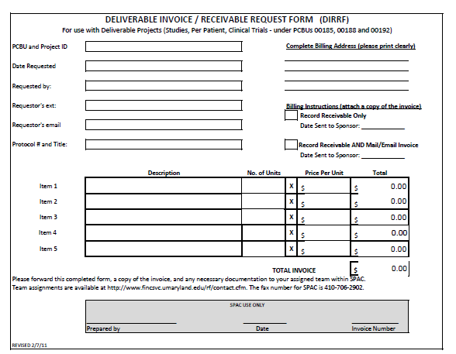
Old DIRRF

Slide 18
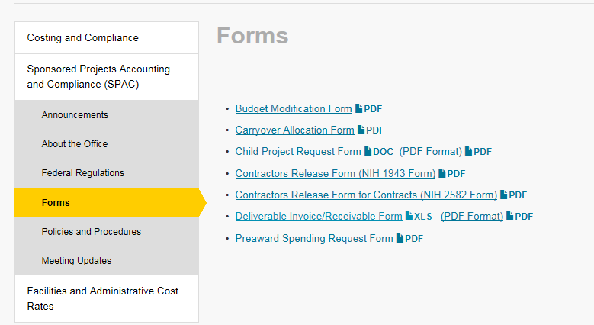
Where to Find the DIRRF

Slide 19
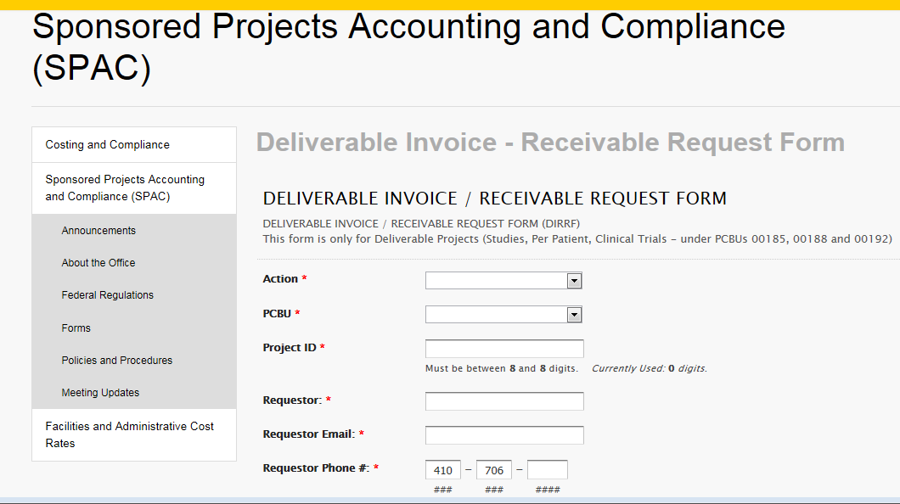
New Online DIRRF
link

Slide 20
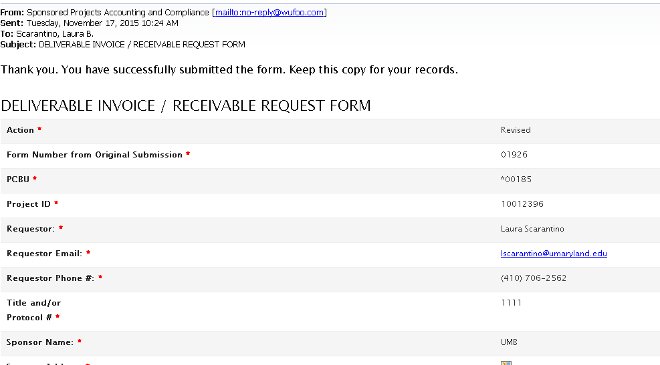
DIRRF Email
Laura

Slide 21
When To Use the Online DIRRF
Beginning December 1, 2015
Revisions – use the online form, use the form number from your original DIRRF
Was a receivable created? Check online GPV
Questions – contact your team

Slide 22
Change in Deliverable Close-Out Schedule

Slide 23
Current Deliverable Schedule
Every 3 months
Email sent to the Distribution emails
Departments have 30 days to reply

Slide 24
New Deliverable Schedule
Every 4 months
April, August, November
Email sent to the Distribution emails
Departments have 30 days to reply
3 x’s per year!

Slide 25
Gift Card System
Questions: Larry Miller

Slide 26
Gift Card System
Unused Gift Cards in your Department?
Financial Services has developed a system to advertise unused Gift Cards
Departments basically sell and buy cards by providing accounts to charge from and to
The actions still mimic a working fund request

Slide 27

Gift Card System: Seller
1. Selling department enters all unused cards into an inventory list
  The vendor name
  Quantity g
  Amount of the cards are required
  2. Seller is now finished.
  Process is similar to listing tickets on StubHub.

Slide 28
Gift Card System: Buyer
1. Buyer reviews the inventory and selects the desired cards.
  It can be all, or a portion of the cards listed by a department
  All cards selected go into the buyer’s Shopping Cart
  These cards and are removed from the inventory list.
2. Buyer clicks the Checkout button
  An email pops up that will require the buyer to attach justification for the cards (same documentation as a WF request would require).
  3. Buyer forwards the email to Disbursements.
  This must be done in 24 hours, or the cards will automatically be returned to the inventory.

Slide 29
Gift Card System: Financial Services
Disbursements will review the documentation
  If appropriate they will click an approval button
  An email will automatically generate that is forwarded to both the buyer and seller.
  This will be completed within 24 hours of receiving the email.
It is then up to the two parties to make the arrangement to transfer the cards.
Disbursements will complete the JE using the information provided when the buyer and seller began the process.

Slide 30
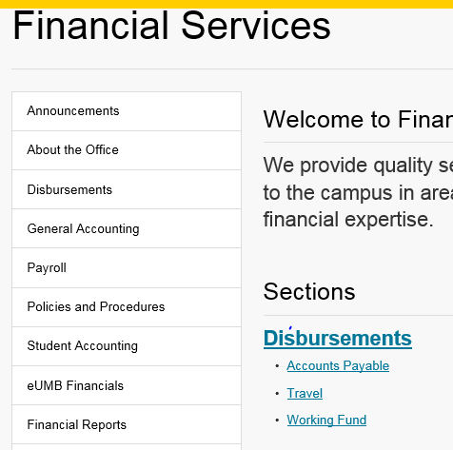
Gift Card System: Where/When
The link will be on the FS web site, in the Disbursements section.
Targeting the first several weeks of December
The system is simple and intuitive
Questions: Larry Miller, AD Financial Services

