Slide 1
SPA/SPAC Updates
1st Quarter 2019
September 20, 2018
2:00 – 3:30 pm
Pharmacy Hall: N111 Lecture Hall

Slide 2
Kuali Research
Info & Guides on SPA website
  http://www.umaryland.edu/kualicoeus/user-resources-and-help/
  Navigating and searching in KR
  PI certification and approval
KR New User Training Dates (CITS enrollment database)
  10/10/18 & 11/7/18 10-12:30PM
New email for KR “Report a Problem”
  DLKualiResearchHelp@umaryland.edu
KR FAQ’s available

Slide 3
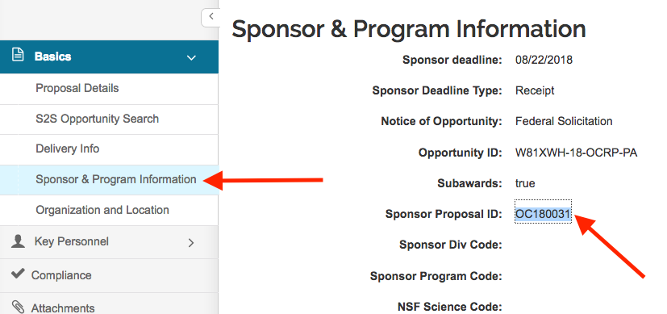
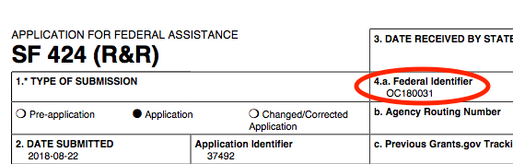
DOD Proposals
Pre-Application Log # MUST go in the proposal
Sponsor & Program Info tab
Enter the Log# on in the “Sponsor Proposal ID” field

Slide 4
Unfunded Agreements
Beginning 11/1/18, unfunded agreements must be routed
  DUA, CDA, Teaming Agreements, etc.
Unfunded = no budget included
Instructions will be provided by SPA via the RAC DL and on the website

Slide 5
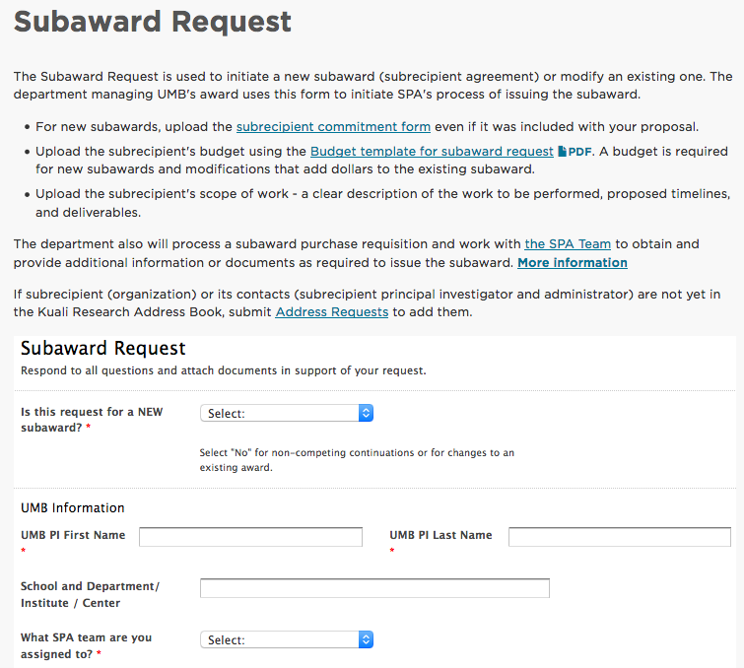
JPA
Joint Personnel Agreements
Assignment of personnel and reimbursement of salary for UMB and BREF
Use the online Subaward Request
http://www.umaryland.edu/spa/collaborations-and-subrecipients/subrecipient-agreements/subaward-request/

Slide 6
GASP
The last classes of GASP will end this year!
New name…
Current registered staff are completing remaining classes
New curriculum being developed
  Online modules
  In class case studies/discussions
  Knowledge testing

Slide 7
S
P
A
R
K
S
Sponsored
Programs
Administration
Research &
Knowledge
Seminars

Slide 8
KR Proposals Reminders
Proposals created the same day will not show on SPA’s deadline report (internal)
Subrecipient Commitment Form is still a requirement at the time of proposal
PI’s must certify the proposal
Be careful when copying proposals that were created in KC!
Proposals with human subjects
  Instructions for NIH proposals with human subjects http://www.umaryland.edu/kualicoeus/user-resources-and-help/nih-human-subjects-forms/

Slide 9
Reminders
Please, please use the team emails when communicating with SPA, unless an action has been triaged and you know who the SPA person that is working on that action.
Ask your general questions at Research Matters http://researchmatters.umaryland.edu
If you change the deadline date, please update your team or the person working on your proposal immediately!
Please give SPA adequate time to review your proposal.
Get your proposals in early!!!

Slide 10

Questions?

Slide 11
SPAC Updates
1st Quarter 2019
September 20, 2018
2:00 – 3:30 pm
Pharmacy Hall: N1111 Lecture Hall

Slide 12
SPAC Agenda
Personnel
Fringes
Year End Cost Challenges
F&A
Effort
Deadlines
VA
Updates
Audits and Reviews
Upcoming
Quantum

Slide 13
Cost Agenda
Personnel Update
Discrepancies in Fringe encumbrance Balances
FY18-27 DR and 19-01 Funding Profiles
Posting of DR credits for 18-27 PCA balances
Finalized Fringe Benefits
F&A Rate Negotiation – Extension Approved
Delinquent Effort Forms and Quantum Implementation
063018 Effort Statistics and Initiation
Effort Training for Next Year

Slide 14
Cost Personnel Update
Christina Tabb is no longer with Cost
Tracy Nguyen has been hired with start date 10/15/2018
Beryl Gwan, Senior Manager Cost
  Binita Shah, Cost Accountant
  Amy Sallese, Cost Accountant
  Tracy Nguyen, Accountant I

Slide 15
Discrepancies in Fringe Encumbrance Balances
No salary encumbrance, but an outstanding fringe encumbrance on a project
Negative fringe encumbrance balance
  Caused by Mid year rate change
  Fringe encumbrance calculated at original fringe rate
  DR is done and the reversal encumbrance credit uses the new fringe rate
  Results in a net credit encumbrance balance
Your SPAC closeout team will work with the Cost office at closure to relieve these encumbrances. Verify with your closeout team that this is the action you want taken when you send your final report.

Slide 16
DRs for FY18-27 and Entering Funding Profiles for 19-01
HRMS reads 18-27 as the same Pay Period as 19-01 for Direct Retro purposes
  FY2018 18-27 06/24/18 to 06/30/18
  FY2019 19-01 07/01/18 to 07/07/18
  HRMS PP 18-27 is within 19-01 (06/24/18-07/07/18)
HRMS: when a DR is done for the crossover period
  For 18-27, we enter 19-01 and FY2018
  For 19-01, we enter 19-01 and FY2019
  If a DR is processed for a pay period (PP), you can no longer do a BR for the same pay period

Slide 17
DRs for FY18-27 and Entering Funding Profiles for 19-01, Continued
Funding Profiles for 19-01 should be entered and approved before submitting DR for 18-27
  If DR is processed for PP 18-27 before you set up the 19-01 funding profile HRMS will read that there is already a DR for that period (19-01)
  The EFP will need to be input from 19-02.
  The 19-01 expense will need to be moved via a DR

Slide 18
Posting of DRs for 18-27 – credit to PCA balance
If you have an outstanding debit on the PCA for PP18-27 and a DR has been processed
Verify that 18-27 DR’s have been processed by checking the 19-01 PCA balance because that is where the Direct Retro credit balance posts
  Payroll Charge Detail (PCD) report will show a lower balance in the 19-01
  Or if ran by accounting period, one debit line for 19-01 payroll, and one credit for 18-27 DR
  If there is no fringe expense on PCD for 18-27, that’s a good indication that the balance was moved appropriately
“How to View a DR in HRMS”
Finding a Direct Retro in HRMS - SPA-SPAC Meeting 11-20-14 PDF

Slide 19
Finalized Fringe Benefit Rates
A memo was sent out to Campus to announce the Implementation of the approved Fringe Benefit Rate Agreement by Laura Scarantino
FY19 rates were set up in HRMS from 19-01
The memo and rate agreement have been uploaded to our website
  http://www.umaryland.edu/cost/fringe-benefit/

Slide 20
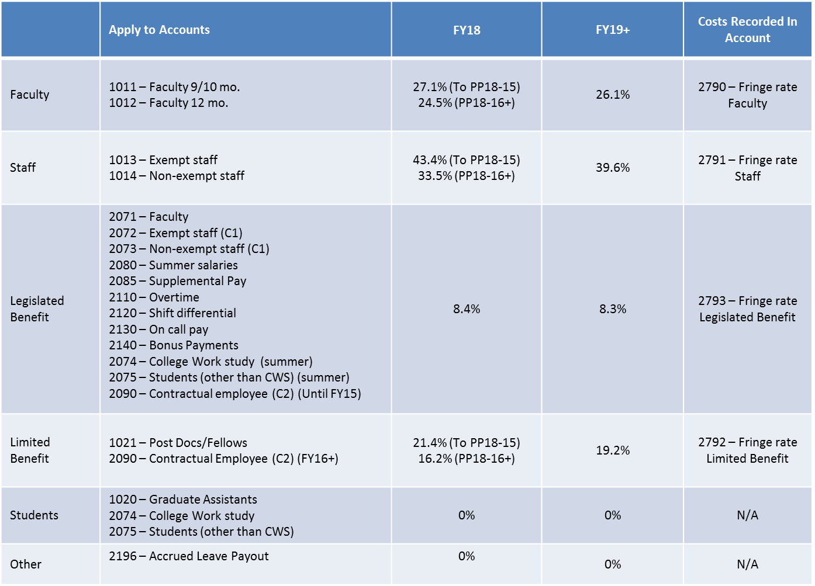
FY19 Finalized Fringe Benefit Rates

Slide 21
FA Rate Negotiation for FY19 and beyond - Update
Our current rates were expiring 6/30/2018.
UMB’s Base year was FY2017 we requested an extension
The extension was approved. They have been made final through 06/30/2021.
Our next base year is the FY ended 06/30/2020

Slide 22
Effort Reporting and new Quantum Implementation
All outstanding effort forms must be completed before the new Quantum system is implemented
In the following months, there will be a more aggressive effort by the Cost office to resolve and certify all outstanding forms
Total delinquent forms in ERS today: 260

Slide 23
063018 Effort Reporting Period and Initiation
Due date for 063018 Effort forms is next Tuesday, 09/25/18
The new 093018 period will be initiated the day after, on 09/26/18
Please have your certifiers complete forms, especially for employees who will change departments
For 063018 Period alone there are
  2,254 Completed
  378 Pending Pre Review
  438 Pending Certification

Slide 24
Effort Training Class for Next Year
  Dates for the next effort training will be put out for the entire year, subject to change.
  These will be available on the Cost website at the link below:
    http://www.umaryland.edu/cost/training/
  Tentative Dates are
    Wednesday October 31st, 2018
    Thursday January 31st, 2019
    Tuesday April 30th, 2019 and
    Wednesday July 31st 2019

Slide 25

Questions

Slide 26
SPAC’s Agenda
Staffing Updates
Deadlines
VA Invoicing Update
Lockbox Update
Audits and Reviews
Reminders and New Stuff
  SCR Reporting SPAC ACT Website
  Closure Meetings New DIRRF Email Traffic
  QUANTUM – Lynn McGinley

Slide 27
SPAC Staffing Updates
New Hires
Shane Dubiel - as an Accountant 1
Lilly Liu – Manager Team Central
Promotions:
Neda Karimi promoted to Financial Analyst with Team Red
In the process of another internal promotion to Team White Financial Analyst
Ajesh Singh was promoted from Team Red/White to a Financial Accountant in Team Central
OPEN POSITIONS
Accountant 1 – Close
Closure Consultant

Slide 28
SPAC Staffing Updates
COST | CENTRAL
Beryl Gwan Sr. Manager Binita Shah Cost Accountant Amy Sallese Pt Cost Accountant New Hire 10/15 Accountant 1 | Lilly Liu Manger Mary Miller Accountant Colin Fleming Accountant 1 VACANT Accountant 1 Marcelle Finyom Accountant 1 Neli Georgieva Financial Acct Ajesh Singh Financial Acct PI Leaving - SPACrelinquishing@umaryland.edu DLB Closeout dlb-closeout@umaryland.edu

Slide 29
SPAC Staffing Updates
KRISTA SALSBERG, SENIOR MANAGER
TEAM RED | TEAM WHITE
Chris Hook
Accountant 1 – rs-spac-dlb-billing@umaryland.edu
Brenda Hester
Accountant - Collections

Slide 30
SPAC Staffing Updates
WHITE TEAM | RED TEAM
Mila O’Callaghan Manager Financial Accountant Analyst Tammira Barnes Financial Accountant Analyst Ron Hill Financial Accountant Analyst Vacant Financial Accountant Analyst Claude Street Accountant 1 | Cheryl Williams-Smith Manager Shernett Wynter Financial Accountant Analyst Krissy Long Financial Accountant Analyst Neda Karimi Financial Accountant Analyst Jean Indrova Gonzales Accountant 1
Shane Dubiel Accountant 1

Slide 31
Deadlines
Sponsors required dates for final reports are not the departments required dates
In order to process final invoices accurately we need signed ROE’s in preferably 20 days in advance of due date to the sponsors and no later than 15 days to ensure delivery to the sponsor in time
As the federal government tightens their deadlines it flows through.

Slide 32
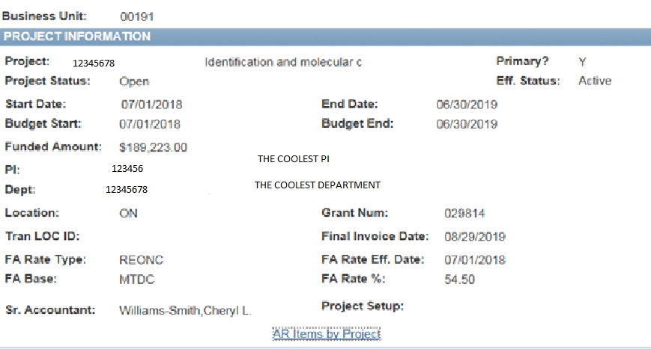
Deadlines
Do you agree at setup? We can move this date back in order to comply.

Slide 33
VA Invoicing Update
List to VA of 151 Awards for expense to 6/30/18 of which 9 had current PO’s
Total outstanding Expense unpaid $4M
Received 55 new PO’s to replace rejected or old PO’s
Allows us to bill 2.7M of the outstanding Expense
SPA is not accepting awards without PO #’s assigned

Slide 34
VA Invoicing Update
New process - SPA/SPAC will receive any new awards with required PO to a Distribution List
Just like Federal awards, SPAC will set up award and email the PI, SPA and the department DL
Each month, SPAC runs a “Pre-Award” list (those projects that have not received the PO)
This list will be sent to the VA, SPA and SOM

Slide 35
Lockbox Update
Just a reminder, for Lockbox Expedited payments:
  Lockbox Services Box # 41428
  University of Maryland, Baltimore
  7175 Columbia Gateway
  Columbia, MD 21046
  https://www.umaryland.edu/spac/sponsored-projects-accounting-and-compliance-spac/about-the-office/spac-banking-information/

Slide 36
Audits and Reviews
Legislative Audit
SOM
  Psychiatry
  Cardiac Surgery
  Oncology (CRF)
SSW
SOP
SON
Legislative Audit
Draw process
Preaward Maint
F&A rates
Fringe Rates
AR’s
  Negatives
  Collections
Department Expense
General Processes
S&B will be in the office by the end of next week starting their review!

Slide 37


REMINDERS AND NEW STUFF

Slide 38
What is coming!
SCR Reporting
  Due by October 12th
  For Federal Service Contracts Only
  Esther Ndiangui from our office notified you
Closure meetings Next 90 days
  Defining lists of projects for departments
  Setting up meetings to discuss action plans for closure
  Need to get these DLB’s off the books!

Slide 39
What is Coming
New DIRRF (S/B here by 9/30/2018)
  Last updates s/b finished
  Will send out the link, it will replace the old link
  Be able to measure cancels and revisions and who
  SPAC_ACT (S/B here by 9/30/2018)
    Actions for Customer Service & Training
    Taking ideas for SPA/SPAC meetings, brown bags and customer service improvements
    Suggestion box that will be monitored by our ADMIN
    Not a complaint box – they still go to the management

Slide 40
What’s coming
SPAC website makeover by calendar year end
Look at email traffic – and the why (up 15-20%)
Looking at sending bulk requests rather than 1 off ROE’s, FFR’s and invoices
QUANTUM!!!!
http://www.umaryland.edu/quantum/

Slide 41
Questions

