Slide 1

Temporary Project IDs
SPARKS
August 18, 2026
Jill Frankenfield and Janet Simons

Slide 2
What is a Temporary Project ID?
An account set up that allows a department/PI to charge expenses to a specific project even though the sponsor has not (yet) issued an award.
Notes:
University of Michigan calls these “Hardship Authorization Requests”.
Other universities call them Advance Accounts or At-risk Accounts.

Slide 3

Today’s discussion:
Benefits of a temporary PID
Risks of a temporary PID
Procedure and Expectations

Slide 4
Benefits of a Temporary PID
Allocation of expenses to the project – reduces the need for payroll and other cost transfers
Reduced audit risks
For federal grants and cooperative agreements, “Preaward Spending” is permitted within 90 days prior to the award start date, allowing departments to begin purchasing, initiate hiring process, etc.

Slide 5

Risks of a Temporary PID
Award is never issued and department must cover the costs.
Award is issued but with details that require setup of a different SOAPF (more work for SPAC and department).
PI performs work and provides deliverables/results to a corporate sponsor. Sponsor now has less incentive to negotiate agreement terms with UMB.
Award start date is later than anticipated. Project costs incurred prior to that date may not be allowable (or will need sponsor approval).
  Project (and expense) start date may be the date of final signature
Receipt of federal grants and cooperative agreements is not as predictable as it used to be.

Slide 6
Procedures and Department Expectations
Temporary Project Procedures
“Approval for a temporary project ID may be requested before receipt of an award when there is a very high likelihood that the award will be made.”
Departments should assess the likelihood that the sponsor will issue the award.
Departments must provide a guarantee SOAPF: In the unlikely event that the award is not made, all expenditures are guaranteed by the Department.
Departments are expected to follow up with the Sponsor

Slide 7
Procedures
Department completes and submits the Temporary Project Request (Kuali Build form). The form:
  REQUIRES that a routed, approved proposal exists in Kuali Research.
  Is approved by PI, department approver if required by department, and Chair/director/designee with authority to provide the guarantee.
  Is approved by SOM Deans Office for Baltimore VA IPAs only
SPA verifies the provided information: proposal and (for continuations/extensions) award, Sponsor, Prime Sponsor, and IDC rate.
SPA processes the request to SPAC.
SPAC reviews and sets up award/PID as appropriate.

Slide 8
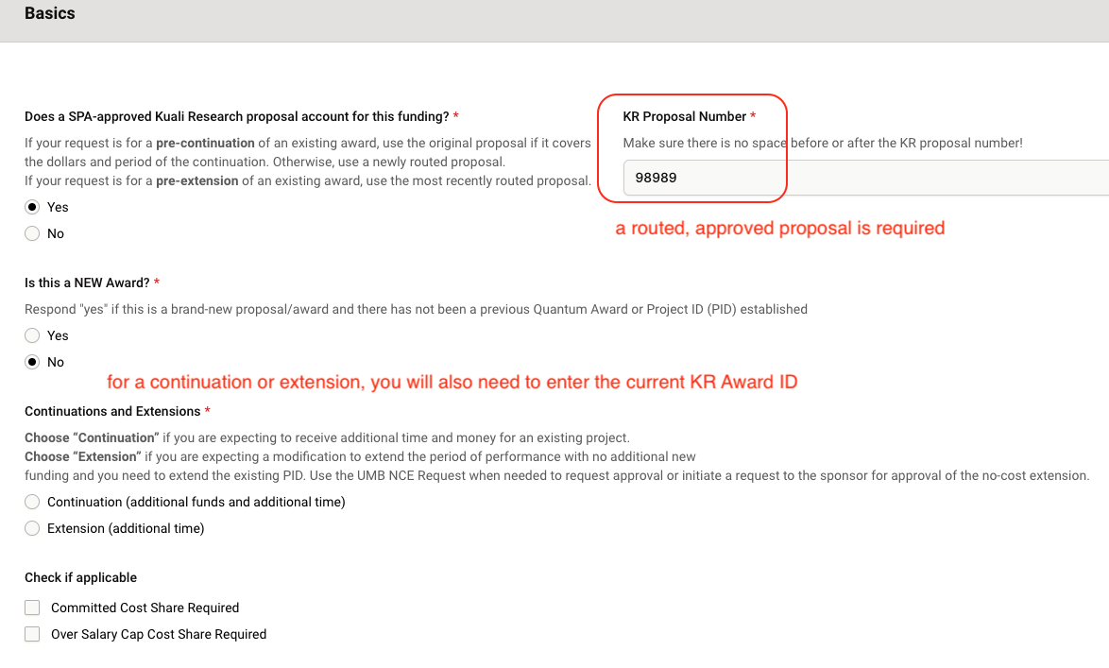
Basics section

Slide 9
Details and request types
Request types
  New
  Continuation (additional funds + additional time)
    May get a new PID or continue using existing PID, depending on financial reporting needs
  Extension (additional time – while awaiting sponsor approval of an NCE)
    Temporarily extends existing PID with no additional funding expected
Over salary cap
Committed cost share
Subawards - will not be issued under temporary PIDs

Slide 10

Correct proposal number is key
NEW
This proposal contains the data for the temporary PID records
Is the proposal fully approved in KR?
CONTINUATION
SPA will check that the requested temp account dates and anticipated funding are covered by the existing approved proposal
KR Award will also be required – should match the current PID you entered in the Basics section
EXTENSION
Proposal – Current PID – KR Award should all match

Slide 11
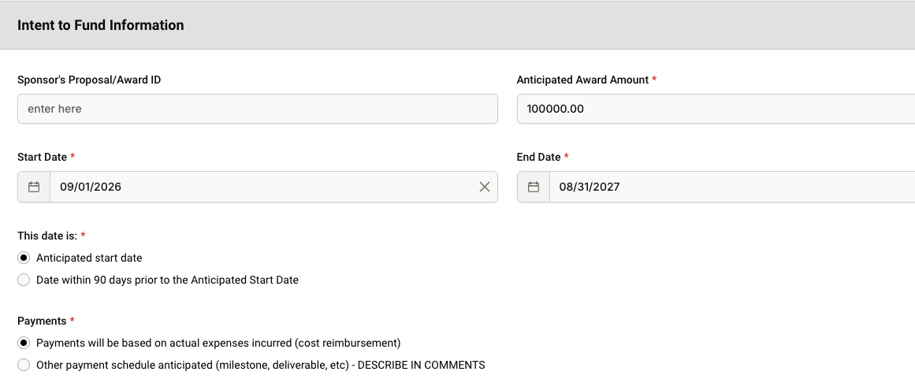
Intent to Fund

Slide 12
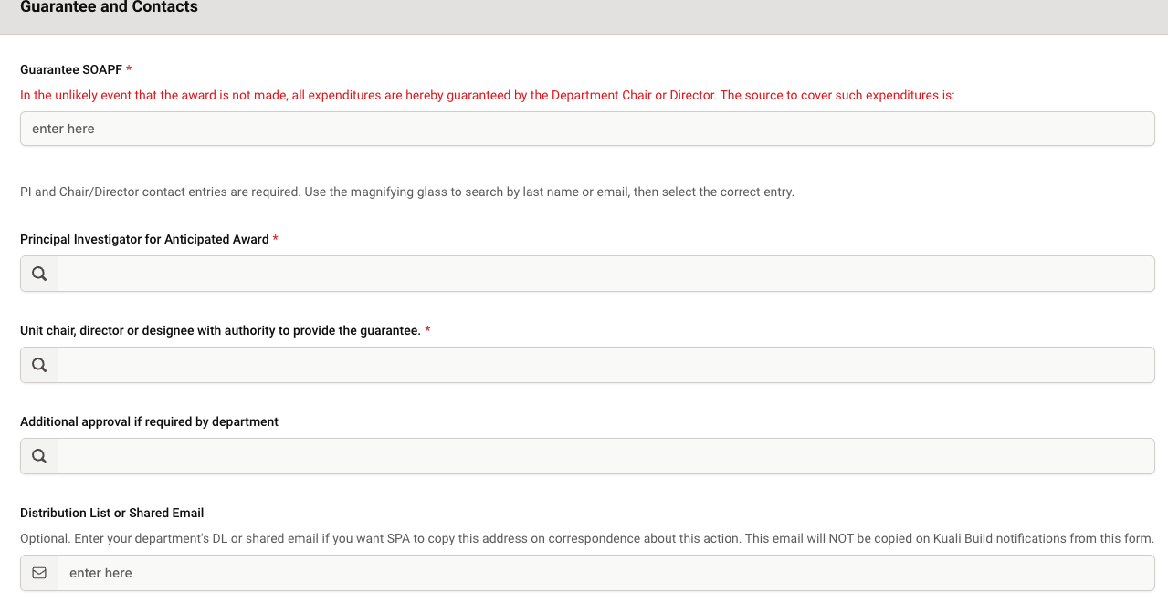
Approvals (Guarantee and Contacts)

Slide 13

More Details
Child accounts – requests for child accounts under a Temporary PID are handled by SPAC
PIDs are set up for no longer than one year.
  You should be concerned if you don’t have an award by then…
  Requests to extend the PID for longer than one year are handled by SPAC.
This Photo by Unknown Author is licensed under CC BY-NC-ND

Slide 14

Next steps
Normally, the award will be received and the award/PID finalized by SPAC
IF NO AWARD IS ISSUED: Coordinate with SPAC to move all expenses to the department (guarantee) SOAPF and close out the Temporary PID/award
  Costs cannot be moved to a different sponsored account due to audit risk
IF SOME OR ALL COSTS ARE DISALLOWED BY SPONSOR: Initiate direct retros or cost transfers to move disallowed expenses to a non-sponsored account.
  This may happen if the sponsor will only reimburse for expenses incurred after the award execution date, or if there are unexpected expense restrictions in the award terms.
IF AWARD INFO CHANGES: SPAC will contact you if a new SOAPF must be set up and will ask you to move the expenses to the new PID.

Slide 15
Reminders
Department’s risk assessment: The department should have reasonable certainty that:
  The award will be forthcoming.
  Necessary expenditures will be allowable under the anticipated award terms and start/end dates.
If the award has been received or is partially executed (FX due any day now), don’t request a Temporary PID.
All costs incurred on a Temporary PID must meet the same compliance and allowability criteria as costs incurred after the award arrived.
Collaborate with your PI and with SPA to communicate with the Sponsor about the anticipated award.

Slide 16

Questions?

