Slide 1
Proposal Attachment Guide
What needs to be attached in my KR proposal?

Slide 2
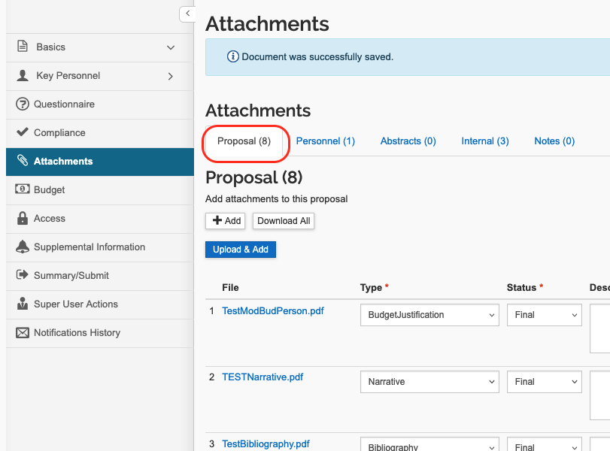

Step One: Proposal Attachments
In Kuali Research, navigate to the attachments tab. This is where you will upload the necessary documents.
This guide will lead you through the required attachments for each type of proposal.
More information about attachments

Slide 3

What kind of proposal?
Select the type of proposal you are submitting to learn more about required attachments.
Federal system-to-system
Examples: Federal grants, cooperative agreements, fellowships
Sponsor portal submission
Examples: TEDCO, MIPS, Proposal Central, Research.gov, NASA NSPIRES
Submission to sponsor – other methods (email, etc.)
Examples: Clinical trials (CCT), some Foundations, State of Maryland, subawards (UMB is the subrecipient)
Unfunded agreements
Examples: confidentiality agreement, data use agreement

Slide 4




Step One: Proposal Attachments
Federal system-to-system (S2S)
Click here to return to
“What kind of proposal?”
What is it? System-to-system (S2S) allows you to submit your proposal to Grants.gov through Kuali Research. S2S is very convenient because you only need to enter your data once and KR will populate all required fields.
Examples: Federal grants, cooperative agreements, fellowships
What to attach: Follow sponsor requirements. S2S will automatically list and include all mandatory forms. Optional forms can be added by clicking the “include” button.
Proceed to step 2

Slide 5
Step One: Proposal Attachments
Sponsor portal submission
Click here to return to
“What kind of proposal?”
What is it? Proposals submitted via a sponsor’s unique and separate portal.
Examples: TEDCO, MIPS, Proposal Central, Research.gov, NASA NSPIRES
What to attach:
  Final budget
  Budget justification
  Letter(s) of commitment/support
  Subaward documentation
  Research plan/technical scope of work, this may be in draft format and replaced during routing by the proposal creator
Please note: The final copy of submitted proposal must be provided to SPA.
Special instructions: If the sponsor’s system allows proposal submission by the PI, be sure to route the proposal in Kuali Research BEFORE submission. After-the-fact routings should be rare.
Proceed to step 2

Slide 6
Step One: Proposal Attachments
Submission to sponsor – other methods (email, etc.)
Click here to return to
“What kind of proposal?”
What is it? Proposals to sponsors that do not have submission forms on their website and request documents in alternate ways, like through email.
Examples: Clinical trials (CCT), some Foundations, State of Maryland, subawards (UMB is the subrecipient)
What to attach:
  Final scope of work
  Budget
  Budget justification
  Letter(s) of commitment/support
  Subaward documentation
Special instructions: If your routing includes an agreement (grant agreement, MOU, etc.), respond “yes” to the UMB Questionnaire question, “Is there a contract document included as an attachment in this proposal?” SPA or CCT will review and (if needed) negotiate the agreement and sign on behalf of UMB.
Award Review
Proceed to step 2

Slide 7
Step One: Proposal Attachments
Unfunded agreements
Click here to return to
“What kind of proposal?”
What is it? Agreements that address specific needs related to sponsored projects but are not a funding instrument.
Examples: confidentiality agreement, data use agreement
What to attach:
  Completed questionnaire
  Statement of work
  Proposed agreement, if applicable
Questionnaire
Routing instructions for Unfunded Agreements
Proceed to step 2

Slide 8
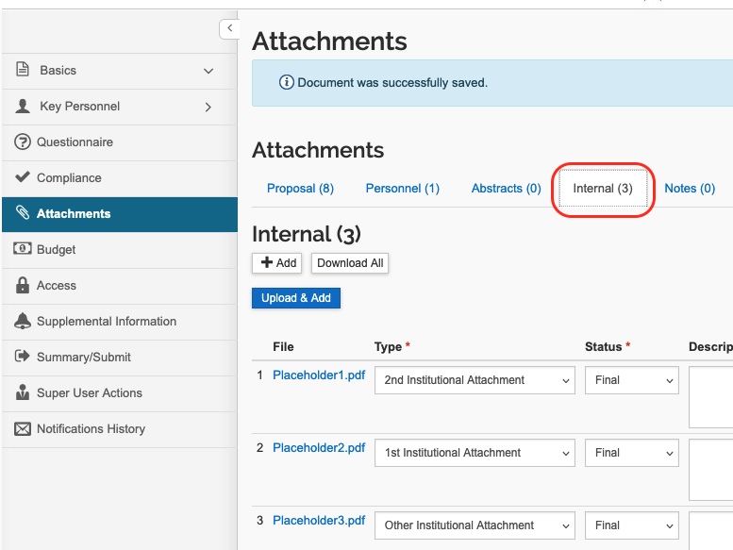
Step Two: Internal Attachments
After uploading all required proposal attachments, click “Internal.” This is where you will upload all documents that are added for internal review and reference but are not intended for submission to the sponsor.
Required attachments:
  3 placeholder attachments (add for ALL proposals)
  Sponsor instructions/request for proposal, etc. (if not federal S2S)
Examples of other documents you may need to attach
  Routing memo outlining any anomalies in the solicitation or proposal, any unusual form or signature requirements, submission requirements, after-the-fact routing, incremental funding, etc.
  All letters or documents for SPA signature in their final form, ready for SPA to review and sign
  Approved indirect cost waiver
  PI eligibility waiver
  Other useful documents that will not be submitted to sponsor
Request an F&A Rate Waiver
PI Eligibility Waiver Request

