Slide 1
Kuali Research and the Kuali Build apps:
a post-award guide to what to route where
Encore presentation 6/11/26

Slide 2
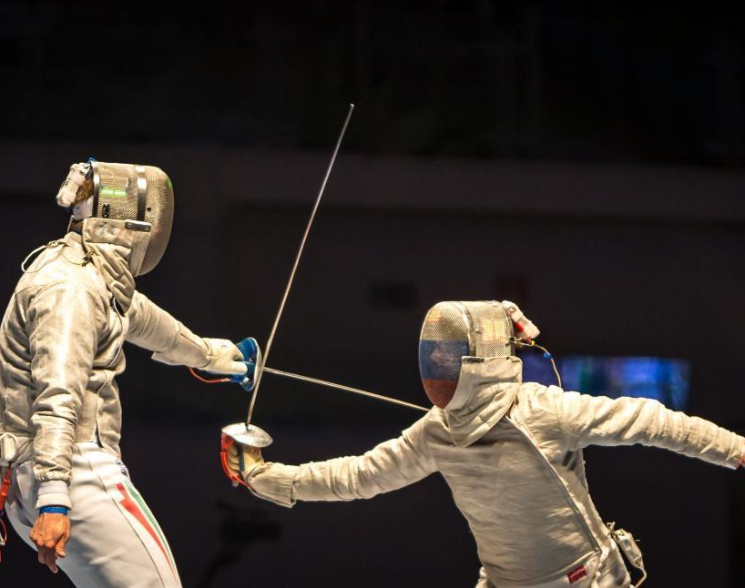
Or…
KR vs KB

Slide 3
Kuali Research
Use for:
New proposals
  Funded or unfunded
New $$: Any funds not included in the original proposal. EXAMPLES:
  Continuation year
  Supplement
  Additional funds awarded by sponsor
Change of PI
Change of department

Slide 4
Searching In Kuali Research
Many forms require an Award ID, a Subaward ID a Proposal ID, or an Address Book ID from Kuali Research
General KR Search reference: https://www.umaryland.edu/kuali/user-resources-and-help/searches/
Awards KR Searches: https://www.umaryland.edu/kuali/user-resources-and-help/awards/
Subawards KR Searches: https://www.umaryland.edu/kuali/user-resources-and-help/subawards-in-kr/

Slide 5
Kuali Build apps for post-award actions
Award Modification
No-cost Extension Request
Departing Investigator
Subaward Request (for Outgoing Subawards – new and modifications)

Slide 6
Kuali Build
Award Modification
Increase in $$ must be covered by a KR proposal (identify the proposal # in the form)
Use for:
Post-award changes to existing awards such as:
  Continuation funding
  Requests and modifications approved by sponsor including approved NCEs
  Amendment to an unfunded agreement
  Modifications signed by CCT (Mike Rollor)
Changes/modifications to unfunded agreements
SPA signatures on documents for existing awards

Slide 7
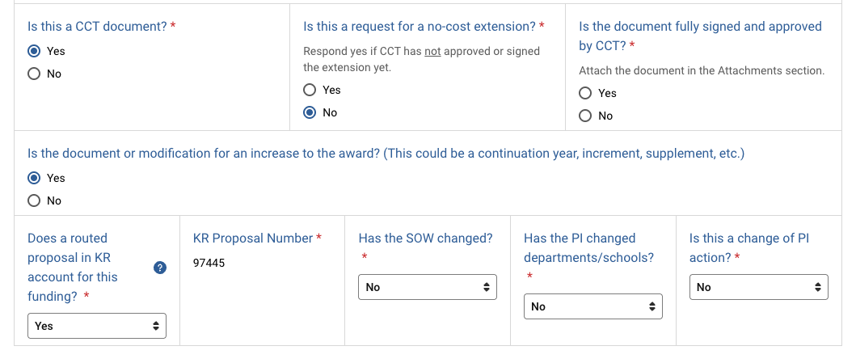
Award Modifications

Slide 8
No-cost Extension (NCE) Request
Is Sponsor approval needed?
If no - the request must be submitted for internal approval.
  Currently, both CCT and SPA use this form for internal NCE approvals

Slide 9
NCE Request for Sponsor Approval
When UMB must submit a request to the sponsor for an NCE:
Is there a requirement the request come from an AO/AOR? If so, the dept should use this app for SPA to submit the request to the sponsor
If no firm requirement the request come from an AO/AOR, the dept or PI may ask the sponsor for the NCE
  In this case, once approved by the sponsor, the dept submits the sponsor approval (or formal mod) via the KB Award Mod app

Slide 10
Departing Investigator
Applies to departure for any reason
Addresses all active sponsored awards – funded and unfunded
Addresses all award dispositions – transfer, change of PI, termination, etc. All currently active awards should have a disposition.
Use one form for the PI’s entire portfolio of awards.
The workflow collects required approvals for the action.
  NOTE: Change of PI and/or change of department must ALSO be submitted as a KR proposal (collects certification & additional approvals).

Slide 11
Subaward Request for Outgoing Subawards
Request to issue a new subaward or modify an existing subaward
Sponsor approvals
  Approved as part of the proposal or
  Approved by sponsor in writing
Federal Contract question
  Most federal awards are grants or cooperative agreements
  To verify, look in Kuali Research for the Award Type (in the search results if you use Common Tasks > Search Awards)

Slide 12
Send to SPA via e-mail
Pre-award/post submission requests such as:
  Just-in-time responses
  Representations & certifications for SPA signature
New award that doesn’t have a KR Award ID yet
Federal progress and final report actions (RPPRs)
Carryover requests
Budget modification requests

Slide 13

More tips
The KR Award that you enter must be in Approved status.
The PI of the KR Award that you enter must be an active UMB employee/affiliate. (Does not apply to Departing PI form)
The data that autofills is the current data in the KR record.
When you enter the Award or Subaward ID, make sure there is no blank space before the number.

Slide 14
A few final words
Kuali is our UMB auditable system of record – routing is important.
Requests may be lost if sent in via email only.
Kuali helps SPA monitor and manage workload – many eyes
If you aren't sure, please ask

Slide 15
Latest Forms – Announced at SPA-SPAC
KR Address Temporary Project Request – pilot testing
  mandatory as of July 1
KR Address Request - request to add non-UMB persons, performance sites, sponsors and subrecipient organizations that are not already in Kuali Research (same as the prior form)
KR User Roles Request – request Kuali Research roles for new users, update roles/units for existing users, remove users, update approvers for your unit (replaces 2 old forms + email requests)

Slide 16
More useful forms
Add Degrees in KR User Profile
Account Request for NIH or NSF
  eRA Commons accounts and Research.gov accounts

Slide 17

Questions?

Slide 18
Resources
Award modifications:
  https://www.umaryland.edu/spa/award-management/award-modification/
  Decision tool (PPT opens in play mode) https://www.umaryland.edu/media/umb/ord/documents/spa/Award-Modifications-Clickable-PowerPoint-.ppsx
Outgoing subaward requests
  https://www.umaryland.edu/spa/collaborations-and-subrecipients/subrecipient-agreements/subaward-request-instructions/
No-cost extensions
  https://www.umaryland.edu/spa/award-management/changes-to-project-or-budget/no-cost-extensions/
Departing investigators
  https://www.umaryland.edu/spa/award-management/faculty-transfers---outgoing/
  https://www.umaryland.edu/spa/award-management/award-reports-and-close-out/final-reports-and-close-out/

