Slide 1


Editing the Human Subjects Study Form
Click “Presenter View” from the Slide Show Tab to listen to the presentation or click on the Microphone button on each slide to listen to each slide individually.
Sponsored Programs Administration
FY25
eRA Online Help Link
* Credit: All slides were snipped from the eRA Online Help Editing Studies topic for the Research Performance Progress Report (RPPR)
Notes:
In the words of our favorite television friends, "Could there BE... a more frustrating form?" From preaward to postaward, the Human Subjects Form is tricky to complete and technically complicated to upload. This is an attempt to help you tackle one of the most common headache's experienced a the time of the RPPR, which is updating the Human Subjects Study Enrollment Form. Let's give it a try!

Slide 2
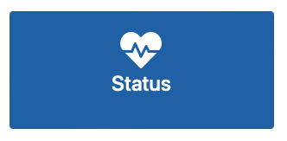
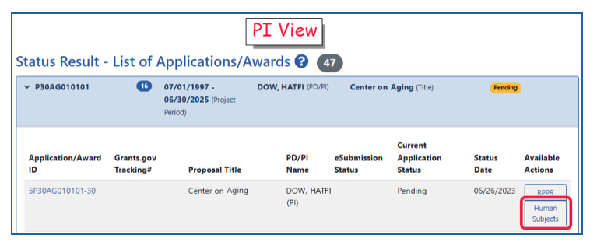
Access the Human Subjects Study Form
Notes:
First, you will access the Human Subjects Form from the "Status" Section of eRA Commons.

Slide 3

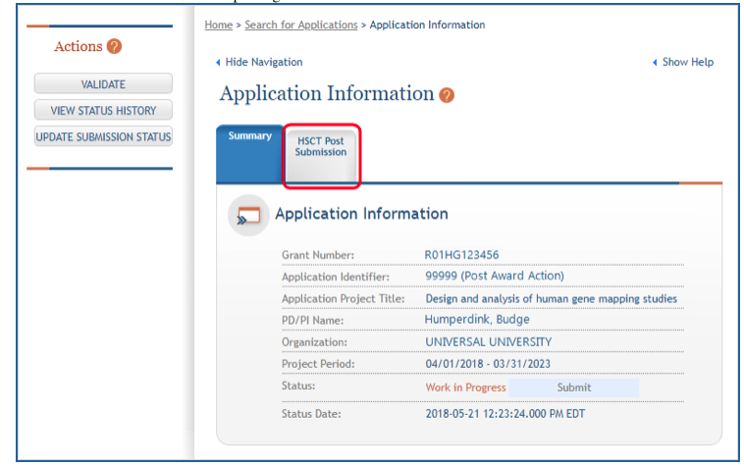
Work in Progress
Notes:
Once "Human Subjects" is clicked you will be taken the to ASST website to update the form . If the form Status is not “Work in Progress”, click on the Update Submission Status button to the left. Another screen will open for you to change the submission status to Work in Progress. As long as the status is Work in Progress, you can get to work. Just
Click on HSCT Post Submisison and your study record or records will open for editing.

Slide 4
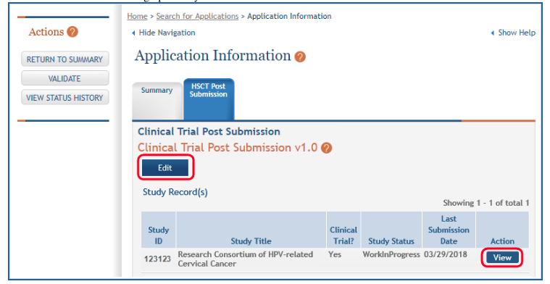
Opening the Study
Notes:
At the next screen, Simply Click "Edit" and then Click "View" to Open your study.

Slide 5
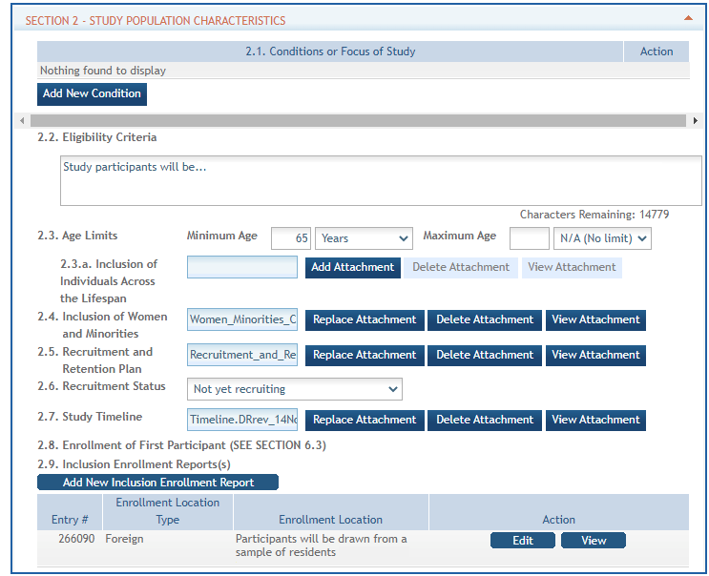
Find the Enrollment Form under Section 2.
Notes:
Now you are Section 2 to of the Human Subjects Study Form. Just under 2.9 (Inclusion Enrollment Report), you will find the Enrollment form for editing. Click Edit.

Slide 6
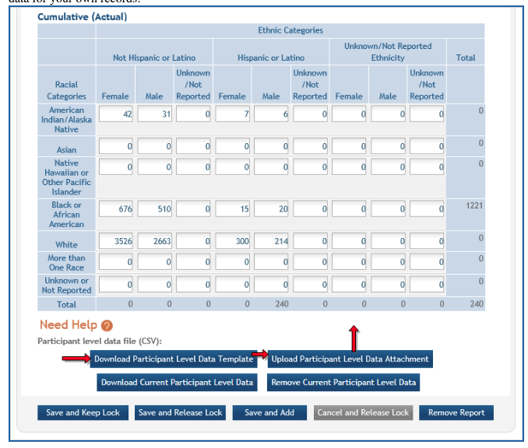
Uploading the Participant Level Data Template
Notes:
Once opened, navigate to the blue buttons under the Cumulative (Actual) Enrollment Table. if this is your first time to uploading data, Click on the button that says Download Participant Level Data Template. If enrollment data has been entered before, click Download Current Participant Level Data. Fill the template out with data and then upload the spreadsheet by clicking the Upload Participant Level Data Attachment button. This uploaded data will populate the cells in the report. You must provide data on sex/gender, race, ethnicity and age at enrollment

Slide 7
Entering Data
Participant Level Data Tip Sheet
Delete the sample data with your data-race, ethnicity, sex or gender, age at enrollment, and age unit
Use the sample as an exact guide for how to enter data
Age at enrollment may be reported in units from minutes to years
DO NOT change the template format or column names in any way as this will result in uploading errors.
Don’t use unacceptable values for ethnicity or age. Only allowable category values are included. For example, you cannot use Spanish. The correct value is Hispanic or Latino.
If 90 years old + or unknown, leave age blank and unit set to unknown
Notes:
I encourage you to take a look at the Participant Level Data Tip Sheet that the NIH has published. This sheet includes a link to the spreadsheet template as well as a link to a video that demonstrates how to upload data into this template. To access that tip sheet, just click on the blue link I have provided in this slide. In the meantime, take a look at a few of the tips from that sheet on this slide.

Slide 8
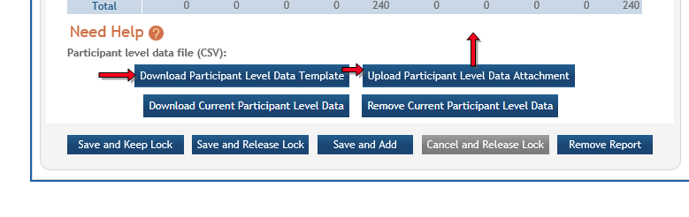

After Upload
Click the Save and Release Lock to save the changes
The submission status changes to Work in Progress
Notes:
After upload, Click the Save and Relesase Lock Blue Button that is just under the Cumuilative (Actual) Table to save the changes. The submission status will then change to Work in Progress.

Slide 9
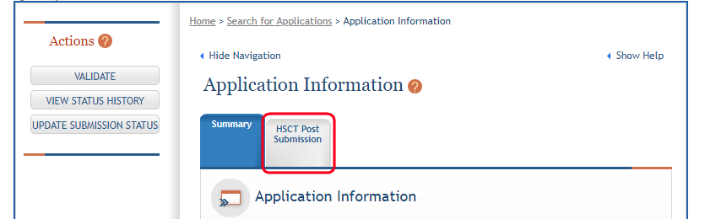
Marking your Study ”Ready for Submission” and Sending it the UMB Signing Official
Return to the Application Information Screen and click on the Update Submission Status button to the left
Form here change the Status to “Ready for Submission”
The Signing Official will receive an email that the application is ready for submission.
Notes:
Finally, you need to mark your study Ready for Submission to submit it to the UMB Signing Official to submission to the NIH.

Slide 10

You did it!
Always reach out to your Department Administrator first for support as they are your frontline collaborator in the RPPR process. However, all are welcome to contact SPA at anytime for help!!
Contact SPA-Grants@umaryland.edu for support.
Notes:
”Congratulations! You did it! If you have need additional support, please connect with your Department Grants Administrator. Please contact SPA for additional help at spa-grants@umaryland.edu.

Slide 11
Quick Guide for Warnings and Errors
No cumulative enrollment data
“G4.b No cumulative enrollment data has been provided to the Study #XXXX, is this correct?
  If enrollment has not begun, navigate to Section 6 and update the anticipated dates. The Anticipated dates must be in the future. The Actual dates must be current of in the past.
  If using an existing dataset, the cumulative enrollment should match the planned enrollment.
  If a Clinical Trial (all 4 questions from Section 1.4 were answered yes), use the Clinical Trials.gov Identifier at 1.5 to pull in updates from Clinical Trials.gov. Information there must match the information in Section 6.
Notes:
The following two slides include a few tips on how to resolve warnings, errors, and clinicaltrial.gov issues. It is not comprehensive as every project is unique, but they do address the most common errors. As you know the world of grants is ever evolving, so please reach out SPA if you find any inconsistencies with this information or if have any tips on how to improve this presentation on how to edit the human subject study form. We really want to take the headache out of completing this form. Let us know how we can help! Thanks for watching and listening, Your UMB SPA Team!

Slide 12
How to fix ClinicalTrials.gov Issues
Signing Official (SO) will set the status of the Human Subjects report back to Work in Progress. If it is in a “Submitted” status, no data can be updated to HSS.
The associated fields should be updated at CT.gov and saved by the PI.
Once completed the PI can go back into ASSIST/Commons and click the ‘Populate’ button at 1.5 of the Human Subjects Form to trigger the NIH systems to pull in the updated information. The system will pull in the new information in ‘near’ real-time. They may need to click ‘Populate’ again if they don’t see the changes right away.
Once the data populates, the SO must resubmit the HS report to NIH. The yellow/red bar will not clear or refresh until the report is in a Submitted status again.
User Guide for Recipients includes instructions. Sections 4.1 and 4.2: https://era.nih.gov/files/ASSIST_user_guide.pdf

