Slide 1
Does UMB export? Complying with the U.S. Export and Sanction Regulations
Awareness Education
Updated November 2019
University of Maryland Baltimore http://www.umaryland.edu/ord/export-compliance/

Slide 2
Why does the government control exports?
The U.S. government controls certain technologies that it considers to be strategically important for:
National Security Reasons
Nuclear Non-Proliferation Reasons
Missile Technology Controls
Anti-Terrorism
Chemical & Biological Controls
Regional Stability
Crime Control Measures
Anti-boycott Reasons

Slide 3
U.S. Export Control Regulations
Are designed to advance national security, foreign policy and economic interests of the United States
Govern the export of strategic technologies, equipment, hardware, software or providing technical assistance to Foreign Persons.

Slide 4
Who is a Foreign Person?
Any person who is NOT a:
U.S. citizen
U.S. Permanent Resident (Green Card holder)
Person who has been granted political asylum by the U.S.
Any foreign corporation, entity, partnership or group that is not incorporated or organized to do business in the U.S.
Any foreign government
Individuals (including U.S. citizens) who represent a foreign government or foreign entity

Slide 5
Export includes
Things, information, services
Either within the U.S. or abroad

Slide 6
Export examples
Transmission of material goods
Items shipped out of the U.S.
Items hand-carried (laptop, memory devices) out of the U.S.
Use of controlled materials by a foreign person
Use or application of controlled technology on behalf of, or for the benefit of, any foreign person or entity
Dissemination of research data and information to a foreign person
Email
Website
Face-to-face
Visual inspection that reveals controlled technical data
Conference

Slide 7
Export without crossing borders
Deemed Export
“In its simplest terms, a “Deemed Export” can be defined as (1) the release (2) of technology or source code (3) having both military and civilian applications (4) to a foreign national (5) within the United States. Thus, even though the release in question takes place within the confines of the United States, the transaction is “deemed” to be an export and therefore subject to certain United States Government export control regulations. The logic is that knowledge transferred to an individual within the United States can readily be transported abroad should the recipient wish to do so.”
--The Deemed Export Rule in an Era of Globalization, December 20, 2007, report to the U.S. Secretary of Commerce

Slide 8
Controlled Technology and Transactions
U.S. Export Control Regulations define controlled technologies, items, information, services
The regulations include exceptions, exclusions, general licenses and authorizations
The regulations identify countries, entities and persons that are prohibited or restricted from certain exports, transactions, or services

Slide 9
How do we know what is controlled?

Slide 10
Details
What we need to know to determine control and licensing requirements:
Who will receive services, information, technology or technical data (individuals and entities)?
What is the destination country?
Who will benefit from services provided?
What is the end use of the item?
What information, technology or technical data is involved? Is it controlled?

Slide 11
Analysis of the Details
Legal and technical analyses determine whether a technology/transaction is controlled
Scientific/technical analysis of the regulations determines whether the item under review meets the detailed specifications for control
Legal analysis of the regulations determines whether an exception, exclusion, general license, or authorization is available for the transaction or if a specific license or authorization will need to be sought.

Slide 12
Investigator Roles
Identify export red flags in your programs (science, services, trainings, collaborations)
Work with administrators in processing foreign national employees and visitors/volunteers – provide description of research or other activities; complete the deemed export control form
Never accept publication restrictions, even “off the record”

Slide 13
Implementing UMB’s Policy
The following slides describe
The three key sets of U.S. export regulations
Exclusions from the export regulations (and how the exclusions can be negated)
Red flags
UMB review procedures

Slide 14
Three agencies Three sets of regulations
Treasury Department | Commerce Department | State Department
Office of Foreign Assets Control (OFAC) | Bureau of Industry and Security (BIS) | Directorate of Defense Trade Controls (DDTC)
Foreign Assets Control Regulations | Export Administration Regulations (EAR) | International Traffic in Arms Regulations (ITAR)
Sanction Programs | Commerce Control List (CCL) | United States Munitions List (USML)
Prohibits transactions with countries, entities and persons subject to boycotts, trade sanctions and embargoes | Exports and re-exports of commodities, software, equipment and technology including dual-use (civil and military) items | Transfers of defense articles and provision of defense services; inherently military technologies

Slide 15
Sanctions and Restricted Parties
The U.S. government applies economic boycotts, trade embargoes or other actions against specific countries, regimes, and/or specific activities (such as terrorism or trafficking)
Primarily administered by the Department of the Treasury, Office of Foreign Assets Control (OFAC)
The Departments of State, Commerce and Treasury maintain lists of persons (individuals and entities) denied export privileges and/or barred from financial and other transactions for reasons related to U.S. security, foreign policy or economics
https://www.treasury.gov/resource-center/sanctions/SDN-List/Pages/consolidated.aspx
NOTE: View slides in PLAY mode to access live (blue) links.

Slide 16
Sanctioned countries
http://www.treasury.gov/resource-center/sanctions/Programs/Pages/Programs.aspx https://www.bis.doc.gov/index.php/policy-guidance/country-guidance
Sanctions change frequently - check the regulations for latest restrictions affecting countries and parties with which you plan to do business.
OFAC countries of highest concern (comprehensive sanctions of services and transactions)
Cuba
Iran
North Korea
Russia
Syria
Ukraine
EAR countries of highest concern (sharing of tangible goods or non-fundamental research results)
Cuba
Iran
Iraq
North Korea
Sudan
Syria
As of October 2019

Slide 17
Categories of Sanctions
Comprehensive Sanctions: Generally prohibit all imports and exports of materials, financial transactions of any kind, and/or providing services of any kind. Transactions will require a specific license or exemption from OFAC before any transaction can take place.
Limited Sanctions: Block specific practices. Most research and business activities may be conducted without an OFAC special license, so long as specific criteria are met as outlined in the regulations for a General License.
Regime or List-Based Sanctions: Blocks specific property of targeted foreign governments, regimes, supporters and persons that are not necessarily country-specific, but which may be owned, controlled by, or acting for or on behalf of, targeted countries or entities as a front organization.

Slide 18
ITAR
Department of State: Arms Export Control Act
International Traffic in Arms Regulations (ITAR)
Covers commodities and technologies with a predominantly military use or space application
U.S. Munitions List - 22 CFR Part 121
Examples: certain biological agents, vaccines, and medical countermeasures, especially if developed or produced under a Department of Defense contract or other funding authorization
https://www.pmddtc.state.gov/ddtc_public?id=ddtc_kb_article_page&sys_id=%2024d528fddbfc930044f9ff621f961987

Slide 19
EAR
Department of Commerce: Export Administration Act
Export Administration Regulations (EAR)
Covers commercial technologies
Covers “dual use” technologies (i.e., civil + military applications)
Commerce Control List - 15 CFR Part 774
Examples: computers, software, sensors, lasers, toxins, pathogens, night vision goggles or cameras
http://www.bis.doc.gov/index.php/regulations/export-administration-regulations-ear

Slide 20
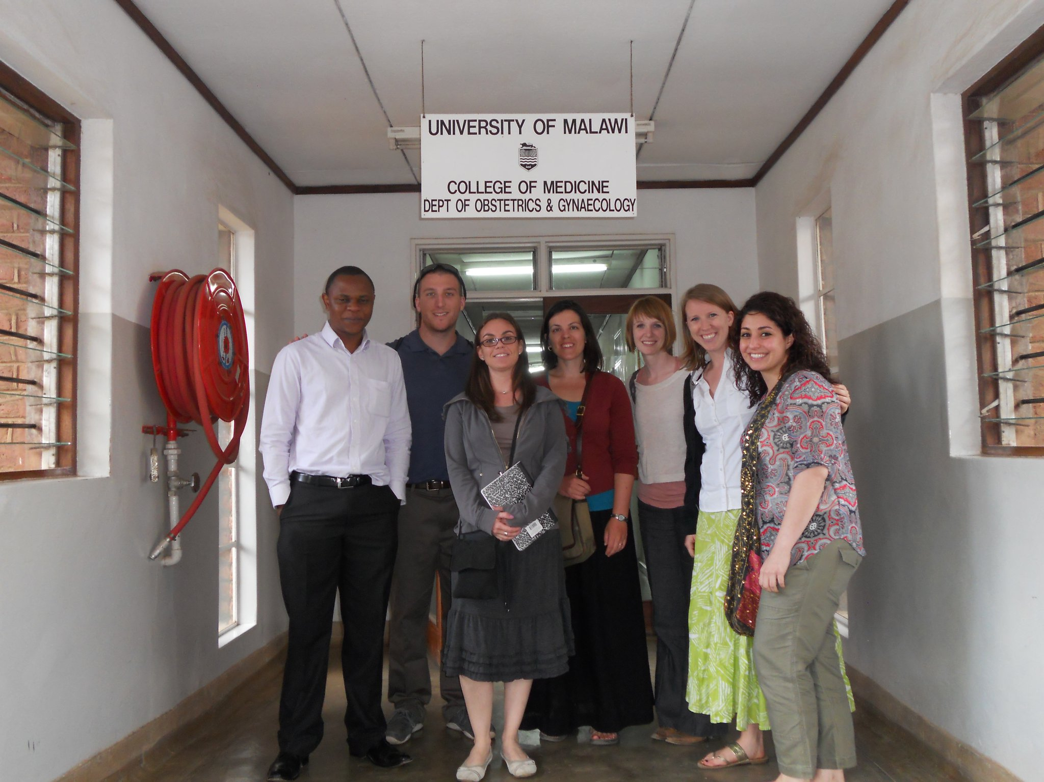
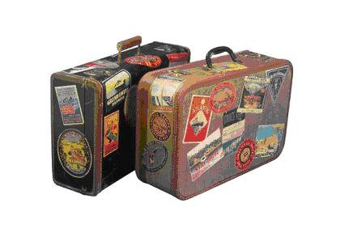
How does UMB export?

Slide 21
How UMB exports:
Global collaborations, international sponsors, foreign subrecipients, foreign consultants, international travel
Deemed export (see slide 7): Foreign persons on campus (visiting scientists, employees on work visas, students)
Most UMB export concerns relate to country sanctions
Export laws apply regardless of funding source

Slide 22
University policy on export controls
UMB and its personnel must comply with applicable laws and regulations governing Export Controls and Sanctions. UMB Personnel must comply with the provisions of any license, conditions of any other government approval, policy or UMB‐directed certification, technology control plan, or procedure if an export, activity, or transaction is subject to Export Controls and Sanctions.
http://www.umaryland.edu/policies-and-procedures/library/research/policies/iv-9900a.php

Slide 23
UMB is a “Fundamental Research” university
UMB (and many other U.S. institutions) rely on the fundamental research exclusion for international collaborations on campus
http://www.umaryland.edu/ord/export-compliance/fundamental-research/

Slide 24
What is Fundamental Research?
Fundamental research (defined in EAR and ITAR) is: basic and applied research in science and engineering at accredited institutions of higher learning in the U.S. where the resulting information is ordinarily published and shared broadly in the scientific community
Applies to research performed on campus here in the U.S. that has no restrictions on publication or dissemination of the research results

Slide 25
Fundamental Research Exclusion
Research data and information resulting from fundamental research is excluded from (not subject to) EAR or ITAR
Does not cover:
Exports of hardware, software and technology (tangible items)
Encryption software
Research where there is no intention to publish the results
Research conducted outside of the United States
Project work that is not research (services, training)
OFAC or other sanctions/embargoes may still apply

Slide 26
UMB and Export Compliance
By policy, UMB does not accept on-campus research that includes restrictions on publication
A reasonable delay of publication to protect patentable subject matter is not considered a restriction
Thus, most research at UMB is not subject to EAR or ITAR
But, UMB must still comply with OFAC sanctions and watch for other “red flags”

Slide 27
Protecting the Fundamental Research Exclusion (FRE)
Research must be intended for publication.
Terms that require approval or consent to publish negate the FRE and are in conflict with University policy.
A “side” agreement that agrees to publication restrictions negates the FRE (examples: correspondence between PI and sponsor; confidentiality agreement with publication restriction)

Slide 28
Protecting the FRE
Participation restrictions
Terms that restrict participation of foreign nationals in the project may negate the FRE and they limit your ability to assign students, fellows, staff and investigators to the project without sponsor approval
Accepting export-controlled material or information from a sponsor or collaborator
Agreement terms should require the provider to identify export-controlled information/material and allow UMB and its investigator to decline receipt and/or modify UMB’s research to remain fundamental

Slide 29
DURC
The fundamental research exclusion may be lost if research is identified as Dual Use Research of Concern (DURC)
http://www.umaryland.edu/ehs/programs/biosafety/dual-use-research-of-concern-durc/

Slide 30
Other Exclusions from Export Controls
Other exclusions from the EAR and ITAR that may lead to a determination that the research or transaction is not subject to export controls:
Public domain/publicly available information
Full-time employee
Educational information/registered students
Definitions and limitations are described in the EAR and ITAR.
http://www.umaryland.edu/ord/export-compliance/fundamental-research/other-exclusions/

Slide 31
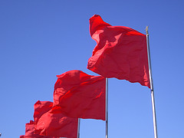
Export Red Flags
Red flags identify items for further review and due diligence
Restrictive terms in agreements (publication or participation)
Work done abroad
Sending abroad materials or equipment
Sending, transmitting or disclosing to a sanctioned country (or citizens of those countries) or a person or organization on the restricted party lists
Ultimate destination or use unknown (you send item/info overseas and the recipient sends it to someone else)
http://www.umaryland.edu/procedures/research/sponsored-projects/export-controls-checklist.php

Slide 32
How do I comply with U.S. Export Controls?
Know and recognize “red flags”
Determine what technologies/information in your work may be controlled
See “Dig Deeper” (slide 51 and following)
Ask for “restricted party screening” for foreign persons, whether in your lab or overseas
Ask for advice before you export covered technology

Slide 33
Compliance procedures

Slide 34
Export Compliance Reviews at UMB
UMB export officers use a subscription software tool for screening foreign persons (entities and individuals) against restricted party lists and country sanctions, and to initiate license review for potentially controlled items.
Restricted party screening – PI or administrator will be contacted for more information if required (to eliminate false hits)
Project/technology-related questions, e.g., research, training or service details or equipment/software to be used – PI will be contacted for more information if required

Slide 35
Analysis of potential issues
Does an exclusion, exemption, general license, or authorization allow the transaction?
If yes, the determination is documented and the PI is informed of any conditions or restrictions
If no, then UMB’s export officers work with the PI to decide whether or not to request a license or other authorization from the regulating agency.
If a specific license or authorization is needed: the timetable for agency response and obtaining a license or authorization is weeks to months, with no guarantee that the request will be granted. Be prepared for a “plan B”.

Slide 36
Key Export Compliance Reviews at UMB
Deemed export review and I-129 visa petition export control certifications for foreign national employees
Foreign national visiting scientists and scholars
Subawards, consultant agreements, material transfer agreements for non-U.S. entities/persons
Review of awards with overseas project work (on a risk basis)

Slide 37
Other available reviews (performed on request or as spot-checks)
Potential issues at the proposal stage
International travel
International shipping
Restricted party screening may be requested for any transaction with foreign individuals or entities, e.g., international conference attendees on campus, overseas wire transfer not associated with a subaward, foreign national consultants, etc.

Slide 38
Deemed Export Control review
Submit the Deemed Export Control Form for review of all foreign national employees on work visas including H-1B, paid J-1, F-1 OPT, etc.
Included with HR and Office of International Services packets
http://www.umaryland.edu/media/umb/ord/documents/DEForm-rev-Aug2016.pdf
http://www.umaryland.edu/ord/export-compliance/procedures/deemed-exports/

Slide 39
Visiting scientists/scholars
http://www.umaryland.edu/ord/export-compliance/procedures/international-visitors/
Export review includes restricted party screening of visitor and their home organization (if any) and review of proposed activities at UMB
Visiting scientist agreement required – Visitors/Volunteers who are not paid by UMB and who will have independent access to facilities (i.e., a UMB One Card) must sign a Visiting Scientist Agreement
Protects UMB and PI with terms addressing intellectual property, confidentiality, other issues

Slide 40
Subawards
Export control review usually occurs after the department submits a Subaward Request naming a foreign subrecipient
Export officer reviews the scope of work and screens organization, subrecipient PI and other key individuals against the restricted party lists
http://www.umaryland.edu/ord/export-compliance/procedures/international-subrecipients/

Slide 41
Other reviews
Proposal development: Proposals to flag for review should include:
Proposals involving known sanctioned countries
Proposals potentially involving a “Defense Article” or “Defense Service” (defined on the next two slides)
International MOUs, teaming agreements and affiliation agreements should always be reviewed.
http://www.umaryland.edu/spa/developing-proposals/projects-with-international-components/mous-for-international-initiatives/
Contact jsimons@umaryland.edu to initiate review.

Slide 42
“Defense article” defined:
Defense Article: 22 CFR §120.6
Any item or technical data (defined on next slide) listed on the United Stated Munitions List (USML) (22 CFR §121.1), including technical data recorded or stored in any physical form, models, mockups or other items that reveal technical data directly relating to items on the USML. It does not include basic marketing information on function or purpose or general system descriptions. Defense Articles listed in the USML include weapons, ammunition, vehicles, explosives, military training and equipment, personal protective equipment, certain lasers, infrared cameras and other detection equipment/devices, certain chemical agents, biological agents and nerve agents. The USML also defines certain items funded specifically by the Department of Defense as Defense Articles.
The detailed specifications in the USML must be reviewed carefully.
The determination for inclusion on the U.S. Munitions List is guided by the following criteria:
specifically designed, developed, configured, adapted, or modified for a military application,
does not have predominant civil applications, and
does not have performance equivalent (defined by form, fit and function) to those of an article or service used for civil applications;

Slide 43
“Defense service” defined
Defense Service: 22 CFR §120.9
The furnishing of assistance (including training) to foreign persons, whether in the U.S. or abroad in the design, development, engineering, manufacture, production, assembly, testing, repair, maintenance, modification, operation, demilitarization, destruction, processing or use of Defense Articles;
The furnishing to foreign persons of any technical data (as defined in §120.10), whether in the United States or abroad; or
Military training of foreign units and forces including formal or informal instruction of foreign persons in the U.S. or abroad or by correspondence courses, technical, educational, or information publications and media of all kinds, training aid, orientation, training exercise, and military advice.
Technical data: 22 CFR §120.10
Information other than software which is required for the design, development, production, manufacture, assembly, operation, repair, testing, maintenance, or modification of Defense Articles, and classified information relating to Defense Articles and Defense Services on the USML and 600-series items controlled by the [EAR] Commerce Control List
Software directly related to Defense Articles
NOT information concerning general scientific, mathematical or engineering principles commonly taught in schools, colleges and universities or information in the public domain (i.e., public domain and fundamental research exclusions as defined in 22 CFR §120.11)
22 CFR §120.3 (Note): The intended use of the article or service after its export (i.e., for a military or civilian purpose), by itself, is not a factor in determining whether the article or service is subject to the controls of this subchapter [ITAR controls].

Slide 44
International travel
http://www.umaryland.edu/ord/export-compliance/procedures/international-travel/
International travel to meetings or for other scientific exchange is generally exempt from export controls UNLESS the findings to be presented include detailed information regarding controlled items or technologies, or research identified as DURC.
Research or educational activities (including conference attendance or presentation) are restricted in sanctioned countries.
Taking UMB-owned equipment out of the country?
Some equipment (e.g., GPS, specialty software) may require a license.

Slide 45
Global travel and technology 1
Take security precautions when visiting sensitive countries/areas (Middle East, China, Russia, and others). Recommendations for highest security include:
Use clean laptops or other IT devices when available;
Ensure systems are updated with the most recent security and malware definition files prior to travel;
Remove all unnecessary UMB data and/or personal data from laptops or electronic devices before taking such devices overseas (only what you need to complete the reason for your visit). If you cannot afford to lose it, or if the loss of the information or data would create financial or reputational risk to the University, leave it at home;
Remove ALL third-party proprietary, confidential, or sensitive data and all export controlled data and materials from any electronic devices prior to travel;
Remove any encrypted files and encryption capable software, other than system critical or software support encryption technologies (for instance, built-in Windows encryption resources). Encryption technologies are strictly controlled for entry and exit from countries such as China;
Do not use any Wi-Fi connections from unknown third-party providers/sources;
Always use VPN back into UMB systems; note that China prohibits use of VPN unless specifically approved for use
Refrain from use of publicly available Wi-Fi connections if possible, even if labeled as secure and/or requiring passwords for use, as these connection points are often subject to intrusion software risks such as keystroke loggers;
To the extent possible, keep laptops/devices in your personal possession at all times.
Never accept or attach unknown devices or drives (including flash/USB drives) as malicious code may be installed on such devices at any time, including at manufacture or after; and,
Have your electronic devices scanned for malware upon return prior to connection to the UMB network.
Source: Pennsylvania State University, edited

Slide 46
Global travel and technology 2
In most countries, you have no expectation of privacy in internet cafes, hotels, offices, or public places. In some countries, hotel rooms are often searched.
All information you send electronically – no matter the method – can be intercepted.
Security services and criminals can track your movements using your mobile computing/electronic device and can even turn on the microphone in your computing/electronic device when you think that it’s off.
Security services and criminals can insert malicious software into your computing/electronic device through any connection that they control. When connecting to your home or University systems or networks, this malware can be transmitted back to these systems as well.
Transmitting sensitive information from abroad is risky.
If your mobile computing/electronic device is examined, or if your hotel room is searched while you are not present, you should assume that your device’s data has been copied and/or compromised.
Source: Pennsylvania State University, edited

Slide 47
Global travel and anti-bribery regulations
Foreign Corrupt Practices Act
Unlawful for a U.S. person, including UMB and its personnel, to bribe a foreign official for the purpose of obtaining or retaining business, or to otherwise securing an improper advantage
Bribes include money, favors, and other inducements
More information and training: http://www.umaryland.edu/ord/export-compliance/foreign-corrupt-practices-act/

Slide 48
Shipping
Be aware of the requirements for proper labeling and marking.
Shipping tangible items outside of the United States usually requires an export license determination to correctly complete the shipping documentation.
Contact Environmental Health and Safety for information and training.

Slide 49
UMB Export Officers
Office of Research and Development
Janet Simons, Director, Research Policy
410-706-5632 jsimons@umaryland.edu
Environmental Health and Safety
Melissa Morland, Biosafety Officer
410-706-7845 mmorland@umaryland.edu

Slide 50
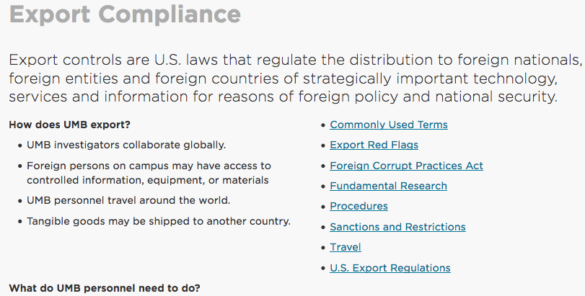
More information
http://www.umaryland.edu/ord/export-compliance/

Slide 51
Dig Deeper
The following slides provide additional references, links and information about:
EAR
ITAR
Country Issues (Embargoes/Sanctions)
Violations and Penalties
Related Laws
Flowcharts and Questionnaires

Slide 52
Regulations
Export Administration Regulations (EAR)
Department of Commerce export controls (15 CFR §§734-774)
International Traffic in Arms Regulations (ITAR) Department of State export controls (22 CFR §§120-130)
Foreign Assets Control Regulations (FACR)
U.S. Treasury exchange controls (31 CFR §§500-599)
US Customs Service Regulations
Automated Export Shipping documentation (15 CFR §§30-199)
Look up a CFR reference: https://www.ecfr.gov/cgi-bin/ECFR

Slide 53
EAR/Commerce Control List
Category 0 - Nuclear Materials, Facilities & Equipment (and Miscellaneous Items)
Category 1 – Special Materials and Related Equipment, Chemicals, Microorganisms, and Toxins
Category 2 - Materials Processing
Category 3 - Electronics
Category 4 - Computers
Category 5 - Telecommunications and Information Security
Category 6 - Sensors and Lasers
Category 7 - Navigation and Avionics
Category 8 - Marine
Category 9 - Aerospace and Propulsion

Slide 54
EAR/Commerce Control List URL
Copy and paste this link into your browser to view the Commerce Control List (CCL):
https://www.ecfr.gov/cgi-bin/text-idx?SID=8c4f74d9182f632f40e160ffeaa797d9&mc=true&node=pt15.2.774&rgn=div5

Slide 55
EAR/Commerce Control List – Category 1
EXAMPLES of Category 1 controlled items
Gas masks, protective suits designed to protect against chemical warfare, tear gas, radioactive materials, biological agents
Chemicals that may be used as precursors for toxic chemical agents
ECCN 1C351 Human and animal pathogens and toxins; ECCN 1C354 Plant pathogens
Viruses
Rickettsia
Bacteria (e.g., Bacillus anthracis, Chlamydia psittaci, Francisella tularensis, Shigella dysenteriae)
Toxins (e.g., Botulinum toxins, Shiga toxin, Staphylococcus aureus toxins
Fungi
ECCN 1C353 Genetic elements and genetically modified organisms associated with the pathogenicity of microorganisms controlled by 1C351.a to .c or 1C354.
ECCN 1C991 Vaccines against items controlled by ECCN 1C351, 1C353 or 1C354. Vaccines that contain genetic elements or genetically modified organisms identified in ECCN 1C353.
ECCN: Export Control Classification Number

Slide 56
ITAR/U.S. Munitions List
Category I - Firearms, Close Assault Weapons and Combat Shotguns
Category II - Guns and Armament
Category III - Ammunition/Ordnance
Category IV - Launch Vehicles, Guided Missiles, Ballistic Missiles, Rockets, Torpedoes, Bombs, and Mines
Category V - Explosives and Energetic Materials, Propellants, Incendiary Agents, and Their Constituents.
Category VI – Surface Vessels of War and Special Naval Equipment.
Category VII – Ground Vehicles
Category VIII - Aircraft and Related Articles
Category IX - Military Training Equipment and Training
Category X – Personal Protective Equipment
Category XI - Military Electronics
Category XII - Fire Control, Laser, Imaging, and Guidance Equipment
Category XIII – Materials and Miscellaneous Articles
Category XIV - Toxicological Agents, Including Chemical Agents, Biological Agents, and Associated Equipment.
Category XV – Spacecraft and Related Articles
Category XVI - Nuclear Weapons Related Articles
Category XVII - Classified Articles, Technical Data and Defense Services Not Otherwise Enumerated
Category XVIII - Directed Energy Weapons
Category XIX – Gas Turbine Engines and Associated Equipment
Category XX - Submersible Vessels and Related Articles
Category XXI – Articles, Technical Data, and Defense Services Not Otherwise Enumerated

Slide 57
ITAR/U.S. Munitions List URL
Copy and paste link into your browser to view the U.S. Munitions List (USML):
https://www.ecfr.gov/cgi-bin/text-idx?SID=8c4f74d9182f632f40e160ffeaa797d9&mc=true&node=pt22.1.121&rgn=div5

Slide 58
ITAR/USML – Category XIV
EXAMPLES of Category XIV controlled items
Nerve agents
Genetically modified biological agents (as specified) having non-naturally occurring genetic modifications that are known to or are reasonably expected to result in an increase in the ability to defeat or overcome standard detection methods, personnel protection, natural or acquired host immunity, host immune response, or response to standard medical countermeasures
Technical data and defense services related to defense articles

Slide 59
Country Issues
For export purposes, the United States comprises:
50 States and District of Columbia
Puerto Rico
U.S. Virgin Islands
Guam
American Samoa
Northern Mariana Islands

Slide 60
OFAC Sanctions/Embargoes
Always check the latest sanctions and embargoes which change frequently http://www.treasury.gov/resource-center/sanctions/Programs/Pages/Programs.aspx Any type of transaction – including financial, collaboration, and travel – should be reviewed for comprehensively sanctioned countries such as Iran or Cuba. The review will document:
Screening for restricted/prohibited parties
Whether a specific license must be applied for, or, if not,
What provision(s) of the regulations authorize the transaction

Slide 61
Country Issues - ITAR-prohibited Export Destinations
Afghanistan
Belarus
Burma (Myanmar)
Central African Republic
China
Cuba
Cyprus
Democratic Republic of Congo
Eritrea
Haiti
Iran
Iraq
Lebanon
Libya
North Korea
Somalia
South Sudan
Sudan
Syria
Venezuela
Zimbabwe
See 22 CFR 126.1
As of 10/25/19

Slide 62
Country Issues - EAR
Country sanctions under EAR: Cuba, Iran, North Korea, Sudan, Syria
In addition, most export restrictions are determined by the technology or product to be exported and the country of destination
EAR Part 744 – Supplement 4 – Entity List (downloads a document)
Lists certain entities subject to license requirements for specified items
Examples: Kitro Corporation (Canada); Sichuan University (China); 54th Research Institute of China; Northwestern Polytechnical University (China); Ben Gurion University (Israel); Pyramid Technologies (U.A.E.)

Slide 63
Penalties for Violation of the U.S. Export Control Regulations
Denial of export privileges
Seizure and forfeiture of goods
Suspension; debarment
Negative publicity
UMB: Disciplinary action up to termination and dismissal
May apply to the individual(s) involved and/or the university
Federal penalties applied may be Criminal and/or Civil

Slide 64
Penalties for Violation
EXAMPLES:
OFAC: Criminal – University – A fine of up to $1,000,000 for each violation
OFAC: Criminal – Individual – A fine of up to $1,000,000 or up to twenty years in prison, or both, for each violation
ITAR: Civil penalty up to $500,000 fine for each violation
ITAR: Criminal penalty, willful violation, up to $1,000,000 fine and/or imprisonment not more than 10 years
EAR: Civil penalty up to $500,000 fine for each violation
EAR: Criminal penalty, fine of up to five times the value of the exports or reexports involved or $50,000, whichever is greater and/or imprisonment not more than 5 years; in more egregious cases of willful violation, fine of up to $250,000 and/or imprisonment not more than 10 years

Slide 65
University-related export cases
Roth case, University of Tennessee: Why the Professor Went to Prison
Graduate student, Iowa State University:
Accused - http://www.umaryland.edu/media/umb/ord/documents/ISU_student_accused_amestrib.pdf
Sentenced - http://www.umaryland.edu/media/umb/ord/documents/ISU_Sentenced_DepartmentOfJustice.pdf

Slide 66
Related Laws
Trading with the Enemy Act (1917) authorized the use of economic sanctions against foreign nations, citizens and nationals of foreign countries, or other persons aiding a foreign country and is the oldest such statute still in use by the United States. 50 U.S.C. App. §§ 1-44
International Emergency Economic Powers Act (1977), 50 U.S.C. §§ 1701-1707
USA PATRIOT Act (Uniting and Strengthening America by Providing Appropriate Tools Required to Intercept and Obstruct Terrorism Act of 2001) – makes it a crime to provide material support to a foreign organization engaged in terrorist activity.

Slide 67
Other U.S. regulations that may affect international collaborations
Nuclear Regulatory Commission (NRC) (Nuclear imports/exports)
Department of Energy (DoE) (Assistance with foreign atomic energy activities)
Bureau of Alcohol, Tobacco, Firearms and Explosives (ATF)
Patent and Trademarks Office (PTO) (Foreign IP licenses)
Customs and Border Protection (CBP) (Imports/Exports)
US Bureau of the Census (Foreign trade statistics)
US Fish & Wildlife Service (Certain flora and fauna)
Animal and Plant Health Inspection Service (APHIS) (Animals & plants, soil& organisms)
Food and Drug Administration (FDA)(imports of samples of food, drugs, tobacco, cosmetic, etiological agents, med devices)
Federal Aviation Administration (FAA)(Hazardous materials)
Drug Enforcement Agency (DEA) (controlled substances)
BIS: Anti-boycott Regulations
Department of Justice (DoJ) (Foreign corrupt practices)
U.S. Citizenship and Immigration Service (USCIS) (Visas)

Slide 68
External Resources
University of Maryland, College Park’s Export 101
Stanford University’s Decision Tree (copy and paste link into your browser) https://doresearch.stanford.edu/research-scholarship/export-controls/export-controls-decision-tree
University of Tennessee’s FAQs
AUECO Guidance Papers

