Slide 1
Nov. 16, 2023
Virtual Town Hall:
All Standards

Slide 2
Nov. 16, 2023, Town Hall: All Standards
Call to Conversation
Bruce E. Jarrell, MD, FACS President Roger J. Ward, EdD, JD, MSL, MPH, Provost and Executive Vice President
Mark A. Reynolds, DDS, PhD, MA, Dean, School of Dentistry Co-Chairs, Middle States Steering Committee
Gregory C. Spengler, MPA Associate Vice President for Institutional Effectiveness Middle States Accreditation Liaison Officer

Slide 3
Nov. 16, 2023, Town Hall: All Standards
UMB Is Accredited as an Institution by MSCHE
MSCHE stands for the Middle States Commission on Higher Education.
MSCHE is recognized by the U.S. Department of Education as an institutional accreditor and has accredited over 500 institutions.
Institutional accreditors do not accredit individual programs, units, or locations, they accredit institutions in their entirety. That’s why schools and programs have their own separate system of accreditation.
Notes:
*Originally, there were “REGIONAL” accreditors and “NATIONAL” accreditors. As a regional, MSCHE covered only a specific geographic portion of the US; a handful of contiguous states (MD, DE, NY, NY, PA); plus DC, Puerto Rico and the US Virgin Islands.
In 2020, the Department of Education eliminated both titles and the combined accreditors are called institutional accreditors. MSCHE’s footprint now extends to 48 states (the exceptions being North Dakota and Montana); two U.S. Territories (Puerto Rico and the U.S. Virgin Islands); and the District of Columbia. Its footprint extends to 94 countries.

Slide 4
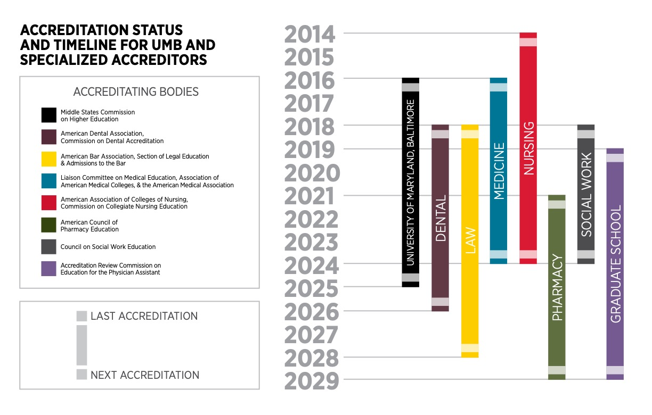
Nov. 16, 2023, Town Hall: All Standards

Slide 5
Nov. 16, 2023, Town Hall: All Standards
Why Does Middle States Matter?
Institutional accreditation provides a “seal of approval” that is a prerequisite for receiving federal financial aid funds!
MSCHE mandates that its member institutions meet rigorous and comprehensive standards, which are addressed in the context of the mission of each institution and within the culture of ethical practices and institutional integrity.
If UMB were to lose its accreditation, EVERY school and program would be at risk.
Notes:
Select the Self-Study design most appropriate for UMB. The themes in the design should align with our core values and the priorities in our Strategic Plan. This task should be completed no later than April 25, 2023.
Design an inclusive and transparent self-study process that actively and deliberately seeks to engage members of the University community from every corner of campus.
Produce a Self-Study report that demonstrates our compliance with the Middle States Commission on Higher Education accreditation standards and provides forward-looking recommendations to move the institution further along its quest for excellence in graduate and professional education, research, clinical activities, and service for the public good.

Slide 6
Nov. 16, 2023, Town Hall: All Standards
Middle States Standards and Requirements
Accredited institutions are expected to demonstrate compliance with MSCHE’s seven standards (and related requirements), to conduct their activities in a manner consistent with the standards and requirements, and to engage in ongoing processes of self-review and improvement.
Standard I – Mission and Goals
Standard II – Ethics and Integrity
Standard III – Design and Delivery of the Student Learning Experience
Standard IV – Support of the Student Experience
Standard V – Educational Effectiveness Assessment
Standard VI – Planning, Resources, and Institutional Improvement
Standard VII – Governance, Leadership, and Administration

Slide 7
Nov. 16, 2023, Town Hall: All Standards
UMB’s Accreditation Components and History
The accreditation process has two main parts:
The creation and submission of a Self-Study report to MSCHE.
A multiday site visit and review in spring 2025 by a team composed of peer evaluators from other accredited institutions organized by MSCHE.
UMB’s MSCHE accreditation was reaffirmed in June 2016.
UMB’s accreditation status will be acted on again by MSCHE in 2025.

Slide 8
Nov. 16, 2023, Town Hall: All Standards
Intended Outcomes of the Self-Study
To engage in an inclusive and transparent self-appraisal process.
To produce a Self-Study report that demonstrates compliance with the seven standards and related requirements.
To develop forward-looking recommendations to inform UMB’s next Strategic Plan to move the institution further along in its quest for excellence in graduate and professional education, research, clinical activities, and service for the public.
Notes:
Self Study Approach
The Standards Based self-study design was chosen as the one in which the University could focus most intensely on its strategic priorities. UMB has a robust culture of planning and accreditation. Part of the reason for our unique culture is that each of UMB’s professional schools is accredited by their own unique accrediting organizations and as such UMB is continually examining its practices and making improvements. UMB is fortunate that the Middle States Self-Study affords the University yet another opportunity to integrate existing planning and accrediting processes.

Slide 9
Nov. 16, 2023, Town Hall: All Standards
What Are Today’s Objectives?
Divide into small groups to assist the Working Groups in their assessment of UMB’s satisfaction of the relevant standard and related requirements.
Small groups also will consider questions seeking to identify opportunities for improvement.
This town hall is an important part of UMB’s self-review process. Thank you for taking the time to be engaged!
Notes:
Drs. Ward, Reynolds, and Greg Spengler to introduce Co-chairs

Slide 10
Nov. 16, 2023, Town Hall: All Standards
Click on the link for a UMB and Middle States Check-In
https://www.menti.com/al978yr53rkn

Slide 11
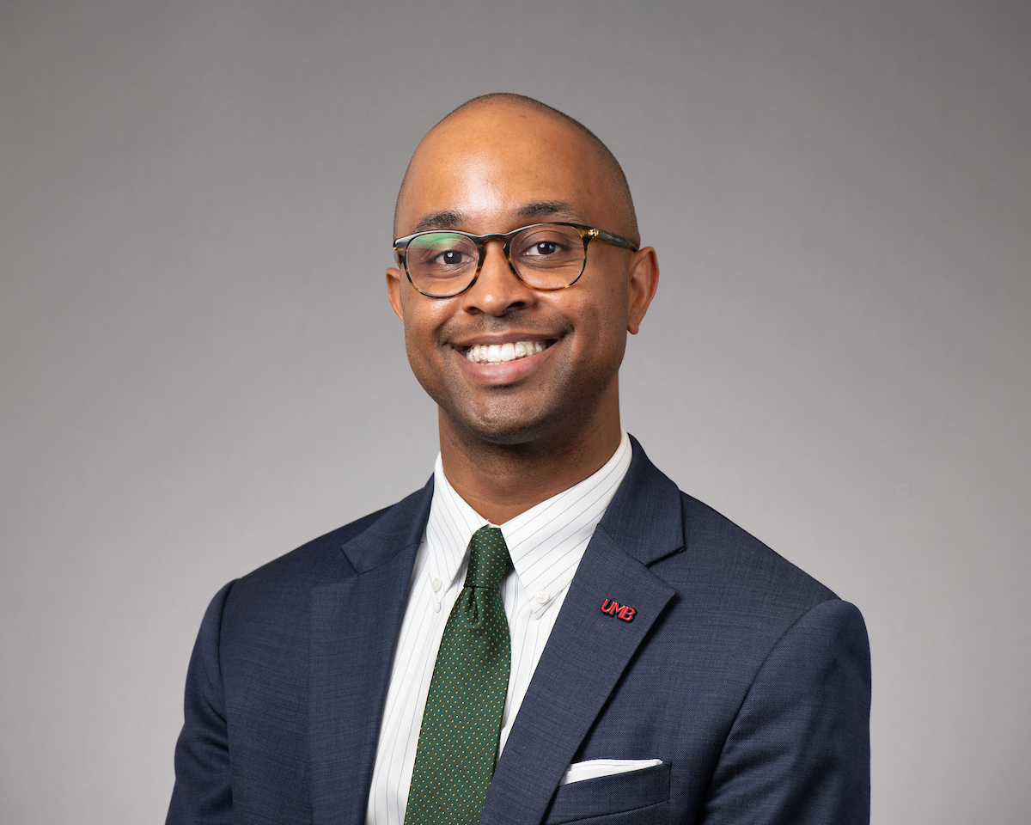
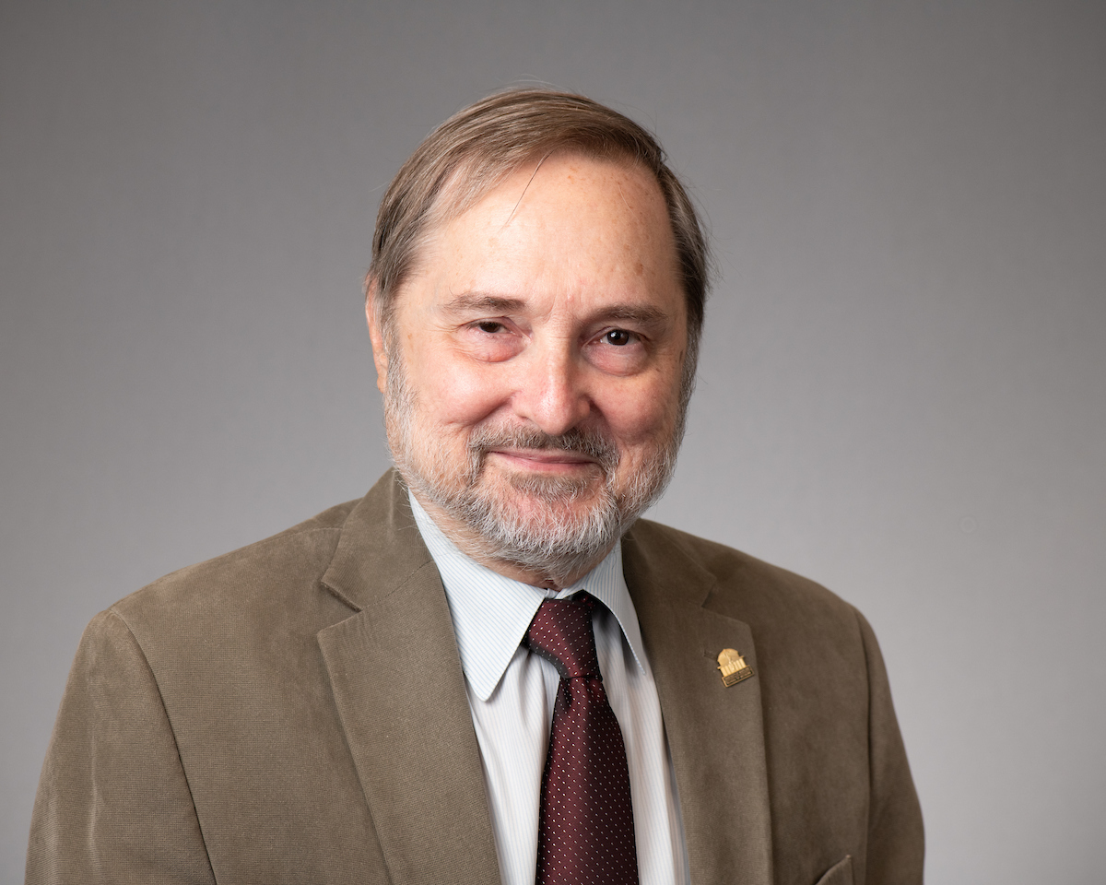
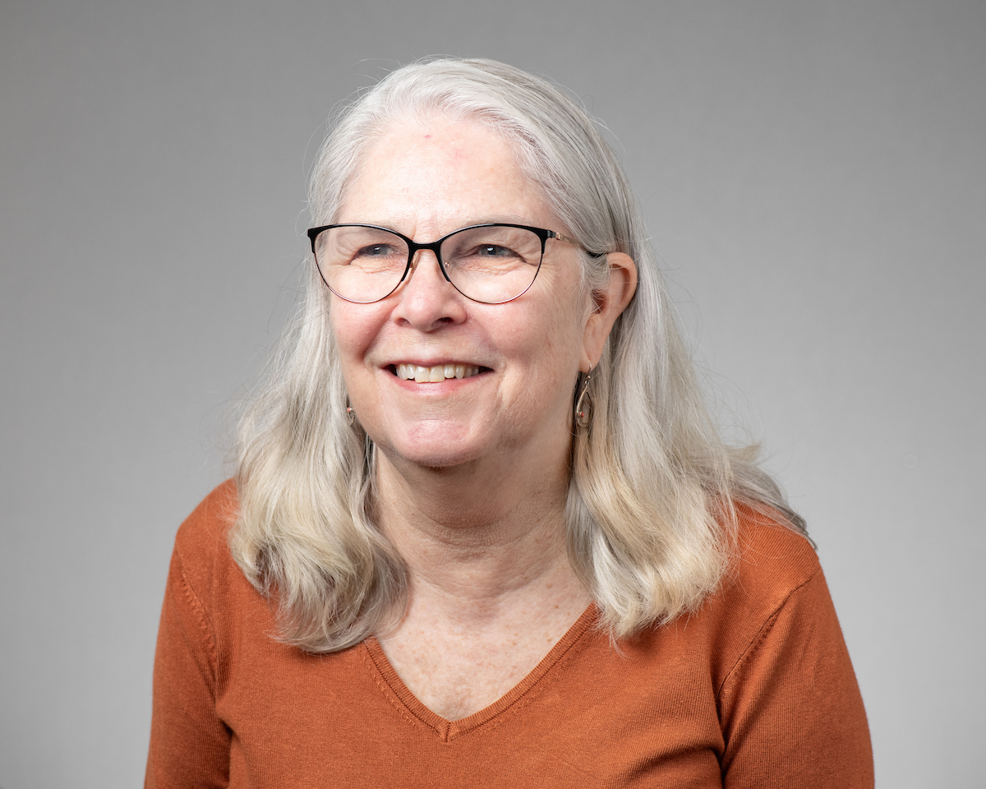
Standard I – Mission and Goals
Bill Joyner,
JD, MSW
James B. Kaper,
PhD
Alexa A. Mayo,
MLS, AHIP
Logistics Committee Liaison: Victoria Meadows

Slide 12
Standard I – Mission and Goals
UMB’s Mission Statement: To improve the human condition and serve the public good of Maryland and society at-large through education, research, clinical care, and service.
Standard I focuses on the appropriateness, effectiveness, and alignment of the mission and goals of UMB and its constituent organizations such as schools and administrative units.
This standard also focuses on how well the institutional mission and goals are integrated into organizational processes and activities such as budgeting and teaching.
Notes:
From : https://www.msche.org/standards/thirteenth-edition/#standard1 and
https://www.umaryland.edu/middlestates/design/organizational-structure-of-groups-and-committees-/

Slide 13
Standard I – Mission and Goals
How does UMB’s mission statement shape its current strategic plan?
To what extent should UMB’s mission statement be reviewed and revised to reflect post-pandemic shifts, especially as they relate to:
a. How we teach our students
b. How we conduct research; and
c. How we strengthen equity, diversity, and inclusion
What can UMB do to demonstrate the economic and social impact of its community engagement initiatives in Baltimore?
Notes:
From : https://www.msche.org/standards/thirteenth-edition/#standard1 and
https://www.umaryland.edu/middlestates/design/organizational-structure-of-groups-and-committees-/

Slide 14
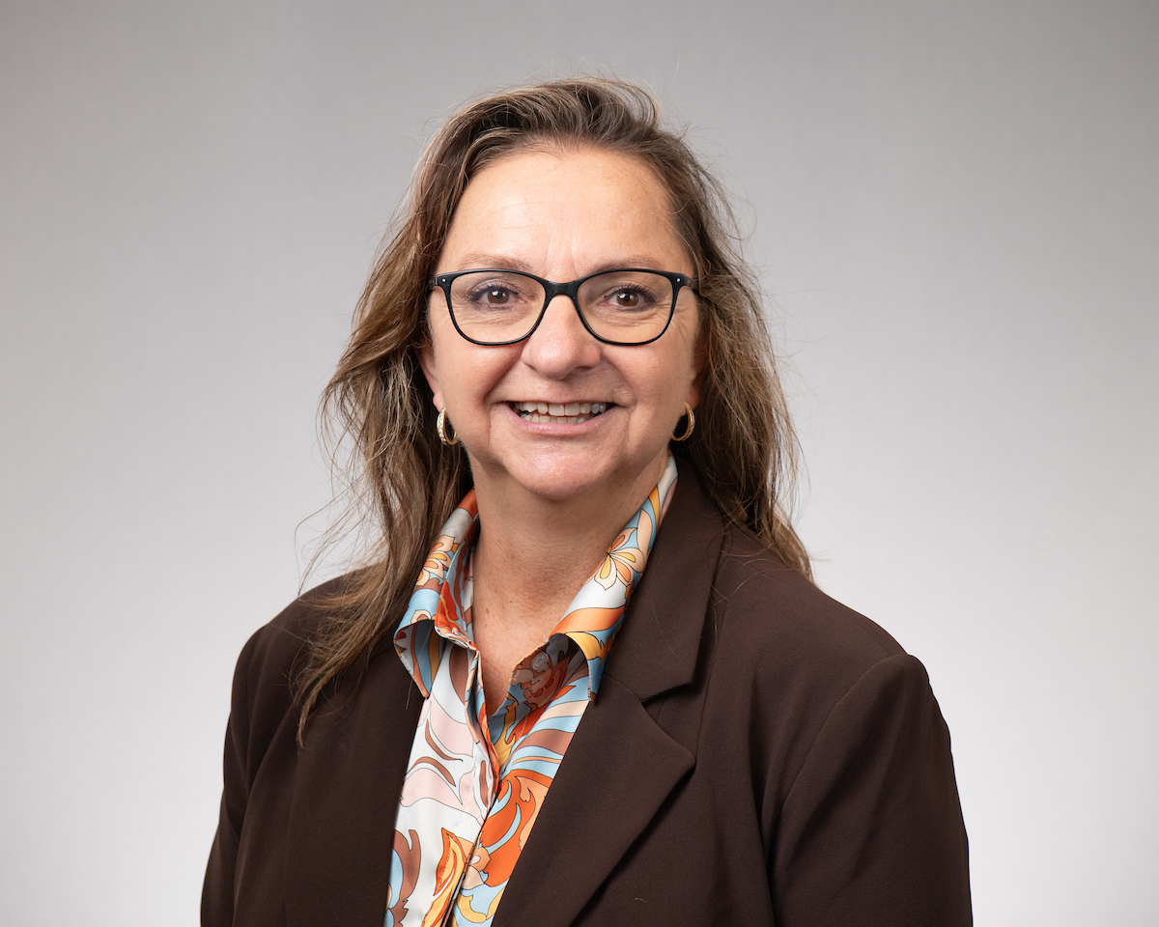
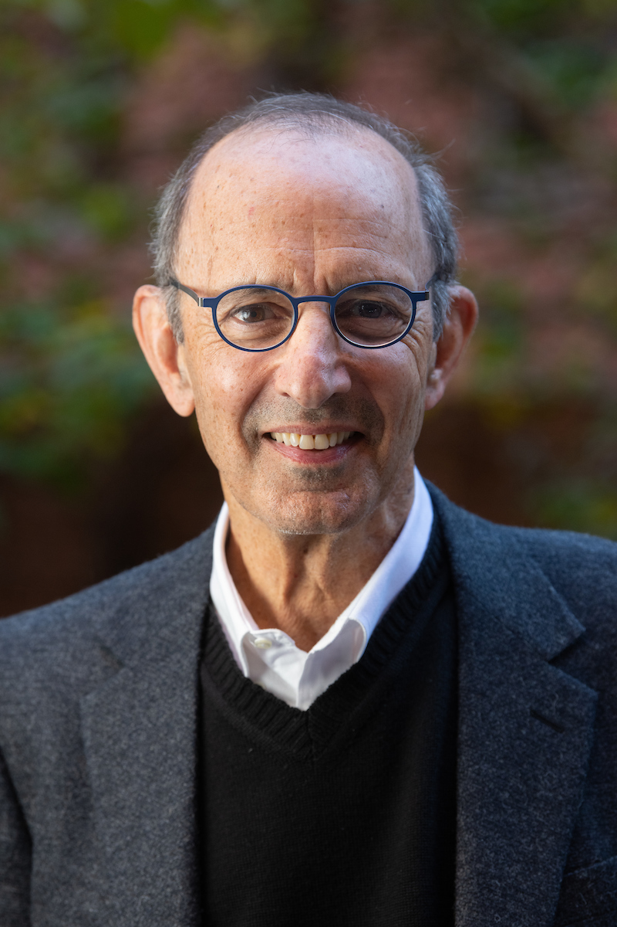
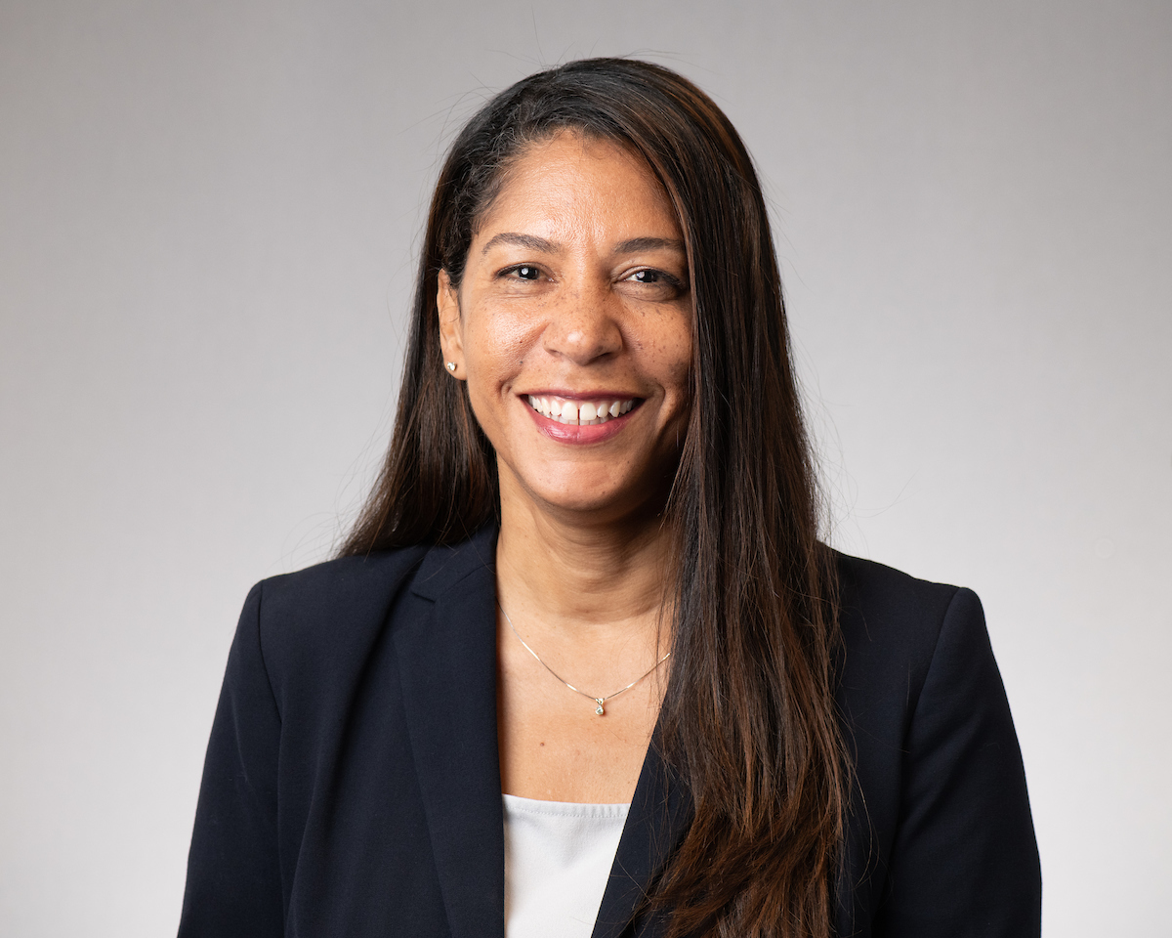
Standard II – Ethics and Integrity
Susan Buskirk,
DM, MS
Geoffrey Greif, PhD, MSW,
LCSW-C
Vanessa Harrington,
MS, SHRM-CP
Logistics Committee Liaison: Courtney Resnick

Slide 15
Standard II – Ethics and Integrity
Ethics and integrity are central, indispensable, and defining hallmarks of effective higher education institutions. In all activities, whether internal or external, an institution must be faithful to its mission, honor its contracts and commitments, adhere to its policies, and represent itself truthfully.

Slide 16
Standard II – Ethics and Integrity
Where are UMB’s policies relating to ethical expectations?
What UMB programs promote ethical conduct?
How do we know that our policies/procedures are working? What does it look like. What does it feel like?
Are these policies applied equitably across groups?
How can UMB’s ethical practices and reporting mechanisms be improved?
Why is it important for members of the UMB community to act ethically?
Notes:
Ethical conduct across the mission areas
Does the UMB infrastructure – polices, procedures, etc. - promote ethical behavior across the University?

Slide 17
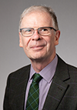
Standard III – Design and Delivery of Student Learning Experience
Susan Antol,
PhD, MS, RN
Richard Dalby, PhD, BPharm
Jenny Owens, ScD, MS
Logistics Committee Liaison: Karen Matthews

Slide 18
Standard III – Design and Delivery of Student Learning Experience
An institution provides students with learning experiences that are characterized by rigor and coherence at all program, certificate, and degree levels, regardless of instructional modality. All learning experiences, regardless of modality, program pace/schedule, level, and setting, are consistent with higher education expectations.
Notes:
From : https://www.msche.org/standards/thirteenth-edition/#standard1 and
https://www.umaryland.edu/middlestates/design/organizational-structure-of-groups-and-committees-/

Slide 19
Standard III – Design and Delivery of Student Learning Experience
How does the design and delivery of academic programs at UMB support student success, both while they are enrolled as well as after graduation?
How does the design and delivery of educational programs at UMB support our core values of equity, diversity, and inclusion?
How does UMB support the educational and career objectives of students through its design and delivery of academic programs?
To what extent does the way a course or program is taught (in-person, hybrid or virtual) influence the way it is designed and operationalized?
How can UMB support individual schools in assessing and enhancing the rigor and relevance of educational offerings?
Notes:
From : https://www.msche.org/standards/thirteenth-edition/#standard1 and
https://www.umaryland.edu/middlestates/design/organizational-structure-of-groups-and-committees-/

Slide 20
Standard IV – Support of Student Experience
Patty Alvarez, PhD, MS
Gregory Brightbill, EdD
Barbara Gontrum, JD, MLS
Logistics Committee Liaison: Kate Noonan

Slide 21
Standard IV – Support of Student Experience
Across all educational experiences, settings, levels, and instructional modalities, the institution recruits and admits students whose interests, abilities, experiences, and goals are congruent with its mission and educational offerings. The institution commits to student retention, persistence, completion, and success through a coherent and effective support system sustained by qualified professionals, which enhances the quality of the learning environment, contributes to the educational experience, and fosters student success.

Slide 22
Standard IV – Support of Student Experience
What strategies has UMB adopted and what resources have been allocated to assure the financial, physical, and mental wellness of enrolled students?
How does UMB support the transition of new students at all levels to assure their success in and out of the classroom?
What support does UMB provide to promote the successful placement of graduates in appropriate careers and post degree academic programs?
What approaches has UMB adopted to promote an equitable and inclusive cocurricular learning environment?
What concerns or opportunities exist in the areas outlined above?
Notes:
Ethical conduct across the mission areas
Does the UMB infrastructure – polices, procedures, etc. - promote ethical behavior across the University?

Slide 23
Standard V – Educational Effectiveness Assessment
Mark Macek,
DDS, DrPH
Lynn Chen,
PhD
Greg Spengler, MPA
Logistics Committee Liaison: Greg Spengler

Slide 24
Standard V – Educational Effectiveness Assessment
Assessment of student learning and achievement demonstrates that the institution’s students have accomplished educational goals consistent with their program of study, degree level, the institution’s mission, and appropriate expectations for institutions of higher education.
Notes:
From : https://www.msche.org/standards/thirteenth-edition/#standard1 and
https://www.umaryland.edu/middlestates/design/organizational-structure-of-groups-and-committees-/

Slide 25
Standard V – Educational Effectiveness Assessment
How might UMB evaluate its assessment processes and practices through the lens of equity, diversity, and inclusion?
How might UMB organize its various assessment efforts, across the diverse set of academic programs, so they are standardized?
How might UMB encourage the use of educational assessment data to promote learning outcome improvements at the program and campus levels?
Notes:
From : https://www.msche.org/standards/thirteenth-edition/#standard1 and
https://www.umaryland.edu/middlestates/design/organizational-structure-of-groups-and-committees-/

Slide 26
Standard V – Educational Effectiveness Assessment
What additional steps might UMB take to heighten visibility of educational assessment processes at the institutional level while maintaining a spirit of cooperation and accountability across schools/programs?
How might UMB make its institutional learning outcomes (ILOs) an integral part of its assessment programs at both the program and campus levels?
Notes:
From : https://www.msche.org/standards/thirteenth-edition/#standard1 and
https://www.umaryland.edu/middlestates/design/organizational-structure-of-groups-and-committees-/

Slide 27
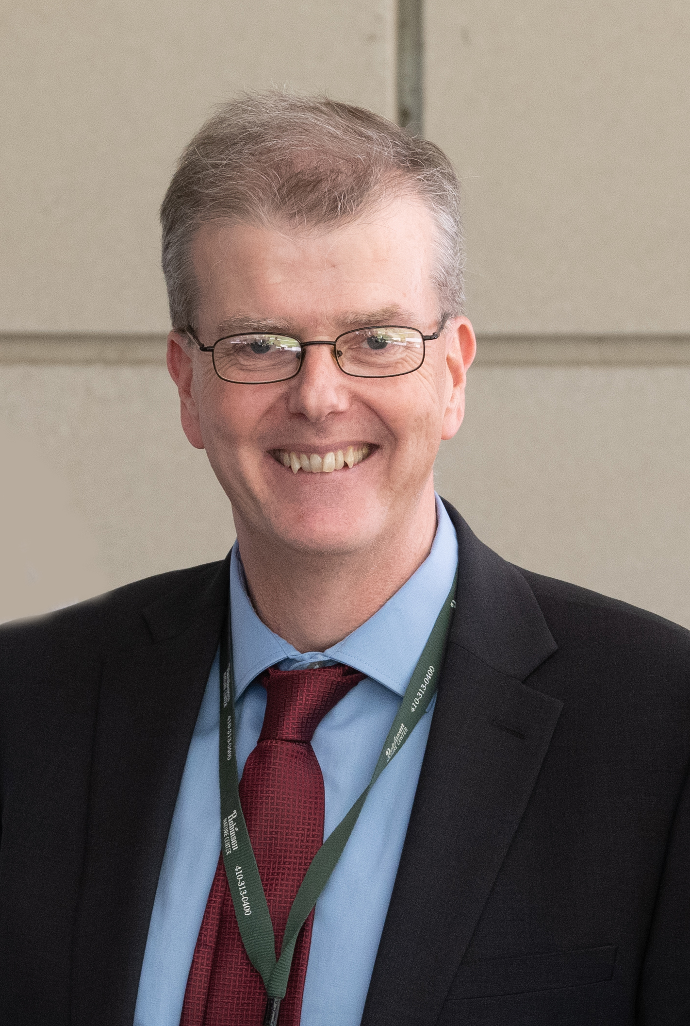
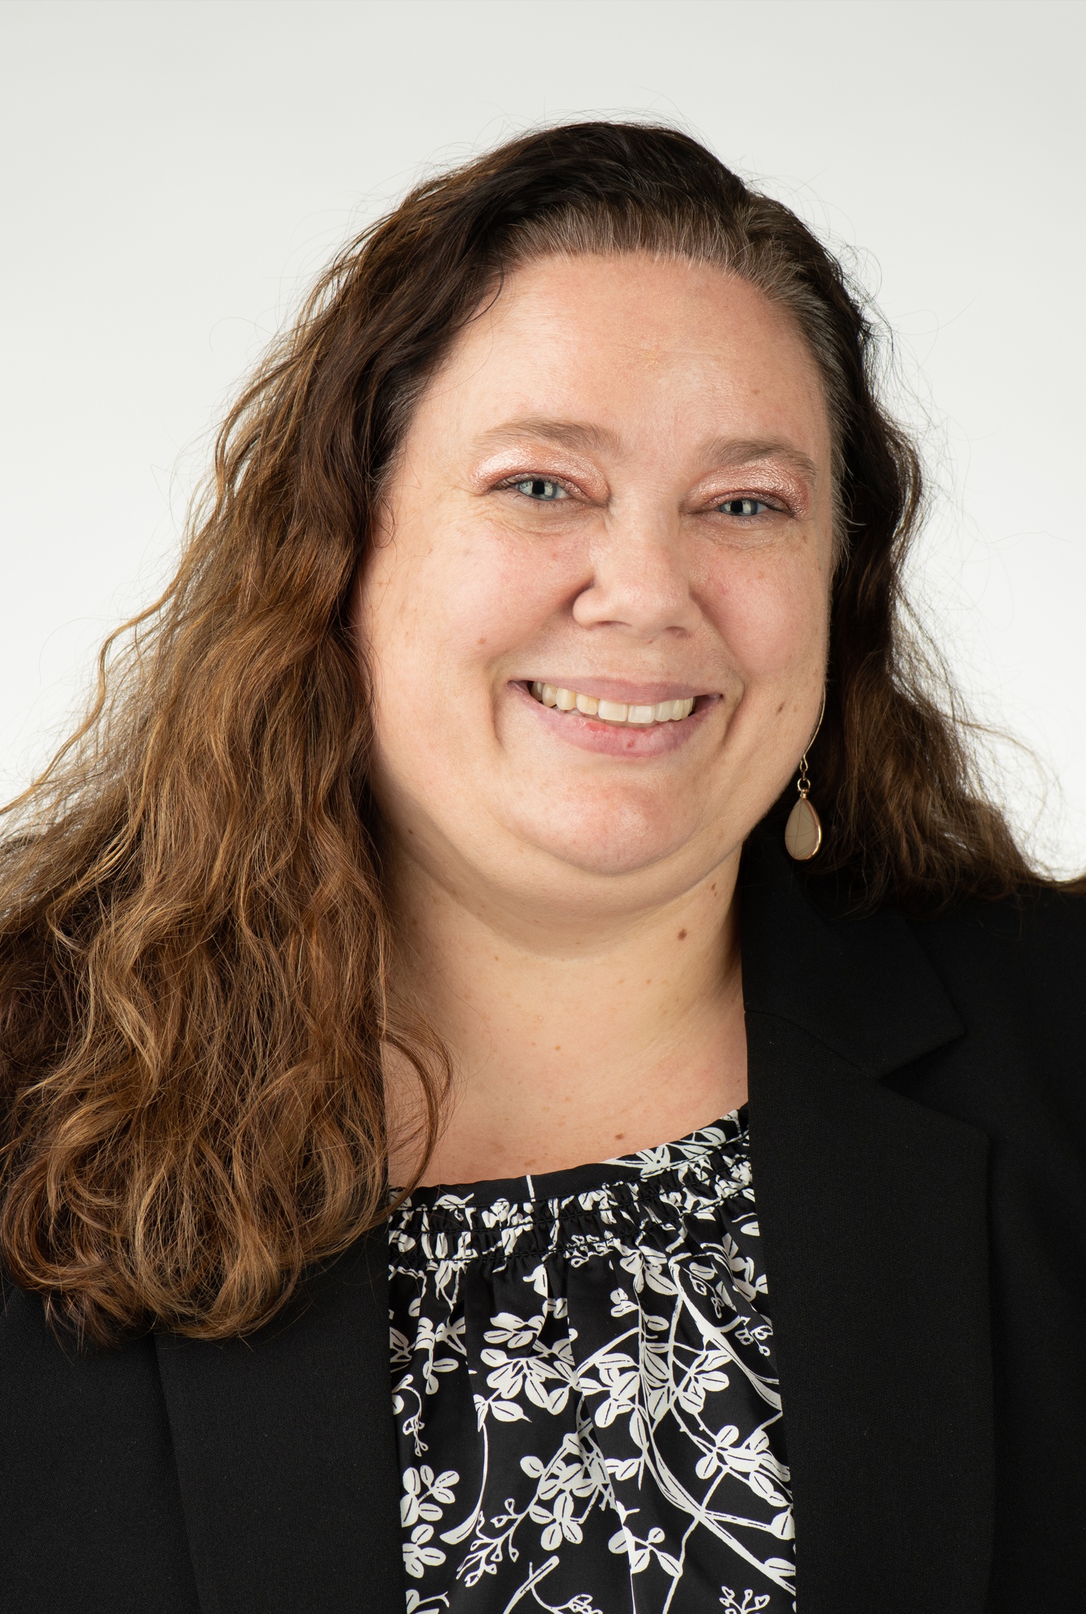
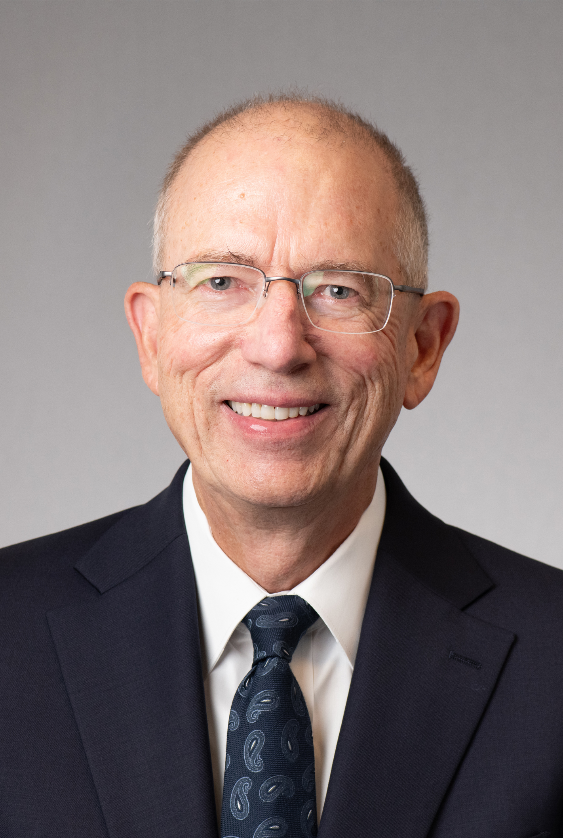
Standard VI – Planning, Resources, and Institutional Improvement
Kevin Donegan, MBA, FCCA
Jill Frankenfield, MSL, MS
Peter Murray, PhD, CAS, MS
Logistics Committee Liaison: Tricia O’Neill

Slide 28
Standard VI – Planning, Resources, and Institutional Improvement
The institution’s planning processes, resources, and structures are aligned with each other and are sufficient to fulfill its mission and goals, to continuously assess and improve its programs and services, and to respond effectively to opportunities and challenges.
Notes:
From : https://www.msche.org/standards/thirteenth-edition/#standard1 and
https://www.umaryland.edu/middlestates/design/organizational-structure-of-groups-and-committees-/

Slide 29
Standard VI – Planning, Resources, and Institutional Improvement
To what extent do UMB policies and procedures for planning, budgeting resources, and institutional improvement support institutional priorities?
How are resources allocated in alignment with our mission, goals, and strategic institutional priorities?
How does planning and resource allocation reflect the goals and long-range plans at the school/unit level?
What data is used to guide the planning process? To what extent do all constituencies participate in the planning, resource allocation, and improvement process?
Notes:
From : https://www.msche.org/standards/thirteenth-edition/#standard1 and
https://www.umaryland.edu/middlestates/design/organizational-structure-of-groups-and-committees-/

Slide 30
Standard VI – Planning, Resources, and Institutional Improvement (continued)
To what extent is UMB measuring and assessing the effectiveness of planning, resource allocation, and budgeting processes to ensure efficient utilization and financial sustainability?
How does the allocation process ensure that there is sufficient human, fiscal, and infrastructure resources to support our mission and goals?
How does UMB measure and ensure its strategic goals are implemented at all levels across the campus?
How are the planning and decision-making processes communicated across campus? Are planning and improvement processes clearly documented and communicated?
Notes:
From : https://www.msche.org/standards/thirteenth-edition/#standard1 and
https://www.umaryland.edu/middlestates/design/organizational-structure-of-groups-and-committees-/

Slide 31
Standard VI – Planning, Resources, and Institutional Improvement (continued)
How does UMB assess the performance and effectiveness of the administrative programs, services, and offices that support the operational and academic functions of the institution?
What process is used to periodically assess our planning, resource allocation, and institutional renewal processes?
How do we use a systematic approach to improve efficiency, contain costs, and develop revenue streams to support our mission and goals?
After reviewing the above questions, how can UMB improve in any of these areas?
Notes:
From : https://www.msche.org/standards/thirteenth-edition/#standard1 and
https://www.umaryland.edu/middlestates/design/organizational-structure-of-groups-and-committees-/

Slide 32
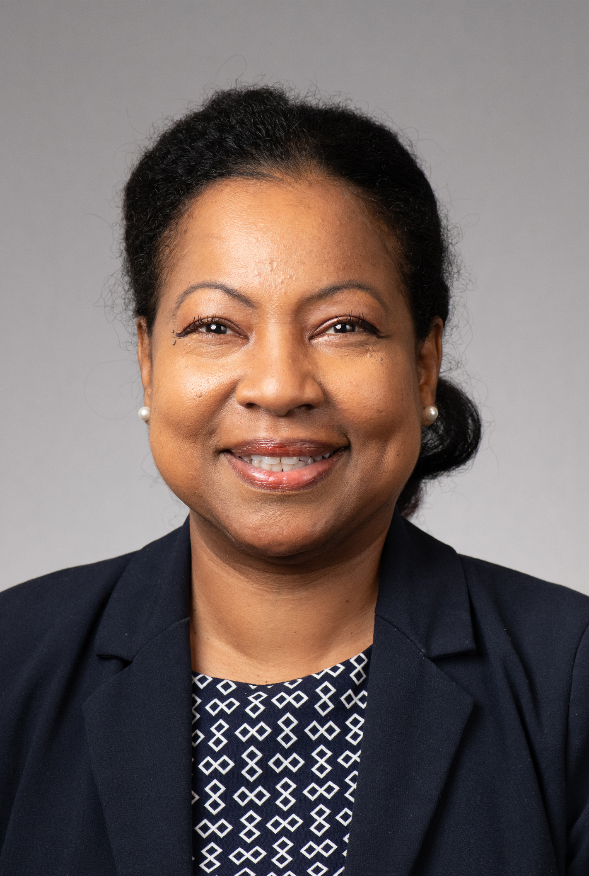
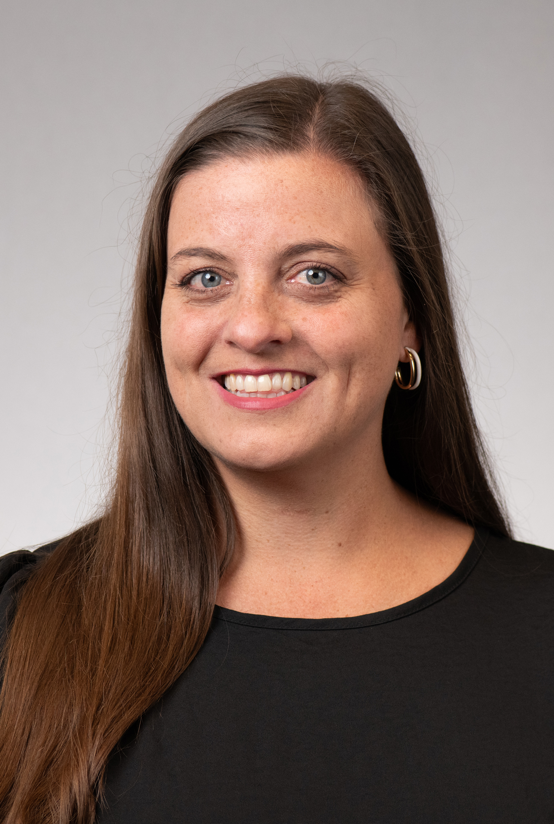
Standard VII – Governance, Leadership, and Administration
Diane Forbes Berthoud, PhD, MA
Monica Maggiano
Logistics Committee Liaison: Michael Brown

Slide 33
Standard VII – Governance, Leadership, and Administration
The institution is governed and administered in a manner that allows it to realize its stated mission and goals in a way that effectively benefits the institution, its students, and the other constituencies it serves. Even when supported by or affiliated with governmental, corporate, religious, educational system, or other unaccredited organizations, the institution has education as its primary purpose, and it operates as an academic institution with appropriate autonomy.

Slide 34
Standard VII – Governance, Leadership, and Administration
How do we show that there's a well-defined system of shared governance with written rules that explain what different people involved are responsible for?? How are these policies shared with the campus community? What evidence exists that the written policies are adhered to?
What structures are in place to avoid conflicts of interest and to make sure that the board and its relevant communities play an appropriate role in the oversight of the institution’s policies and financial affairs? What processes are in place to identify any need for changes to the structure and membership?
What policies and procedures are there to ensure that the top executive and other leaders have the right qualifications, experience, resources, and support?
Notes:
Ethical conduct across the mission areas
Does the UMB infrastructure – polices, procedures, etc. - promote ethical behavior across the University?

Slide 35
Standard VII – Governance, Leadership, and Administration (continued)
4. How do we show a clear organizational structure that explains who reports to whom and who makes decisions in different areas?
5. Do we regularly assess how effective our governance, leadership, and administration are?
6. To what extent does UMB’s administration possess skills, time, assistance, technology, and expertise required to perform their duties? How does UMB use systematic procedures for evaluating administrative units and for using assessment data to enhance operations?
7. What is the role of the UMB Foundation?
Notes:
Ethical conduct across the mission areas
Does the UMB infrastructure – polices, procedures, etc. - promote ethical behavior across the University?

Slide 36
Nov. 16, 2023, Town Hall: All Standards
Small Group Discussions
1. Questions to be answered 2. Potential evidence 3. Potential recommendations and opportunities
Notes:
Logistics
Group identifies a notetaker and presenter
Report out to the Standard group and opportunity to share key takeaways, comments with the larger group
Ask co-chairs to capture notes and write them up post-town hall with the logistics liaison

Slide 37
Input and Considerations from Your Groups
Nov. 16, 2023, Town Hall: All Standards
Standard I: https://www.menti.com/al4h92w3i1gu
Standard II: https://www.menti.com/alyxx3eo7rmj
Standard III: https://www.menti.com/alwme3959417
Standard IV: https://www.menti.com/aljxytdxqu9e
Standard V: https://www.menti.com/al7hehxwoinp
Standard VI: https://www.menti.com/alosq5oveh8m
Standard VII: https://www.menti.com/al8ppt6n1pra
Notes:
Logistics
Group identifies a notetaker and presenter
Report out to the Standard group and opportunity to share key takeaways, comments with the larger group
Ask co-chairs to capture notes and write them up post-town hall with the logistics liaison

Slide 38
Nov. 16, 2023, Town Hall: All Standards
For Continued Updates
https://www.umaryland.edu/middlestates/
Notes:
Dr. Ward and Dr. Reynolds
Brief reflection on what they heard from the discussions; key takeaways, etc.
The self-study enables UMB to look at ourselves; identify ways to self-assess and improve
This is an organic process for UMB
Community discussions will serve as the launching point for our next strategic plan
Invite groups to briefly share a takeaway, comment, question, etc.
Next steps
Upcoming town halls and how to register AND QR code to provide feedback on Town Hall (CLICK TO PROGRESS SLIDE)
One (1) suggestion, idea, question that came up for you.
What improvement(s) should be made to the Middle States Accreditation Town Halls?
Thank you!

Slide 39
Nov. 16, 2023, Town Hall: All Standards
Click the link to provide feedback about today’s meeting.
https://umaryland.az1.qualtrics.com/jfe/form/SV_eL6bx5jvIijaJiC

