Slide 1
Nov. 8, 2023
Town Hall: Standards III and IV

Slide 2
Nov. 8, 2023, Town Hall: Standards III and IV
Call to Conversation
Bruce E. Jarrell, MD, FACS President
Roger J. Ward, EdD, JD, MSL, MPH, Provost and Executive Vice President
Mark A. Reynolds, DDS, PhD, MA, Dean, School of Dentistry Co-Chairs, Middle States Steering Committee
Gregory C. Spengler, MPA Associate Vice President for Institutional Effectiveness and Middle States Accreditation Liaison Officer

Slide 3
Nov. 8, 2023, Town Hall: Standards III and IV
UMB Is Accredited as an Institution by MSCHE
MSCHE stands for the Middle States Commission on Higher Education.
MSCHE is recognized by the U.S. Department of Education as an institutional accreditor and has accredited over 500 institutions.
Institutional accreditors do not accredit individual programs, units, or locations, they accredit institutions in their entirety. That’s why schools and programs have their own separate system of accreditation.
Notes:
*Originally, there were “REGIONAL” accreditors and “NATIONAL” accreditors. As a regional, MSCHE covered only a specific geographic portion of the US; a handful of contiguous states (MD, DE, NY, NY, PA); plus DC, Puerto Rico and the US Virgin Islands.
In 2020, the Department of Education eliminated both titles and the combined accreditors are called institutional accreditors. MSCHE’s footprint now extends to 48 states (the exceptions being North Dakota and Montana); two U.S. Territories (Puerto Rico and the U.S. Virgin Islands); and the District of Columbia. Its footprint extends to 94 countries.

Slide 4
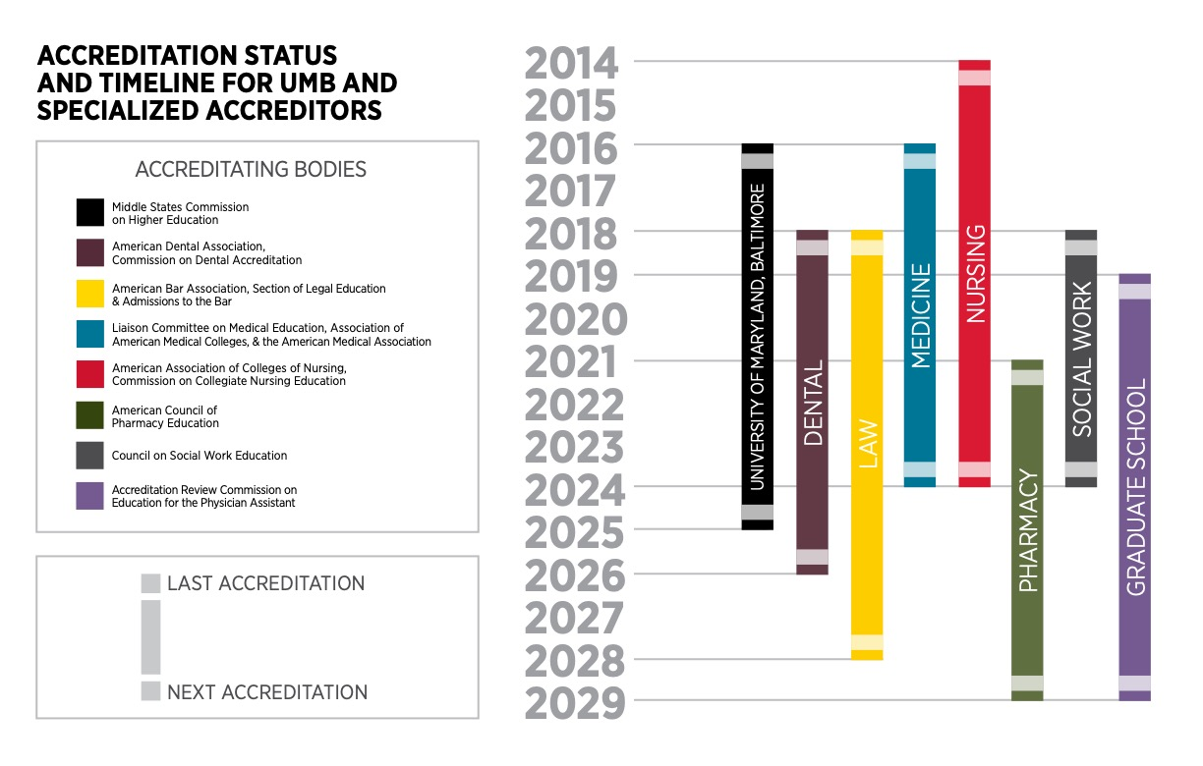
Nov. 8, 2023, Town Hall: Standards III and IV

Slide 5
Nov. 8, 2023, Town Hall: Standards III and IV
Why Does Middle States Matter?
Institutional accreditation provides a “seal of approval” that is a prerequisite for receiving federal financial aid funds!
MSCHE mandates that its member institutions meet rigorous and comprehensive standards, which are addressed in the context of the mission of each institution and within the culture of ethical practices and institutional integrity.
If UMB were to lose its accreditation, EVERY school and program would be at risk.
Notes:
Select the Self-Study design most appropriate for UMB. The themes in the design should align with our core values and the priorities in our Strategic Plan. This task should be completed no later than April 25, 2023.
Design an inclusive and transparent self-study process that actively and deliberately seeks to engage members of the University community from every corner of campus.
Produce a Self-Study report that demonstrates our compliance with the Middle States Commission on Higher Education accreditation standards and provides forward-looking recommendations to move the institution further along its quest for excellence in graduate and professional education, research, clinical activities, and service for the public good.

Slide 6
Nov. 8, 2023, Town Hall: Standards III and IV
Middle States Standards and Requirements
Accredited institutions are expected to demonstrate compliance with MSCHE’s seven standards (and related requirements), to conduct their activities in a manner consistent with the standards and requirements, and to engage in ongoing processes of self-review and improvement.
Standard I – Mission and Goals
Standard II – Ethics and Integrity
Standard III – Design and Delivery of the Student Learning Experience
Standard IV – Support of the Student Experience
Standard V – Educational Effectiveness Assessment
Standard VI – Planning, Resources, and Institutional Improvement
Standard VII – Governance, Leadership, and Administration

Slide 7
Nov. 8, 2023, Town Hall: Standards III and IV
UMB’s Accreditation Components and History
The accreditation process has two main parts:
The creation and submission of a Self-Study report to MSCHE.
A multiday site visit and review in spring 2025 by a team composed of peer evaluators from other accredited institutions organized by MSCHE.
UMB’s MSCHE accreditation was reaffirmed in June 2016.
UMB’s accreditation status will be acted on again by MSCHE in 2025.

Slide 8
Nov. 8, 2023, Town Hall: Standards III and IV
Intended Outcomes of the Self-Study
To engage in an inclusive and transparent self-appraisal process.
To produce a Self-Study report that demonstrates compliance with the seven standards and related requirements.
To develop forward-looking recommendations to inform UMB’s next Strategic Plan to move the institution further along in its quest for excellence in graduate and professional education, research, clinical activities, and service for the public.
Notes:
Self Study Approach
The Standards Based self-study design was chosen as the one in which the University could focus most intensely on its strategic priorities. UMB has a robust culture of planning and accreditation. Part of the reason for our unique culture is that each of UMB’s professional schools is accredited by their own unique accrediting organizations and as such UMB is continually examining its practices and making improvements. UMB is fortunate that the Middle States Self-Study affords the University yet another opportunity to integrate existing planning and accrediting processes.

Slide 9
Nov. 8, 2023, Town Hall: Standards III and IV
What Are Today’s Objectives?
Divide into small groups to assist the Working Groups in their assessment of UMB’s satisfaction of the relevant standard and related requirements.
Small groups also will consider questions seeking to identify opportunities for improvement.
This town hall is an important part of UMB’s self-review process. Thank you for taking the time to be engaged!
Notes:
Drs. Ward, Reynolds, and Greg Spengler to introduce Co-chairs

Slide 10
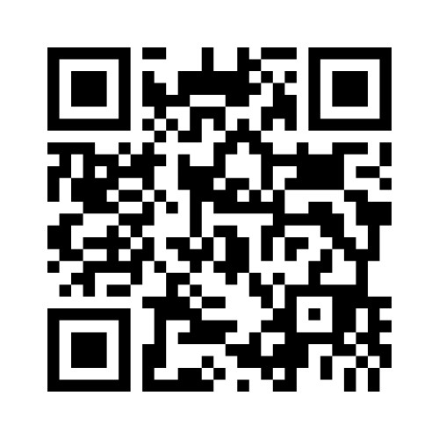
Nov. 8, 2023, Town Hall: Standards III and IV
Scan the QR code for a UMB and Middle States Check-In

Slide 11
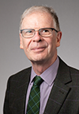
Standard III – Design and Delivery of Student Learning Experience
Susan Antol,
PhD, MS, RN
Richard Dalby, PhD, BPharm
Jenny Owens, ScD, MS
Logistics Committee Liaison: Karen Matthews

Slide 12
Standard III – Design and Delivery of Student Learning Experience
An institution provides students with learning experiences that are characterized by rigor and coherence at all program, certificate, and degree levels, regardless of instructional modality. All learning experiences, regardless of modality, program pace/schedule, level, and setting, are consistent with higher education expectations.
Notes:
From : https://www.msche.org/standards/thirteenth-edition/#standard1 and
https://www.umaryland.edu/middlestates/design/organizational-structure-of-groups-and-committees-/

Slide 13
Standard III – Design and Delivery of Student Learning Experience
How does the design and delivery of academic programs at UMB support student success, both while they are enrolled as well as after graduation?
How does the design and delivery of educational programs at UMB support our core values of equity, diversity, and inclusion?
How does UMB support the educational and career objectives of students through its design and delivery of academic programs?
To what extent does the way a course or program is taught (in-person, hybrid or virtual) influence the way it is designed and operationalized?
How can UMB support individual schools in assessing and enhancing the rigor and relevance of educational offerings?
Notes:
From : https://www.msche.org/standards/thirteenth-edition/#standard1 and
https://www.umaryland.edu/middlestates/design/organizational-structure-of-groups-and-committees-/

Slide 14
Standard IV – Support of Student Experience
Patty Alvarez, PhD, MS
Gregory Brightbill, EdD
Barbara Gontrum, JD, MLS
Logistics Committee Liaison: Kate Noonan

Slide 15
Standard IV – Support of Student Experience
Across all educational experiences, settings, levels, and instructional modalities, the institution recruits and admits students whose interests, abilities, experiences, and goals are congruent with its mission and educational offerings. The institution commits to student retention, persistence, completion, and success through a coherent and effective support system sustained by qualified professionals, which enhances the quality of the learning environment, contributes to the educational experience, and fosters student success.

Slide 16
Standard IV – Support of Student Experience
What strategies has UMB adopted and what resources have been allocated to assure the financial, physical, and mental wellness of enrolled students?
How does UMB support the transition of new students at all levels to assure their success in and out of the classroom?
What support does UMB provide to promote the successful placement of graduates in appropriate careers and post degree academic programs?
What approaches has UMB adopted to promote an equitable and inclusive cocurricular learning environment?
What concerns or opportunities exist in the areas outlined above?
Notes:
Ethical conduct across the mission areas
Does the UMB infrastructure – polices, procedures, etc. - promote ethical behavior across the University?

Slide 17
Nov. 8, 2023, Town Hall: Standards III and IV
Small Group Discussions
1. Questions to be answered 2. Potential evidence 3. Potential recommendations and opportunities
Notes:
Logistics
Group identifies a notetaker and presenter
Report out to the Standard group and opportunity to share key takeaways, comments with the larger group
Ask co-chairs to capture notes and write them up post-town hall with the logistics liaison

Slide 18
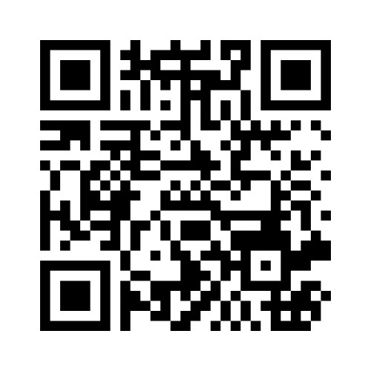
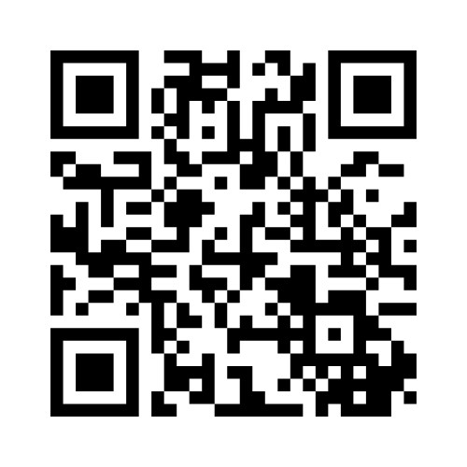
Input and Considerations from Your Groups
Nov. 8, 2023, Town Hall: Standards III and IV
Standard III
Standard IV
Code: 11453401
Code: 36533256
Notes:
Logistics
Group identifies a notetaker and presenter
Report out to the Standard group and opportunity to share key takeaways, comments with the larger group
Ask co-chairs to capture notes and write them up post-town hall with the logistics liaison

Slide 19
Nov. 8, 2023, Town Hall: Standards III and IV
Upcoming Town Halls – Join the Conversation
EDUCATIONAL EFFECTIVENESS ASSESSMENT Nov. 13, 2023 2:30 p.m. | SMC Campus Center | Elm Ballroom ADDRESSING ALL SEVEN STANDARDS Nov. 16, 2023 11 a.m. | Virtual via Zoom
umaryland.edu/middlestates/register/
Notes:
Dr. Ward and Dr. Reynolds
Brief reflection on what they heard from the discussions; key takeaways, etc.
The self-study enables UMB to look at ourselves; identify ways to self-assess and improve
This is an organic process for UMB
Community discussions will serve as the launching point for our next strategic plan
Invite groups to briefly share a takeaway, comment, question, etc.
Next steps
Upcoming town halls and how to register AND QR code to provide feedback on Town Hall (CLICK TO PROGRESS SLIDE)
One (1) suggestion, idea, question that came up for you.
What improvement(s) should be made to the Middle States Accreditation Town Halls?
Thank you!

Slide 20
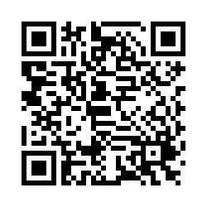
Nov. 8, 2023, Town Hall: Standards III and IV
Scan the QR code to provide feedback about today’s meeting.

