Slide 1


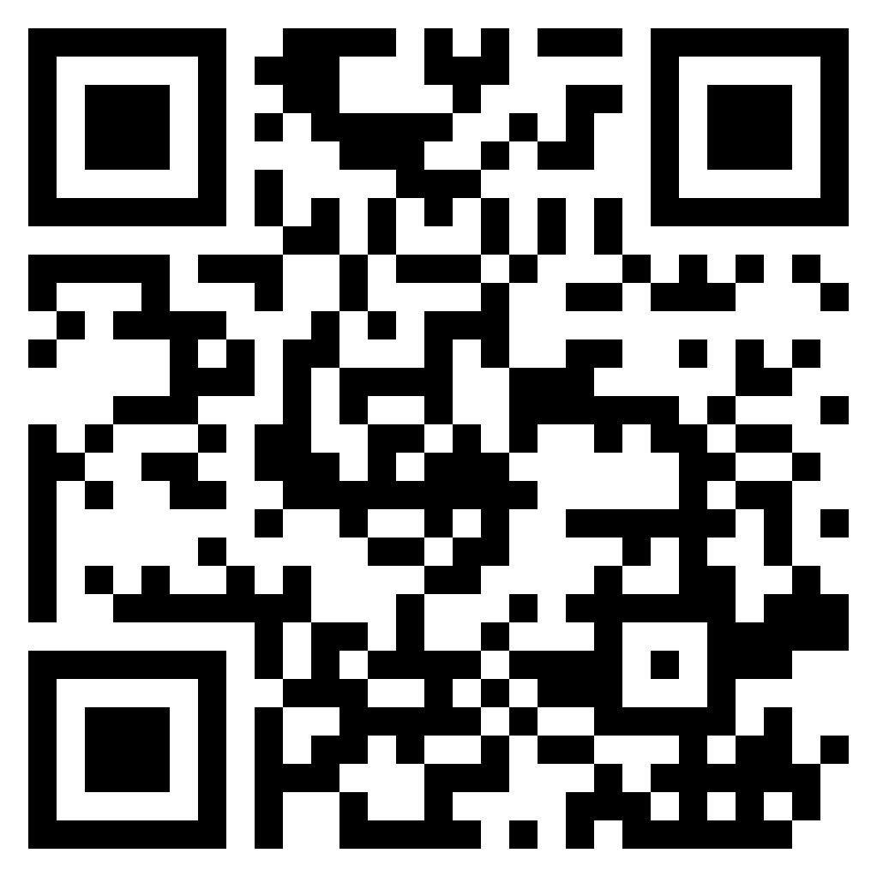
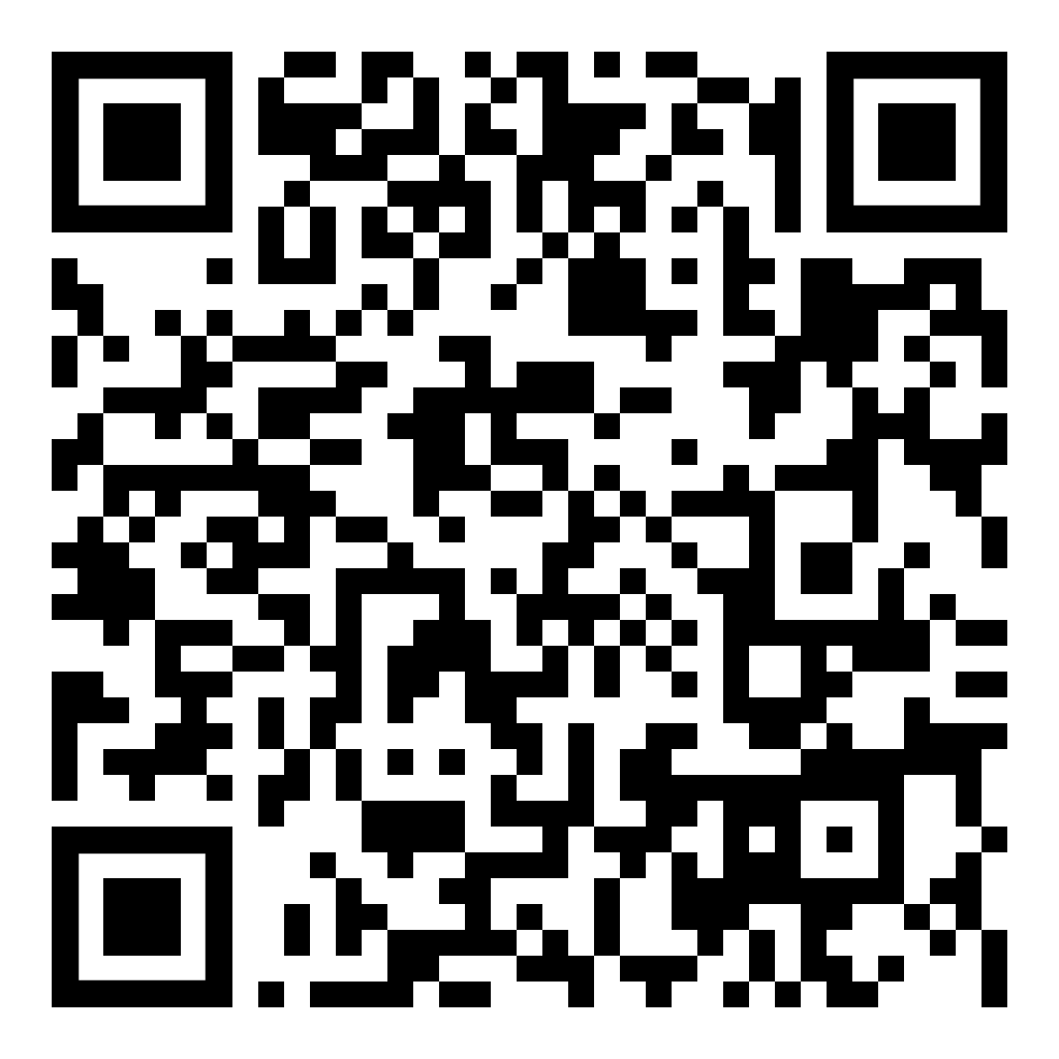
Monthly 5K
All runs begin at 12 p.m. in the lobby of the Campus Center at 621 W. Lombard St. *All 5K’s are a great place for Gym Buddies to attend and meet up! See below for the Gym Buddies QR code!*
EVENT | DATE | THEME
Fall Kickoff Run | September 11 | UMB Attire
Monster Dash | October 31 | Halloween Attire
Turkey Trot | November 13 | Fall Attire
Holiday Jog | December 10 | Holiday Attire
Resolution Run | January 22 | Plain T-shirt
Cupid Shuffle | February 13 | Valentine’s Day Attire
Maryland Run | March 17 | Maryland Attire
Earth Day Run | April 16 | Earthy Attire
Final Frolic | May 6 | UMB Pride Attire
Win a prize if you attend all nine 5K’s. More information at https://www.umaryland.edu/urecfit/fitness/monthly-5k/
Monthly 5K Schedule
Gym Buddies

