Slide 1


MULTI-LANGUAGE MANAGEMENT
– An End-User’s Guide –
v2023.11.06
Günther Rezniczek, PhD
Ruhr-Universität Bochum / Marien Hospital Herne
guenther.rezniczek@rub.de

Slide 2
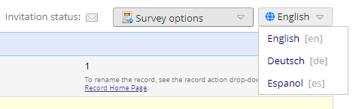
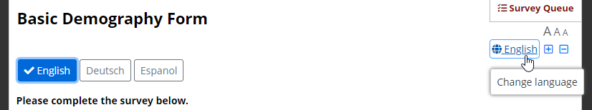
What is Multi-Language Management (MLM)?
Provides the ability to present REDCap data entry interfaces in multiple languages (Data Entry and Survey Pages, Missing Data Codes, ASIs, Alerts & Notifications, PDFs)
Compatible with piping, field embedding, branching logic
Users / survey respondents can switch among the available languages
at will
Easy to administer, purely opt-in

Slide 3
How does it work? – Basic concepts
There are two translation domains for each language:
In projects, everything is opt-in (i.e., MLM will only translate what is specifically enabled / provided)!
User interface translations
i.e., all the strings that are displayed by REDCap in the context of data entry or surveys.
Their (project-specific) default values are set by he REDCap admin.
Admins can provide UI translations in the form of
SYSTEM LANGUAGES
Project-specific translations
i.e., all data dictionary items (questions/field labels, choice labels, etc.), survey settings (survey title, survey instructions, etc.), survey queue custom message, ASI and alert message subjects and contents, etc.
Projects can override user interface items (when allowed by admins)
Think of these
as the REDCap
instance’s library
of UI translations
that projects can
use to get started

Slide 4
Getting started with MLM in projects
Depending on the global MLM settings, there are up to three methods for initializing project languages:
Initializing from the available MLM system languages (preferred)
Importing from an existing file (.csv, .json, .ini)
Building from scratch (not recommended)
Set up all languages a user/survey respondent should be able to choose from
Then, data dictionary (and other items) can be translated
Directly on the project’s MLM setup page
Offline (by a professional translator)
  Export all items that need to be translated
  Import the translations
Note: The MLM setup page is locked
in production projects. Switch
to draft mode first.
Furthermore, only one user may
edit MLM settings at a time.

Slide 5
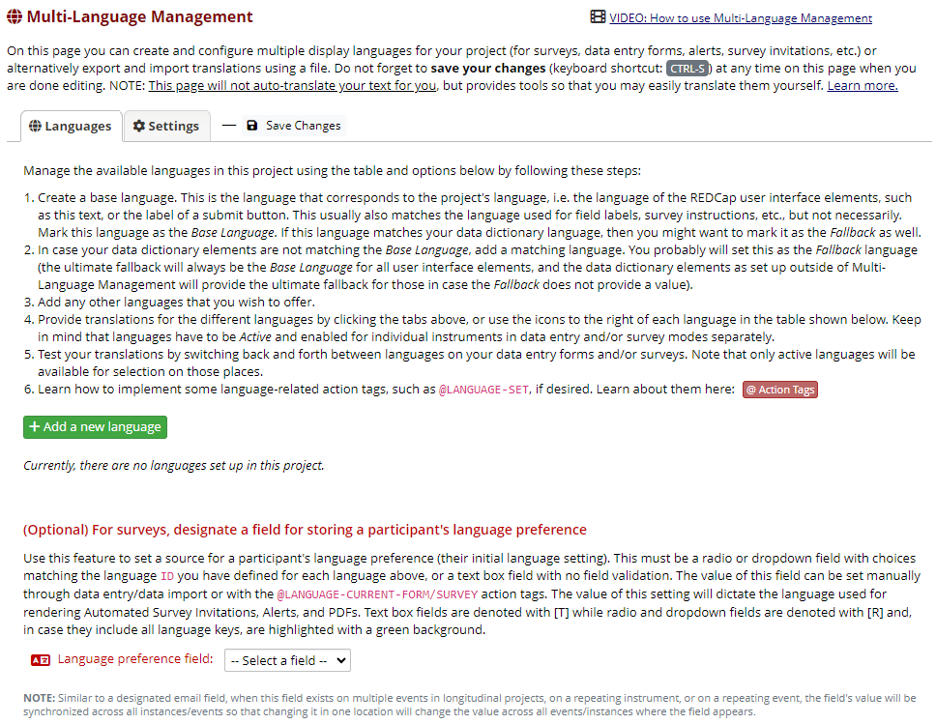
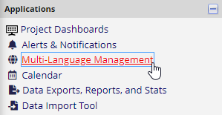
Adding languages to projects
Bring up the Multi-Language Management page by clicking the link in the Applications menu
Click the Add a new language button
Note: Project Design
user rights are required
to be able to access the
MLM setup page (this
may change in future
versions)
❶
❷

Slide 6
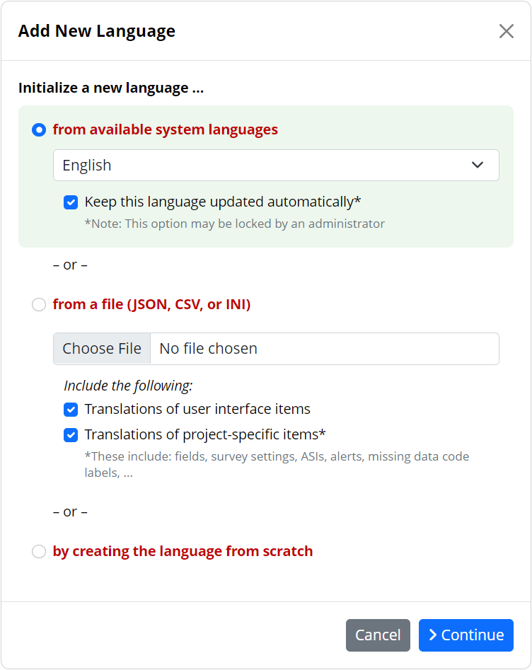
Adding languages to projects (ctd.)
Choose one of the option to initialize a new language.
Depending on the availability of system languages and restrictions imposed by
the REDCap admins, not all options may be available*.
  From available system languages
  with or (if not enforced) without automatic updates
  From a language file
  using only UI strings, project-specific items, or
  both
  By creating from scratch
Click Continue to proceed to the next
step
  * On some installations, admins may, e.g., restrict
  project languages to a set of centrally maintained
  languages. In this case, initialization from a system
  languages would be the only available option.
❸
❹

Slide 7
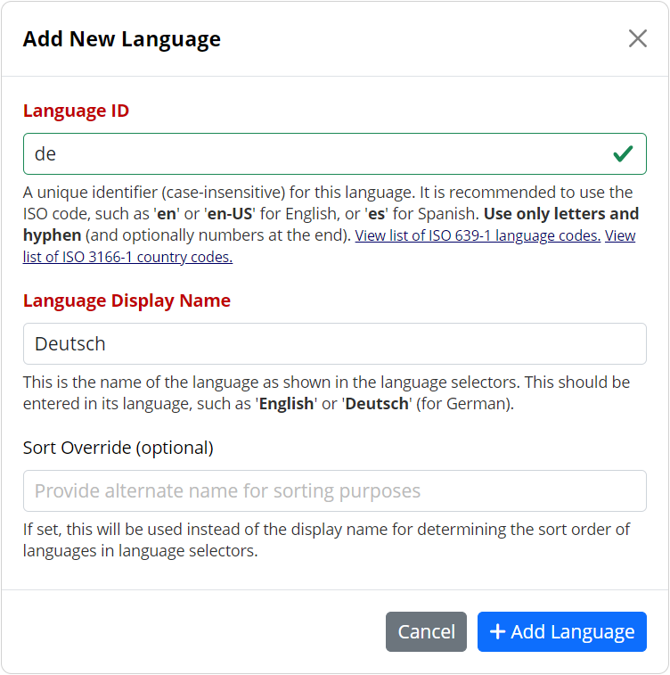
Adding languages to projects (ctd.)
Finally, enter (or change if not already set) the ID and the Display Name.
Optionally, a Sort Override can be specified.
Click the Add Language button to add
the language to the project.
  Further options to control (and update)
  languages are available on the languages
  table.
❺
❻

Slide 8
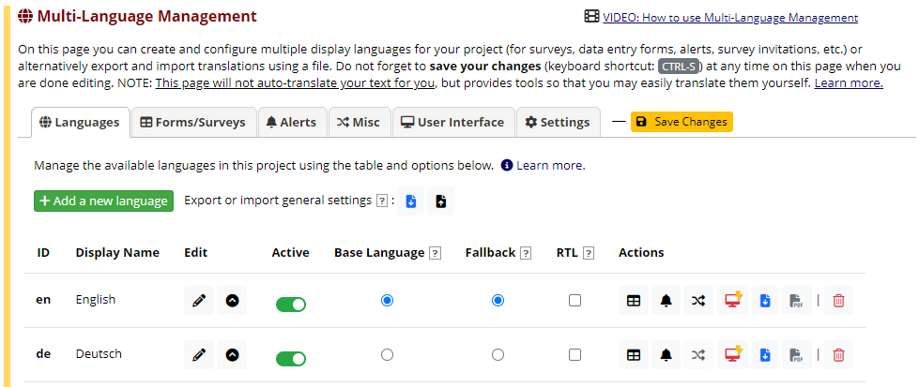
Managing languages in projects
Turn on/off languages by setting their Active state
Set a language to represent the Base Language or to serve as Fallback (more on this later)
Specify, whether a it’s a right-to-left (RTL) language
Use the Action buttons to go to editing subsection or to perform various operations on
individual languages
Don’t forget to
save your changes
(an orange save button/
orange strip signals
that there are unsaved
changes)
❺
❶
❷
❸
❹

Slide 9
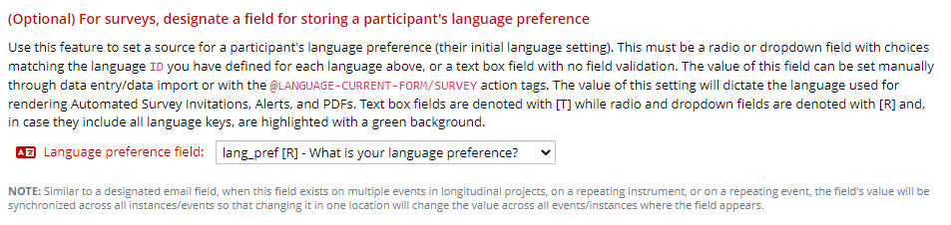
Managing languages in projects (ctd.)
Optional: Designate a Language preference field.
For certain operations and under some circumstances, REDCap cannot deduce the appropriate language to use. In such cases, the value of the language preference field, if available, will be used to set to language.
Note: This field behaves very similar to the designated email field, i.e. it will be synchronized across all events / repeat instances.
❻

Slide 10











Managing languages in projects (ctd.)
The icons / buttons in the table on the Languages tab explained:
  Edit the language’s display name and id
  Update a language (including importing from a file)
  Access the Forms/Surveys tab for this language
  Access the Alerts tab for this language
  Access the Misc tab for this language (disabled for the Base Language)
  Access the User Interface tab for this language (a red icon means that the language was
  initialized from a system language; an additional flash indicates that this language
  is “subscribed”, i.e., subject to automatic updates). Depending on administrative settings,
  translation of user interface items may be blocked.
  Export translations for this language
  Download translated instrument PDFs for this language
  Delete this language

Slide 11
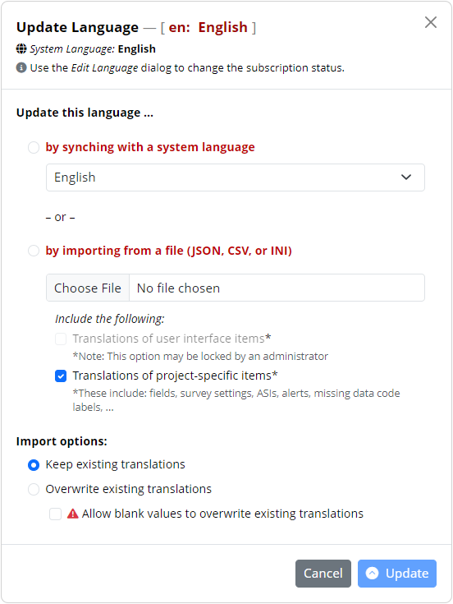
Updating a language
To update a language (from a system language when
not subscribed) or to import translations into a
language, access the Update Language dialog ( ).
Note: The available options may be limited, depending on
administrative settings.
Any update are overlaid on the current configuration. This
means that any subset of translations can be imported
at any time. To erase translations (i.e., overwrite with
blank values), they need to be in the import set and the
“Allow blank values to overwrite existing translations”
must be selected.

Slide 12
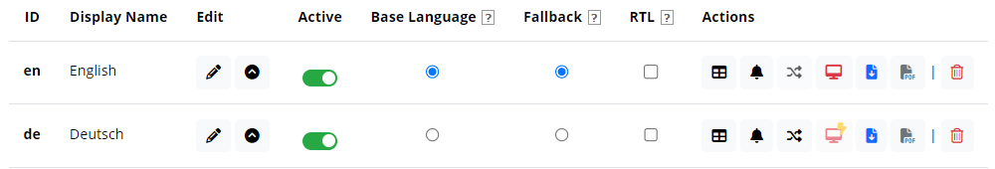
Understanding Default and Fallback
The Base Language …
should match the project language (i.e. the language that user interface elements, such as menus and dialog messages are displayed in).
usually is also the language used during project design, i.e. for all data dictionary items, survey settings, ASI or alert messages, missing data code labels, etc.
If this is not the case, then a language corresponding to the project’s UI language should still be added and set as “Base Language” (but it can be set as inactive).
The Fallback language …
will be used when a translation is not available in the language that currently should be displayed. In case the fallback translation is missing, too, the project’s base language will be used (i.e. whatever is in the data dictionary or, in case of UI strings, whatever language has been configured for the project by an admin).

Slide 13
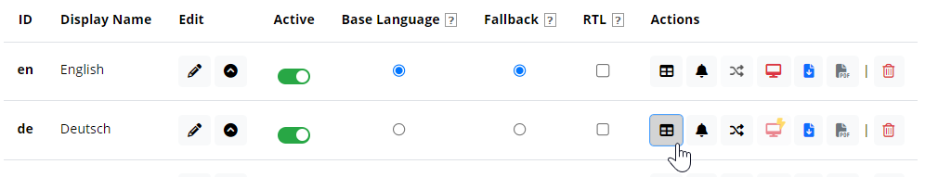
Translating project items
Click on tab or the corresponding icon in the languages table
  Forms / Surveys (fields, survey settings, ASIs, survey queue customizations)
  Alerts
  Misc (Missing Data Codes, PDF customizations, Protected Email customizations)
  User Interface – UI strings are usually set from a system language, but there can be project-specific overrides, unless such overrides have been disallowed by the REDCap admin:

Slide 14
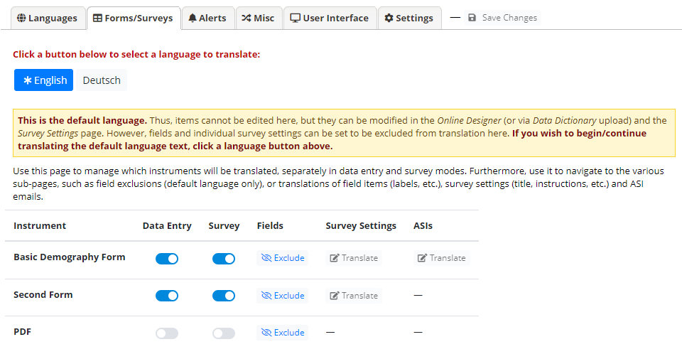
Forms/Surveys (base language)
On each language tab, control whether this language is available for selection, separately for data entry forms and surveys.
The base language tab (indicated by an asterisk) is special:
There is nothing to translate, but fields can be excluded from translation (i.e., they won’t show up
on the respective tabs for other languages).
Note, a common pitfall
is to forget to enable
languages for individual
data entry forms or surveys!
❷
❸
❶

Slide 15
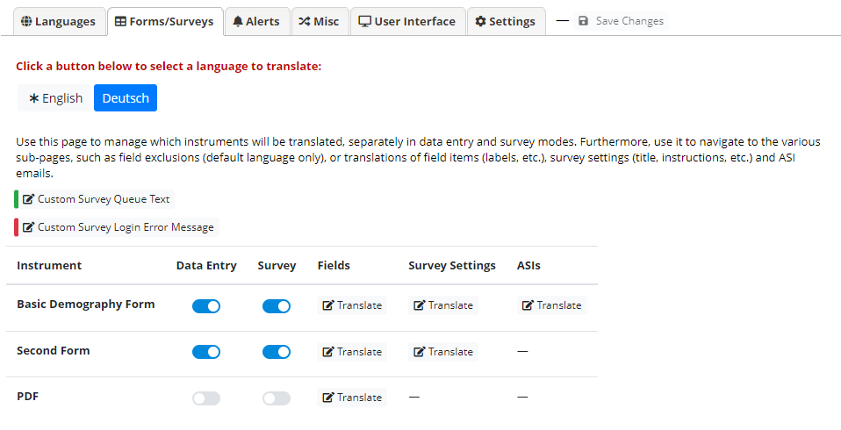
Forms/Surveys (other languages)
On each language tab, control whether this language is available for selection, separately for data entry forms and surveys.
Depending on whether an instrument is enabled as a survey and has ASIs, corresponding Translate buttons are available.
In case the Survey Queue is enable with custom texts, translation buttons are available for these
items.
Note, a common pitfall
is to forget to enable
languages for individual
data entry forms or surveys!
❸
❶
❷

Slide 16
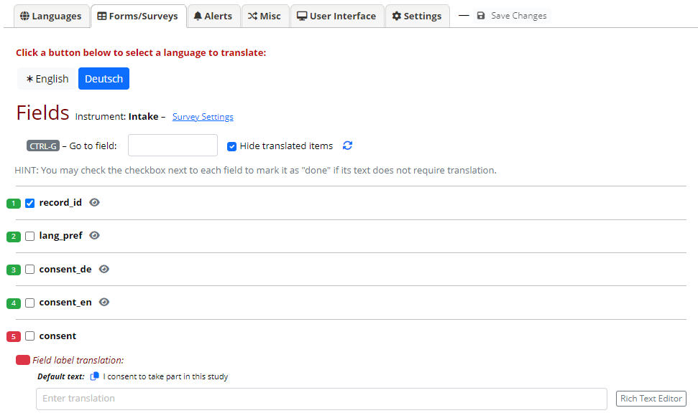
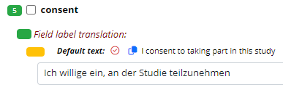
Forms/Surveys – Fields
Use the Go to field dropdown to quickly navigate to a specific field
Enter translations. When appropriate, a Rich Text Editor button is available
Indicators reflect the translation status of items/subitems (green = complete; red = not translated)
Hints:
The copy icons next to the
default text can be used to
quickly copy/paste them to
translation tools
In case an item changes after
having been translated, this will
be indicated (orange indicator):
❶
❸
❷

Slide 17
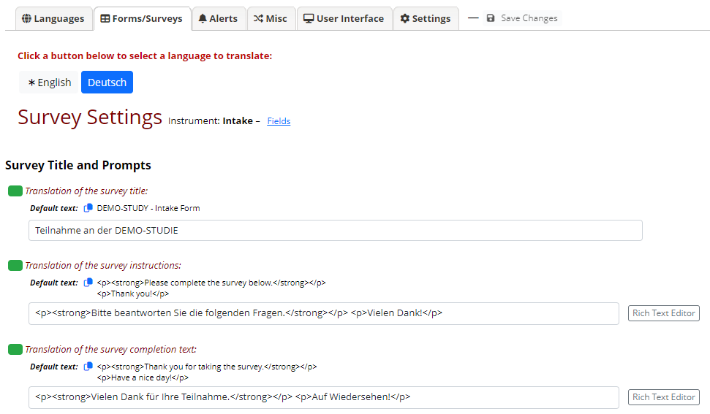
Forms/Surveys – Survey settings
Translate each item
Use the Rich Text Editor for any settings supporting HTML
Note, there is nothing to
translate for the base
language (marked with an
asterisk). When clicked,
this will take you to the field
exclusion page)
❶
❷

Slide 18
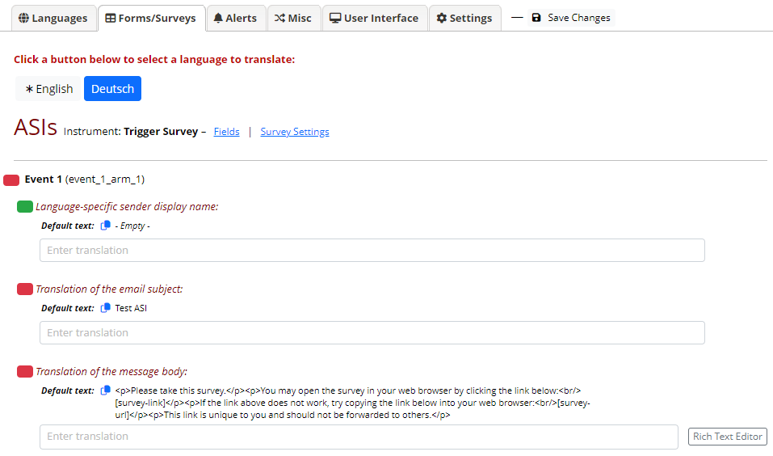
Forms/Surveys – ASIs
Translate each item
Use the Rich Text Editor for any settings supporting HTML
Note, ASIs for each event must →
must be translated separately
Make sure to faithfully replicate →
any pipings in the translations!
❶
❷

Slide 19
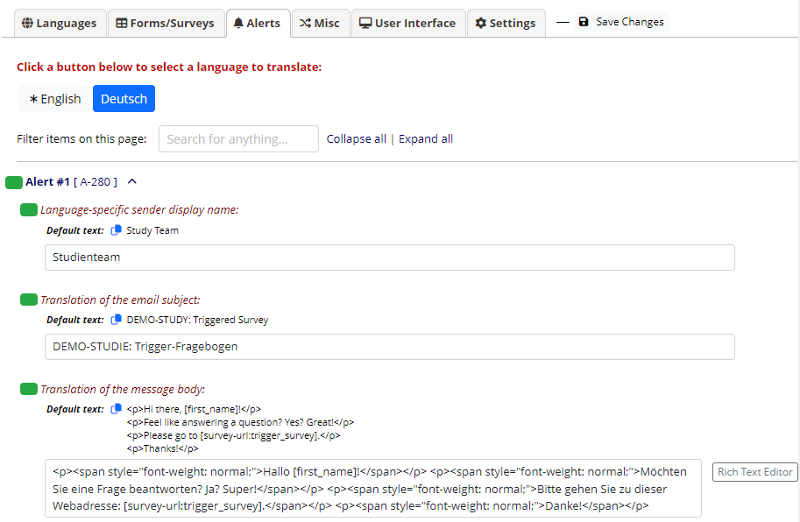
Alerts
Use the search box to quickly find the item you would like to translate / edit.
Use the Rich Text Editor for any settings supporting HTML
For Alerts, there are important →
settings to be made on the
default language’s page!
Make sure to faithfully replicate →
any pipings in the translations!
❶
❷

Slide 20
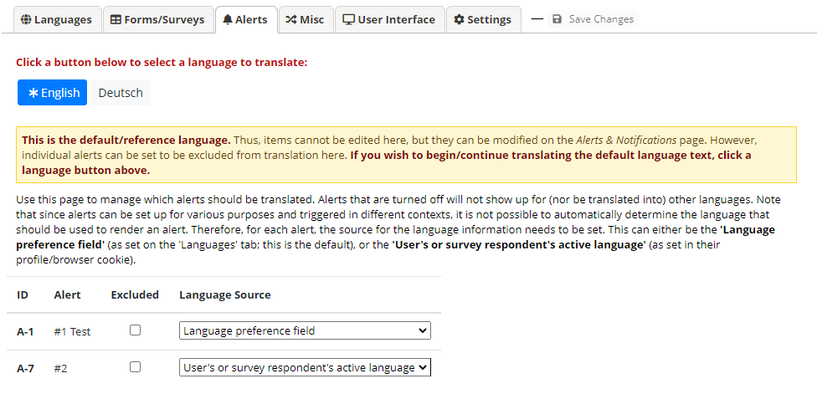
Alerts – Base language special options
Individual alerts can be excluded from translation
Since alerts may trigger under circumstances when the proper language cannot be determined automatically, use this to set a Language Source for each event.
  Language preference field or User’s or survey respondent’s active language
  What to choose will depend on how the alert is triggered (generally, however, this will be “Language preference field”)
Select the base →
language to get
to this page!
❶
❷

Slide 21
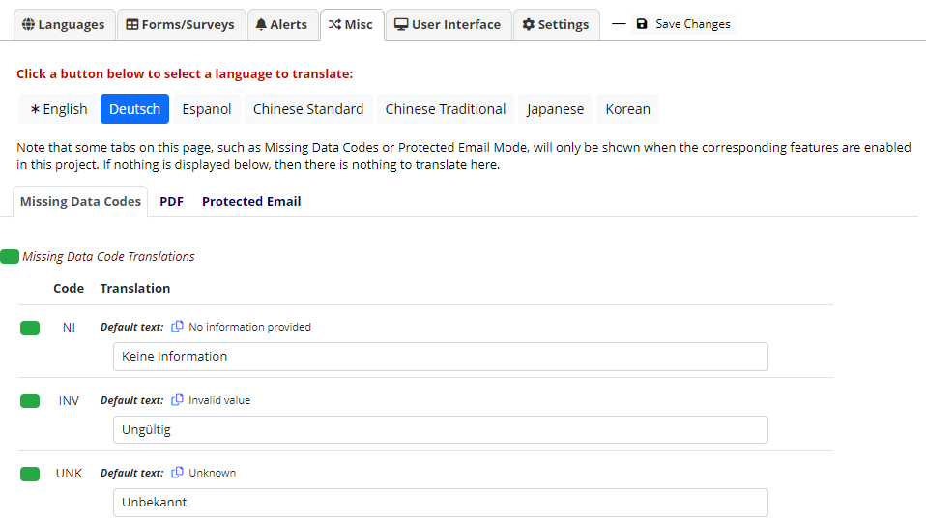
Miscellaneous items
Missing Data Codes
PDF customizations
Protected Email customizations
For the base language, there →
is nothing to translate.
Sub-tabs will only show when there →
are customizations set outside
of MLM. This means, it is not
possible to add new text using
MLM, but only to replace text (with
translations).

Slide 22
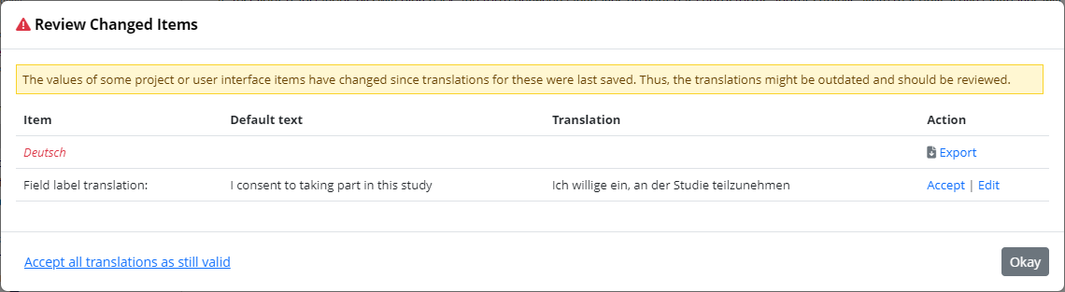
Change notification
Whenever an underlying item changes, MLM will display a notification
After reviewing the items, they can be edited or accepted as still being valid.

Slide 23
What determines the currently active* language?
* i.e., the language a page, email, PDF is rendered in
Generally:
A user’s (survey respondent’s) choice:
  Set via the language selection widget (or a radio field when used with the @LANGUAGE-SET action tag)
  On repeat visits through a cookie value (surveys, non-authenticated users) or user setting (data entry pages, authenticated users)
When this is not available, e.g., in a process triggered by ASI logic:
A field in the project:
  Set through the Language preference field option on the MLM setup page
  Its value must correspond to the ID of an active language
  It can be set manually (e.g., on an intake form) or captured into a field with @LANGUAGE-CURRENT-FORM/SURVEY action tag
  On data entry forms/surveys, it can be used with @LANGUAGE-FORCE
Note: When testing, always test in a fresh, private/incognito browsing window in order to not have “tainted” cookies!

Slide 24
Setting the initially displayed language for surveys
Generally, the language displayed for survey respondents is governed by a browser cookie that is set when they (first) select a language.
For new visitors, there are several ways to control the initially displayed language
  Add a field tagged with the @LANGUAGE-SET action tag to the survey while also populating it
  with @DEFAULT, setting the desired language id.
  This field can be hidden, but when displayed, it should be a radio field and, when capturing the language used by the survey respondent is of interest, have the @LANGUAGE-CURRENT actin tag applied.
  By adding a parameter (__lang – nite the two underscores!) to the survey URL:
  The @LANGUAGE-FORCE action tag can be used but will prevent the survey respondent from changing the language.

Slide 25








MLM’s language determination algorithm
Data Dictionary / Settings
SURVEY
Cookie
User setting
@ACTION TAG
Perferred lang field
MLM
Data Dictionary or .ini file
Desired language or
fallback
Base Language
Email, Text, MyCap*
Cron or other trigger
ASI / Alert
Data Entry, Data Import
* planned

Slide 26
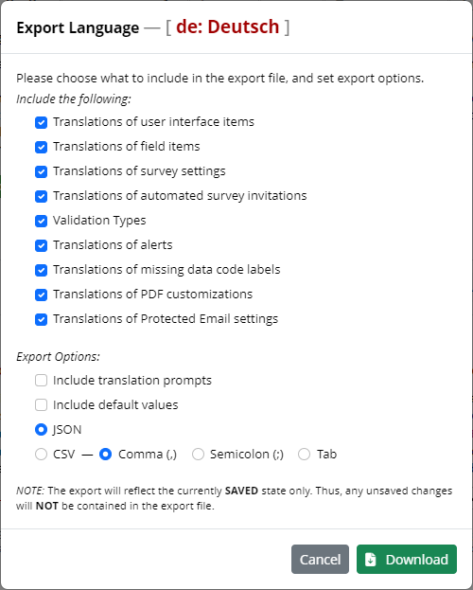
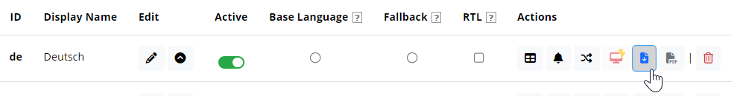
Exporting languages (for re-use/offline translation)
Click on the Export button in the language’s row in the languages table
Choose the items that should be included
in the export
Choose whether to include translation prompts
and/or default values, as well as the file
format (JSON or CSV)
Click the Download Language button
For offline translation, include prompts and default values!
For transfers or backups, these are not needed.
❷
❸
❶
❹

Slide 27
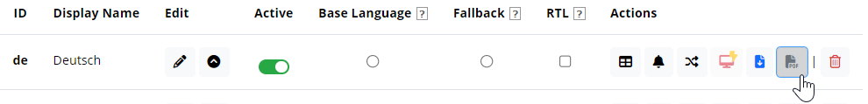
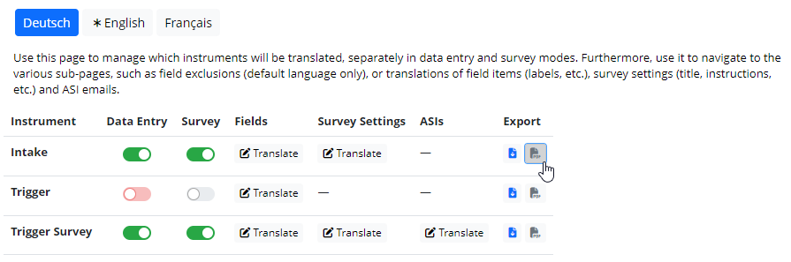
Exporting translated instrument PDFs
Export all (empty) instrument PDFs for a language
Export a translated (empty) PDF for an individual instrument
  Note: Instruments without translations will be rendered in the default language
❶
❷

Slide 28
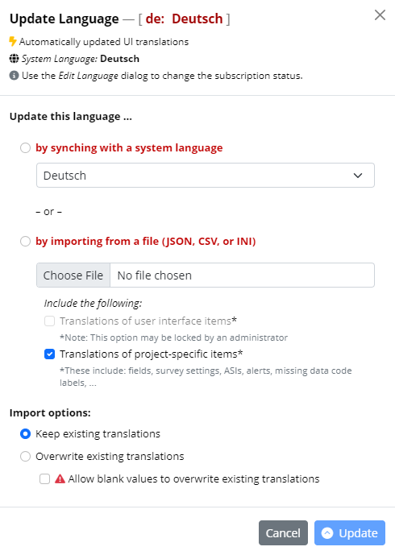
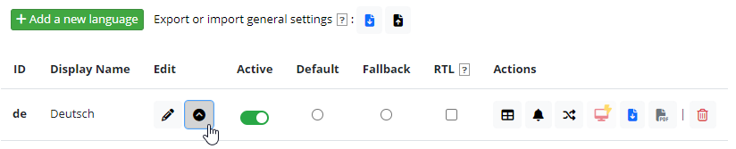
Importing (updated) translations
Click the Update Language button in the
corresponding row in the languages table
The Update Language dialog will inform
about the linkage/subscription to a
system language (when applicable)
Choose an update source and what to import
(choices may be limited depending on system settings)
Set import options
Click Update to perform the import (or synch)
operation
❷
❸
❹
❶
❺

Slide 29
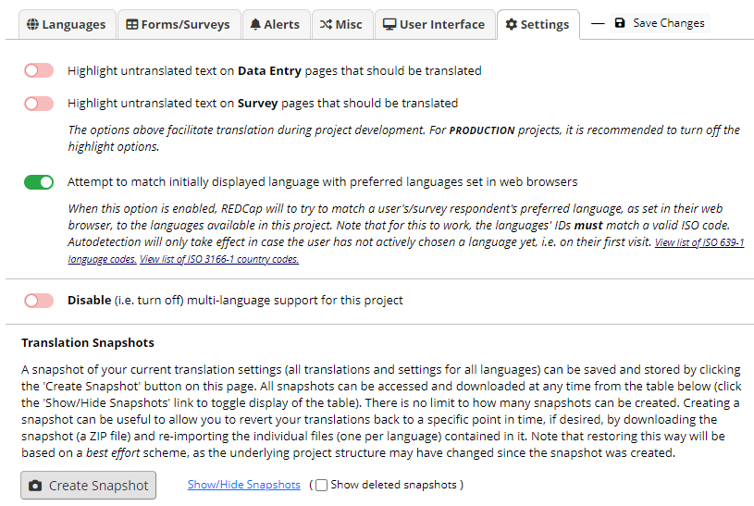
Other MLM settings / Translation snapshots
There are a number of options available under the Settings tab, such as the option to …
Highlight untranslated text (this is useful during development as a visual check for items
missing translations in the set language on data entry form and surveys)
Attempt to auto-detect the language to initially use from the browser
Disable multi-language
support in the project
(useful for troubleshooting)
Create Snapshot
(this will archive a ZIP with
export files for all languages –
these can be used to restore or
backup all project language)
❶
❷
❸
❹

Slide 30
Action Tags
There are a number of MLM-related action tags available:
@LANGUAGE-CURRENT-FORM
@LANGUAGE-CURRENT-SURVEY
@LANGUAGE-SET
  These action tags do not take any parameters. Instead, they use the field that they are applied to as target (@LANGUAGE-CURRENT) or source (@LANGUAGE-SET) for their effects, respectively.
@LANGUAGE-FORCE
@LANGUAGE-FORCE-FORM
@LANGUAGE-FORCE-SURVEY
These action tags require a string parameter corresponding to a language’s ID (most often, this will be the language preference or related field).
Syntax: @LANGUAGE-FORCE="en" or @LANGUAGE-FORCE-SURVEY="[radio_field:value]"
Piping is supported. When piping from radio fields, be sure to add the :value modifier !
On multi-page surveys, @LANGUAGE-FORCE and @LANGUAGE-FORCE-SURVEY affect the current page only!

Slide 31
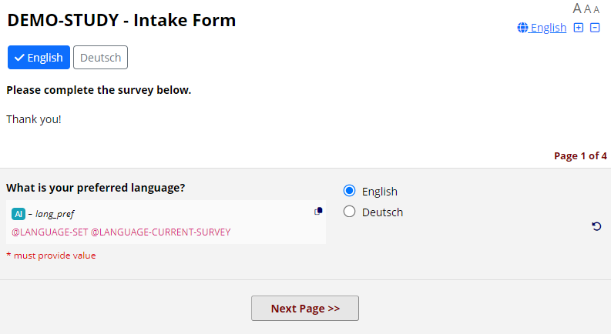
Action Tags – Exemplary use case
Consider a study targeted at populations speaking various languages. On the intake survey, you might want to ask candidates about their language preference before presenting consent information in this language and asking whether they are willing to participate in the study in the chosen language:
❶
Note that both, @LANGUAGE-SET and @LANGUAGE-CURRENT-SURVEY have been applied to the lang_pref field (a radio field with the codes en and de, corresponding to the MLM language ids).
This will sync the language menu (❶) with the radio field (❷).
❷
Field annotations provided by the Admin Insights External Module

Slide 32
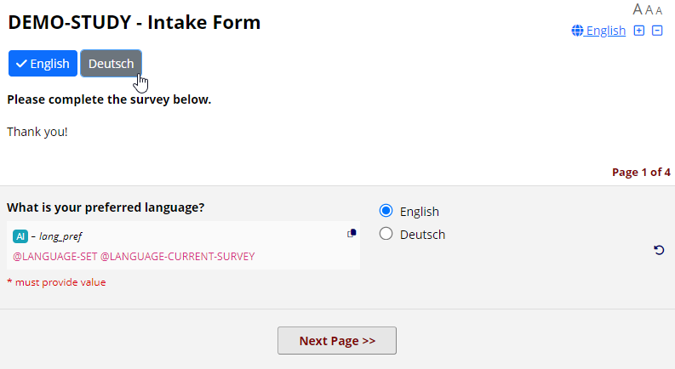
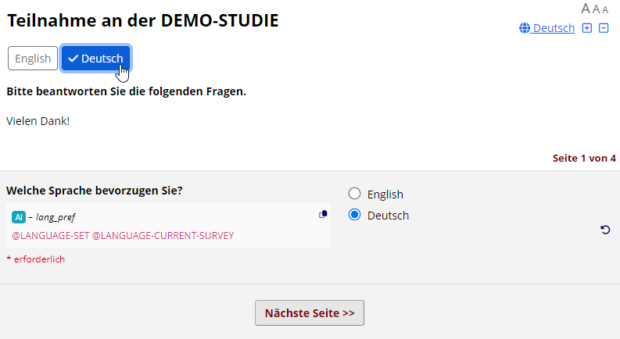
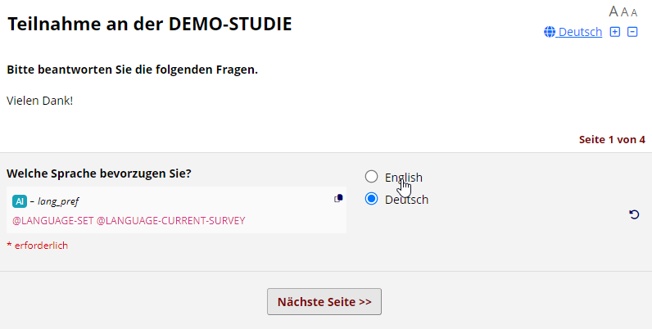
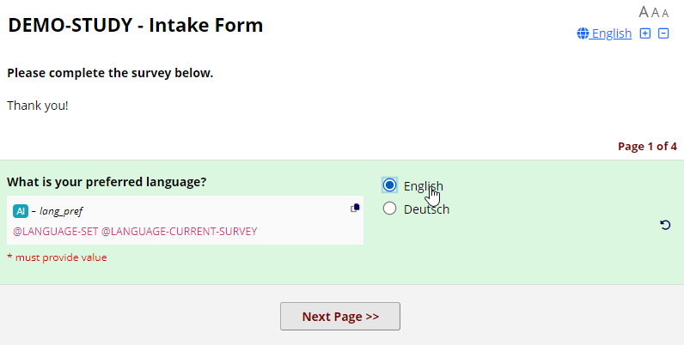
Action Tags – Exemplary use case (ctd.)
Clicking “Deutsch” on the language menu (❶) will swap English strings with their corresponding German translations AND change the radio field to the “de” choice (❷).
Conversely, clicking the “English” radio choice (❸), will switch to the “English” language (❹).
❶
❷
❹
❸

Slide 33
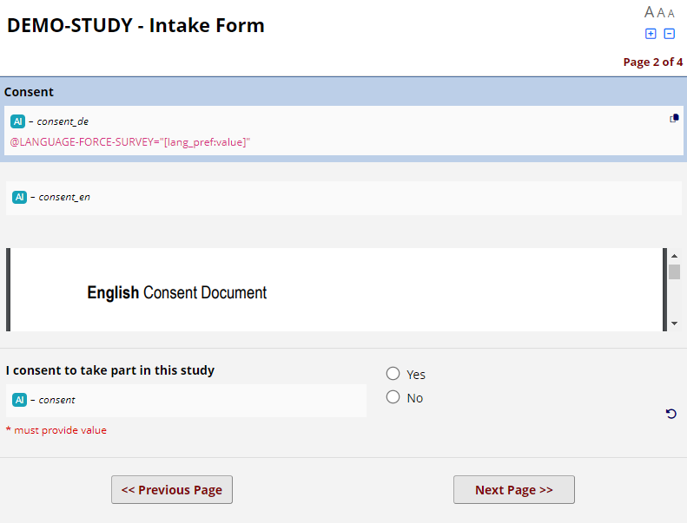
Action Tags – Exemplary use case (ctd.)
Assuming the survey respondent chose “English” as their preferred language and moved to the next survey page, this is what will be displayed:
Note that the language menu toggle is not displayed (❶).
This is due to the @LANGUAGE-FORCE-SURVEY action tag on the field consent_de (❷) It mandates the current survey page only to be rendered in English. Note that :value had to be added because lang_pref is of type radio button field.
Branching logic is used to show the appropriate consent document (❸).
❶
❷
❸

Slide 34
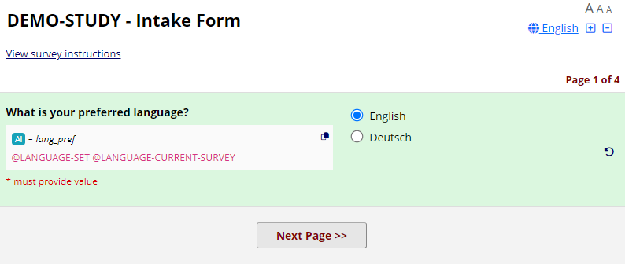
Action Tags – Exemplary use case (ctd.)
Going back to the first page of the survey will re-enable the language selection (❶), because there is no @LANGUAGE-FORCE-SURVEY action tag on this page.
It is up to the project designer or study requirements whether survey respondents should be locked into a certain language after it has been chosen initially (or preset, e.g. on a non-survey administrative form).
❶

Slide 35
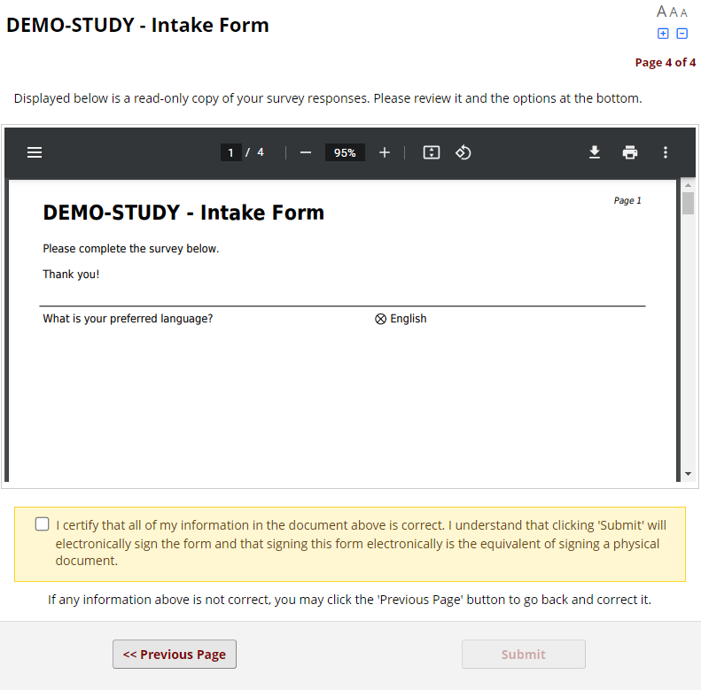
Action Tags – Exemplary use case (ctd.)
The language menu is never shown on the e-consent page (❶), but the language in use on the previous page will be locked in (this is because on-the-fly swapping of the PDF’s language is not supported).
❶

Slide 36
Action Tags – DOs and DON’Ts
Be specific! If language preference is collected on a survey (using @LANGUAGE-CURRENT-SURVEY) and multiple languages are supported in data entry mode as well, you probably do not want to have @LANGUAGE-CURRENT-FORM on this field as well.
Similarly, if a survey field is synchronized with the language menu (via @LANGUAGE-SET) and the study team has multi-lingual data entry forms, you might want to limit synchronization to surveys only. This can be achieved by selectively applying @LANGUAGE-SET via @IF and the smart variable [is-survey].
There is probably rarely a reason to use @LANGUAGE-FORCE or @LANGUAGE-FORCE-FORM.
Keep in mind that @LANGUAGE-FORCE / @LANGUAGE-FORCE-SURVEY) is limited to the currently displayed page in a multi-page survey!
When piping from a radio button field into the @LANGUAGE-FORCE action tag’s parameter, be sure to apply the :value modifier!

