Slide 1

PCard Refresher Training
Co-hosted by SSAS & MAS
PCard-Admin@umaryland.edu
MAS-help@umaryland.edu

Slide 2
Agenda
PCard Security and Controls
Procurement Compliance and Security (IT-PCS) Form
Socially Responsible Purchasing
Life Cycle of a PCard Transaction
End of Fiscal Year
Quantum UPKs
PCard Material Update
FAQs

Slide 3
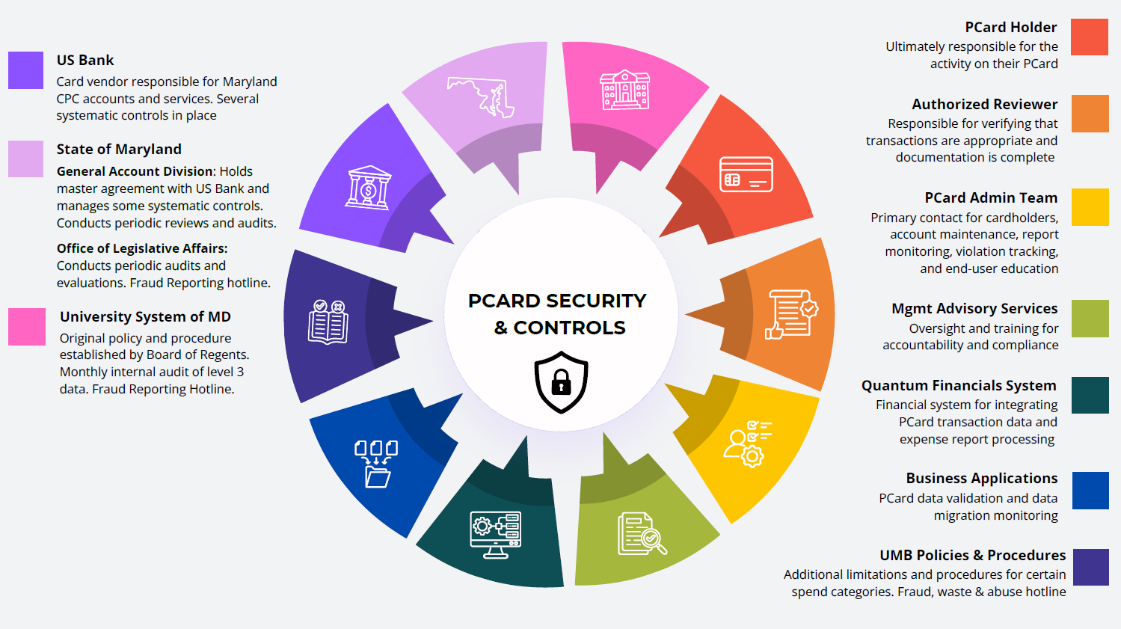

Slide 4
Procurement Compliance and Security (IT-PCS) Form
This form is required for the purchase of IT services, software solutions, and certain hardware.
For more information, visit: IT Procurement Compliance and Security Form
Security and Compliance Reviews
Web Accessibility Assessments
Integration with Central Systems
Fiscal Oversight
Redundancy Checks

Slide 5

Socially Responsible
Purchasing
Green Purchases
Maryland’s Department of General Services (DGS) has specifications for state agencies to follow when purchasing goods and services to prioritize environmentally and socially beneficial procurement practices.
Examples of vendors currently under contract UMB:
  Office Supplies, equipment, and furniture
    AJ Stationers
    Blind Industries and Services of Maryland (BISM)
    Maryland Correctional Enterprises (MCE)
    Rudolph Supply
  Lab Supplies, equipment, and safety products
    Fisher Scientific
    VWR
For more information, please visit:
Procurement Buy Green
Supplier Diversity
Cardholders are expected to seek out minority and women owned businesses where possible as they make purchases.
The Sweeten application makes finding diverse suppliers easy!
      For more information, please visit:
        Procurement MBE

Slide 6
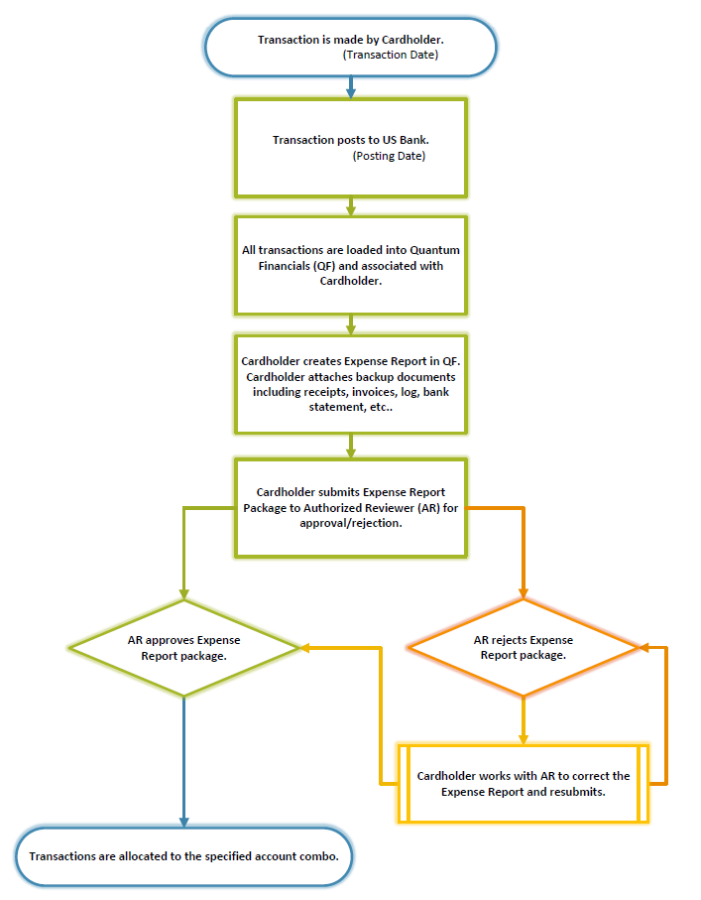
Life Cycle of a PCard Transaction
Four important stages
Transactions load into Quantum 2 days after posting date, after 3pm
Expense reports can be created at any time throughout the month. Multiple expense reports may be submitted, one report must include statement and transaction log.
Transactions must be reconciled and submitted to the Authorized Reviewer 7 days after the statement is available (typically on the 26th of the following month)
Expense reports must be approved by the 25th of the following month

Slide 7
End of Fiscal Year: June 26th
FY 2026 transactions made through June 24th MUST be submitted & approved by 5pm on June 26th.
Transactions made on June 24th MUST be submitted & approved between 3pm -5pm on June 26th.
Consider pausing PCard activity on the 23rd or sooner to avoid this tight processing turn around.
For more information, visit: Announcements - Office of the Controller

Slide 8
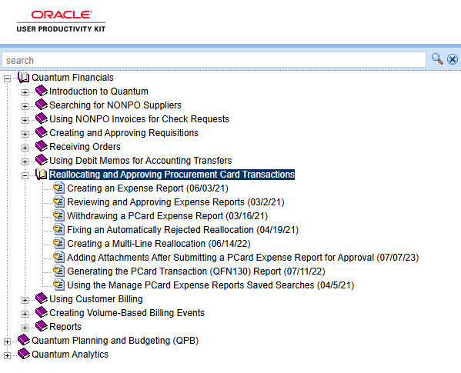
UPKs
Quantum (Oracle) User Productivity Kits
Interactive training software that allows you to learn at your own pace. Return to these modules as necessary to refresh your knowledge of various processes.
https://cfapps.umaryland.edu/upk/quantum/PlayerPackage/data/toc.html

Slide 9
PCard Materials
2026 Updates
PERCIPIO TRAINING
user’s guide
New survey
https://umaryland.percipio.com/linked-contents/077aed24-de5d-4511-a032-c505c0e9cfc4/landing?sharelink=3w7T8YJ2V
https://www.umaryland.edu/media/umb/af/procurement/guides/User's-Guide-04-2026.pdf
https://forms.office.com/pages/responsepage.aspx?id=SrzNPUx-e0CA93-2dXGC8hjo-kTjegRGvmMaSmNQRVdUMktRSFpBWlpYQTJVSk40SjlPVUQxMVpFTi4u&route=shorturl

Slide 10
FAQs
Extended Leave (3+ weeks)
  Do I need to notify the PCard Admin Team?
Increasing limits
  When do I provide my justification?
Tax Exempt Status
  Where can I find the Maryland State Tax Exemption Card?
Other Questions?

Slide 11


Up Next…
Management Advisory Services

