Slide 1

PCard Refresher Training
Co-hosted by SSAS & MAS
PCard-Admin@umaryland.edu
MAS-help@umaryland.edu

Slide 2
Agenda
PCard Security and Controls
Department Purchase Request Form
Socially Responsible Purchasing
PCard Spending Patterns
Furniture Purchases
Reminders
FAQs
Management Advisory Services

Slide 3
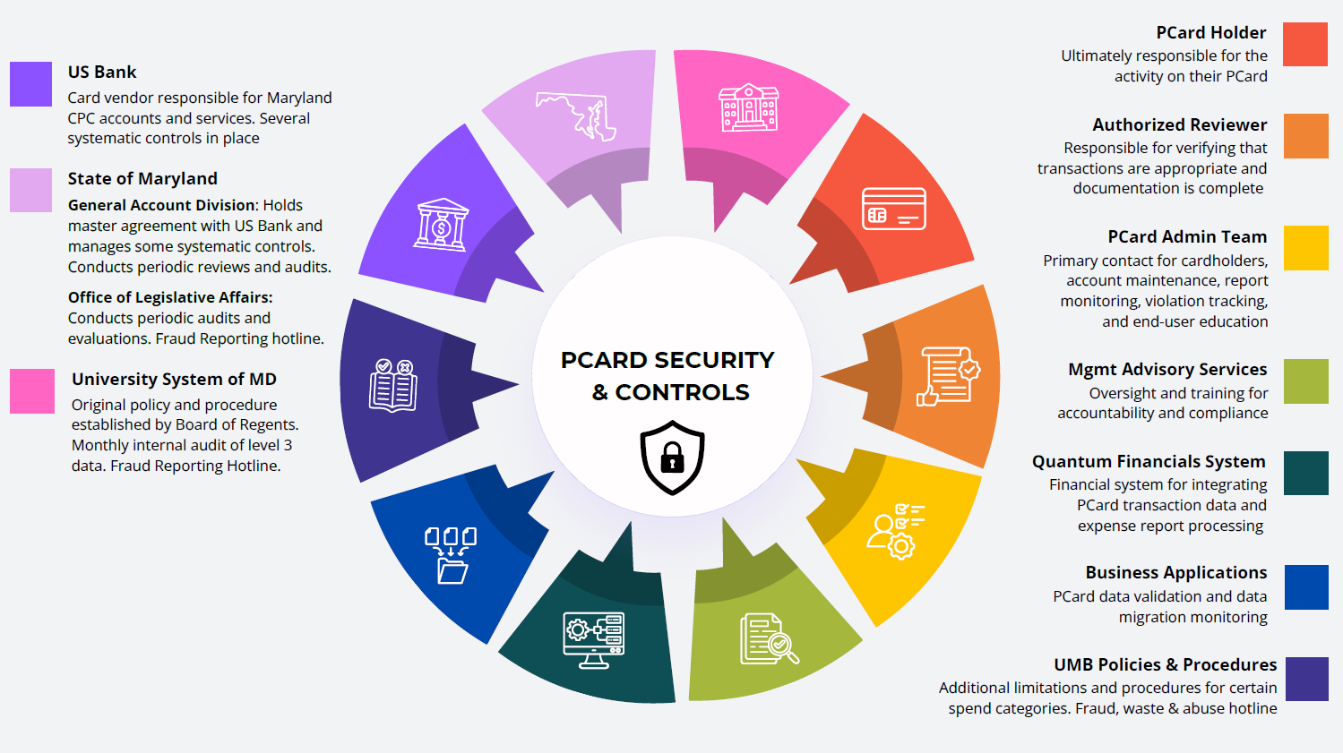

Slide 4
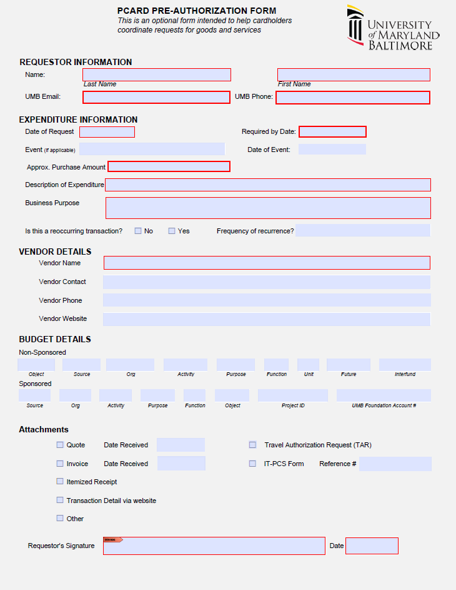
PCard Pre-Authorization Form
Optional
Streamlines internal purchase requests
Gathers information for expense reports
documentation attachment option
“Required by date” for planning
Helps Avoid potential split risks

Slide 5

Socially Responsible
Purchasing
Green Purchases
Maryland’s Department of General Services (DGS) has specifications for state agencies to follow when purchasing goods and services to prioritize environmentally and socially beneficial procurement practices.
Examples of vendors currently under contract UMB:
  Office Supplies, equipment, and furniture
    AJ Stationers
    Blind Industries and Services of Maryland (BISM)
    Maryland Correctional Enterprises (MCE)
    Rudolph Supply
  Lab Supplies, equipment, and safety products
    Fisher Scientific
    VWR
For more information, please visit:
Procurement Buy Green
Supplier Diversity
Cardholders are expected to seek out minority and women owned businesses where possible as they make purchases.
The Sweeten application makes finding diverse suppliers easy!
      For more information, please visit:
        Procurement MBE

Slide 6
SUPPLIER DIVERSITY
A Win-Win for UMB & Our Community
WIN
Purchase Card Program • Staff Training
+
WIN
Good for UMB. Good for business. Good for Baltimore.
Arnold M. Jolivet II
Supplier Diversity Program Manager
Notes:
[object Object],[object Object]

Slide 7
THE BUSINESS CASE
Why Supplier Diversity Matters
More Competition
Better Overall Value
More Opportunity
A broader pool of qualified suppliers creates healthy competition and challenges vendors to earn UMB’s business.
Competition can strengthen pricing, service, responsiveness, innovation and the quality of solutions available to UMB.
Intentional consideration gives capable small, minority-owned and local firms greater access to institutional purchasing opportunities.
Supplier diversity does not lower the standard — it widens the field of qualified businesses competing to meet it.
Notes:
[object Object],[object Object]

Slide 8
EVERY PURCHASE IS A DECISION
The Purchase Card Holder’s Role
The easiest question is:
The better question is:
“Who do we usually buy from?”
“Who else is qualified to provide this?”
1. Pause
2. Consider
3. Compare
Before defaulting to the familiar supplier, consider the market.
Could a qualified small, diverse or local supplier meet the need?
Evaluate qualified options on price, quality, service and fit.
Intentional purchasing starts with one extra question.
Notes:
[object Object],[object Object]

Slide 9
VALUE BEYOND PRICE
What UMB Gains
Competitive Pricing
Responsive Service
More qualified choices can create stronger price competition.
Smaller or local suppliers may offer agility, accessibility and faster problem-solving.
Supplier Resilience
Fresh Solutions
A broader supplier base reduces overreliance on a narrow set of vendors.
New suppliers can introduce different capabilities, ideas and approaches.
The goal is not simply the lowest price. The goal is the best overall value for the University.
Notes:
[object Object],[object Object]

Slide 10
ACCESS CREATES CAPACITY
What Small & Local Businesses Gain
ACCESS
An opportunity to compete
REVENUE
Business that supports growth
EXPERIENCE
Institutional past performance
RELATIONSHIPS
Connections that can lead to future opportunities
CAPACITY
A stronger platform to grow and hire
A purchase that feels routine to a large institution can be meaningful to a growing business.
Notes:
[object Object],[object Object]

Slide 11
OUR PURCHASING HAS LOCAL IMPACT
The West Baltimore Multiplier
UMB PURCHASE
LOCAL BUSINESS
BUSINESS GROWTH
JOBS + SPENDING
STRONGER COMMUNITY
When qualified local firms participate in UMB purchasing, more economic activity can circulate through the community we serve.
That is how a purchasing decision can become part of a larger economic impact.
Notes:
[object Object],[object Object]

Slide 12
STANDARDS STILL MATTER
Opportunity ≠ Entitlement
Supplier diversity IS
Supplier diversity IS NOT
• Expanding access
• Broadening competition
• Intentionally considering qualified firms
• Creating a fair opportunity to compete
• Lowering standards
• Sacrificing quality
• Ignoring price or performance
• Guaranteeing business based on status alone
The objective: qualified suppliers + meaningful access + strong performance.
Notes:
[object Object],[object Object]

Slide 13
PUT IT INTO PRACTICE
One Simple Challenge
Before your next Purchase Card transaction, ask:
“Is there another qualified small, diverse or local supplier we should consider?”
One decision may feel small. Collectively, our purchasing decisions can create significant impact.
GOOD FOR UMB • GOOD FOR BUSINESS • GOOD FOR BALTIMORE
Notes:
[object Object],[object Object]

Slide 14

PCARD SPEND FY 2026: $38.4 million
AMAZON SPEND FY 2026: $1.26 million (3.3% of spend)
PCard Spending Patterns
60% of all office, lab and cleaning supplies are made with Amazon
Is there a small, local or minority business that would benefit from this purchase?
For more information, visit: Minority Business Enterprise (MBE)

Slide 15
Purchasing Furniture
What to know…
state requirement
Furniture waiver
Plan ahead
State regulations require UMB to purchase all furniture from MCE unless a waiver is requested and granted by Maryland Correctional Enterprises (MCE)
Ordering Information, Catalogs and more can be found at: https://www.mce.md.gov/
Contact SSAS to discuss furniture purchasing guidelines and to learn about the waiver process.
Elle Crestborn
ecrestborn@umaryland.edu
Standard products available in MCE’s catalog can take 8 -10 weeks for delivery. Please keep this in mind when planning your purchase.
More information can be found at
https://mce.md.gov/Quick-Ship

Slide 16
PCARD MAINTENANCE FORM PROCESSING
Reminder!
Due to the Quantum One transition, all new PCard Applications and Account Maintenance Forms are paused.
We will resume processing on October 12th.

Slide 17
FAQs
Extended Leave (3+ weeks)
  Do I need to notify the PCard Admin Team?
  Forms - Strategic Sourcing and Acquisition Services
Tax Exempt Status
  Where can I find the Maryland State Tax Exemption Card?
    pcard-admin@umaryland.edu
Quantum Financials
  Who is my best resource for help?
https://www.umaryland.edu/quantum/qhcm/
Other Questions?

Slide 18


Up Next…
Management Advisory Services

