Slide 1
Chart of Accounts

Slide 2
Agenda
High level overview of the Quantum project
Basic Review of Funding Structures – Key Concepts
Chart of Accounts
PPM/ Sub-ledger
Quantum Examples

Slide 3
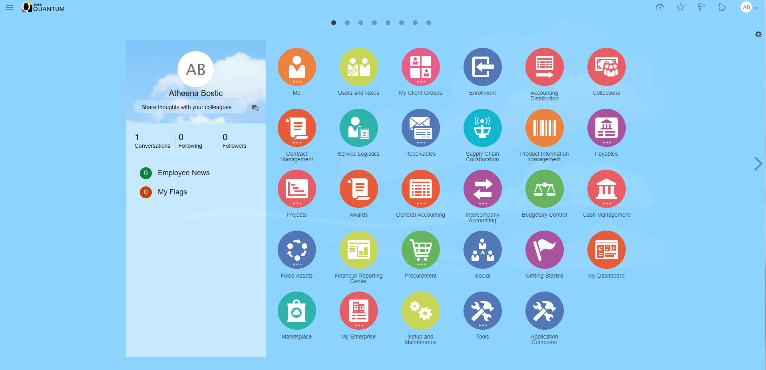
Quantum Home Page

Slide 4
Benefits of Quantum Chart of Accounts
The Account Combo allows for:
  Breaking transactions down to a more detailed level, which then means...
  More dynamic reporting
Two optional segments to support tracking activities
  Also enhances reporting across multiple types of funding sources, departments, or functions
Homepage resembles smartphone/app environment

Slide 5
Fund Accounting Basics

Slide 6
UMB Funding Structure – Key Concepts
Two Main Categories of Funds: Unrestricted and Restricted
Unrestricted:
UMB determines how funds will be used.
Examples of Unrestricted Funds:
  State Appropriations
  Revolving
  Auxiliary
Examples of how funds may be used:
  To fund job positions
  Instruction
  Facilities
  General Operations
Restricted:
A Third Party determines how the funds will be used.
Examples of Restricted Funds:
  Research Sponsors
  Donors
Example of how funds may be used:
  Research

Slide 7
Quantum Financials
Design and Important Concepts
Unrestricted/Nonsponsored Funds
  Select Account Combo
  Examples: State, Revolving, Auxiliary Enterprise
  Hereafter referred to as NONSPON
Restricted/Sponsored Funds
  Select Project
  Transferred to the General Ledger
  Examples: Grants, Contracts, Capital Projects
  Hereafter referred to as SPON

Slide 8
Quantum Financials
Design and Important Concepts (cont’d)
What does NONSPON vs. SPON mean to me?
  NONSPON transactions do not have a project number
  SPON transactions have a project number

Slide 9
Quantum Chart of Accounts
Quantum Account Combo
Object | Source | Organization | Activity | Purpose | Function | Unit | Future | Interfund
xxxx | xxx | xxxxxxxx | xxxxxx | xxxxxxxx | xxx | xx | xxxxx | xxx

Slide 10
NONSPON

Slide 11

NONSPON
Remember that NONSPON transactions are recorded directly into the General Ledger
  What does that mean?
The transactions include the accounting values that are used to record revenues, expenses, assets, liabilities, and net assets/equity.
These accounting values are defined in the Chart of Accounts.

Slide 12
Quantum Chart of Accounts
NONSPON
When NONSPON transactions are entered, the desired Account Combo is selected.
The following slides describe each of the segments that make up the Account Combo.

Slide 13
Quantum Segment
NONSPON
Object (4 characters)
  What it is:
Revenue
Expense
Assets
Liabilities
Net Assets
Quantum:
Object | Source | Organization | Activity | Purpose | Function | Unit | Future | Interfund
xxxx | xxx | xxxxxxxx | xxxxxx | xxxxxxxx | xxx | xx | xxxxx | xxx

Slide 14
Quantum Segment
NONSPON
Source (3 characters)
  Groups transactions according to how they are funded
    Identifies source of funds
    Example: State, Revolving, Auxiliary
Quantum:
Object | Source | Organization | Activity | Purpose | Function | Unit | Future | Interfund
xxxx | xxx | xxxxxxxx | xxxxxx | xxxxxxxx | xxx | xx | xxxxx | xxx
Notes:
Source includes PCBU eliminated in Quantum – included within Source
Duplicated in eUMB

Slide 15
Quantum Segment
NONSPON
Org (8 characters)
  Indicates a specialized functional area within UMB, usually a department.
Quantum:
Object | Source | Organization | Activity | Purpose | Function | Unit | Future | Interfund
xxxx | xxx | xxxxxxxx | xxxxxx | xxxxxxxx | xxx | xx | xxxxx | xxx

Slide 16
Quantum Segment
NONSPON
Activity (6 characters)
  Defined by University/ School/ Department
  Used to segregate and/or aggregate different activities for budget or other tracking purposes when they fall within a unique combination of Source, Org, and Function
  May be prescribed at the Dean/VP level
  Use for Activity may vary
  Default is 000000 if not defined
Object | Source | Organization | Activity | Purpose | Function | Unit | Future | Interfund
xxxx | xxx | xxxxxxxx | xxxxxx | xxxxxxxx | xxx | xx | xxxxx | xxx

Slide 17
NEW – Quantum Segment
NONSPON
Purpose (8 characters)
  Defined by University/ School/ Department
  Used to segregate and/or aggregate different activities for budget or other tracking purposes when they fall within a unique combination of Source, Org, and Function
  May be prescribed at the University level
  Use varies
  Default is 00000000 if not defined
Object | Source | Organization | Activity | Purpose | Function | Unit | Future | Interfund
xxxx | xxx | xxxxxxxx | xxxxxx | xxxxxxxx | xxx | xx | xxxxx | xxx
Notes:
Defaults to 0s
Use varies

Slide 18
Quantum Segment
NONSPON
Function (3 characters)
  Group expenses (and related revenues) according to the purpose for which the costs are incurred.
    The classifications tell why an expense was incurred rather than what was purchased.
  Examples: instruction, research, academic support
  See Function Definitions
Quantum:
Object | Source | Organization | Activity | Purpose | Function | Unit | Future | Interfund
xxxx | xxx | xxxxxxxx | xxxxxx | xxxxxxxx | xxx | xx | xxxxx | xxx

Slide 19
Quantum Segment
NONSPON
Unit (2 characters)
  Represents the entity that is required to issue a separate set of financial statement
  Currently not in use – value is always 00
Quantum:
Object | Source | Organization | Activity | Purpose | Function | Unit | Future | Interfund
xxxx | xxx | xxxxxxxx | xxxxxx | xxxxxxxx | xxx | xx | xxxxx | xxx

Slide 20
Quantum Segment
NONSPON
Future (5 characters)
  Reserved for potential future functionality
  Serves as a placeholder for now
  Currently not in use – value is always 00000
Object | Source | Organization | Activity | Purpose | Function | Unit | Future | Interfund
xxxx | xxx | xxxxxxxx | xxxxxx | xxxxxxxx | xxx | xx | xxxxx | xxx

Slide 21
eUMB Chartfield – Quantum Segment
NONSPON
Interfund (3 characters)
  Provides the offsetting transactions that are needed when activities cross Source so that Source can be the balancing segment
  Currently not in use – value is always 000
Object | Source | Organization | Activity | Purpose | Function | Unit | Future | Interfund
xxxx | xxx | xxxxxxxx | xxxxxx | xxxxxxxx | xxx | xx | xxxxx | xxx

Slide 22
Non-Sponsored Sources of Funds
NONSPON
SOAPF refers to the below portion of the full account combo. It is the fundamental identification of a Nonspon cost center/account.
Quantum:
S
O
A
P
F
Object | Source | Organization | Activity | Purpose | Function | Unit | Future | Interfund
xxxx | xxx | xxxxxxxx | xxxxxx | xxxxxxxx | xxx | xx | xxxxx | xxx

Slide 23
SPON

Slide 24
Project Portfolio Management (PPM)
SPON
PPM is the mechanism in Quantum for managing projects
  A project is a plan or method for achieving objectives
  There is a stated beginning and an end
  Thus, a project is temporary
PPM is used for sponsored projects, contracts, or grants (SPON)
Note that capital projects are also managed in PPM
  Accounting for capital projects is managed centrally and not included in this presentation

Slide 25
Project Portfolio Management (PPM)
SPON
Project values are transferred to the General Ledger so that the transactions can be recorded to the appropriate Chart of Account values.

Slide 26
eUMB Chartstring to Quantum Chart of Accounts
SPON
When SPON transactions are entered, the desired Attributes are populated. Most attributes will automatically fill based on the project set up.
The following slides describe each of the Attributes.

Slide 27
Project Attribute
SPON
Assigned only to grants, contracts or capital projects
Project Number | Task Number | Expenditure Type | Expenditure Organization | Contract Number | Funding Source
xxxxxxxx | X | xxxx | xxxxxxxx | xxxxxxx

Slide 28
Task Attribute
SPON
Defaults to ‘1’
Project Number | Task Number | Expenditure Type | Expenditure Organization | Contract Number | Funding Source
xxxxxxxx | X | xxxx | xxxxxxxx | xxxxxxx

Slide 29
Expenditure Type Attribute
SPON
Maps to the Object segment
Project Number | Task Number | Expenditure Type | Expenditure Organization | Contract Number | Funding Source
xxxxxxxx | X | xxxx | xxxxxxxx | xxxxxxx
Notes:
Remind them that Object is today’s Account (4-digit ‘bucket’ for expenses)
For this example – requisitions – the Expenditure Type maps in from the Category

Slide 30
Expenditure Organization Attribute
SPON
Identifies the department which entered a transaction
Project Number | Task Number | Expenditure Type | Expenditure Organization | Contract Number | Funding Source
xxxxxxxx | X | xxxx | xxxxxxxx | xxxxxxx

Slide 31
Contract Number Attribute
SPON
Populates from the Project
No entry required after entering Project
Some pages refer to this as “Award”
Project Number | Task Number | Expenditure Type | Expenditure Organization | Contract Number | Funding Source
xxxxxxxx | X | xxxx | xxxxxxxx | xxxxxxx

Slide 32
Funding Source Attribute
SPON
Organization which provides the funds – today’s Sponsor
EX: External Sponsor (sponsor name) or committed cost sharing (CCS) or over the salary cap (OTC)
Alpha field associated with the project set up/Contract Number
Project Number | Task Number | Expenditure Type | Expenditure Organization | Contract Number | Funding Source
xxxxxxxx | X | xxxx | xxxxxxxx | xxxxxxx

Slide 33
Recap: Sponsored (SPON) Attributes
SPON
POETAF
  • P – Project
  • O – (Expenditure)Organization (transaction department)
  • E – Expenditure Type (maps to COA Object)
  • T – Task (default to 1)
  • A – Award/Contract (will populate from Project)
  • F – Funding Source (populate based on the Contract/Award)
Project Number | Task Number | Expenditure Type | Expenditure Organization | Contract Number | Funding Source
xxxxxxxx | X | xxxx | xxxxxxxx | xxxxxxx

Slide 34
Mapping PPM Costs to General Ledger
Revenues and expenses related to many projects and awards will be mapped to the same COA Account Combo
Example: 3 Projects belong to Owner Org 10417050
PPM:
Project Numbers: PPM Org: Expenditure Type:
10015502 10408120 3135
10015571 10417053 3210
10021882 10417020 3311
General Ledger:
Project Numbers: Org: Object:
None 10417050 3135
None 10417050 3210
None 10417050 3311
Notes:
Quantum Analytics replaces RAVEN Financials Inquiry pages

Slide 35
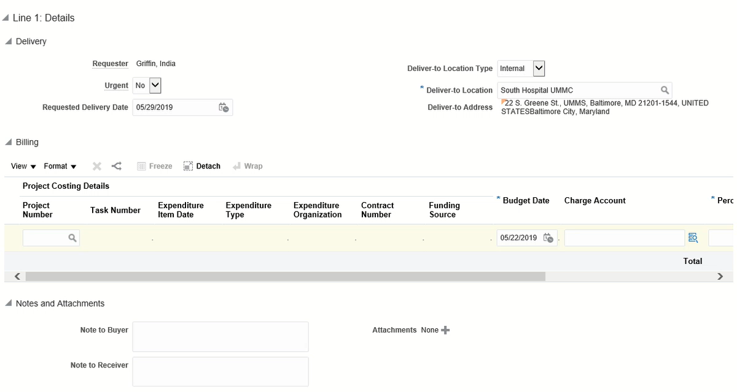
POETAF (SPON/Project)
SPON

Slide 36
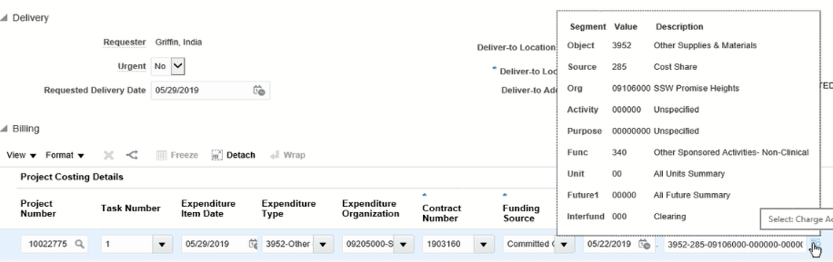
‘POETAF’ in PPM Subledger is Translated to ‘SOAPF’ in the General Ledger
SPON
A system process will generate and post the related SOAPF
in the General Ledger.

