Slide 1
UMB Institutional Learning Outcomes:
Why Interprofessional Education
Heather B Congdon, PharmD, BCPS, CDE, FNAP
Co-Director, Center for Interprofessional Education
School of Pharmacy

Slide 2
UMB Institutional Learning Outcomes
Interprofessional Education (IPE)
Community Engagement
Global Engagement and Education
Leadership
Cultural Competency (Diversity, Equity, and Inclusion)
Ethics and Integrity

Slide 3

Outline – IPE
Drivers for IPE
  Accreditation standards for schools at UMB
  Many UMB schools have IPE learning outcomes
  UMB Strategic Plan and Center for IPE
  USM Workforce Report
  National educational competencies specific to IPE
Example IPE Initiatives at UMB
  Buckets of IPE
  Highlight IPE opportunities from each bucket
Next Steps for IPE at UMB and Need for ILO
  Formal website designated to house all IPE activities at UMB
  Tiered digital badging for IPE
  Stakeholders
  Example ILO for IPE

Slide 4
Driver for IPE: Accreditation Standards
Most accreditation standards for UMB disciplines now require or strongly encourage interprofessional education and practice as part of their didactic and experiential curriculum.
Example – Pharmacy
  The curriculum prepares all students to provide entry-level, patient-centered care in a variety of practice settings as a contributing member of an interprofessional team. In the aggregate, team exposure includes prescribers as well as other healthcare professionals.
    11.1. Interprofessional team dynamics – All students demonstrate competence in interprofessional team dynamics, including articulating the values and ethics that underpin interprofessional practice, engaging in effective interprofessional communication, including conflict resolution and documentation skills, and honoring interprofessional roles and responsibilities. Interprofessional team dynamics are introduced, reinforced, and practiced in the didactic and Introductory Pharmacy Practice Experience (IPPE) components of the curriculum, and competency is demonstrated in Advanced Pharmacy Practice Experience (APPE) practice settings.
    11.2. Interprofessional team education – To advance collaboration and quality of patient care, the didactic and experiential curricula include opportunities for students to learn about, from, and with other members of the interprofessional healthcare team. Through interprofessional education activities, students gain an understanding of the abilities, competencies, and scope of practice of team members. Some, but not all, of these educational activities may be simulations.
    11.3. Interprofessional team practice – All students competently participate as a healthcare team member in providing direct patient care and engaging in shared therapeutic decision-making. They participate in experiential educational activities with prescribers/student prescribers and other student/professional healthcare team members, including face-to-face interactions that are designed to advance interprofessional team effectiveness

Slide 5
Driver for IPE: UMB School Learning Outcomes
Discipline | School-Based Student Learning Outcome(s)
Nursing | PhD: Design, conduct, analyze, and disseminate research findings to expand knowledge in nursing and related disciplines Graduates will Initiate, facilitate, and participate in interdisciplinary research with nurses and scholars from related disciplines
 | DNP: Graduates will initiate, facilitate, and participate in collaborative efforts that influence health care outcomes with scholars, practitioners, clinicians, and policy makers from other disciplines
 | MSN: Graduates will lead evidence-based and interprofessional approaches for the design and delivery of comprehensive, culturally competent care to individuals/families, communities, and populations Graduates will practice advanced nursing roles in collaborative relationships across disciplines and in partnership with communities (i.e. nursing education, nursing administration, nursing informatics, advanced clinical practice, and clinical nursing leadership)
 | BSN: Graduate will employ interprofessional communication and collaboration to ensure safe, quality care across the lifespan.
Medicine | 3.8 Participate in the education of patients, families, students, trainees, peers and other health professionals 4.2 Communicate effectively with colleagues within one's profession or specialty, other health professionals, and health related agencies 4.3 Work effectively with others as a member or leader of a health care team or other professional group 4.4 Act in a consultative role to other health professionals 6.2 Coordinate patient care within the health care system relevant to one's clinical specialty 7.1 Work with other health professionals to establish and maintain a climate of mutual respect, dignity, diversity, ethical integrity, and trust 7.2 Use the knowledge of one’s own role and the roles of other health professionals to appropriately assess and address the health care needs of the patients and populations served 7.3 Communicate with other health professionals in a responsive and responsible manner that supports the maintenance of health and the treatment of disease in individual patients and populations 7.4 Participate in different team roles to establish, develop, and continuously enhance interprofessional teams to provide patient- and population-centered care that is safe, timely, efficient, effective, and equitable
Pharmacy (PharmD) | TPO 33 – the PharmD graduate will be able to: Actively participate as an interprofessional healthcare team member by demonstrating mutual respect, understanding, and values to meet patient care needs
Dental | 2-20: Graduates must be competent in communicating and collaborating with other members of the health care team to facilitate the provision of health care.
Dental Hygiene | 2-15: Graduates must be competent in communicating and collaborating with other members of the health care team to support comprehensive patient care.
Medical Laboratory Science | Graduates will be able to grow professionally, maintain high standards of achievement and interact appropriately with other health care practitioners.
Master’s Genetic Counseling | MGC students will understand how to engage with other health care professionals to provide quality holistic patient care.
Masters Public Health | Perform effectively on inter-professional teams
Physical Therapy | N/A
Masters Social Work | N/A
Law | N/A

Slide 6
UMB Strategic Plan and Center for IPE
UMB Strategic Plan
Collaborate internally and externally to provide impactful education, services, and expertise to benefit Maryland and society at large.
A demonstrated commitment to interdisciplinary faculty development to spotlight, celebrate, and scale exemplary pedagogical approaches.
Additional interdisciplinary centers of excellence that fully leverage the expertise of the UMB faculty across schools and programs.
UMB Center for IPE
Mission is to prepare health, law, and human services professionals to work collaboratively on interprofessional teams focused on improving the lives of people locally, nationally, and globally.

Slide 7

Driver for IPE: USM Workforce Report
USM Board of Regents and then Chancellor Robert Caret convened Health Care Workforce Working Group to investigate the following.
  The role of USM in preparing highly trained healthcare workforce for the state
  Recommend ways to enhance the quality of our academic programs.
Four areas of urgency were identified.
  Nursing articulation and collaboration
  Clinical partnerships and placements
  Interprofessional education
  Simulation facilities
IPE-Specific Recommendations
  Scale effective IPE programs System-wide
  Support IPE research and scholarship within USM

Slide 8


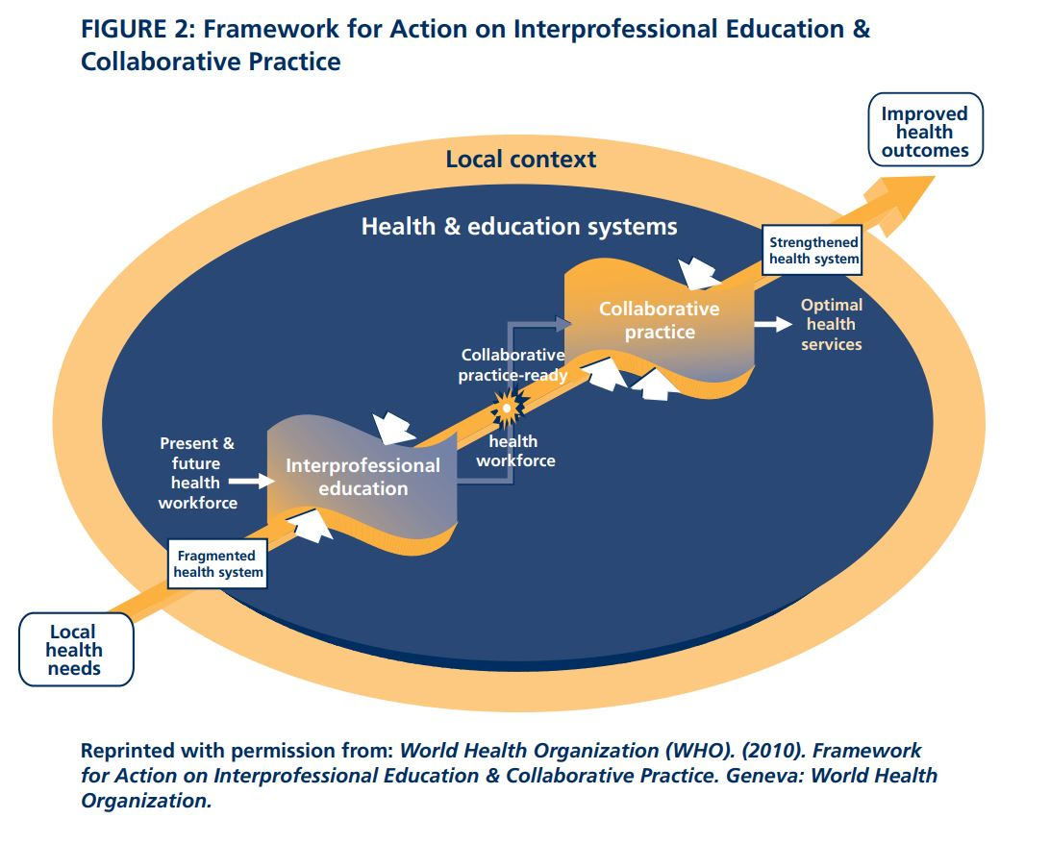
Driver for IPE:
IPEC Competencies
Created and supported by associations including:
  American Association of College of Pharmacy
  American Association of Colleges of Nursing
  American Dental Education Association
  Association of American Medical Colleges
  Association of Schools and Programs of Public Health
  American Council of Academic Physical Therapy (ACAPT)
  Council on Social Work Education (CSWE)
  Physician Assistant Education Association (PAEA)
Four competency domains
  Roles and Responsibilities
  Values and Ethics for Interprofessional Practice
  Interprofessional Communication
  Teams and Teamwork

Slide 9
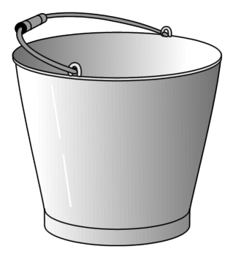
“Buckets” of IPE
EXPOSURE
IMMERSION
COMPETENCE

Slide 10
Example IPE Exposure Opportunity
Foundations of Interprofessional Education and Practice
Two Tracks
  Track 1: Pharmacy, Nursing (CNL and BSN), Medicine, Dental, Dental Hygiene, Physical Therapy
  Track 2: Law, Public Health, Social Work
Track 1 (~940 students enrolled = 75 groups)
  One credit hour of content over 2 semesters
  Four modules (2 in fall / 2 in spring)
  Each module highlights one of the four IPEC Competency domains
  Each module includes individual learning followed by group assignment and meeting with group faculty facilitator.

Slide 11
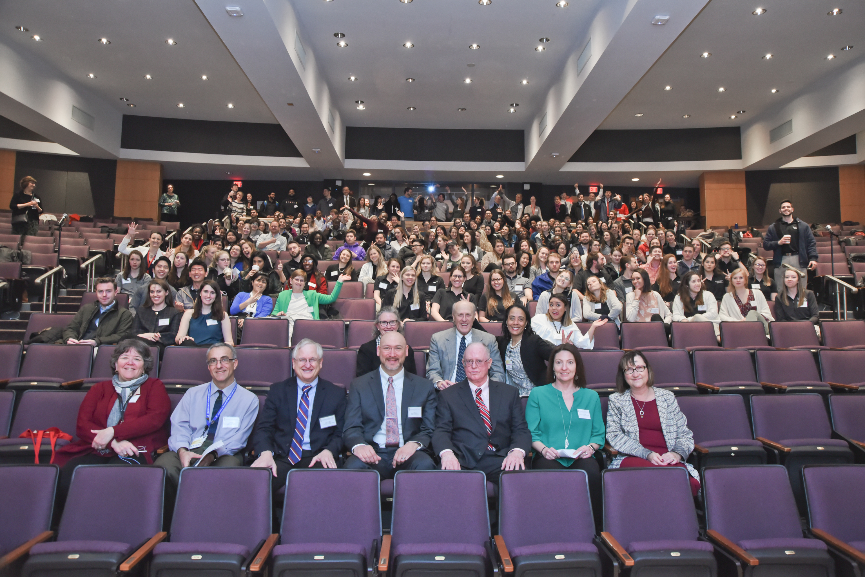
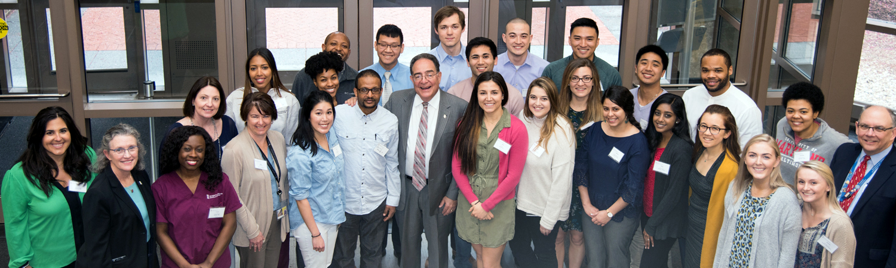
Example IPE Immersion Opportunity
IPE Day
Annual half day event open to all students on campus
Usually draws 200-300 students per year
Applies concepts learned in the “Foundations” course to a simulated patient case
Students placed in groups work with standardized patients to solve patient case scenarios/problems

Slide 12
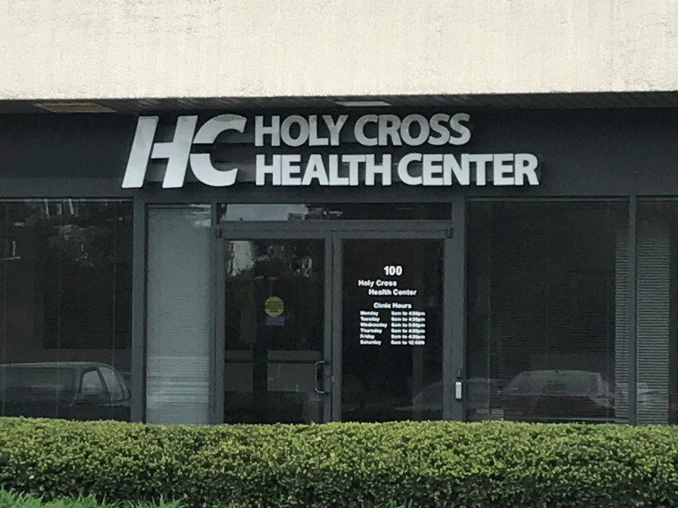
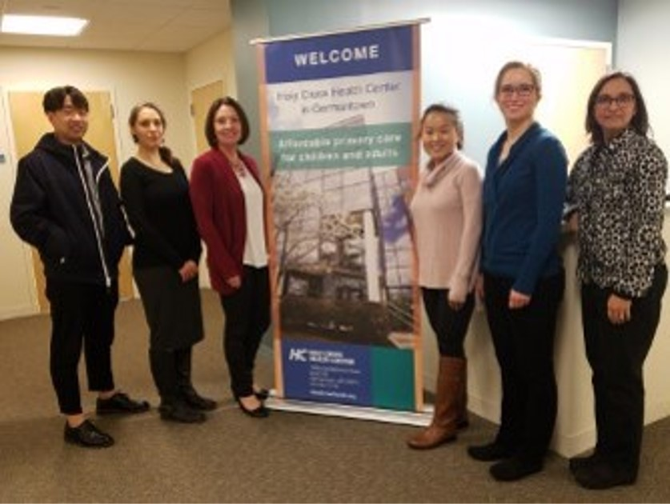
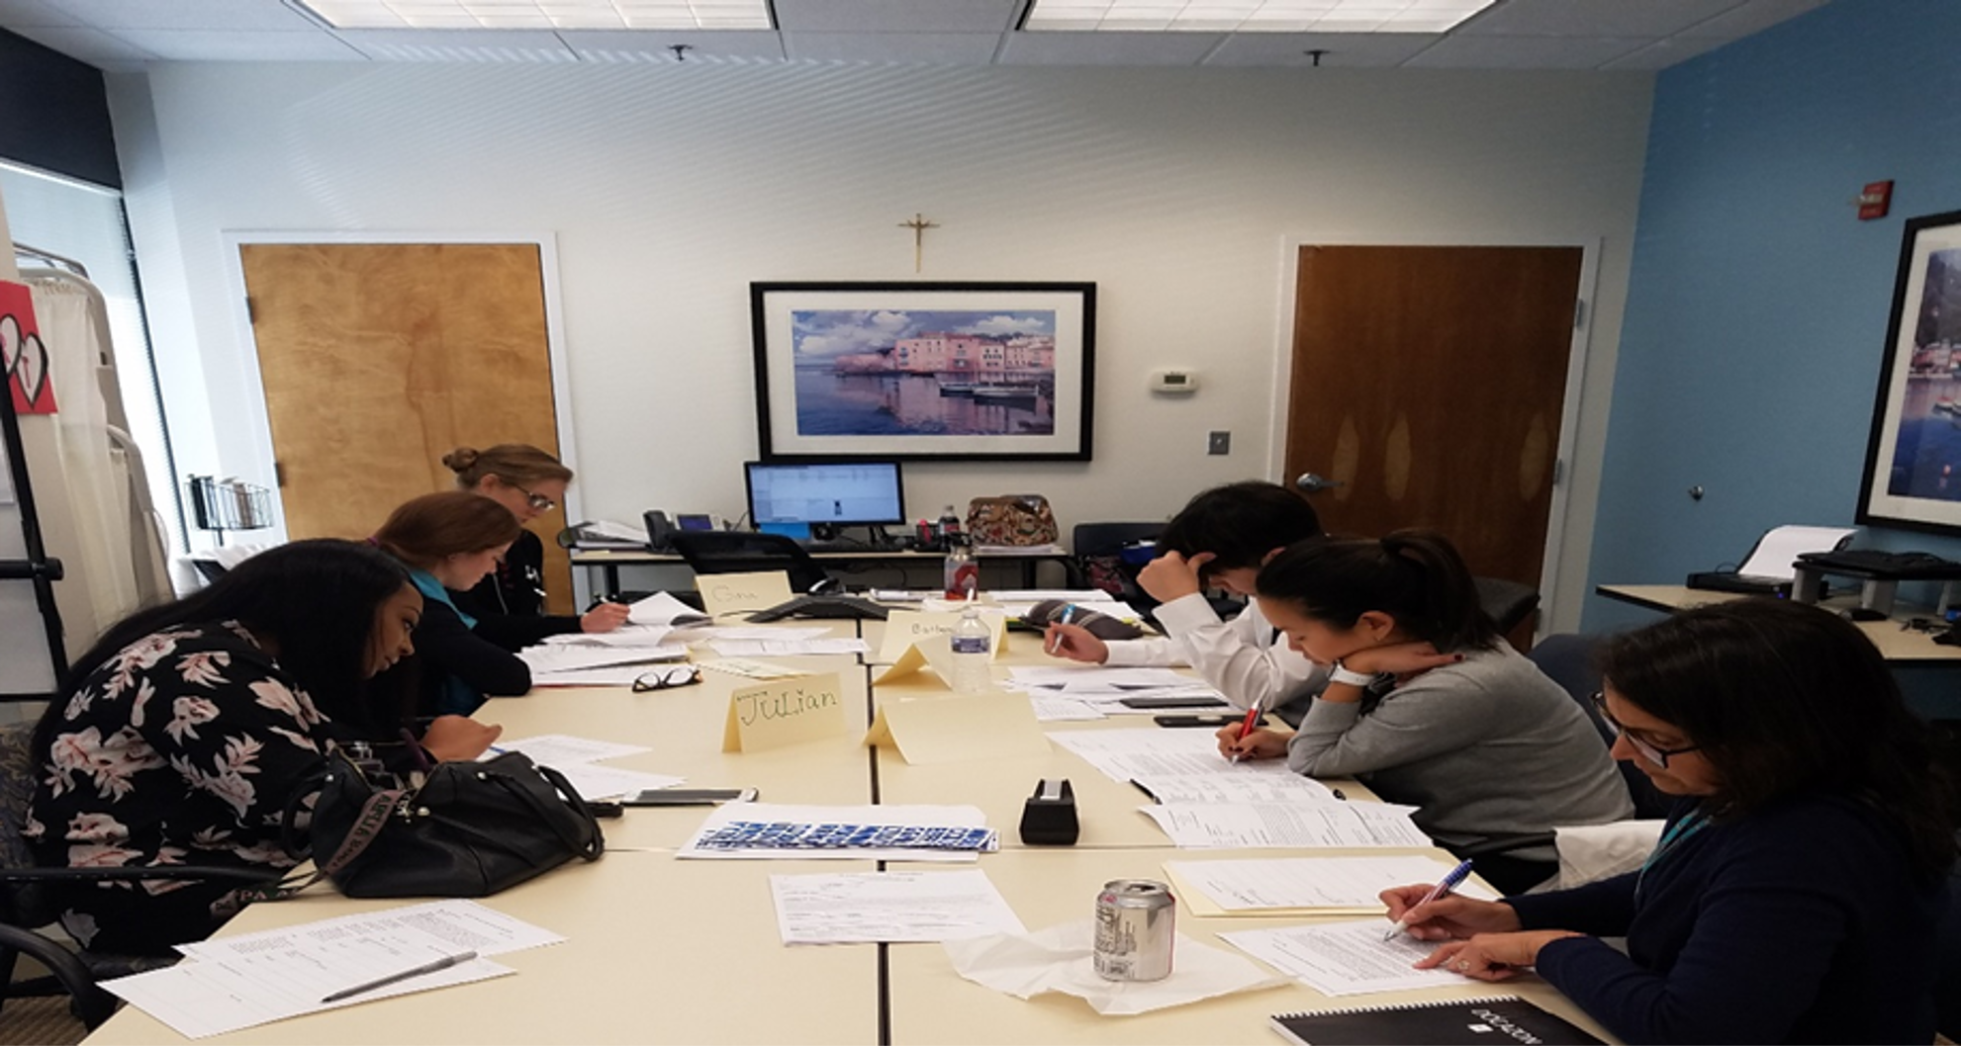
Example IPE Clinical Competence Opportunity
IPE Team Care Clinic
Goals
  To enhance and expand care for medically complex, uninsured, ethnically diverse patients through coordinated interprofessional care.
  To educate and train healthcare professional students from pharmacy, nursing, and social work programs at the University of Maryland, Baltimore (UMB) to efficiently and effectively provide coordinated care through mastery of the Interprofessional Education Collaborative (IPEC) Core Competencies for Interprofessional Practice.
Disciplines represented
  Pharmacy
  Nursing (DNP / FNP)
  MSW
  Dietetics (UMCP)
Examples of interventions made by IPE Clinic
  Medication and chronic condition education
  Medication adjustment to reach therapeutic goals
  Enhanced access to medication, food and clothes
  Referrals to specialty clinics, screening, etc.

Slide 13
IPE Team Care Clinic Outcomes
Student Outcomes: Teams Skills Scale
Please rate your ability to carry out each of the following tasks | N Pre | N Post | P Value
Function effectively in an interdisciplinary team | 56 | 34 | 0.0990
Treat team members as colleagues | 55 | 34 | 0.1099
Identify contributions to patient care that different disciplines can offer | 56 | 34 | 0.0003
Apply your knowledge of geriatric principles for the care of older persons in a team care setting | 56 | 34 | 0.0172
Ensure that patient/family preferences/goals are considered when developing the team's care plan | 56 | 34 | 0.1003
Handle disagreements effectively | 56 | 34 | 0.0609
Strengthen cooperation among disciplines | 56 | 34 | 0.0020
Carry out responsibilities specific to your discipline's role on a team | 56 | 33 | 0.0063
Address clinical issues succinctly in interdisciplinary meetings | 56 | 34 | 0.0111
Participate actively at team meetings | 56 | 34 | 0.0136
Develop an interdisciplinary care plan | 54 | 34 | 0.0005
Adjust your care to support the team goals | 56 | 34 | 0.0070
Develop intervention strategies that help patients attain goals | 55 | 34 | 0.0069
Raise appropriate issues at team meetings | 55 | 34 | 0.0252
Recognize when the team is not functioning well | 55 | 34 | 0.0252
Intervene effectively to improve team functioning | 56 | 34 | 0.0202
Help draw out team members who are not participating actively in meetings | 55 | 34 | 0.0017
Patient Outcomes | N
 |  | Mean Scores and T-test Dependent Samples Analysis
 |  | Mean (SD*) Pre-score | Mean (SD*) Post-score | Mean Change | P Value
Hemoglobin A1c (%) | 38 | 11.1 ± 2.2 | 8.9 ± 2.1 | - 2.2 | < .001
Systolic Blood Pressure (mm Hg) | 45 | 129.3 ± 15 | 124.8 ± 13.1 | -4.5 | .033
Diastolic Blood Pressure (mm Hg) | 45 | 76.6 ± 8.3 | 72.9 ± 9.2 | -3.1 | .078
Body Mass Index (kg/m²) | 44 | 31.14 ± 7.5 | 30.88 ± 7.3 | -0.26 | .215

Slide 14
Next Steps
UMB Center for IPE looking to institute a comprehensive repository website for all IPE opportunities on campus (accessible to all students and faculty).
Working with USM Kirwan Center for Academic Innovation to institute a system-wise three tiered IPE digital badging process.

Slide 15
Stakeholders and Example IPE ILO
Suggested Stakeholders for IPE ILO
School-based academic deans
School-based curriculum committees
UMB Center for IPE
Example IPE ILO for UMB
Through a climate of mutual respect, diversity, ethical integrity and trust, graduates will employ effective communication and collaboration strategies, as well as the complementary abilities of all members of the interprofessional team in order to optimize patient-centered and community-focused care.

