Slide 1
APAIR Progress Report Guidance & FY25 Updates
Karen Matthews, DM
Gregory Spengler, MPA
Institutional Effectiveness, Strategic Planning & Assessment (IESPA)
Provost Office
July 17, 2024
Session #2

Slide 2
Meeting Objectives
Update
General update
Discuss
APAIR progress reporting and new requirements
Unit requirements, timeline & next steps
Review

Slide 3

Information Sharing
MSCHE updates
  Self-Study status
    Upcoming Information Sessions

Slide 4
The APAIR and Its Impact on Reaccreditation
Compliance with MSCHE Standard V - Educational Effectiveness Assessment
  Demonstrate UMB’s best efforts at standardizing program evaluation and assessment reporting.
Improves institutional accountability and transparency
Helps inform strategic planning priorities.
Reduces redundancy in our campus community.
Notes:
Speak again about why we are undertaking the APAIR as an institutional initiative.

Slide 5
Academic Program Assessment & Improvement Report
(APAIR)
Notes:
Karen

Slide 6
APAIR Status
FY24 APAIRs
  108 Programs (Degree/Certificates)
  54 FY24 APAIRs (IESPA-Reviewed)
  8 FY24 APAIRs (Other Status)
    # of Improvements planned by Category: Total Goals = 164
Goal Type/School | SOD | GS | CSL | SOM | SON | SOP | SSW | Total
Institutional Learning Outcome (ILO) |  | 17 | 5 | 3 |  |  | 1 | 26
Program Operations (PO) |  | 28 | 8 | 3 | 7 |  |  | 46
Program Performance Indicator (PPI) | 27 | 24 | 3 | 10 | 4 | 2 |  | 70
Student Learning Outcome (SLO) |  | 11 |  | 3 | 2 |  | 1 | 17
Other (O) – Not defined |  | 3 |  | 2 |  |  |  | 5
Total | 27 | 83 | 16 | 21 | 13 | 2 | 2 | 164
Notes:
For the first full year of the APAIR, we have 60 APAIR reports covering 108 degree or certificate programs.
Thank you.

Slide 7
ANNUAL Program Assessment & Improvement report (Apair)
Year-End Progress Report
Notes:
To wrap up the first year of progress, we will review the requirements for year-end reporting.

Slide 8
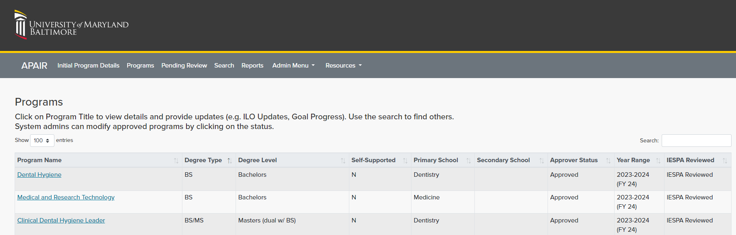
PROGRAMS
Notes:
Upon signing into the APAIR, will see programs for which you have access rights.

Slide 9
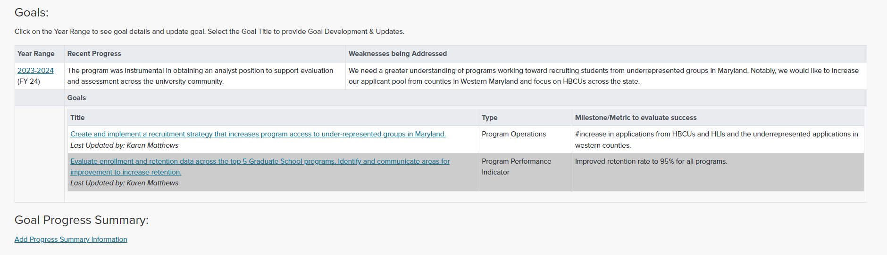
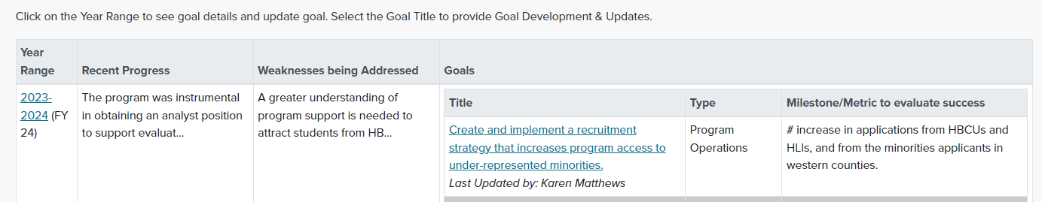
ADD GOAL PROGRESS FOR FISCAL YEAR
Notes:
The goals assigned to your program will be listed accessible when clicking the FY Link.
This program has two goals.

Slide 10
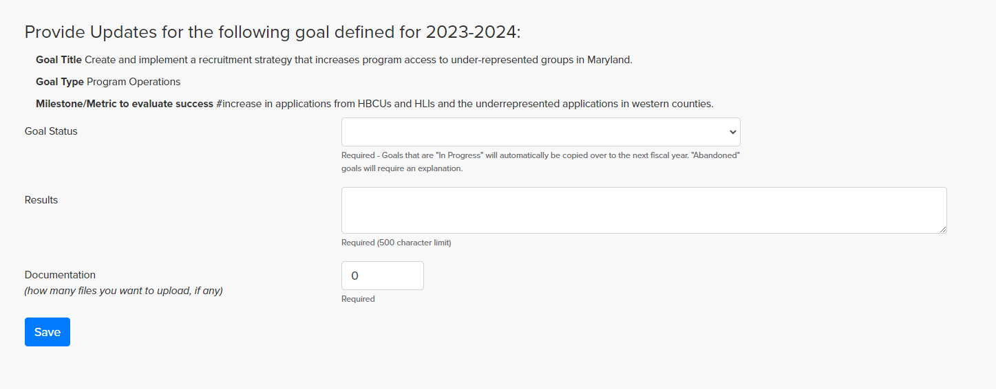
PROVIDE GOAL UPDATE
Notes:
Choose a goal to begin providing the year-end update.

Slide 11
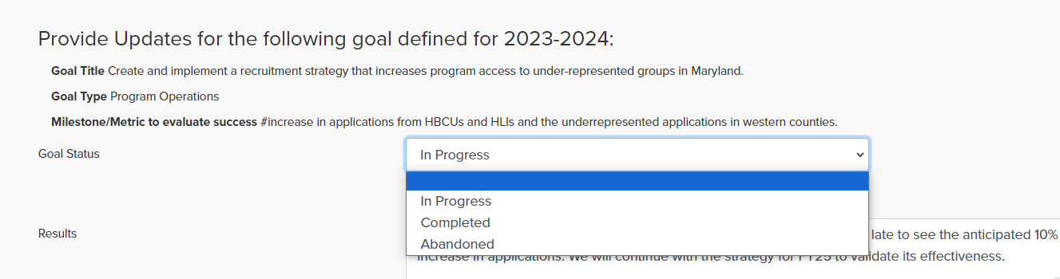
PROVIDE GOAL UPDATE
Notes:
Selection question begins with choosing the status of the goal on June 30, 2024.

Slide 12
Progress Reporting – Goal Status Explained
Goal Status Explained/Resulting Action
  In Progress: The goal did not achieve stated outcome(s); will carryover to next progress report period
  Completed: The goal is 100% complete and metrics achieved; no carryover
  Abandon: The goal canceled with explanation; no carryover
  ***For All goals where results are not known by Progress Report Due Date (i.e., July 31 for the period ending June 30) , report as “In Progress”, with results to be tracked in next fiscal year.***
Notes:
Three options to choose from.
Major program change resulted in the ability to choose the option “In progress”. This option allows the goal to move forward to the next fiscal year and to be updated in the new plan year if results are not known (likely for PPIs).

Slide 13
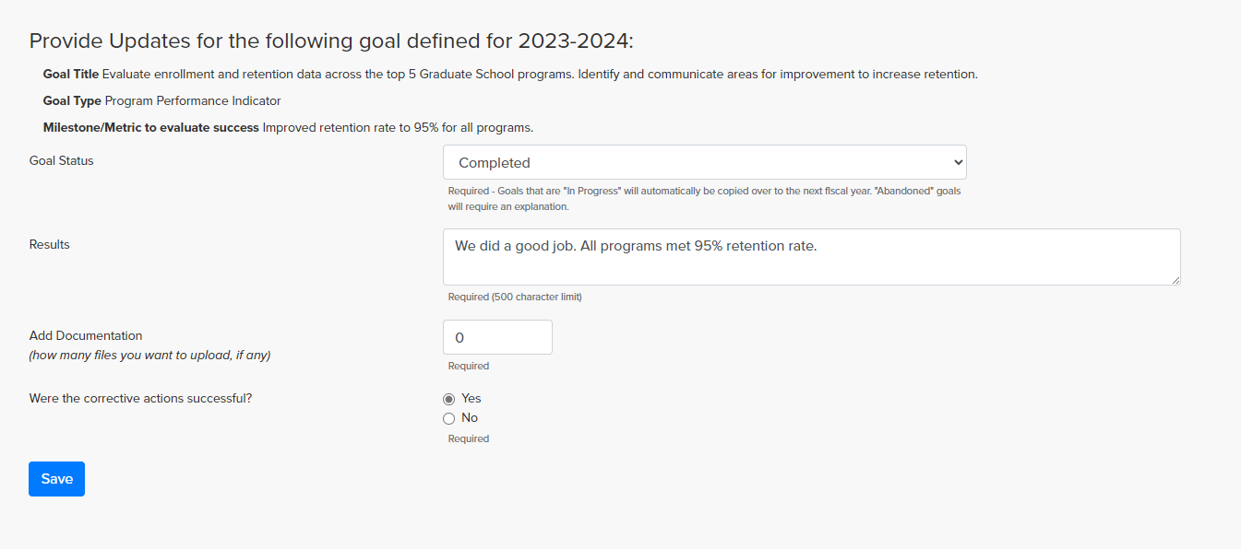
PROVIDE GOAL UPDATE
Notes:
For the second goal, I set the status to complete.

Slide 14
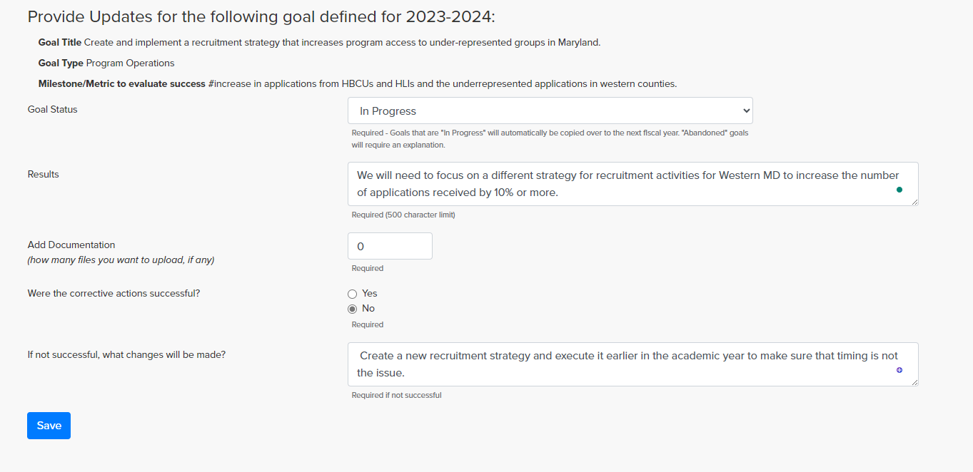
PROVIDE GOAL UPDATE
Notes:
For the first goal, I set the status to In progress to show how the APAIR treats each condition.

Slide 15
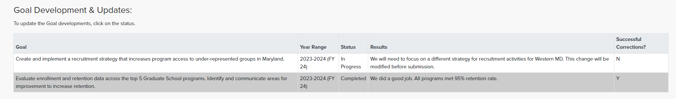
GOALS BY STATUS
OUTPUT for FY 24
Notes:
The summary here shows the current status of the FY24 goals.

Slide 16
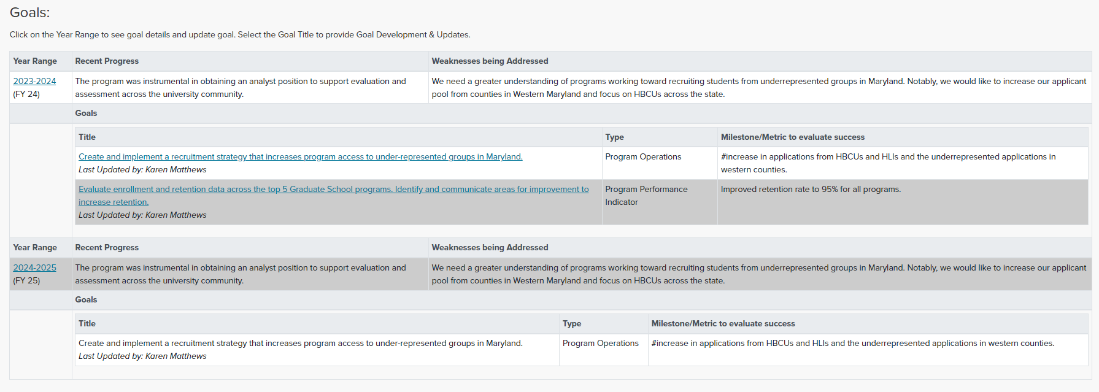
GOALS BY STATUS
Notes:
This slide shows that the “In Progress” goal has now been copied into FY25, along with other information (that is updatable elsewhere.)

Slide 17
ANNUAL Program Assessment & Improvement report (Apair)
Preparing the FY25 APAIR Improvement Plan
Notes:
To wrap up the first year of progress, we will review the requirements for year-end reporting.

Slide 18
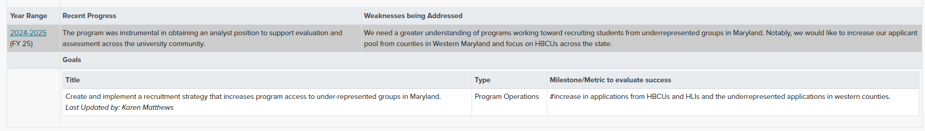
FY 2025 Goals/Improvement Plan

Slide 19
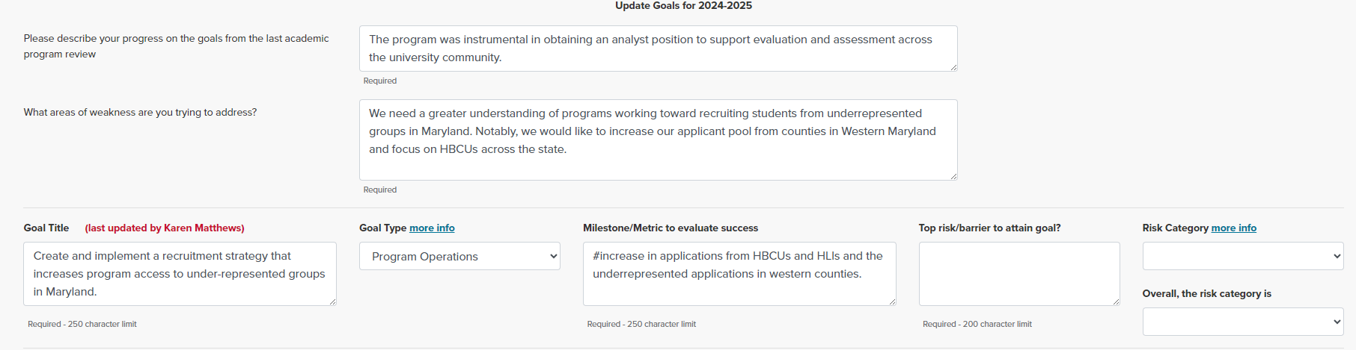
FY 2025 Goals/Improvement Plan
New

Slide 20
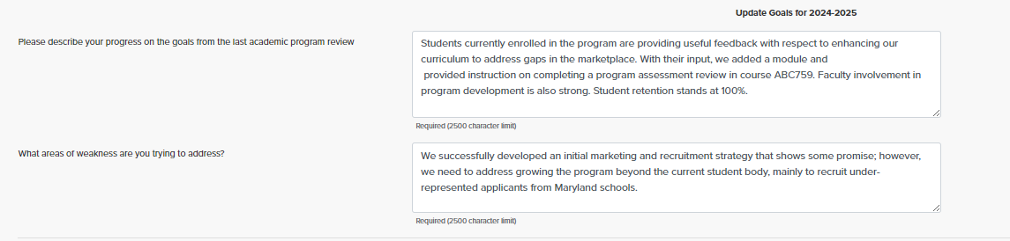
PROVIDE SUMMARY FOR FISCAL YEAR & ADD NEW GOALS
Notes:
Note that the previous year’s “Summary of Progress” and “WEAKNESSES BEING ADDRESSED” carry over from the fiscal year; PLEASE UPDATE BOTH WITH THE NEXT FISCAL YEAR’S (I.E., FY25) AS I HAVE DONE.

Slide 21
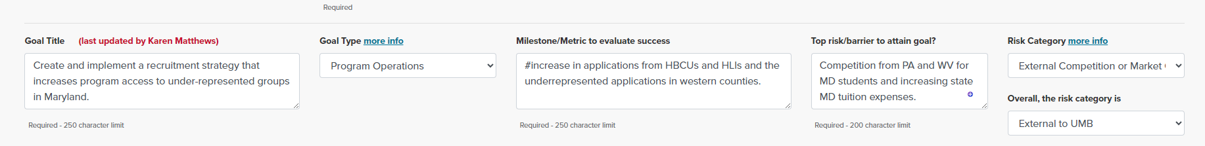
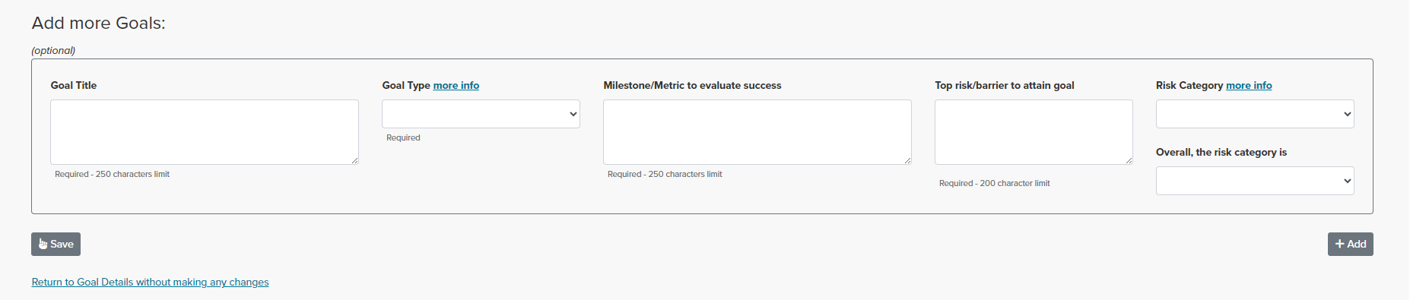
FY 2025 Goals/Improvement Plan
New

Slide 22
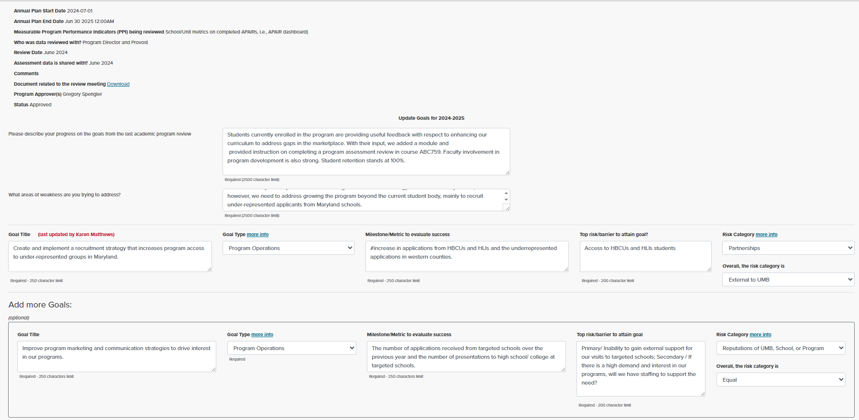
ADD RISK EVALUATION
Notes:
Victoria, would you like to add any additional information for units completing the goal evaluation of risks?
1000 characters.

Slide 23
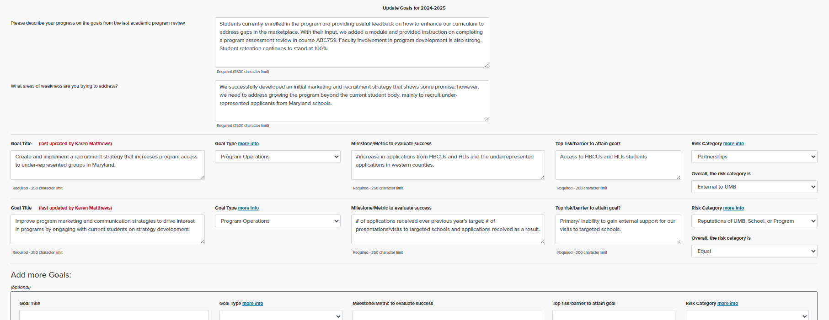
ADD GOALS FOR NEW FISCAL YEAR
Notes:
Note that the goal marked as “In progress” carried over.

Slide 24
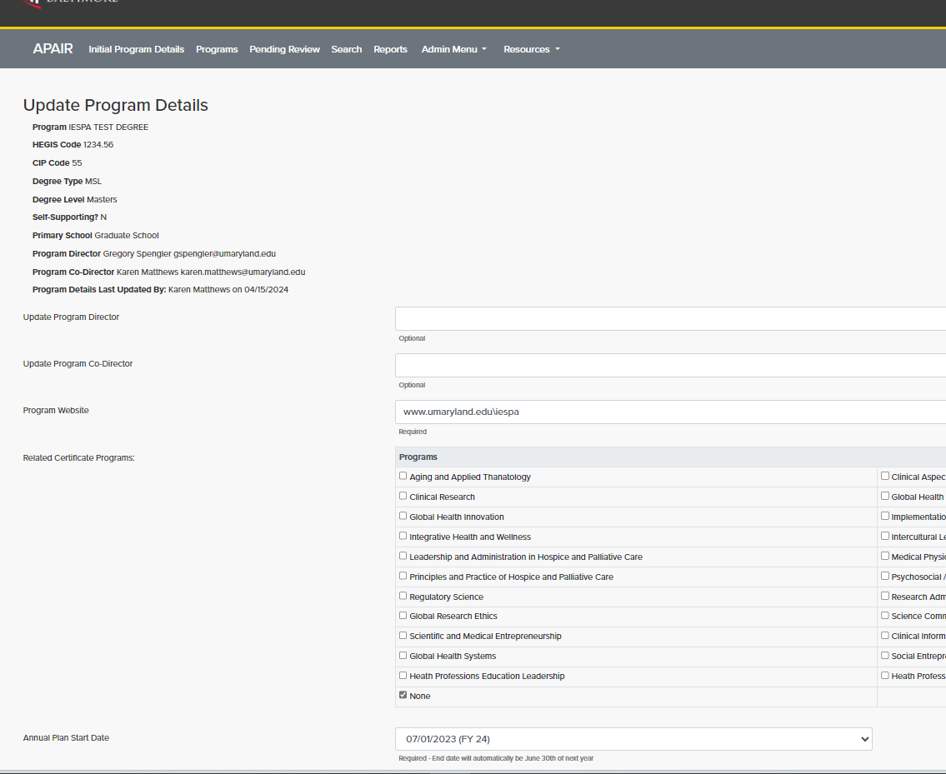
Program Details
Notes:
Please confirm your program details, i.e., Program Director, website, Related Certificates covered under this APAIR - DO NOT CHANGE THE ANNUAL PLAN START DATE –
Recognize that when the Program Details information is changed, it will filter down to all APAIRS regardless of the fiscal year, therefore, please print your FY24 APAIR final report before changing Program Details (if they change).

Slide 25
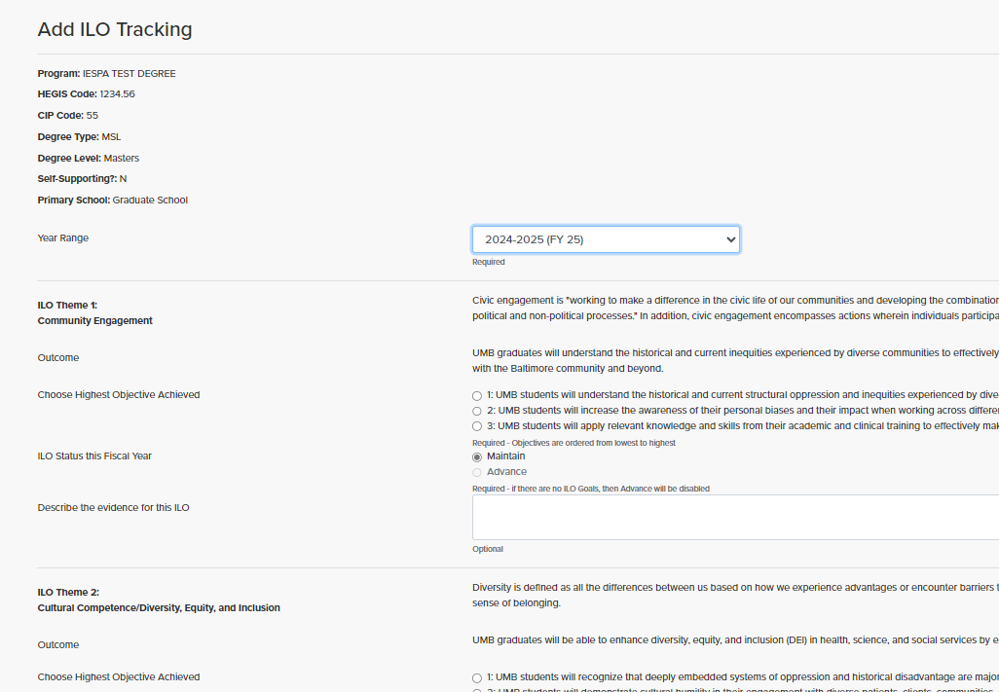
UPDATE ILO MODULE
Notes:
Remember to update your ILO status for the fiscal year 24-25

Slide 26
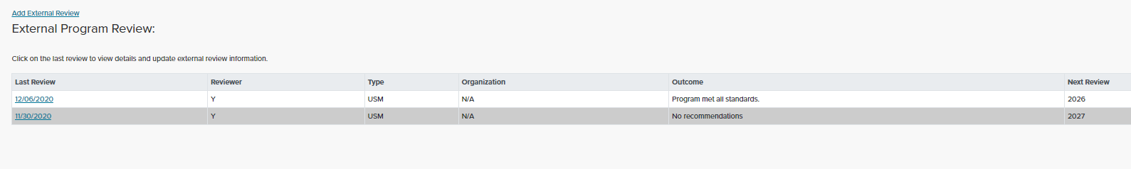
UPDATE EXTERNAL REVIEW MODULE
Notes:
Remember to update your ILO status for the fiscal year 24-25

Slide 27
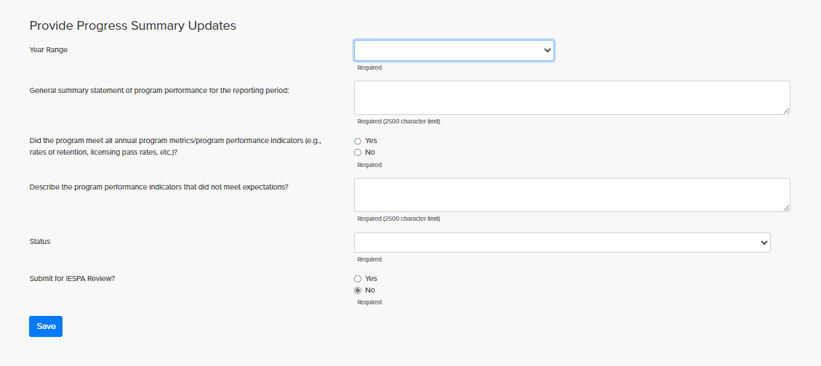
ADD PROGRESS SUMMARY UPDATE AND STATUS OF PPIs
Notes:
Choose a goal to begin providing the year-end update.

Slide 28
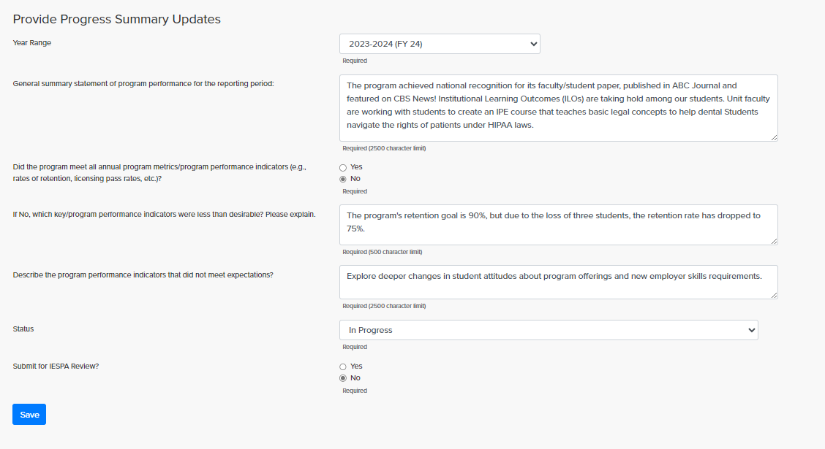
ADD PROGRESS SUMMARY UPDATE FOR PPIs
Notes:
Choose a goal to begin providing the year-end update.

Slide 29
PROGRAM SUMMARY
Provide the following information:
General summary statement of program performance for the reporting period
  Ex: The program achieved national recognition for its faculty/student paper, published in ABC Journal and featured on CBS News! Institutional Learning Outcomes are taking hold among our students. Unit faculty are working with students to create an IPE course that teaches basic legal concepts to help dental students navigate patient rights around HIPAA laws.
Answer:
    Did the program meet all annual program metrics/program performance indicators (e.g., rates of retention, licensing pass rates, etc.)? YES/N0
    If No, which key/program performance indicators were less than desirable? Please explain.
      Response: Program retention goal is 90%; we lost 3 students resulting in a retention rate of 75%
    What areas of improvement for PPIs will be addressed in the next reporting period?
      Explore deeper changes in student attitudes about program offerings and new employer skills requirements
Notes:
Activities that occurred outside the goalsetting period.
Program achieved national recognition for its faculty/student paper published in ABC journal and featured on CBS news! Institutional Learning Outcomes are taking hold among our students. Unit faculty are working with students to create an IPE course that teaches basic legal concepts to help dental students navigate patient rights around HIPAA laws.

Slide 30
Steps to Complete
Complete the Annual Progress Report for FY24.
Complete the FY25 Annual Improvement Plan and review modules.
Unit Approver reviews.
  System closes for updates on August 15, 2024.

Slide 31
FY 2025 APAIR Improvements
Alignment with Enterprise Risk Evaluation System (ERM)
Ability to Transfer Incomplete Goals to Next FY
Adjusted Completion Schedule
31

Slide 32

REVIEW
IESPA opened APAIR for Progress Reporting and FY 25 Improvement Plans/Goals on April 22, 2024.
IESPA updates APAIR Guidance and posts under Resources tab.
DUE: July 31, 2024 : 11:59PM
Close system for reporting on August 15, 2024
Prepare system report for Provost/Deans – October 2024

Slide 33
For More Information
www.umaryland.edu/iespa
Email: UMBAssessment@umaryland.edu
Contacts:
Karen Matthews karen.matthews@umaryland.edu 6-2422
Greg Spengler gspengler@umaryland.edu 6-1264

