Slide 1
Ad-PAIR Overview
Student Affairs Pilot Review
Karen D Matthews, DM, MPA
Gregory Spengler, MPA
Office of Institutional Effectiveness, Strategic Planning, & Assessment (IESPA)
October 29, 2024

Slide 2
Meeting Objectives
HIGHLIGHT
IESPA and Assessment Practices Justification
INTRODUCE
Student Affairs Role/ Ad-PAIR Pilot / Schedule
Ad-PAIR History and Purpose
DISCUSS

Slide 3
Institutional Effectiveness
&
Assessment
The Office of Institutional Effectiveness, Strategic Planning, & Assessment (IESPA)
  Main Functions
    Institutional Research
    Institutional Reporting
    Institutional Assessment
    Accreditation Liaison (Middle States Commission on Higher Education [MSCHE])
Initiatives/ Processes/ Systems Managed
  Strategic Planning (SPIMS)
  Academic Program Assessment and Improvement Reporting (APAIR)
    Institutional Learning Outcomes (ILOs)
  Administrative Program Assessment and Improvement Report (Ad-PAIR)
Notes:
Some background about our office

Slide 4
Academic Program Assessment & Improvement Report
(APAIR)
Notes:
Predecessor Initative -

Slide 5
The APAIR and Its Role in Reaccreditation and Continuous Improvement
Compliance with MSCHE Standard V - Educational Effectiveness Assessment “…the institution’s students have accomplished educational goals consistent with their program of study, degree level, the institution’s mission, and appropriate expectations for institutions of higher education.”
  Demonstrate UMB’s best efforts at standardizing program evaluation and assessment reporting.
  Document assessment activities at the school/academic program levels
Promote strategic and operational planning
Continuously improve
Notes:
The Office of Institutional Effectiveness, Strategic Planning, and Assessment, in conjunction with the Center for Information Technology Services, developed the Academic Program Assessment and Improvement Report (APAIR) to facilitate the documentation of assessment activities at the school and program level and to advance UMB's culture of assessment to continuously improve.
Driven by a few factors: Accreditation Compliance; developing a culture of assessment by relying on the assumption that UMB wants to continuously improve.

Slide 6
APAIRs Status
2024-2025
  101 (Degree and Certificate Offerings)
    65: Approved & IESPA-Reviewed
    3: Programs Discontinued
    2: APAIR Not Initiated*
2023-2024
  101 (Degree and Certificate Offerings)
    54: Approved & IESPA-Reviewed
Notes:
With the successful implementation of the APAIR and to continue with the Provost’s Office’s effort to improve institutional reporting activities that support our accreditation efforts, provide the evidence the institution needs to update its relevant stakeholders – students, faculty, staff, community, government, parents, and so on – we are piloting the implementation of its institutional sibling – the AD-PAIR.

Slide 7

APAIR Summary Facts
Purpose
  Evidence for Accreditation Purposes
  Standardized reporting across all seven schools
  Supports decision-making and continuous improvement efforts
Audience
  Required reporting for all Approved UMB Academic (degree and certificate) Offerings
Components / Modules
  Unit Details
  Priorities Creation
  ILOs Performance
  External Review
Implemented* July 2023-24
*In home-grown system
Notes:
Benefits to home-grown
Designed specifically to meet our institutional needs (Pro)
Flexible (Pro)

Slide 8
APAIR Accomplishments and Next Steps
Successful implementation of APAIR
  Usefulness of the APAIR downstream
  Improves collaboration
Continue efforts to improve institutional reporting and APAIR’s value to its users.
Provide necessary evidence to update stakeholders (students, faculty, staff, community, government, parents).
Pilot the implementation of Ad-PAIR, an institutional counterpart for Administrative Units within UMB.
Notes:
Serves as an annual self-study and check-in;
Improves internal collaboration and planning
Improves planning for continuous improvement with impacted stakeholders

Slide 9
Administrative Program Assessment & Improvement Report
(Ad-PAIR)
Notes:
With the successful implementation of the APAIR and to continue with the Provost’s Office’s effort to improve institutional reporting activities that support our accreditation efforts, provide the evidence the institution needs to update its relevant stakeholders – students, faculty, staff, community, government, parents, and so on, and continuously improve – we are piloting the implementation of its institutional sibling – the AD-PAIR.

Slide 10
The Ad-PAIR and Its Role in Reaccreditation and Continuous Improvement
Compliance with MSCHE Standard IV - Support of the Student Experience and Standard VI – Planning, Resources, and Institutional Improvement
  “The institution commits to student retention, persistence, completion, and success through a coherent and effective support system sustained by qualified professionals, which enhances the quality of the learning environment, contributes to the educational experience, and fosters student success.”
  "The institution continuously assesses and improves its programs and services"
Improves institutional accountability and transparency
Helps inform strategic planning priorities.
Reduces redundancy in our campus community.
Notes:
Speak again about why we are undertaking the APAIR as an institutional initiative.

Slide 11
Why develop the Ad-PAIR?
Universities should conduct self-reviews of their non-academic units in addition to academic units for several reasons:
Impacts overall experience for students and staff;
Aligns services and resources with the university's strategic goals and objectives;
Promotes adaption to meet new demands and expectations
Demonstrates commitment to continuous improvement and accountability
Provides evidence for accreditation purposes
Notes:
Administrative, operational, and student-facing support services directly impact the quality of education, student satisfaction, and the overall effectiveness of the institution. Ensuring that these services are effective and efficient is crucial to providing a positive university experience for students and staff.
Self-reviews of non-academic units allow aligning services and resources with the university's strategic goals and objectives. This helps in ensuring that resource allocation aligns with the mission and that the needs of students, staff, and other stakeholders are prioritized and addressed.

Slide 12
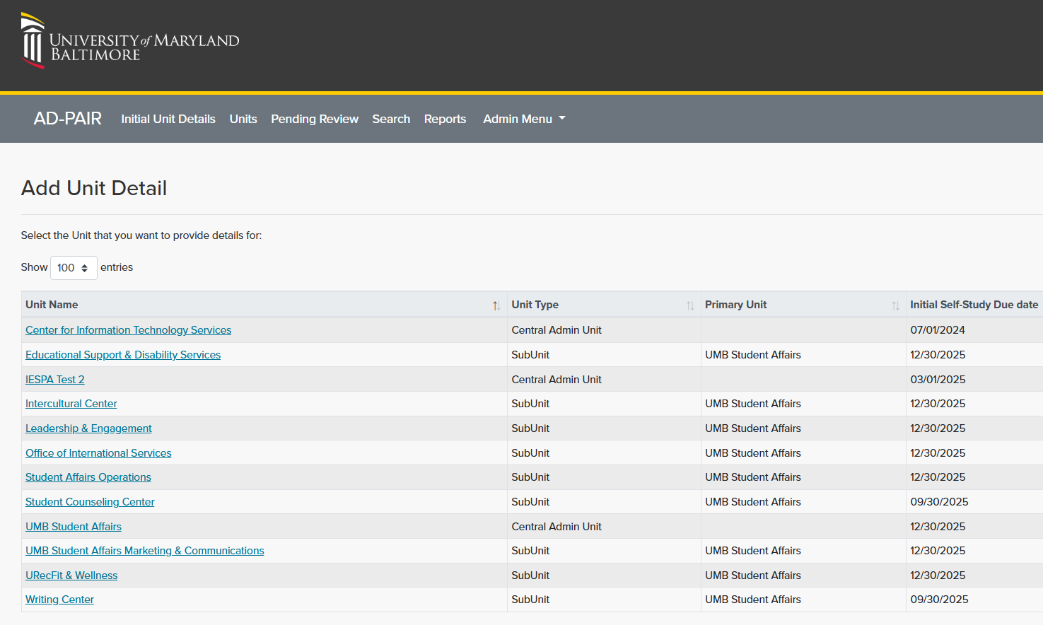
Opening Screen
Ad-pair
ANNUAL Program Assessment & Improvement report
Notes:
Administrative, operational, and student-facing support services directly impact the quality of education, student satisfaction, and the overall effectiveness of the institution. Ensuring that these services are effective and efficient is crucial to providing a positive university experience for students and staff.

Slide 13
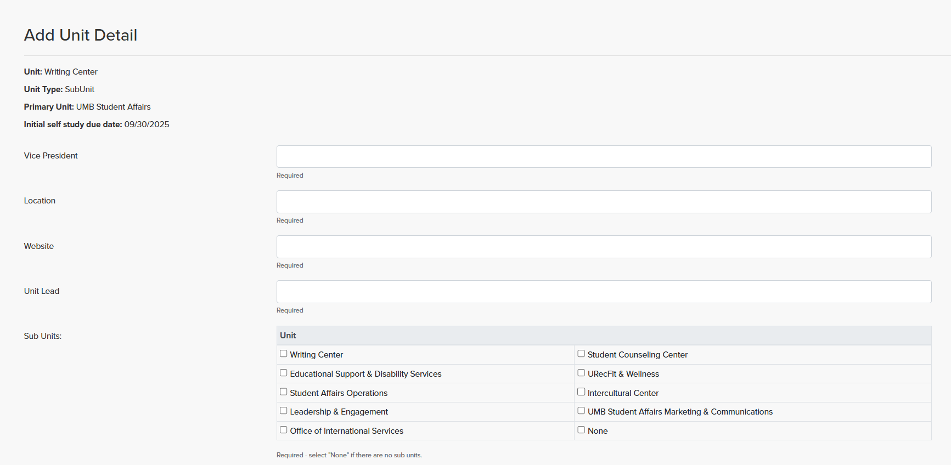
Module – ADD Unit Detail
ANNUAL ADMINISTRATIVE Program Assessment & Improvement report (AD-pair)
Notes:
Administrative, operational, and student-facing support services directly impact the quality of education, student satisfaction, and the overall effectiveness of the institution. Ensuring that these services are effective and efficient is crucial to providing a positive university experience for students and staff.

Slide 14
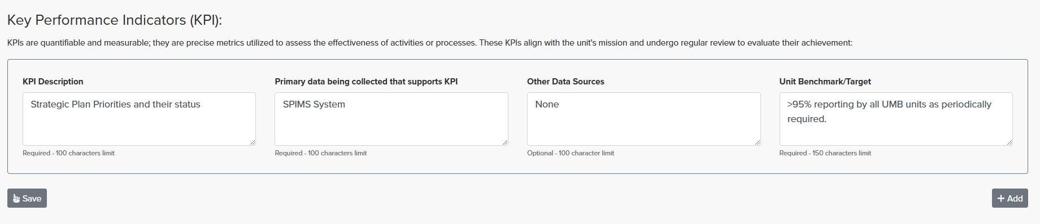
Module
Key Performance Indicators (KPI)
Notes:
.KPIs are a set that gets reviews regularly. If you were the Program Director for an academic program, retention, licensing, time to completion, might all be values the units looks at year to year to answer how well its doing compared to projections, competitors or some other benchmark.

Slide 15
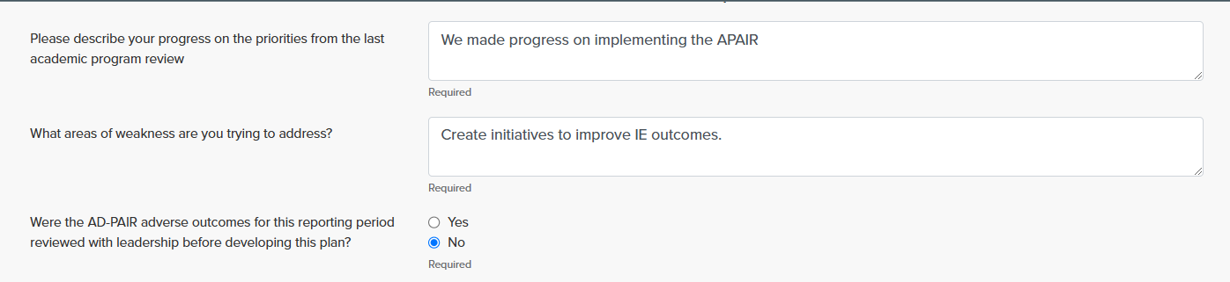
Module
Create (Annual) Priorities
Note: For the prior year (2024-25 only), answer “N/A” for above and “No” for the last question, if Unit did not establish priorities.
Notes:
Administrative, operational, and student-facing support services directly impact the quality of education, student satisfaction, and the overall effectiveness of the institution. Ensuring that these services are effective and efficient is crucial to providing a positive university experience for students and staff.

Slide 16
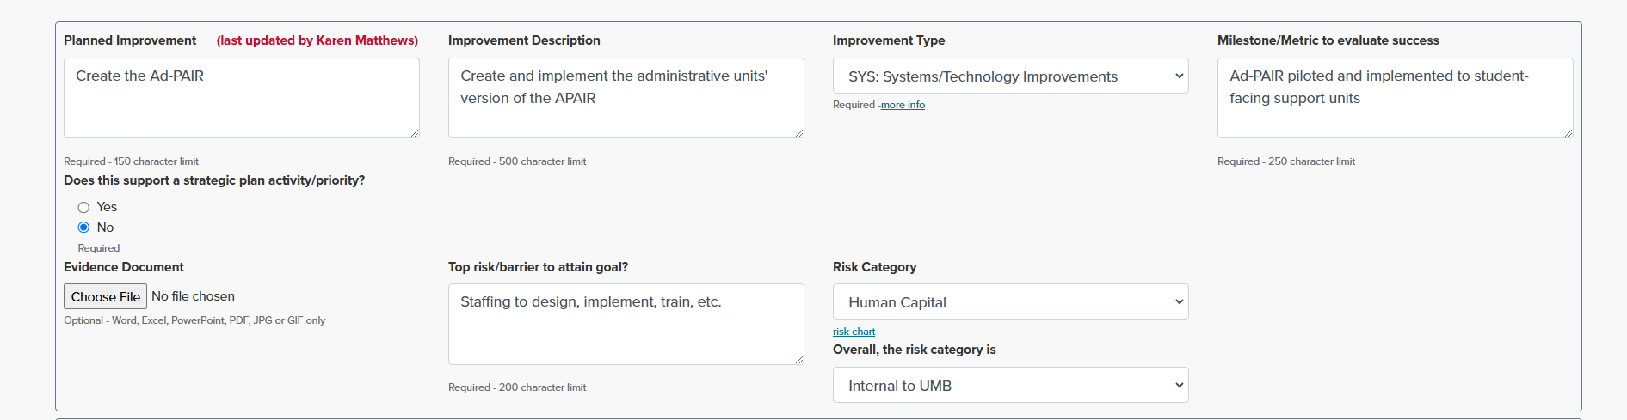
Module
Create (Annual) Priorities*
Current Period: July 1, 2024 – June 30, 2025
*Priorities are an Improvement or Opportunity
Notes:
Please note that the Provost Office now requires an assessment of risk for priorities set. For information on completing the Risk, please reach out to Victoria Meadows, Asst Director, ERM Adhere to SMART format for Improvement Description
Emphasize: Select the description that most describes the Improvement type

Slide 17
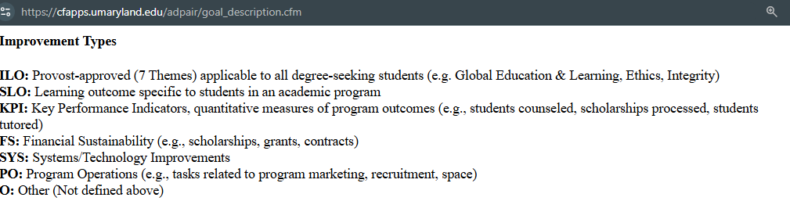
Module
Creating Priorities – Improvement Types Explained
Notes:
Administrative, operational, and student-facing support services directly impact the quality of education, student satisfaction, and the overall effectiveness of the institution. Ensuring that these services are effective and efficient is crucial to providing a positive university experience for students and staff.

Slide 18
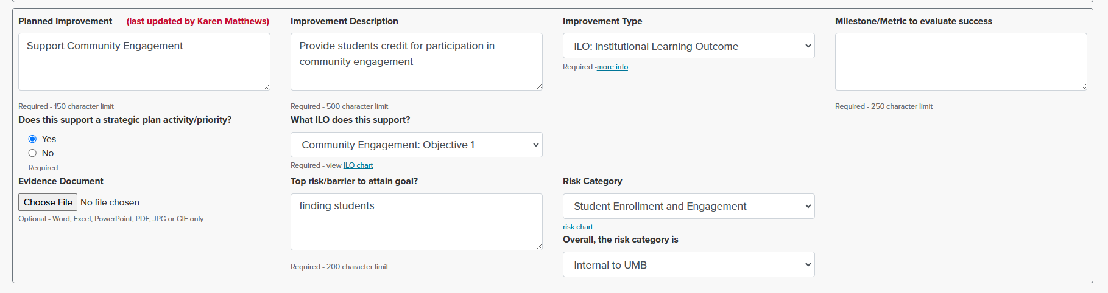
Module
Create (Annual) Priorities
Notes:
Please note that the Provost Office now requires an assessment of risk for priorities set. For information on completing the Risk, please reach out to Victoria Meadows, Asst Director, ERM

Slide 19
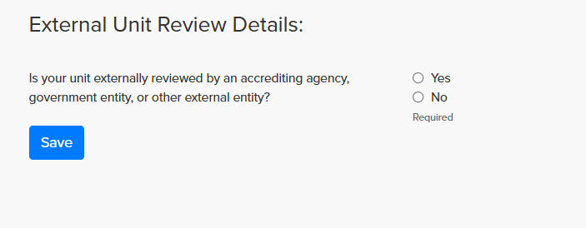
Module
External Review
Definition: Unit self-review conducted at the request of an External Reviewer (e.g., accreditor, regulator, professional organization, USM system) and submitted to the body henceforth.
Notes:
Administrative, operational, and student-facing support services directly impact the quality of education, student satisfaction, and the overall effectiveness of the institution. Ensuring that these services are effective and efficient is crucial to providing a positive university experience for students and staff.

Slide 20
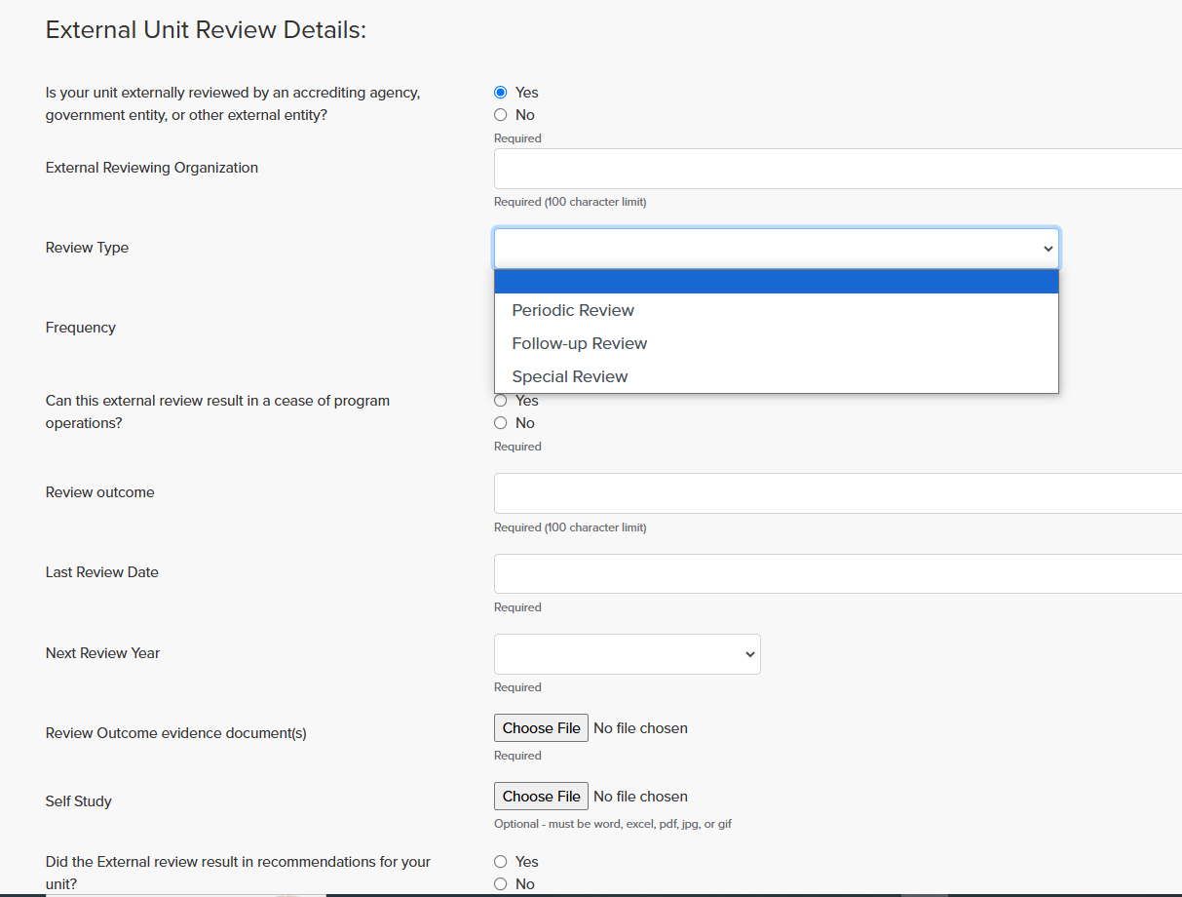
Module
External Review Tracking
Notes:
Administrative, operational, and student-facing support services directly impact the quality of education, student satisfaction, and the overall effectiveness of the institution. Ensuring that these services are effective and efficient is crucial to providing a positive university experience for students and staff.

Slide 21

Module
UMB Self-Study
UMB Self-Study: An intensive, collaborative Self-Study report providing an opportunity to reflect on the unit’s mission, the services provided, strengths and challenges, opportunities, and future priorities.
Notes:
Administrative, operational, and student-facing support services directly impact the quality of education, student satisfaction, and the overall effectiveness of the institution. Ensuring that these services are effective and efficient is crucial to providing a positive university experience for students and staff.

Slide 22
Periodic Unit Self-Review
(Five-Six Year Intervals)
To effectively assess the Unit's performance, the self-study shall focus on the following key areas and descriptions:
Unit mission, goals, history, and context within UMB;
Human Resources and staffing;
Resources (other);
Key performance indicators (KPIs) that align to and support mission attainment;
Evaluation and assessment activities;
Stakeholders served and their feedback;
Strengths, weaknesses, opportunities, threats (SWOT); and
Future directions and priorities.

Slide 23
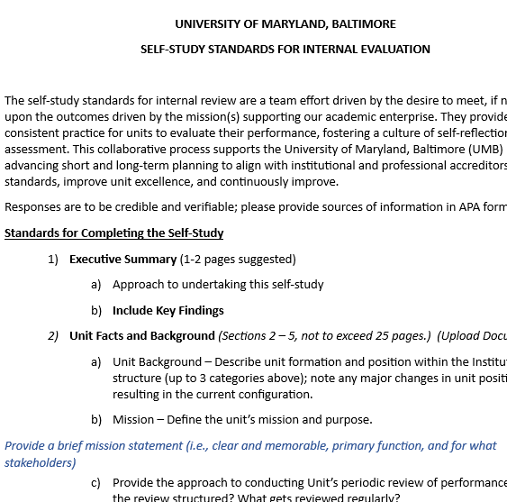
Module
UMB Required Self-Study
UMB Self-Study: A Unit-Intensive Self-Study report providing an opportunity to reflect on the unit’s mission, the services provided, strengths and challenges, opportunities, and future plans.
Notes:
Administrative, operational, and student-facing support services directly impact the quality of education, student satisfaction, and the overall effectiveness of the institution. Ensuring that these services are effective and efficient is crucial to providing a positive university experience for students and staff.

Slide 24

Ad-PAIR System Advantages
Integrates with the SPIMS for Strategic Planning
Supports Enterprise Risk Management
Integrates with ILO tracking when applicable
Tracks related budget requests

Slide 25
Ad-PAIR Summary Facts
Purpose
  Evidence for Accreditation Purposes
  Standardizes reporting across all seven schools
  Supports decision-making and UMB’s continuous improvement
Audience
  Pilot: Student Affairs
  Phase I: Central Administration, Student-Facing Administrative Units
  Phase II: Central Administration Units (Other)
  Phase III: School Administrative Units
Implement Phase I: FY 2025-2026

Slide 26
Student Affairs (Pilot)
Schedule and Due Dates
2024-2025 | Activity/Deadline
11/1/2024 (upon receipt of Guidance) | Contributors/Approver confirms access to Ad-PAIR
11/1/2024* | Ad-PAIR Opens for updating Unit Details, Priorities (thru 6/30/25), and External Review, if applicable
12 months before due date | Download UMB Self-Study Guidelines, if scheduled
12/15/2024 | Ad-PAIR Closes for Unit Details, Priorities-setting, et al.
12/17/2024 | Proposed Feedback Session
04/15/2025 | Ad-PAIR Opens for 2025-2026 Priority Setting (New Priorities Only)**
07/01/2025 | Ad-PAIR Opens for Year-End Progress Reporting
07/31/2025 | Ad-PAIR Closes for Year-End Progress Reporting
*Anticipated; will allow 45 days to Complete
**Also Opens for Phase I Units
Notes:
IP Update

Slide 27
Ad-PAIR Next Steps
PILOT
Student Affairs (SA) and subunits pilot Ad-PAIR through 2024-2025;
SA commences UMB Self-Study – Completion, if applicable
IESPA-held Feedback Session (Pilot Group)
1
Communicate Initiative
Develop communication plan and inform campus community of Ad-PAIR roll-out;
Information / training sessions development
IESPA / Provost Assessment
2
Expand Implementation - Proposed
Phase I: Student-facing Central Administration Units (2025/26)
Phase II: Central Admin Units (Other): (2026/27)
Phase III: School Admin (central) units (2026/27?)
3

Slide 28
Institutional Evaluation and Assessment Tracking
IESPA-Produced Reports
  Ad-PAIR Completion Status
  Evaluation/ Assessment History
  Goal Status / Type
  KPI(s) monitored
Notes:
IP Update

Slide 29
For Addition Information:
Review: the Institutional Effectiveness, Strategic Planning, and Assessment website at
www.umaryland.edu/iespa
OR
Email: UMBAssessment@umaryland.edu
Contacts:
Karen Matthews karen.matthews@umaryland.edu
Greg Spengler gspengler@umaryland.edu
Lauren Crum lcrum@umaryland.edu
Victoria Meadows (Risks questions) Victoria.meadows@umaryland.edu

