Slide 3
Payroll Reps Meeting
Thursday, May 8th, 2024
9am- 11am

Slide 4
Agenda
HCM Project Team
  HCM Project Updates
Human Resource Services
  HR-Compensation
  HR-ELR
Office Of The Controller- Payroll Services (OOTC-PS)
  Payroll Topics

Slide 5
QHCM Project Updates
Payroll Reps Meeting
May 8, 2025

Slide 6
QHCM Project Timeline
2025
Go-Live 10/27
FEBRUARY | MARCH | APRIL | MAY | JUNE | JULY | AUGUST | SEPTEMBER | OCTOBER | NOVEMBER | DECEMBER
System Integrations Testing 2
System Integrations Testing 3
Business Partner Training/UAT
Payroll Parallel Testing
Cutover
Campus Activities (town halls, user fair, demos, etc.)
Change Champions Readiness Workshops
Trainer Preparation
Central Office Training
End User Training
Notes:
The updated project timeline shown here indicates activities completed by the QHCM Project Team such as system testing as well as activities for the UMB campus and key stakeholder groups.
Specific details about each of the campus and stakeholder activities will be released as soon as possible. Stay tuned to find out ways you can get/stay involved in the QHCM Project ahead of the new system going live for campus users on October 27, 2025!
For questions about any of the activities listed here, reach out to the project leadership team (Chiradeep Mukherjee or Stacy Long) or the project's Change Management & Training Team (Michele Evans, Beth Gallico, Robin Reid, or Laura Pogliano).

Slide 7
QHCM Project Change Champions & SMEs Readiness Workshops
Focus
Purpose
Create early learners and embedded experts in high-impact areas
Demonstrate completing transactions in the system to prepare for training
Audience
Training
QHCM Project Change Champions & SMEs
Prepare users for training but not intended as training
Notes:
The focus of these workshops is on creating early learners and embedded experts in high-impact areas within departments to prepare for end user training. These are demonstrations that focus on how to navigate thru the homepage and how to complete topic specific transactions.
The audience is targeted towards the QHCM Change Champions and SMEs and is designed as a readiness exercise before formal training is implemented.
The Readiness Workshops should not be confused with training. Training Implementation will be rolled out in August 2025.

Slide 8
QHCM Project Training
June '25
July '25
Aug. '25
Oct. '25
System
Go-Live​
Central Office Training Launch
Post Go-Live Training Support
Pilot Training & Trainer Preparation
End User Training Launch
Notes:
If you are interested in helping train end users of the new system, we have room for a few more volunteers! Please reach out to Laura Pogliano or Robin Reid to get signed up. We appreciate your willingness to help us on this endeavor to ensure UMB is ready for the new system this fall.

Slide 9
HRS- Compensation

Slide 10
HRS- Employee and Labor Relations

Slide 11
OFFICE OF THE CONTROLLER- PAYROLL SERVICES
(OOTC- PS)

Slide 12
OOTC-PS Contact Information
Payroll/Leave related questions
  DL-BF Payroll Help
NRA related questions
  DL-BF NRA Help
Submit payroll/leave adjustment forms
  DL-BF PAF Help
Submit Glacier packet
  Complete Glacier Submission Form- DocuSign
Staging table requests
  DL-BF PAF Help
  DL-BF Payroll Help (staging table spreadsheet)

Slide 13
Customer Service System

Slide 14
Customer Service System
In the process of implementing a new ticketing system-VEOCI
  Student Financial Services launched this tool in January, 2025
  OOTC-PS- In design phase
  Expect to launch end of May, will send you an announcement when it’s launched
  Stay tuned

Slide 15
Out of State Workers

Slide 16
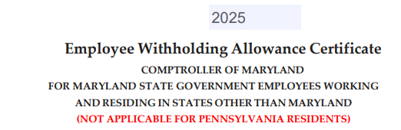
Out of State Workers
Employees who are approved by HR to work and live out of state of Maryland can complete their state tax form
Contact OOTC-PS for other state tax form as we don’t publish them on our webpage
Employee Withholding Allowance Certificate (EWAC) must be completed and sent with any other state tax form

Slide 17
Out of State Workers
Workflow for Out of state employees:
  Departments to contact OOTC-PS when a new employee is approved to work Out of state (prior to onboarding)
  Email to DL-BF Payroll Help with HR’s approval and information
    Name
    Onboarding Date
    State
  OOTC-PS will send you state tax form to be forwarded to your out of state employee

Slide 18
Out of State Workers
Cont’d- Workflow for Out of State employees
  Out of State employee must complete all tax forms and bring to onboarding
    Federal W-4
    Out of State Tax form
  Departments to send EWAC with Section 3 completed back to OOTC-PS prior to onboarding
  OOTC-PS will bring the department signed copy to Onboarding for Out of state employee to complete and sign
  OOTC-PS will have all 3 completed tax forms

Slide 19
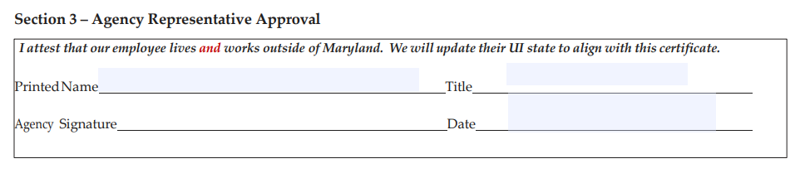
Out of State Workers
Cont’d- Workflow for Out of State employees
  Section 3 of the EWAC (Agency Representative Approval) to be completed by Department Administrator/PR Reps
  You can only sign Section 3 when you have HR’s approval
    to

Slide 20
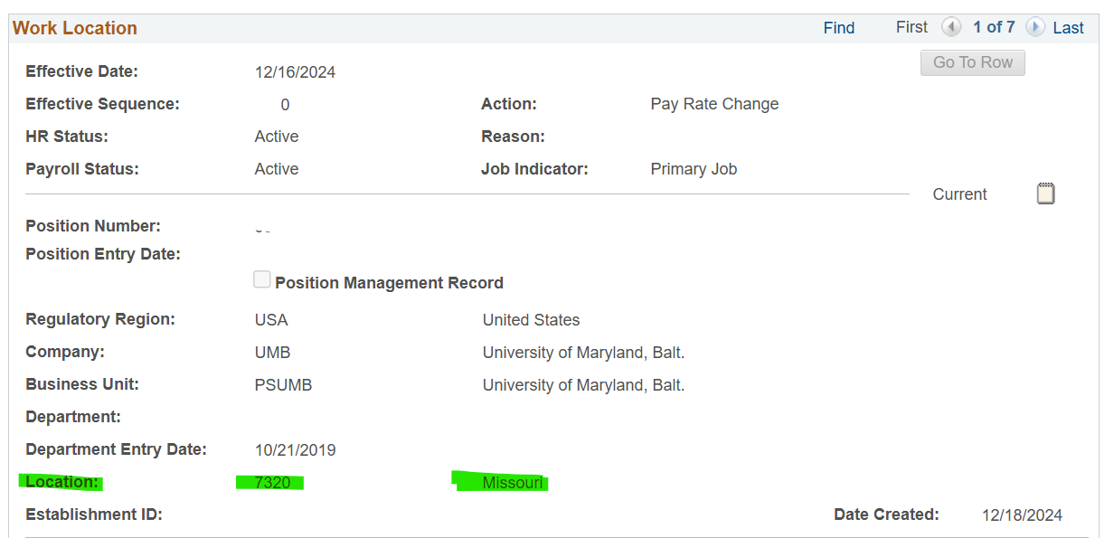
Out of State Workers
Cont’d- Workflow for Out of State employees
  Enter the correct Work Location in the Job Data- Location field
  Please see example below:

Slide 21
Out of State Workers
CPB will start Missouri state tax withholding after
  Receiving all 3 completed tax forms
    Federal W4 form
    State Tax withholding form
    EWAC
  Work location sent to CPB matches the state tax form

Slide 22
Payouts

Slide 23
Final Payouts
Communicate with your terminated employees before initiating a final payout
  Transfer or termination (make sure employees are expecting their payout, not transferring leave to another agency)
    Transfer within UMB- no payout
    Transfer within state- submit Leave Transfer form
    Termination (not transfer)- submit a PAF for final payout
  Deposit into SRA or direct deposit/check
    Deposit into SRA- employee to work with their retirement agency, process in specific pay period
    Direct deposit/check- regular processing

Slide 24
Final Payouts
Prepare Final Payout packet and send to DL-BF PAF Help
  Attach query results from query UMB_ETS_TIMESHEET_HISTORY_EE, all ETS should be in ‘loaded’ status
  Attach paper timesheets for any ETS not in ‘loaded’ status
  Attach leave adjustments if leave was reported on paper timesheets
  Attach UMB Employee Leave Inquiry page or BEN007 report to justify payout hours, list calculation if any adjustment is required
  Attach FAIS (Faculty payout only)
  Attach eUMB Job-Compensation Page to show compensation rate
  Default Tax Period ‘1,’ indicate tax period if needed

Slide 25
Final Payouts
Deposit into SRA- PR Reps to explain procedures:
    Employee: contact his/her retirement agency to confirm amount/% to be deposited and payout pay period
    Employee: work with HR-Benefits of depositing final payout to SRA
    Department: make sure submitting a PAF for the payout request for processing
    Department: cost center report validation

Slide 26
Final Payouts
Cont- Deposit into SRA- PR Reps to explain procedures:
  If the payout is missed, it cannot be reprocessed in the following pay period, contact OOTC-PS to delete the request and need to repeat #1 - #4

Slide 27
Donated Leave

Slide 28
Donated Leave
Leave donation requests must be sent to HR-ELR for approval, they need to check for eligibility
Attach approved leave donation form to both (donor and recipient) PAFs
  Both departments should communicate to make sure PAFs are being sent in the same pay period
  If OOTC-PS only receive 1 PAF, it will be not be processed

Slide 29
Review CCR/PR

Slide 30
Cost Center Report/Payroll Register
Review CCR/PR-
  Processing week (Tuesday – Friday, normal schedule)
    Tuesday, 1st paycalc- regular pay + system calc retro
    Thursday, after we finished all PAFs
      Contact OOTC-PS for any missing adjustments and/or adjustments to prevent overpayments
    Friday, last call review
      Only accept corrections

Slide 31
Cost Center Report/Payroll Register
Cont- Review CCR/PR
  Last Call- CCR/PR Final review
    Required by auditors- approve final CCR/PR
      (Signed and dated by Dept Payroll Approver)

Slide 32
Cost Center Report/Payroll Register
Cont’d- Review CCR/PR
  Non-Processing/Paycheck week
    Tuesday (Net Pay and Leave accrual Process)
    Rerun CCR/PR to compare with the signed CCR/PR to make sure they have the same totals (Signed and Dated by Dept Payroll Approver)
    Review leave adjustments (Required by auditors)

Slide 33
Cost Center Report/Payroll Register
Cont’d- Review CCR/PR
  OOTC-PS needs your help to report issues so that we can investigate if the problem is widespread or just your employees
  Make sure you have a backup payroll staff in case you’re out of the office

Slide 34
Overpayment Procedures

Slide 35
Overpayment Procedures
Refer to the OOTC-PS website
  Summary Chart of Forms including payback options and the required forms
  Compensation Overpayment and Recovery Flowcharts
  Repayment Agreement- active employees
  Notice of Debt- terminated employees
Advise employees to repay before CPB’s deadline (Oct/Nov)
  Year End deadline is determined by CPB
  OOTC-PS will notify you if your overpaid employees will receive a 2nd invoice

Slide 36
Overpayment Procedures
Consequences of not repaid in full before CPB’s YE deadline, employees
  May receive a 2nd invoice because taxes cannot be corrected in time for W2 creation
  Cannot file taxes until overpayment is repaid in full and received a corrected W2
  Account may be referred to SCCU if invoice(s) not paid within 120 days

Slide 37
Overpayment Procedures
Submitting Compensation Overpayment packet immediately will help your overpaid employees
  The sooner they receive an invoice, the sooner they can repay in full before CPB’s deadline
  Employees may only have a short window of time to repay if they get invoice late (after October)
  Instead of repaying in net, employee will need to repay in gross amount after year-end deadline (add’l taxes may be added to their payback)

Slide 38
Overpayment Procedures
Cont’d- Submitting Compensation Overpayment packet immediately will help your overpaid employees
  May need to pay more than they received, especially for overpayments after YE deadline
  Cannot file taxes until W2C is received

Slide 39
Clean Up Efforts
Overpayments
Final Payouts
Timesheets

Slide 40
Overpayment Statistics

Slide 41
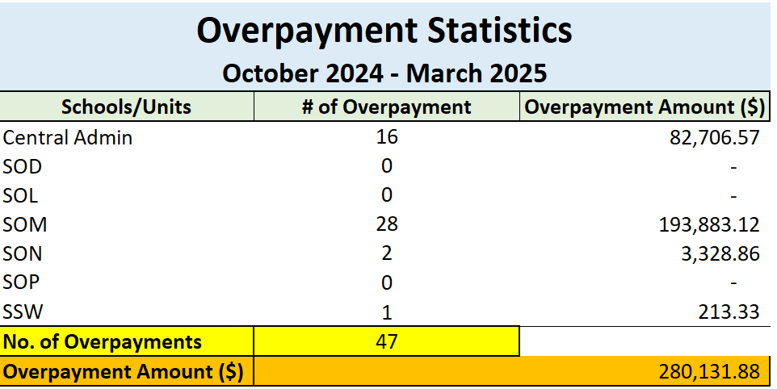
Overpayment Statistics

Slide 42
Final Payouts

Slide 43
Final Payouts
Employees are active within 30 days after termination effective or creation date, whichever date is later
Employees should receive their final payout after their last regular paycheck
Review BEN007 each pay period to clean up leave balances when employees are terminated

Slide 44
Delinquent Timesheets

Slide 45
Delinquent Timesheeets
As of this morning, there are 40 delinquent timesheets. Please continue the clean up as we’re not planning to bring these old timesheets to HCM
Run query UMB_ETS_DELINQUENTS_1_PP or the online ETS Statistics page to assist in identifying the outstanding ETS that need to be cleaned up

Slide 46

Questions or Comments

