Slide 1
Accessibility in Word Documents
Demonstrating accessible formatting practices in Microsoft Word (Microsoft 365)

Slide 2
Objectives
Set Heading levels
Bullets and Lists
Links
Alternative text on images
Tables
Font size, style and color
Accessibility Checker/ Assistant
File name and title

Slide 3
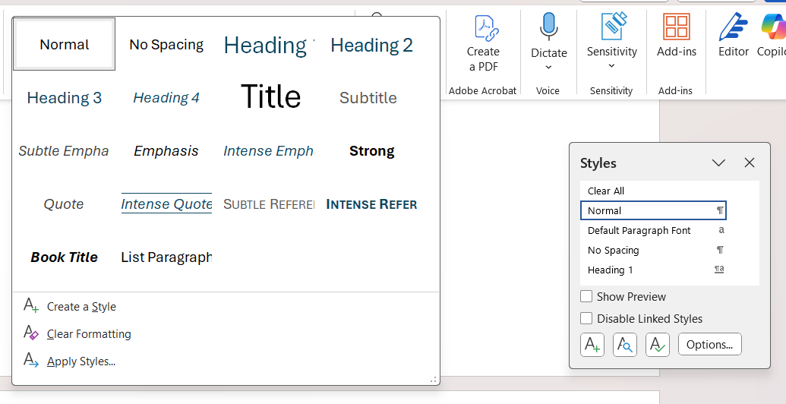
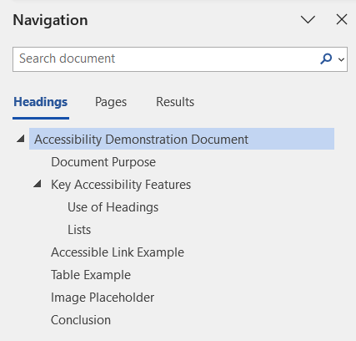
Set Heading levels
Apply a Heading
Home tab > Styles > Heading (or Heading 2, Heading 3, etc.)
Modifying appearance of heading (font color, size)
Right click on Style > Modify
The navigation pane can be opened to easily provide a view of the headings within your document
View tab > Check Navigation Pane box
Notes:
Having descriptive headings helps to provide structure for sighted users but headings need to be marked with correct heading levels so that users with screen readers can quickly understand the structure of the documents to navigate through them.

Slide 4
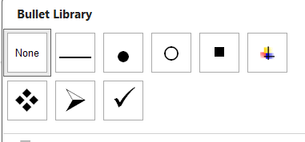
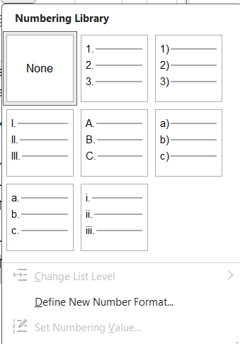
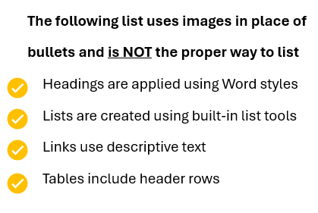
Bullets and Lists
Use bulleted and ordered lists instead of images.
Also avoid typing characters such as dashes. These will not use the list style.
List paragraph styles can be used to adapt spacing and fonts.

Slide 5
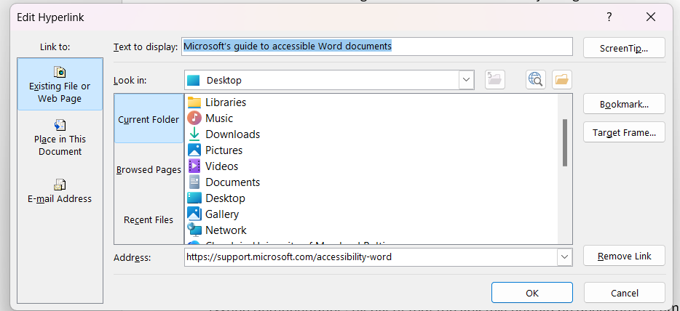
Links
Make sure that links are obvious and self-evident from tabbing onto them with a screen reader.
Enter meaningful name into the text to display field. Try to avoid text like “Click here” so that it makes sense if the user is reading them out of context.

Slide 6
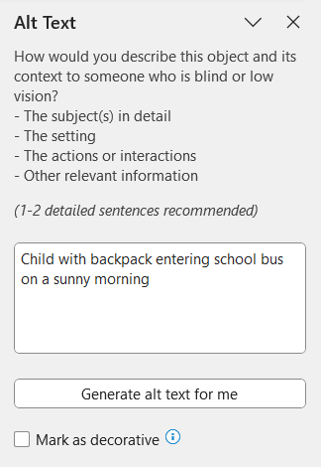

ALTernative text on images
Informative images need to be announced
From the image: Right click the image > edit alt text > type a description decorative
Generate ALT text button can be used as well but may not be as accurate
Decorative images do not need to be announced. Check box should be selected.

Slide 7
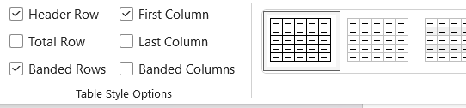
Tables
Avoid complex tables by:
Avoiding merged or split cells
Using multiple layers of headers
Use table headers
Table design tab > Table style options
Select Header Row and First Column if the first column is used as a header row
Do not use tables for formatting (as previously mentioned in lists)
Notes:
Tables also need to be able to be announced when using a screen reader. Headers will be able to be communicated for screen reader users.

Slide 8
Font size, style and color
12 pt. font size or higher
Avoid overly-decorative fonts and continuous capitalization
Text should be readable in a high contrast mode. Use bright colors on opposite ends of the color spectrum. White and black schemes make it easier for people who are colorblind to distinguish text and shapes.

Slide 9
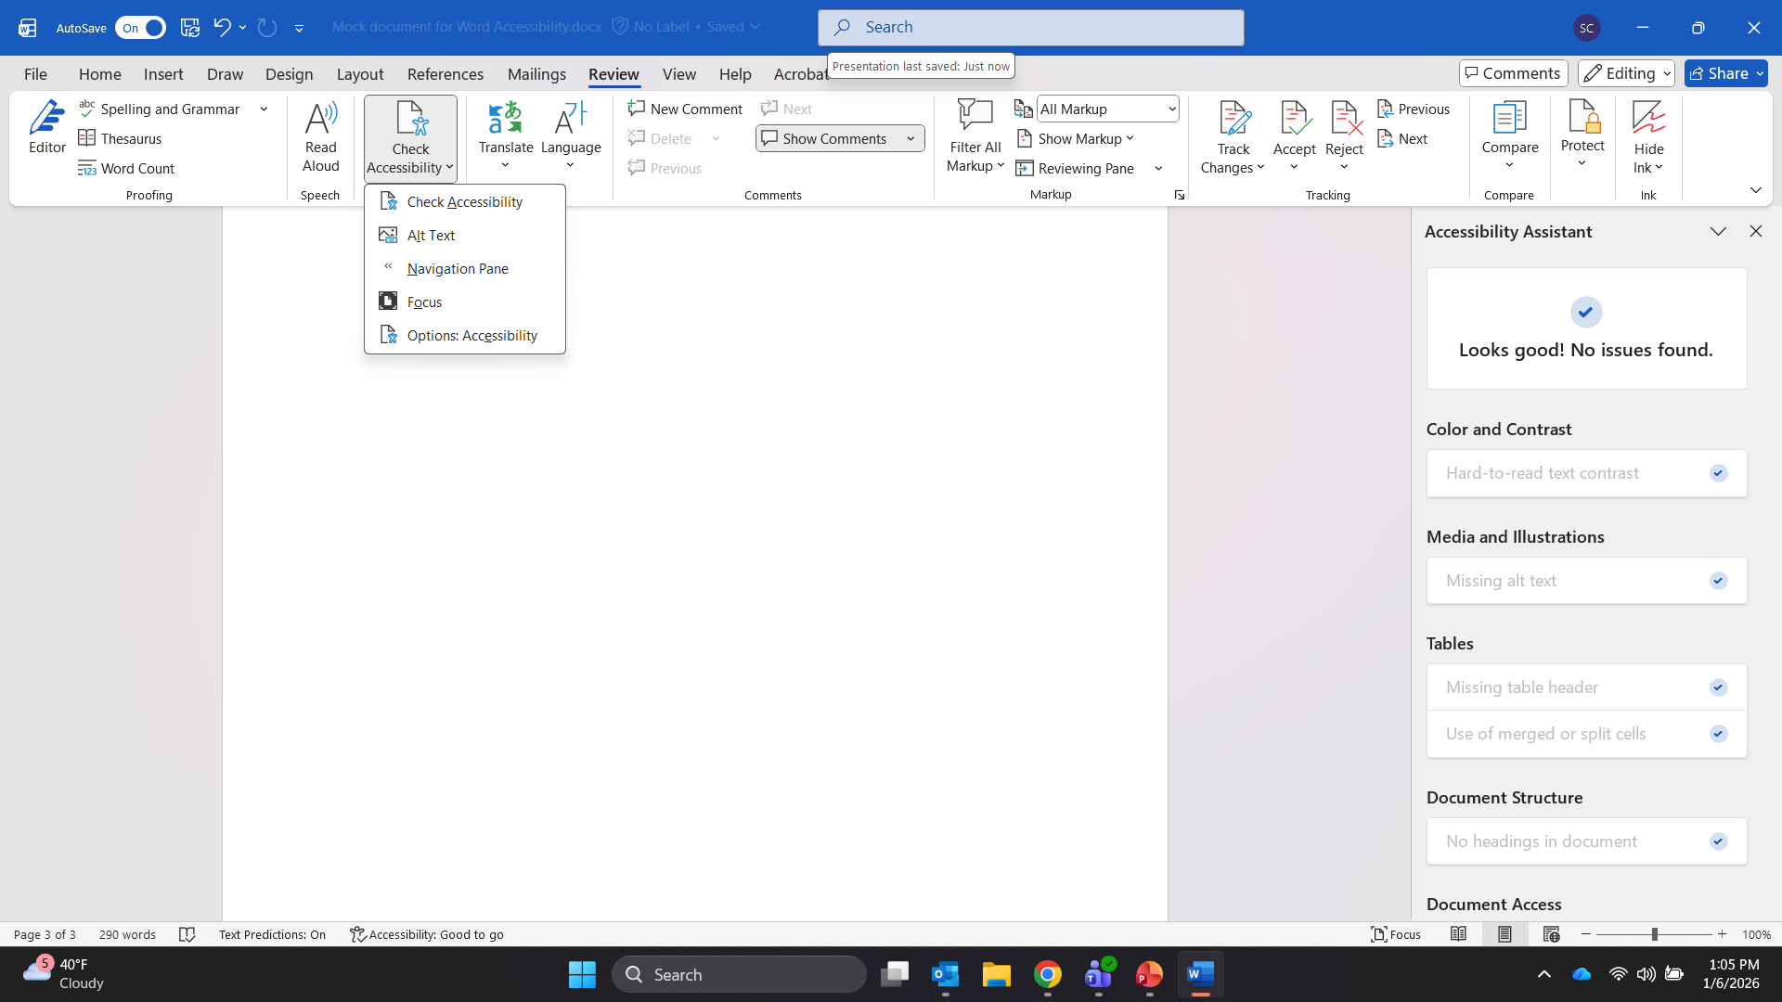
Accessibility Checker/ Assistant
The Accessibility checker/ assistant can be used to find accessibility issues with explanations on why the issue should be fixed and how.
Review tab > Check Accessibility

Slide 10
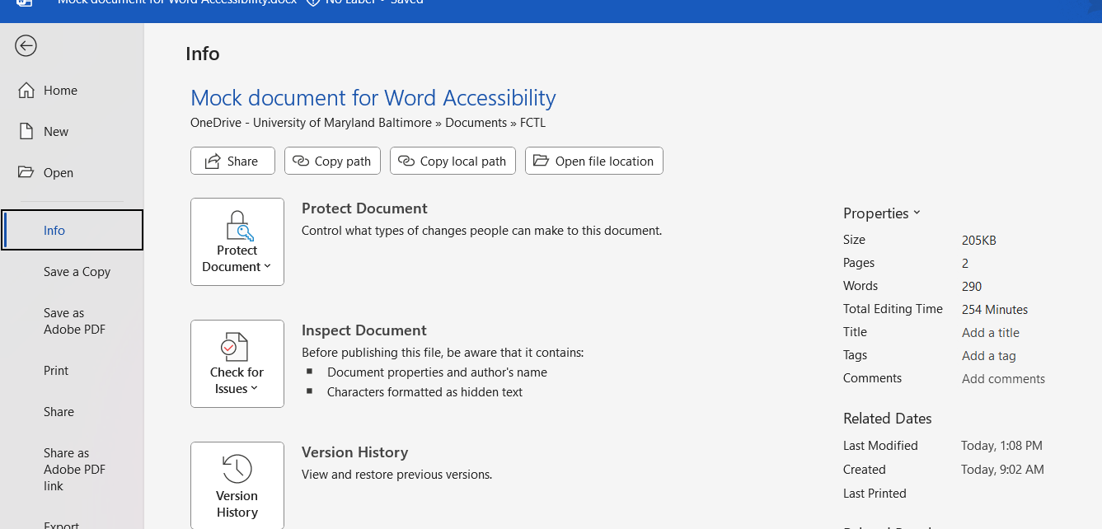
File name and title
Provide a descriptive file name and title for your document
This also ensures that the title reflects if the document is converted into a PDF
File tab > Info > Add a title

Slide 11
Key Takeaways
Apply built-in headings and styles to create a clear and logical document structure
Add alternative text to non-text content and other visuals that communicate information
Use descriptive hyperlink text so users understand the destination or purpose of the link

