Slide 1
PDF Accessibility
Notes:
Presentation - PDFs.pptx

Slide 2
Possible topics
Remediation Tools
Accessibility Checklist (what to look for)
Document properties
Machine-readable (OCR)
Tags
Logical reading order
Alt text
Color & contrast
Using Adobe Acrobat’s accessibility checker
Example documents

Slide 3
Tools
Adobe Acrobat Pro
Downloadable software
Requires license (free 7-day trial available)
CITS Adobe licensing
Equidox
Online platform
UMB has limited license
2 people at a time can be logged into platform

Slide 4
Alternatives to PDF remediation
Avoid using a PDF altogether
HTML/CSS (e.g. web pages, Blackboard pages)
ePub (if available)
Native creation formats (e.g. Word, PowerPoint, Excel)
Recreate the original document
E.g. instructor-made handouts, worksheets
Easier to make a document accessible in Word and convert to an accessible PDF than it is to do all the remediation in the PDF

Slide 5
Accessibility Checklist
Document properties
Machine-readable
Tagged (correctly)
Headings
Lists
Tables
Figures
Links
Form fields
Decorative content
Logical reading order
Alt text
Color & contrast

Slide 6
Document properties
Document Title
Descriptive file name
Initial view set to show Document Title
File > Properties > Description
Security settings
Content Copying for Accessibility is allowed
File > Properties > Security > Security Method
Primary language assigned
File > Properties > Advanced > Language

Slide 7
Machine-readable
Can you highlight specific words?
Digital document (best option)
Designed with a word processing program from the start
Already machine-readable, but may require additional remediation
Optical Character Recognition (OCR)
Tries to recognize text on a scanned image to make it machine-readable
Works best with clear, high-resolution scans
Errors may need to be corrected
Usually requires more extensive remediation
Scanned image of document
Not accessible.

Slide 8
Machine-readable: How to OCR
All tools > Scan & OCR > Enhance Scanned File
Adjusts brightness/contrasts to make text recognition easier
All tools > Scan & OCR > Recognize Text (in this file)
Make necessary corrections if needed

Slide 9
Tags: Overview
Convey document’s formatting and structure to a screen reader
37 possible tags
Container elements
Heading & paragraph elements
Label & list elements
Special text elements
Inline-level elements
Special inline-level elements

Slide 10
Tags: Autotagging vs. Manual
Auto-tagging feature can be helpful but requires checking/fixing
Important tools/panels in Adobe Acrobat:
All tools > Prepare for accessibility > Autotag document
Prepare for Accessibility > Fix reading order
Can toggle between “Page Content Order” and “Structure Types”
Menu > View > Show/Hide > Side panels > Accessibility tags
Menu > View > Show/Hide > Side panels > Order
Menu > View > Show/Hide > Side panels > Content
Tip: When doing manual remediation, save often. No “undo” option if something goes wrong.

Slide 11
Tags: Artifact
<Artifact> is used to identify decorative images, non-essential content
Elements designated as artifacts will not appear in the Tag tree and will not be read by screen readers
Tag tree: shows all the tags used in the document
Will only appear in the Content panel
Content panel: shows a hierarchal view of all the objects that make up the PDF
Menu > View > Show/Hide > Side panels > Content

Slide 12
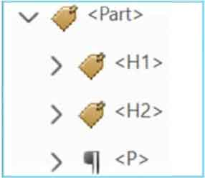
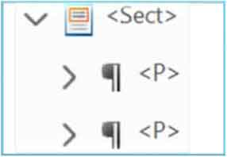
Tags: Container elements
The only required container is the <Document> tag (first item in tags tree, containing all others).
Tag | Description
<Part> | Large major section of a document (e.g., a report chapter). Can be used to group smaller units of content together.
<Div> | Division element is a generic block-level element or group of block-level elements.
<Art> | Article element is a self-contained body of text considered to be a single narrative.
<Sect> | Small section within a larger part (e.g., pull quote, sidebar, boxed text).
Notes:
Provide hierarchal grouping for other elements.
Not required but can be helpful.
Part and section would be more commonly used.

Slide 13
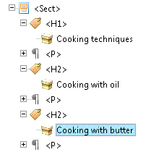
Tags: Heading & paragraph elements
Tag | Description
<H> | Not recommended.
<H1> | Heading level 1. Best used for title/highest section level of document.
<H2> | Main-level headings after title.
<H2> - <H6> | (Sub)heading levels 3, 4, 5, 6.
<P> | Paragraph
Notes:
Start with H1 (title).
Use subsequent heading levels in logical order to indicate hierarchy.
Use paragraph tag for each separate paragraph.

Slide 14
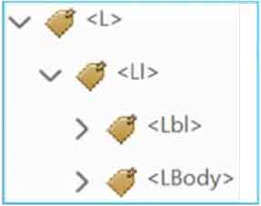
Tags: Label & list elements
Tag | Description
<L> | List element, indicates a list. Must contain list items.
<LI> | List element item, indicates a member of the list. Must have a list body element, might have a label element.
<Lbl> | Label element would be a bullet, number, etc. that precedes the item content.
<LBody> | The content of the list item.
Notes:
<L> (starts list)
<LI> (starts a list item)
<LB> (the bullet/number)
<Lbody> (the item content)
<LI> (starts 2nd list item)
<Lbl> (the bullet/number)
<LBody> (the item content)

Slide 15
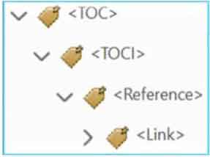
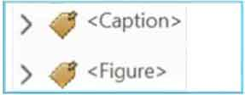
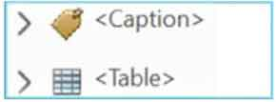
Tags: Special text elements
Tag | Description
<BlockQuote> | For one or more paragraphs of text attributed to someone other than the author of the immediate surrounding text.
<Caption> | Abrief portion of text that describes a table or a figure.
<Index> | A sequence of entries that point out the occurrence of specific text in the main body of the document.
<TOC> | Contains a structured list of items and labels identifying those items; has its own discrete hierarchy.
Notes:
Identify text that isn’t used as a generic paragraph.

Slide 16

Tags: Inline-level elements
Tag | Description
<BibEntry> | Describes where some cited information may be found.
<Quote> | For an inline portion of text attributed to someone other than the author of the text surrounding it; different from a block quote, which is a whole paragraph or multiple paragraphs.
<Span> | Any inline segment of text; commonly used to delimit text that is associated with a set of styling properties.
Notes:
Identifies a span of text that has specific formatting or behavior

Slide 17
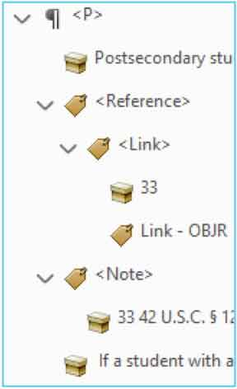
Tags: Special inline-level elements
Tag | Description
<Code> | For programming text embedded within a document.
<Figure> | A graphic or graphic representation.
<Form> | Interactive form-fillable elements (checkboxes, fillable text, signuatures).
<Formula> | For a mathematical formula.
<Link> | A hyperlink container. Must have children: link text & Link – OBJR tag.
<Note> | Explanatory text or documentation, such as a footnote or endnote.
Notes:
Identifies a span of text that has specific formatting or behavior

Slide 18
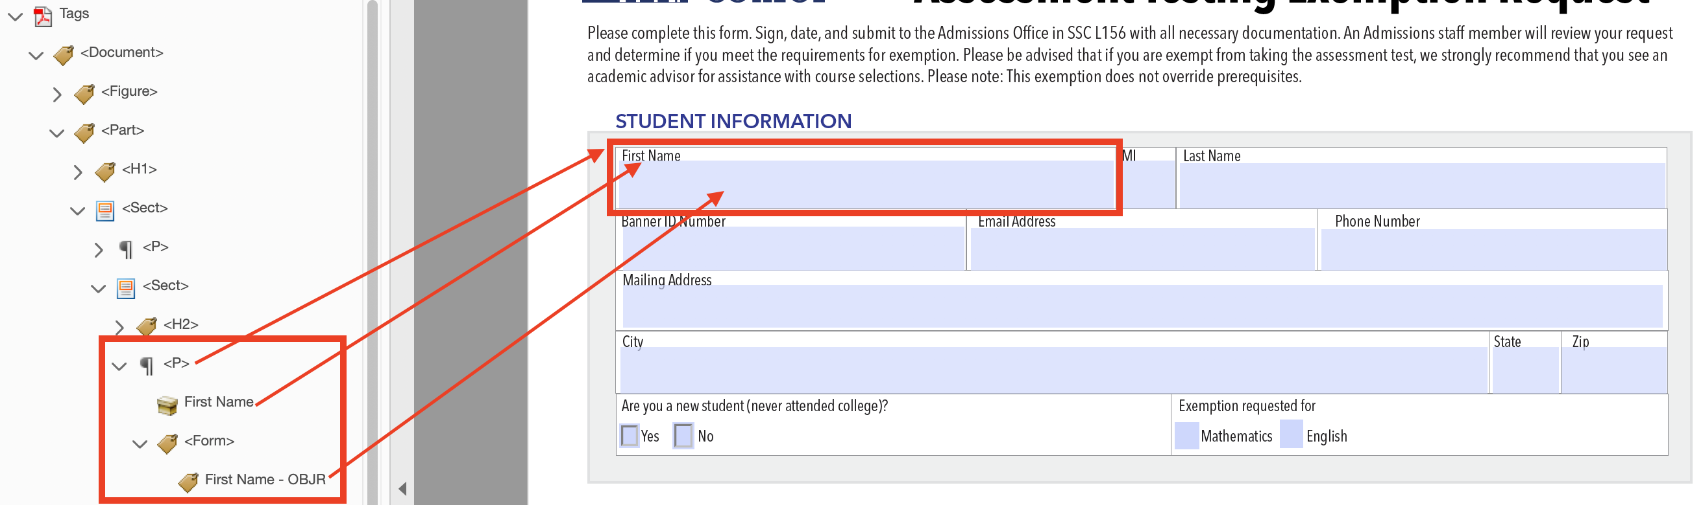
Tags: Forms
CSCU Digital Accessibility: PDFs with Fillable Forms https://accessibility.ct.edu/training/creating-accessible-content/pdfs-fillable-forms/

Slide 19
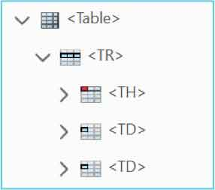
Tags: Tables
Tag | Description
<Table> | Main tag that houses all table tag components.
<TR> | Main tag that houses all tags/cells within a specific row.
<TH> | Heading cells within a table row tag.
<TD> | Data cells within table row tag.
CSUSM: How to properly tag a table in Adobe Acrobat https://www.csusm.edu/iits/services/accessibility/documents/pdf/how_to_properly_tag_a_table_in_adobe_acrobat.pdf

Slide 20
Reading Order
The tags follow the visual/logical reading order of the document.
Menu > View > Show/Hide > Side panels > Order

Slide 21
Alt text: How to add
Images/visual objects that convey meaning are tagged as Figures.
All “Figures” have alternative text that describes its purpose/function.
To add alt text:
From tag panel, right click “Figure tag” > Properties
Open Reading Order, right click “Figure” on page > Edit Alternative Text

Slide 22
Alt text: What to write
How to write alt text
Content and function - why is the image included?
Avoid redundancy
Working with AI
Download the image
Go to Microsoft Copilot
Click the + icon in the prompt box and upload your image.
Input the following prompt: “Can you describe this image for a screen reader? Please format as alt text for PowerPoint.”
Modify as needed.

Slide 23
Color & Contrast
Text has sufficient contrast (including text in images)
Color alone is not used to convey meaning
If manual check required:
Colour Contrast Analyser

Slide 24
Using the Accessibility Checker
All Tools > Prepare for Accessibility > Check for Accessibility
Categories
Document
Page Content
Forms
Alternate Text
Tables
Lists
Headings

Slide 25
Accessibility Checker: Statuses
Passed
Skipped by User (not checked)
Needs Manual Check (e.g. logical reading order)
Failed

Slide 26
Accessibility Checker: Options for items
Fix: Either fixes the item automatically or displays a dialog box prompting you to fix the item manually.
Skip Rule: Skips future checks and changes status to Skipped
Explain: Provides more details about the issue.
Check Again: Use after manually modifying item(s).
Show Report: Report with links to repair tips.
Options: Opens dialog box where you select which checks are performed.

Slide 27
Example: Guidelines for Discussion Forum Posts
Needs title
Tagged – but one unnecessary tag to clear
Logical Reading Order – looks good

Slide 28
Example: How to Create a Blog
Needs title
Tagged – but incorrectly (e.g. figures)
Logical reading order – several items out of order
Figures need alternative text

Slide 29
Equidox interface
Import documents > open document > click into document
“Zones” are the items/blocks that get tagged
When you select a zone, its properties will appear in the left panel
Properties
Name
Type
Language
Order
“Type” properties
Text: tag, indentation, merge, break lines
Heading: Level, merge, break lines, use as template

Slide 30
Resources
General Services Administration. Create Accessible PDFs.
Michigan State University. Word vs. PDF.
University of Wisconsin-Green Bay. Digital Accessibility Tip: When to Use Optical Character Recognition (OCR) on PDFs.
General Services Administration. Common PDF Tags and Their Usage.
NYSED. How to Create or Fix Adobe PDF Link Tags.
WebAIM. Alternative Text.
Vispero. Colour Contrast Analyser (CCA).
CSCU. PDFs with Fillable Forms.
California State University San Marcos. How to Properly Tag a Table in Adobe Acrobat.
Illinois State University. Accessibility.

