Slide 1

Looking Forward
University of Maryland Baltimore
Teaching with Technology Conference
Monday, May 24, 2021
Dr. MJ Bishop
Associate Vice Chancellor and Director
William E. Kirwan Center for Academic Innovation
University System of Maryland
Notes:
Hello and thank you for having me back!
I’m MJ Bishop, Associate Vice Chancellor and Director of the Kirwan Center for Academic Innovation… which, since 2013…

Slide 2
Vision
The Kirwan Center is creating a collaborative culture of academic innovation that catalyzes new ways of thinking about student success, translates ideas into action, and scales and sustains promising practices.
Notes:
Has been… “creating a collaborative culture of academic innovation that catalyzes new ways of thinking about student success, translates ideas into action, and scales and sustains promising practices.”
We are doing that by
Capitalizing on recent findings from the learning sciences and the capabilities of emerging technologies to support the institutions’ efforts to increase access, affordability, and achievement for our students.
Identifying best practices and facilitating efforts to scale and sustain them.

Slide 3
Notes:
Like many of you, I’m sure, I have been reflecting on what was happening around this time last year and how ill-prepared we were for what lay ahead.
I know for me, when I walked out of Elkins at 5:00 on Friday, the 13th of March, I felt a vague sense of dread, but had no clue that would be my last day in the office there for now over a year…
I figured we’d have spring break, maybe extend it a couple of weeks, pull together some solutions to cover classes from a distance for a few more weeks after that, then most likely end the semester back on campus. Surely, we’d be back in time for summer sessions, at the latest.
Boy was I wrong!
In fact, here is the very first guidance paper we wrote and disseminated out of the Kirwan Center…

Slide 4
Notes:
[READ]
Perhaps this was a little naive in hindsight…
but it did point to the fact that, thankfully, the USM institutions were already well poised to address the sift to remote teaching because of the academic innovation work that our faculty had been for the last 10 years or so which has been supported by folks like these…

Slide 5
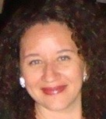
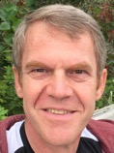
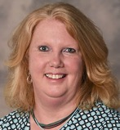
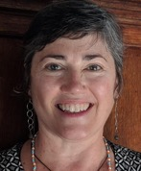
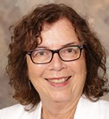
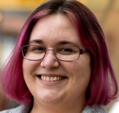
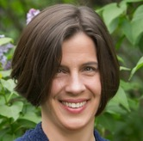
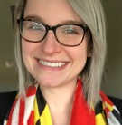

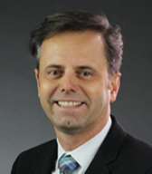
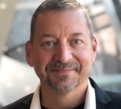
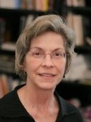
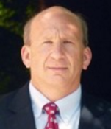
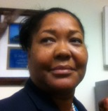
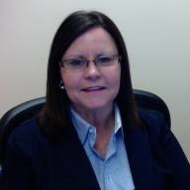

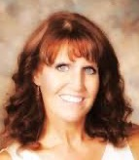
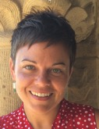
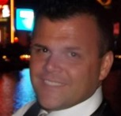
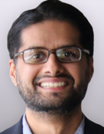
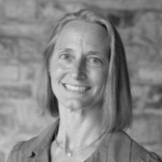
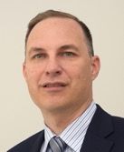
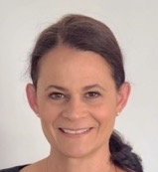
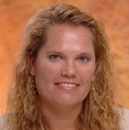
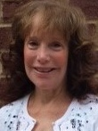
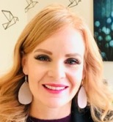
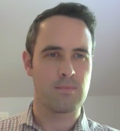
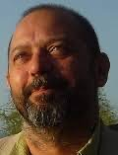
Notes:
The members of the USM’s Academic Transformation Advisory Council and the Council for Advancing Teaching and Learning.
These colleagues --and the units they lead on their campuses-- have undertaken the herculean task for the last year of first, making the transition to remote teaching was as smooth as possible, and then supporting the faculty to ensure an even higher quality online learning experience over this academic year.
But, of course, none of our campuses was prepared with the resources necessary to deal with the SCALE of change that needed to occur…

Slide 6
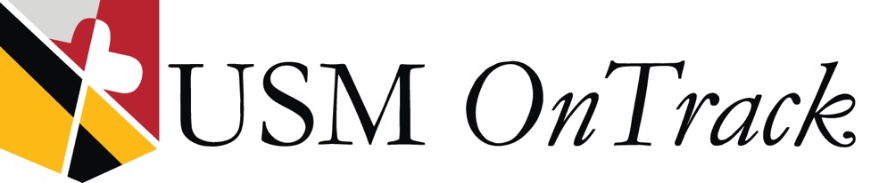
Notes:
Which is why the Kirwan Center’s partnership with UMGC, which was announced last June and supported through CARES Act funds, has been so important as well.
Through that partnership, which we have called USM OnTrack, the Kirwan Center has been able to help “extend the bench” of existing faculty support across our campuses by providing…

Slide 7

USM OnTrack has provided…
More than 1,000 hours of individualized instructional design support and “ask and answer” sessions to more than 200 faculty at 9 institutions.
Full conversion of almost 50 courses across the USM.
Professional development workshops to more than 1,500 faculty and staff on a variety of online teaching topics.
Systemwide access to virtual reality simulations for 215 lab-based courses to more than 5,200 students in AY2020-21.
Access to adaptive learning tools for faculty teaching high-enrollment courses to enhance the asynchronous learning experience.
Notes:
[READ]
It has been tremendously gratifying to be able to provide this additional support to our colleagues across the institutions… to “support the supporters” as I have been telling my team since March.
And for those nay-sayers who used to say “higher education can’t change,” I think we’ve demonstrated that we absolutely can….

Slide 8
Change vs. Innovation
Notes:
…But as we anticipate some “return to normalcy” over the next few months… it’s fair to ask, as you have been exploring through the theme of today’s conference…
what will “normal” look like for teaching and learning? What lessons have we learned? And what’s going to “stick” going forward?
Stated differently… sure, we’ve changed, pivoted… but will we “emerge as more versatile and creative educators”
Have we innovated?
So… what’s the difference?

Slide 9
change
/CHānj/
verb
to make different in some particular.
“never bothered to change the will…”
noun
the act, process, or result of changing.
“a change in the weather…”
Notes:
…Change is incidental. Change works within an existing structure and view of the world. You could view it as tinkering with the system – doing more or less of something or making an existing process better or more accurate in order to restore some balance.

Slide 10

Notes:
But changes, like the murmerations of starlings rapidly changing directions to avoid a marauding falcon or some other external threat, are typically made quickly and reactively, yielding temporary results or, worse --as can happen in complex systems with lots of interacting parts-- the attempt to solve the problem can itself cause problems down the line or elsewhere in the system.
The starting point of change is “the world as it is”…

Slide 11
in·no·vate | in·no·va·tion
/ˌinəˈvāSH(ə)n/
verb
to make substantively different.
“the company’s failure to innovate competitively…”
noun
a new method, idea, product.
“technological innovations to save energy…”
Notes:
Innovation, on the other hand, is structural. It involves seeing the world in a different way, challenging assumptions, and creating a new way of seeing things completely. Inevitably it involves new ways of doing things, changing values and goals, and probably structural change in current processes and systems. It requires new learning and often is often described as ‘transformational’ or “revolutionary.”

Slide 12
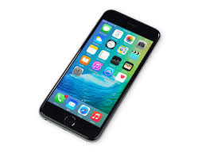



Notes:
And, while it feels like it has been revolutionary to have lived our lives largely via these kinds of devices over the last year, technology and innovation are not the same thing.
A technology can be used to implement innovation --and sometimes even inspire innovation-- but the technology itself doesn’t produce innovation.
Simply introducing new technologies into the mix is not likely to result in meaningful and sustainable innovation without also being very deliberate about how we’re using the tools.

Slide 13
The application of our knowledge about tools, techniques, or systems to solve practical problems.
Notes:
In fact, in the Kirwan Center, we define the term “technology” itself as [READ]
In addition to the fact this isn’t how most people would define technology…there are a few other things that should strike us about this definition.

Slide 14
The application of our knowledge about tools, techniques, or systems to
solve practical problems.
Notes:
First, in some respects, technology is almost more of a verb than a noun. While it often involves some sort of thing (tool, technique, or system) it’s the application --how we use the thing-- that’s key.

Slide 15
The application of our knowledge about tools, techniques, or systems to
solve practical problems.
Notes:
Second, note that what is actually being applied in the definition is our knowledge of the thing. This suggests we must have a keen sense of the affordances or “action possibilities” that the thing provides upon which we might capitalize.

Slide 16
The application of our knowledge about tools, techniques, or systems to
solve practical problems.
Notes:
And, third, the definition presupposes some practical problem that must be solved or need that must be addressed. One might even say that, unless the application of our knowledge of the thing is addressing some practical problem, it cannot be called a technology at all.
Our philosophy has been to avoid the temptation to rush to adopt the next new digital device or “best practice” simply for the sake of being innovative. Instead, we try hard to ground our activities in the problems we’re trying to solve… not lead with the technology.
SO… as I’ve been reflecting on the last year, it has occurred to me that
In the face of widespread closures as a result of the pandemic, the problem we were trying to solve became immediately clear and, perhaps –for the first time ever—we were all rallying together around the solution to that same, shared problem.
**HOW DO WE PROVIDE ACCESS TO INSTRUCTION WHEN WE CAN’T BE ON CAMPUS
But as things progressed over the year, several of the other problems higher education had even before the pandemic with respect to equitable access to education were brought into stark relief.
So, as things continue to slowly get back to “normal,” I’m hoping we don’t lose sight of the problems we’re trying to solve… and that we continue to build on the momentum that has been started in the solution to those problems…
Because, as we know, COVID-19 has been more than a public health crisis. The pandemic and its aftermath are likely to have significant impact on people’s behavior on a variety of fronts, including how they access educational opportunities… and we need to be ready for that paradigm shift.

Slide 17




The "Gravitational Forces" at Play...
Internal pressures, market trends, and environmental impacts must all factor into our future approach.
Environmental Impacts: Fewer students
Demographic shifts
COVID-19
Attitudes toward higher education
Market Trends: Workforce disruption
Bootcamps
Alt-credentials
In-house training
USM: Doing more with less
Budget cuts
Equity and Inclusion
Articulation and Transfer
Notes:
In fact, as the USM has been engaged in developing a new system-level strategic plan…
We’ve been exploring the “gravitational forces” at play for higher education and both the challenges and opportunities they present for USM.
This is a modified version of a slide Deloitte shared in the deck they presented on the Future of Higher Education at a full board meeting. It depicts the extent to which internal pressures, market trends, and environmental impacts are forcing change across the system.
USM: Being asked to do more with less...
Over the last 12 years, starting with the financial meltdown of the 2008 Recession and now COVID and its aftermath have created funding shortfalls and altered campus revenue streams… shifting higher education from what economists perceived as a “public good” to a “private good.” But the longer-term effects of the recession have been more profound and less obvious…
While the proportion of high school graduates who go straight to college continues to increase, there are fewer of those students overall and, when they do come to us, 1 in 5 will quit… Most of those who leave, as we know, are among the most economically disadvantaged. As Brit Kirwan has pointed out many times in the past, the data are chilling . . . a child born into a family in the highest quartile of income has a roughly 85 percent chance of earning a college degree. A child born into a family in the lowest quartile of income has less than an 8 percent chance of earning a degree.
Market Trends: The world of work is undergoing a massive shift.... Some are calling it another “Industrial Revolution”
The scale of disruption in the current world of work with respect to the extent to which computers taking over jobs is being likened to the massive shifts that occurred during the Industrial Revolution in the 18th and 19th centuries and the Information Age that followed in the last century.
Studies are predicting that nearly half of American jobs are at risk of being taken over by computers within the next two decades… and that an estimated one-third of American workers may have to change jobs by 2030 because of artificial intelligence. “Robot-proof jobs”
Environmental Impacts: All pointing to fewer students coming to our institutions…
Enrollment “cliff”…
Of course, no one yet knows the long-term impact that COVID will have but, nationally, we have seen drops in the number of first-time students… the question then becomes whether they enroll after the pandemic ends or whether they decide not to go to college at all. The vast majority of students who decided not to enroll did so for financial reasons, which reflects how the pandemic has magnified the struggles that today’s students already face. We talk a lot about the “return to normal after COVID,” but “normal” wasn’t so good for these students…
And, of course, as graduates leave our campuses unable to find jobs, there will continue to be questions about the value of a 4-year degree.
We need to rethink who today‘s postsecondary students are and figure out how to serve their needs.

Slide 18
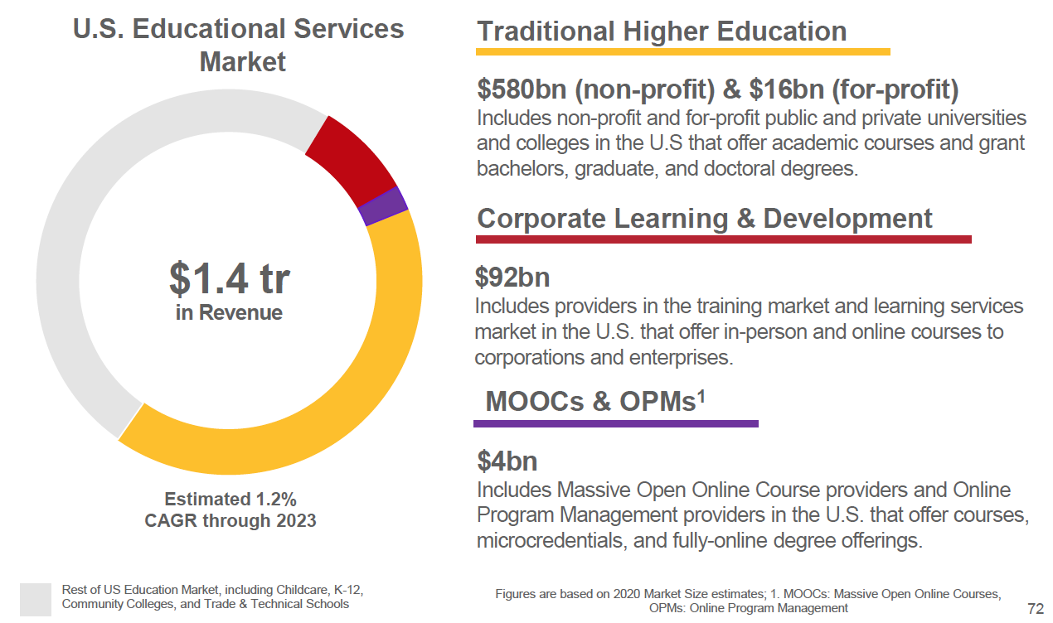
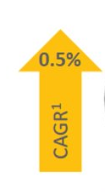
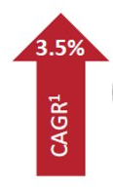

U.S. Educational Market Segments
...and certificates!
Strategies for learning and credentialling at scale.
Notes:
The Regents Enrollment Workgroup has also been working from these data on U.S. Educational Market Segments, which was put together by Deloitte for a different discussion.
The overall $1.4 trillion U.S. education market‘s estimated compound annual growth rate through 2023 is 1.2%.
Out of that “pie,” traditional non-profit 4-year higher education accounts for $580 billion with for-profit providers making up an additional $16 billion. This segment is defined as that portion of the industry that is granting bachelors, graduate, and doctoral degrees... and we would add "certificates" as well.
The other two segments highlighted here are corporate learning and development, which includes providers offering in-person and online courses to corporations and enterprises, and MOOCs and OPMs (online program management providers), which offer courses, microcredentials, and fully-online degree offerings. This final category shouldn't be confused with "online learning," which is a delivery mechanism that can be applied to any of these segments. What's happening in that third category is really best characterized by the "M" in MOOC... massive. This is about learning and credentialling at scale and at very low costs to students.
As you can see by the “compound annual growth rate” or CAGRs on the right side of this slide, steady --but only very small growth-- is projected in the Traditional Higher Education.
And, while the Corporate Learning & Development and the MOOCs and OPMs markets account for a much smaller percentage of the overall market, over the next 3 years they are projected to grow much faster.
But traditional higher education is still a huge part of this pie... even a fraction of a percent of $580 billion is better than a 15% share of a $4 billion market. It's clear that we need to get a whole lot better at exploiting the traditional market (and retaining those students) at the same time we're smartly investing in growth of these other areas.
So, what are we doing in each of these market segments now?

Slide 19
New Traditional Student
  Over 25.
  Dependents.
  First generation.
  Financially independent.
  Took time off before college.
  Went to a community college.
  Attends part time/works full time.
Notes:
With respect to optimizing our traditional higher education market… adult learners!
Our student demographics are changing dramatically… “Non-traditional student” is becoming the new normal, with nearly 1/2 of students who are currently enrolled in higher ed now fitting into this category… attending part-time/working full time, financially independent, caring for dependents, etc., etc.
Unfortunately, too few 4-year institutions are adequately addressing these changes in demographics…Particularly with respect to their constant, competing tension between life obligations and educational obligations. This sends these students the message that “this place is not made for me.”
Many of our campuses are exploring how they prevent that from happening.

Slide 20

Notes:
Building the foundation for our next steps in growth areas probably started in 2015 with kicking the tire on some alternative credentials with our current, matriculated students.
the Badging Essential Skills for Transitions (B.E.S.T.) initiative has been helping students actively explore how their curricular and co-curricular experiences are helping them
acquire the higher-order skills employers are seeking (like leadership, collaboration, critical thinking, and problem solving),
assessing the acquisition of those skills, and then
issuing validated digital badges that communicate to employers the specific ways in which these students are “career ready.”
Unlike a traditional transcript that simply lists what students are taught, digital badges are designed to make visible and validate learning from any kind of formal or informal setting. Sort of like mini-ePortfolios, digital badges carry with them
evidence of what the badge earner did,
an explanation for how the skills represented by the badge were assessed, and
information that speaks to the credibility of the badge issuer, like endorsements or accreditation.
In addition, badges can be shared more openly than a transcript…
Most recently, we’ve been working on developing IPE badge-earning pathways
Digital badges are increasingly gaining traction with employers as a means of understanding specifically what our students know… rather than just what they were taught. Prior to COVID slowing things down a bit, we were collaborating with Cisco on the co-development of badge-earning pathways for a problem-solver badge… and GEICO and NASA are interested as well.

Slide 21
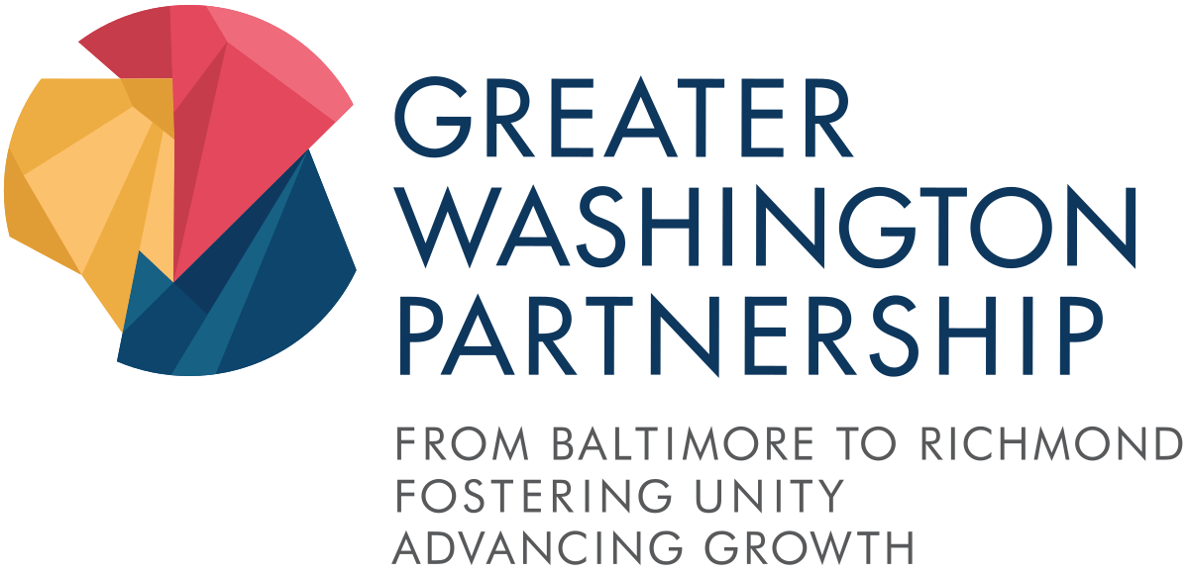
Notes:
Another indication that these kinds of alternative credentials are gaining traction with employers is the work we have been doing over the last year and a half with the Greater Washington Partnership.
The Greater Washington Partnership is a civic alliance of regional employers from Baltimore to Richmond
committed to making the Capital Region one of the best places to live, work, and build a business.
Seeking to increase access and diversity, retain talent, and elevate the region as an innovation hub.
Recently, the GWP launched the Capital CoLAB initiative aimed at
creating opportunities for individuals to acquire in-demand digital skills credentials
diversifying the workforce through intentional talent identification and development of students
and to scaling educational opportunities to meet the region’s need for digital technology workers.
The CoLAB has identified five credentials: Digital Generalist (adjacent skills in tech) and Digital Specialist (Machine Learning, Cloud Computing, Data Analytics, Cybersecurity) and has developed a set of industry-identified list of knowledge, skills, and abilities (KSAs) they want to see incorporated into each.
The Kirwan Center has been coordinating a system-wide effort to support the USM institutions who are interested in offering these credentials to our students.

Slide 22
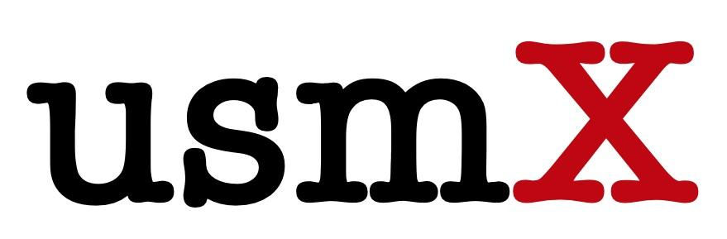
Notes:
With respect to MOOCs and OPMs, we have been systemwide members of edX since 2016… non-matriculated students
Provides system institutions access to an online platform that functions outside of the typical learning management system’s (LMS) authentication firewall. This has enabled institutions to create pathways to graduate degree programs, support existing curricula at the institution level, launch mission-driven community outreach opportunities, and increase the global recognition of USM institutions.
Massively Open Online Courses
MicroMaster’s programs
Professional Certificate programs
To date, the USMx team has supported the development of 95 private and publicly available edX courses that have attracted nearly 1 million cumulative course enrollments
Among the USMx highlights:
UMGC’s impressive 5 MicroMasters programs, more than any other edX member.
The first offering of UMCP’s Applied Scrum for Project Management had over 40,000 learners.
A professional certificate on Environmental Management for Sustainability from UMCES.
UMES’s Introduction to the Hospitality and Tourism Industry course, the first-ever edX MOOC offered by an HBCU.

Slide 23
Notes:
Customized learning solutions for corporations
UMGC - Ed Bach
UMGC works with many clients to serve their education needs. Our alliances span a full range of organizations, including the Federal Government. Here are just some of the companies that have joined forces with UMGC.
Amazon
Amazon Web Services
Papa John’s
Pepsico
TMobile
Boeing
Booz Allen Hamilton
Baltimore Police Department
CSX
GEICO
Jiffy Lube
Leidos
Lockheed Martin
MedStar Health
Smithsonian Institution
Walgreens
UMBC Training Centers
Our corporate training services team is focused on ensuring for-profit organizations have access to critical skills training that matches both specific short-term training needs and long-term learning objectives. UMBC Training Centers provides organizations with discounts to send their employees to our open enrollment training programs through the Enterprise Training Program (ETP).
Discounted tuition for all employees of the organization for eligible open enrollment training courses
Designated point of contact for individual student program inquiries and registrations
Customized registration process for open enrollment courses, if needed
A designated point of contact for private delivery training courses
Corporate payment terms such as the acceptance of purchase orders and support of tuition

Slide 24
Who are Our Customers?
Now and in the future...
Individuals
Seeking Degrees and/or Certificates
"Traditional" 18-year-old students
<5 years out of high school
Adult learners >5 years out of high school (likely with work or military experience)
Seeking alternative credentials
(could be on Degree/Cert path)
Unemployed seeking upskilling
Employed seeking upskilling
Corporate /Non-profits/Government
Purchasing in "bulk"
Upskilling/reskilling employees
Part of benefits package
Lifelong Learners: Consuming education in short spurts when they need it, rather than lengthy blocks of time. Seeking stackable, alternative credentials.
Notes:
Individuals
Degree Seeking
"Traditional" 18-year-old students <5 years out of high school
Adult learners >5 years out of high school (likely with work or military experience)
Not (necessarily) Degree Seeking
Unemployed seeking upskilling
Employed seeking upskilling
Corporate/non-profit/government (purchasing in "bulk")
Upskilling employees
Part of benefits package
The problem with many existing workforce-training programs is that employers, colleges, and local workforce boards responsible for doling out federal funds “all operate separately, calcified in their own silos.” In this new economy, he added, “those worlds will blend together.”
Lifelong Learners: The level of postsecondary preparation that has worked in the past—adding more time to education early in life—does not seem sufficient in the 21st-century economy. Instead the next wave of postsecondary education is likely to be marked by continual training throughout a person’s lifetime—to keep current in a career, to learn how to complement rising levels of automation, and to gain skills for new work. Workers will likely consume this lifelong learning in short spurts when they need it, rather than in lengthy blocks of time as they do now when it often takes months or years to complete certificates and degrees.
With this new wave of postsecondary education will come a shift in how workers perceive retraining. Instead of retraining being something that follows a traumatic event, like a job loss, we’re entering a stage where retraining will be the day-to-day world that people live in.

Slide 25
Emerging "Products"
...to start serving both traditional and emerging markets
Credit for prior learning (PLA).
Clearer pathways, articulations, and “frictionless” transfer.
Competency-based learning records (CLR).
More modularized learning opportunities resulting in stackable micro-credentials.
New degree/certificate types (e.g., professional masters).
Shared programs (both within and outside USM).
Shared courses (online classes to fill needs, low-enrollment courses, inter-institutional registration).
Notes:
AND, with this shift will come increased demand for products and services that we're already being asked to provide.
Credit for prior learning (PLA).
Clearer pathways, articulations, and “frictionless” transfer.
Competency-based learning records (CLR).
More modularized learning opportunities resulting in stackable micro-credentials.
New degree/certificate types (e.g., professional masters).
Shared programs (both within and outside USM).
Shared courses (online classes to fill needs, low-enrollment courses, inter-institutional registration).
But addressing new customer bases and developing the products they will demand will require fundamental changes to our existing business model… everything from technology and organizational infrastructure, to revenue streams, to curriculum design and assessment…

Slide 26
How do we move from change to a culture of innovation?
Notes:
How do we move from short-term pivots to creating a culture of innovation that will create the space for higher education to adapt in these ways?
How do we create an environment that continually introduces new ideas or ways of thinking, then translates them into action to solve specific problems or seize new opportunities.

Slide 27
Implementation Model
Re-envisioning
Transformative
Integration Level
Redesigning
Replacing
Sporadic
Selective
Sweeping
Notes:
We’ve been playing with framing our innovation work using graphics like this… that speaks to what “scale” looks like in terms of the quantitative piece (X-axis) juxtaposed against how we are qualitatively engaging with the new tool, system, or process (Y-axis).
[DESCRIBE…]
Let’s start with online education, as an example…

Slide 28
Implementation Model
Re-envisioning
Exploring new pedagogical
and curricular models (such as modular, competency-based, stackable approaches).
Transformative Use of Online
Redesigning
Addressing learner access needs while ensuring
optimally effective delivery
of learning experience.
Integration Level
Replacing
Moving traditional courses/
programs online to
increase access.
Sporadic
A few interested faculty
Selective
Targeted programs
Sweeping
Pervasive across curriculum
Notes:
Rather than view online education simply as a panacea for enrollment challenges, a more strategic approach capitalizes on the affordances of online to more effectively reach the students we serve in new ways.
When implemented well, online education promises to expand access to students unable to come to campus on a regular schedule, reduce the overall cost of attendance, and improve achievement through personalized, modular content and credentials.
In other words, online education affords higher education institutions the flexibility to envision new ways to fulfill their student success missions.

Slide 29
…teaching online cannot replicate the in-person experience.
Notes:
Online education isn’t intended to replicate the in-person experience.
I heard another one just a couple of hours ago… Virtual labs aren’t a good substitute for hands-on labs.

Slide 30
…our students overwhelmingly want to go back to campus.
Notes:
And my favorite… our students overwhelmingly want to go back to campus.
Error of selection… the residential experience is what we sold these students on. What about the rest of the people who need postsecondary education and cannot as easily access it either physically, financially, or in terms of their preparation??
Normal wasn’t so good for everyone…

Slide 31
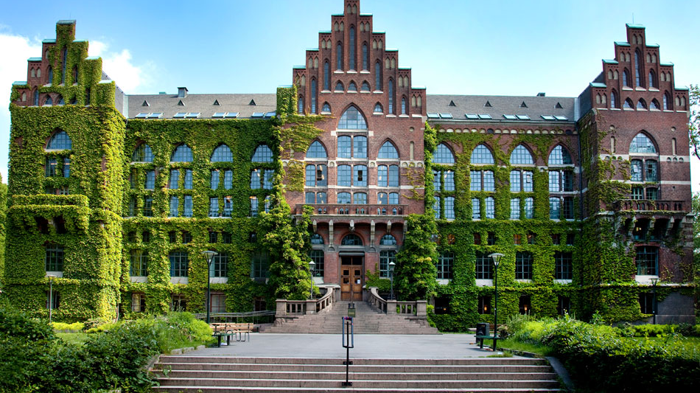
Notes:
Don’t get me wrong… I work out of a system office because I believe there is a huge socio-cultural aspect to learning achieved through being physically together that we have not yet found a way to adequately replicate through distance technologies.
In fact, I would argue that our facilities are actually also tools with affordances that can either prevent action or suggest action.
What do these technologies offer and what kinds of programs should we be designing that capitalize on their affordances? After all, higher education has a whole lot of money invested in these buildings, right?
And, in fact, pre-COVID, the largest growing population of online learners was taking classes from a postsecondary institution within 50 miles of their homes…
But not everything needs to be offered F2F or within the current 8-5:00, 3-credit courses, Monday-Friday delivery model that many of our institutions still largely subscribe to.
We have major education problems that need to be addressed –including our own financial sustainability-- but we won’t find the solutions to those problems if we continue with business as usual.

Slide 32
The Promising Future of Higher Education
More accessible.
More cost-effective.
Better outcomes.
Notes:
…also promise to help make education more accessible, cost-effective, and lead to better outcomes.
But, in and of themselves, these technologies won’t result in the kinds of innovations needed to transform education… that has to come from the people making use of the tools.

Slide 33
Thank you!!
http://www.usmd.edu/cai/
mjbishop@usmd.edu
Notes:
So… THANK YOU for the amazing work you are doing on behalf of students and for taking the time to reflect on the lessons you’ve learned with respect to technology’s role in teaching and learning and how we might capitalize on the affordances of those tools do do things differently moving forward.
I’d also like to invite you to share those experiences beyond UMB with your colleagues across the USM this fall…

Slide 34

Fall 2021 Faculty Showcase
Silver Linings: Lessons Learned from Teaching during the Pandemic
September 30-October 1, 2021
What are the lessons from COVID-19 teaching and learning that we can carry forward? What innovations will “stick” in the future?
Share your challenges, triumphs, lessons learned, and new approaches for supporting quality teaching and learning. Explore novel instructional approaches, active learning pedagogies, student engagement practices, assessment techniques, and faculty-staff and faculty-student partnerships.
More information https://www.usmd.edu/cai/fall-2021-faculty-showcase or cai@usmd.edu.
Proposals are due by 11:59 pm on Thursday, May 27, 2021.
Notes:
NOTE: The CFP is for FRIDAY VIRTUAL sessions. People interested in proposing a session should generally be available on Oct. 1st.
If you get questions about the schedule, it is also listed on the event page, link above. Here it is:
Tentative Schedule
THURSDAY, SEPT. 30, 2021
3:00-4:15 pm – welcome and keynote (virtual)
4:30-5:30 pm – social gatherings – optional for institutions, tbd closer to the date
FRIDAY, OCT. 1, 2021
9:15-10:00 am – concurrent session block 1 (virtual)
10:00-10:15 am – transition
10:15-11:00 am – concurrent session block 2 (virtual)
11:00-11:15 am – transition
11:15 am-12:00 pm – concurrent session block 3 (virtual)
12:00-1:15 pm – midday break
1:15-2:00 pm – concurrent session block 4 (virtual)
2:00-2:15 pm – transition
2:15-3:15 pm – closing plenary (virtual)

