Slide 1
Seven Strategies for Building Resilience and Preventing Burnout for Online Instructors
Michelle Pearce, PhD
Professor
Graduate School, University of Maryland, Baltimore
Teaching with Technology UMB Conference 2021

Slide 2
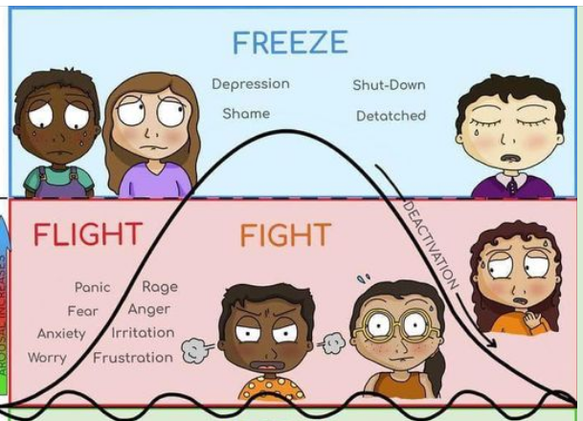
Burnout and The Stress Response

Slide 3
What Puts Us at Risk of Burnout When Teaching Online?
Isolation/lack of community
Heavy reliance on self-motivation and structure
Always on, always available
Fast-paced (e.g., 3 credits in 8 weeks)
Others might not understand how hard/much you work
Challenging to evaluate effectiveness
Lack of movement
Screen fatigue
COVID!

Slide 4
Resilience: Fill Your Cup

Slide 5
1. Know Your Warning Signs
Chronic Stress Response

Slide 6
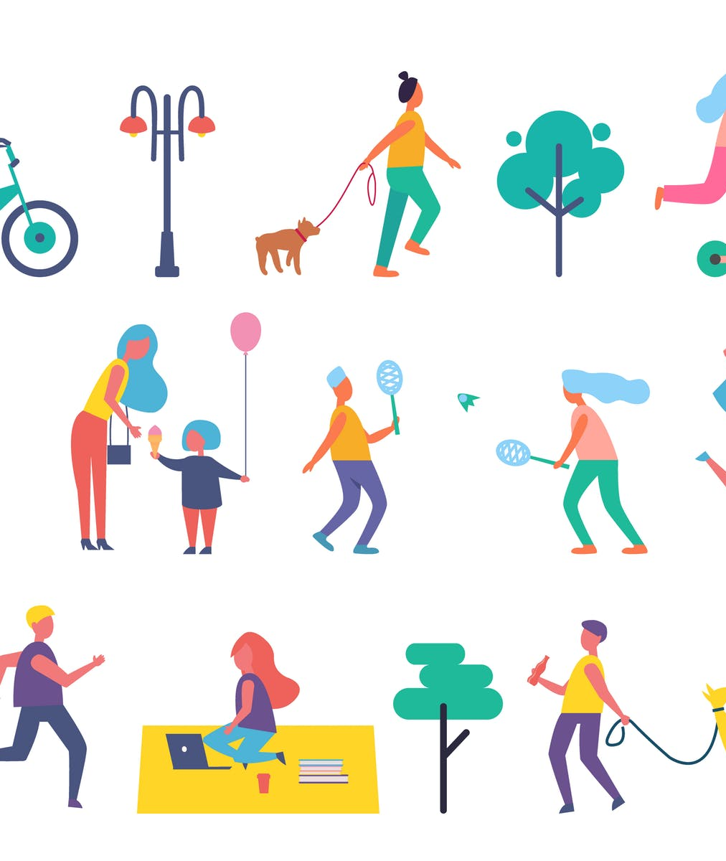
2. Move Your Body
Resources
URecFit (UMB Gym)
Work Out at Home Ideas
Yoga With Adriene YouTube Channel
There’s an app for that! Check your app store for free/low-cost fitness apps and trackers

Slide 7
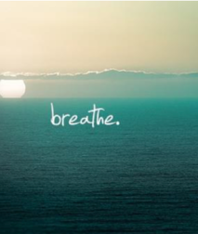
3. Take a Breath and a Mental Break
Resources
Mindfulness TED Talk: All it Takes is 10 Mindful Minutes
How to Meditate
Free Guided Meditations UCLA
More Free Guided Meditations and Guided Imagery

Slide 8
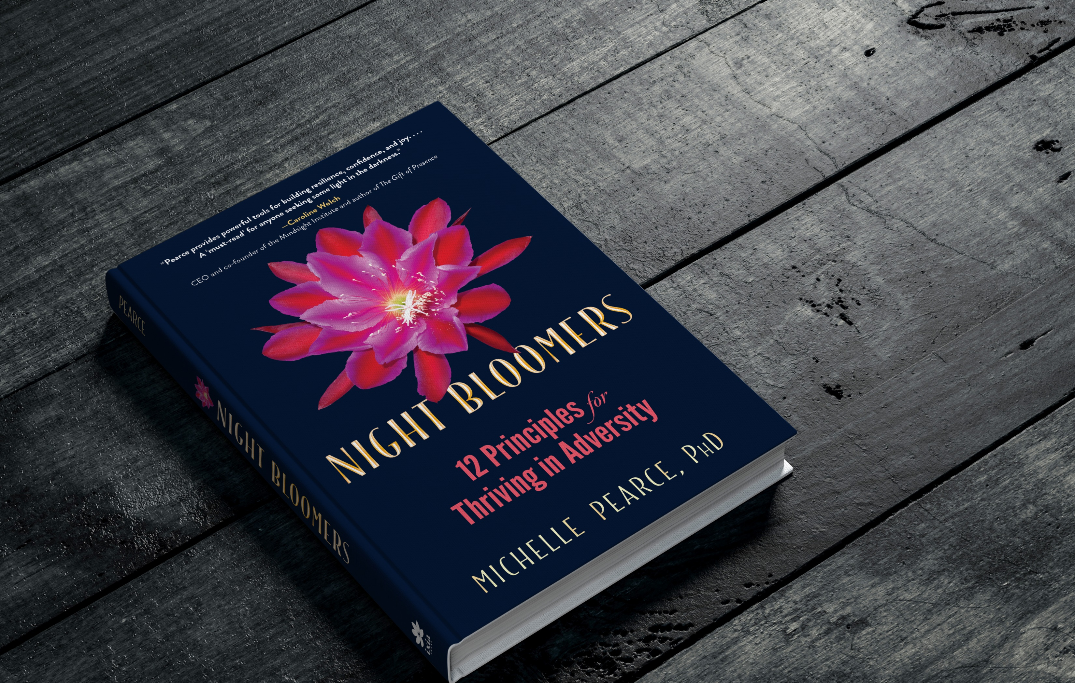
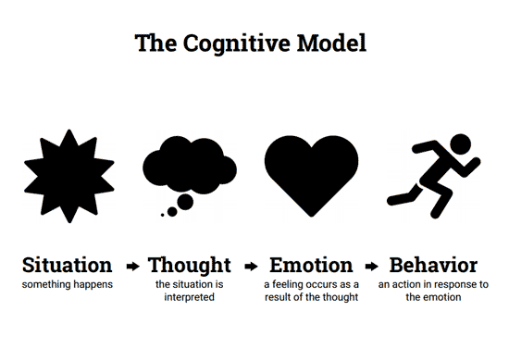
4. Challenge Your Thoughts and Change Your Perspective
More about Challenging Thoughts
Beyond Resilience: How to Bloom in the Dark

Slide 9
5. Protect and Prioritize Your Personal Time
How to Fiercely Protect Your Time
No One Will Protect Your Time for You

Slide 10
6. Connect
UMB Online Teaching Community (To join, email Michelle.Pearce@umaryland.edu)
Meetup.com

Slide 11
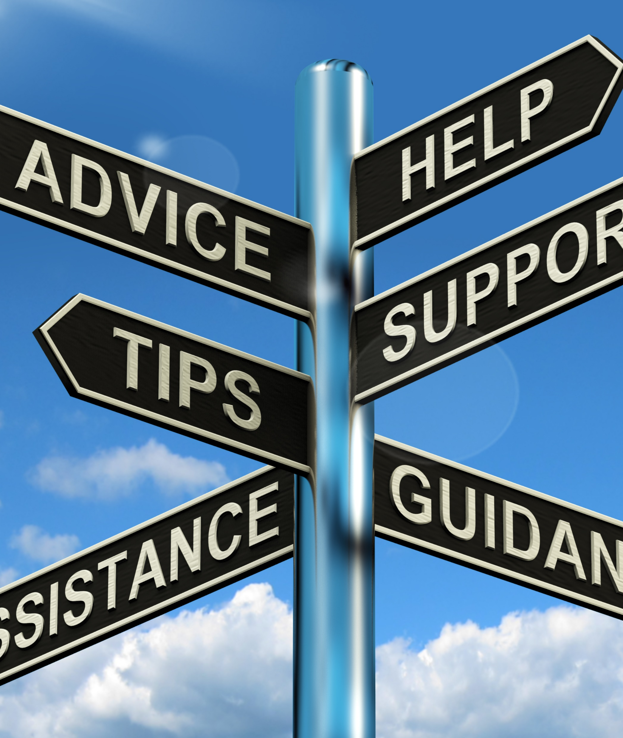
7. Know Your Limits and Ask for Help
Resources
UMB Employee Assistance Program
Professional Development Coaching for UMB Faculty
Faculty Center for Teaching and Learning Consultations
Integrative Health and Wellness Certificate Program

Slide 12
Thank you!
Michelle Pearce, PhD
Email: Michelle.Pearce@umaryland.edu
Website: www.DrMichellePearce.com
IG: @bloomwithdrmichelle

Slide 13
References
Hall, D., Millstein, R., Luberto, C., et al. (2020). Responding to COVID-19 stress: Disseminating mind-body resiliency approaches. Global Advances in Health and Medicine, 9. https://doi.org/10.1177/2164956120976554
Hall, DL, Luberto, CM, Philpotts, LL, et al. Mind-body interventions for fear of cancer recurrence: a systematic review and meta-analysis. Psycho-Oncology. 2018; 27(11):2546–2558.
Luberto, CM, Shinday, N, Song, R, et al. A systematic review and meta-analysis of the effects of meditation on empathy, compassion, and prosocial behaviors. Mindfulness. 2018; 9(3):708–724.
National Academies of Sciences, Engineering, and Medicine. Taking Action Against Clinician Burnout: A Systems Approach to Professional Well-Being. Washington, DC: The National Academies Press; 2019.
Park, ER, Perez, GK, Millstein, RA, et al. A virtual resiliency intervention promoting resiliency for parents of children with learning and attentional disabilities: a randomized pilot trial. Matern Child Health J. 2020; 24(1):39–53.
Shanafelt, TD, Noseworthy, JH. Executive leadership and physician well-being: nine organizational strategies to promote engagement and reduce burnout. Mayo Clin Proc. 2017; 92(1):129–146.

