Slide 1
A Hybrid Healthcare Curriculum Schedule that Promotes Wellness and Avoids Zoom-Fatigue
Andrew Coop, PhD
Professor and Associate Dean for Academic Affairs
Shannon Tucker, MS, CPHIMS
Assistant Dean of Instructional Design and Technology

Slide 2
Objective
Virtual delivery of didactic education is the future, but “zoom-fatigue” severely limits student learning. This session will focus on an approach by the University of Maryland to incorporate limited synchronous activity at regular times across all courses in a class year.

Slide 3
Definition: Zoom-Fatigue
exhaustion with overuse of virtual platforms
Sharp EA, Norman MK, Spagnoletti CL, Miller BG. Optimizing Synchronous Online Teaching Sessions: A Guide to the “New Normal” in Medical Education. Academic Pediatrics. 2021, 21, 11-15. http://www.washingtonpost.com/education/2020/09/06/remote-learning-college-zoom/

Slide 4
Notes:
Poll Title: Do not modify the notes in this section to avoid tampering with the Poll Everywhere activity. More info at polleverywhere.com/support Has your well-being been impacted by "Zoom-fatigue" during the 2020-2021 academic year? https://www.polleverywhere.com/clickable_images/uhDOIhrv77oeiUHNbEDHy

Slide 5
The Problem
“Zoom uses a lot cognitive energy because it violates so many social norms”
…yet..
Academic classes scheduled all day
Sharp EA, Norman MK, Spagnoletti CL, Miller BG. Optimizing Synchronous Online Teaching Sessions: A Guide to the “New Normal” in Medical Education. Academic Pediatrics. 2021, 21, 11-15.
Rutledge PB. Suffering From Zoom Fatigue? Here’s Why. Psychology Today, November 19, 2020. Accessed January 28, 2021.
Supiano B. Teaching: How to Give Students a Break From Their Screens — in an Online Course. The Chronicle of Higher Education, October 15, 2020. Accessed January 28, 2021

Slide 6
The Spring 2020 Pivot – lessons learned
Emergency remote instruction
Maintained academic and exam schedules
East-coast time zone
8:30-5pm
Student, Faculty, and Staff feedback showed negative effects on well-being
Fall 2020 solution: a student-centered, coordinated approach to scheduling that limited synchronous time across the entire curriculum

Slide 7
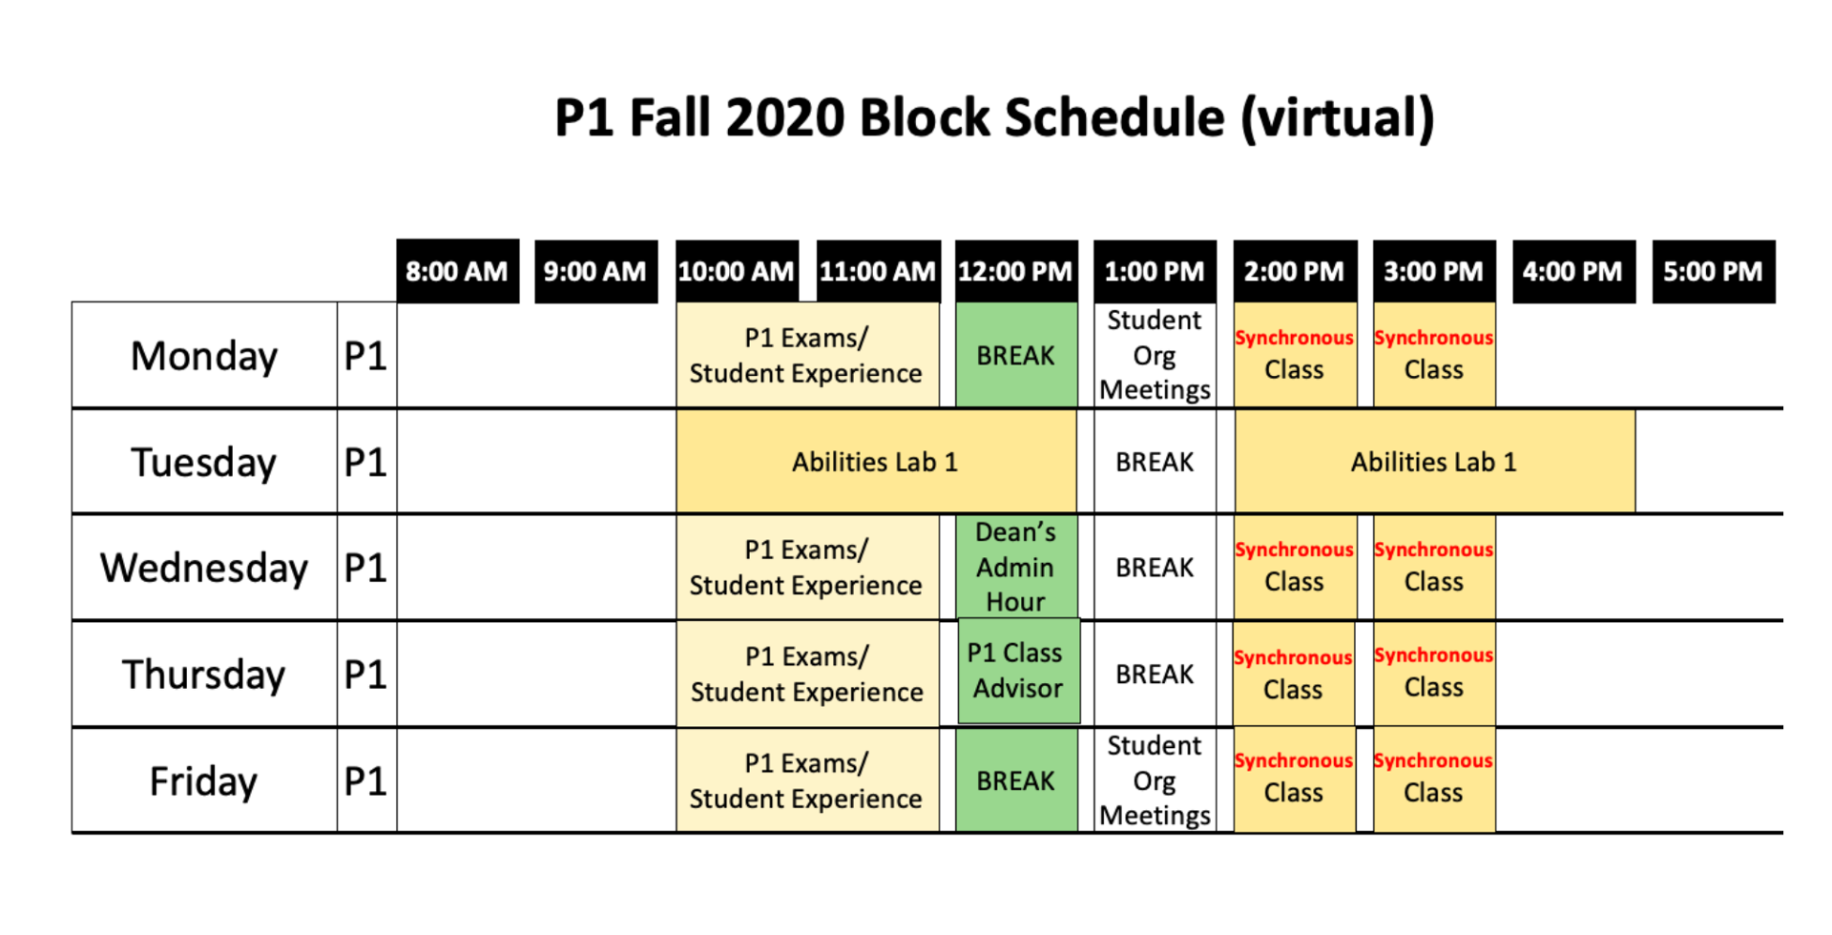

Slide 8
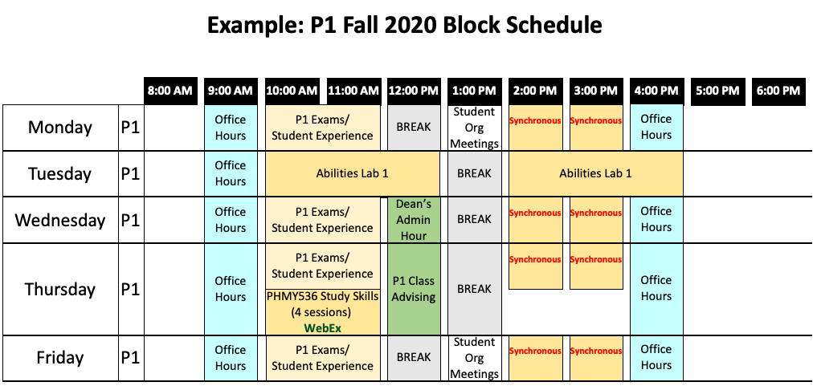

Slide 9
Transition Support
Instructional Design and Academic Affairs staff assigned to each course to
guide the transition from in-person to distance learning
support the use of best-practices in distance education for asynchronous and synchronous activities
coordinate technology support needs during the transition
Regular course manager meetings were scheduled to balance instructional preferences and optimize student learning

Slide 10
Student Workload
Managing perceptions of course “bloat” or the increase of assignments and asynchronous activities
Reinforce the use of Carnegie Units
Transition from seat-time to total workload
Adoption of the Wakeforest Workload 2.0 Calculator
Inclusion of estimations on course syllabi

Slide 11
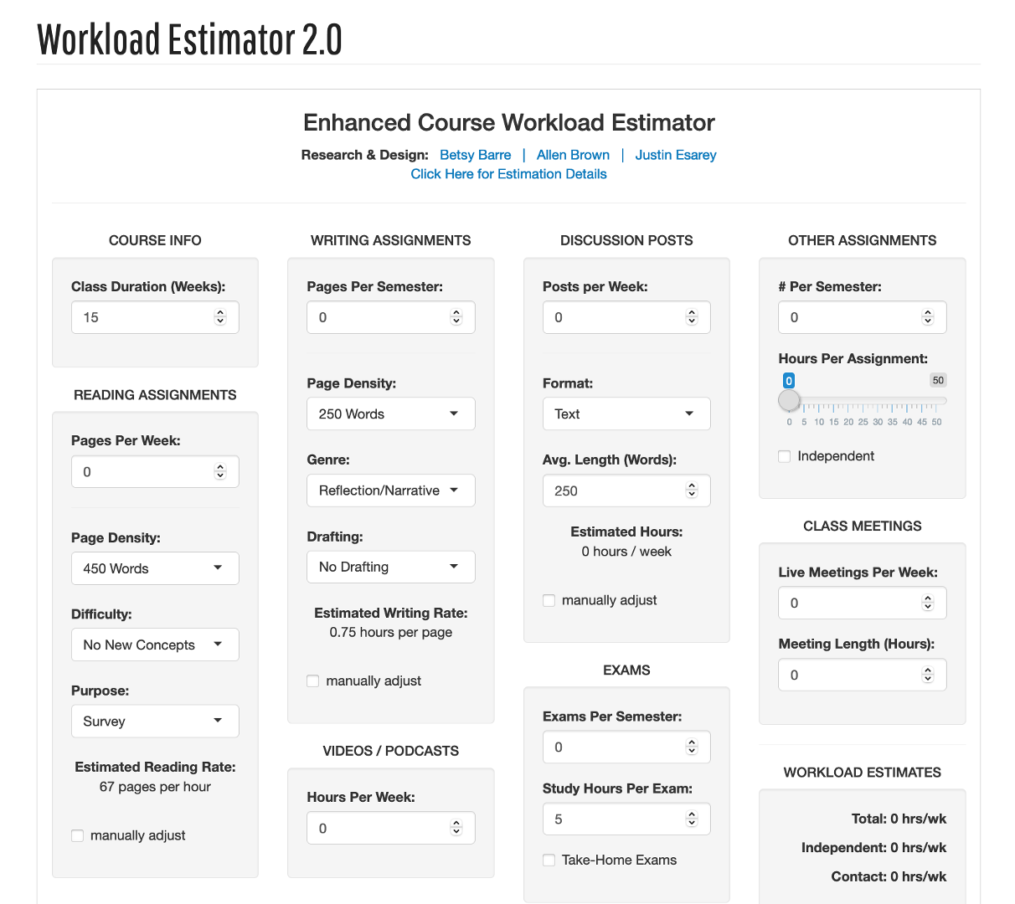
Wakeforest University Center for the Advancement of Teaching. (2020, September 14). Workload Estimator 2.0.
https://cat.wfu.edu/resources/tools/estimator2/.

Slide 12
1 cr. course = 45 hours max | 2 cr. course = 90 hours max | 3 cr. course = 135 hours max
Over 15 weeks = 3 hrs/wk | Over 15 weeks = 6 hrs/wk | Over 15 weeks = 9 hrs/wk
Over 7 ½ weeks = 6 hrs/wk | Over 7 ½ weeks = 12 hrs/wk | Over 7 ½ weeks = 18 hrs/wk
Over 5 weeks = 9 hrs/wk | Over 5 weeks = 18 hrs/wk | Over 5 weeks = 27 hrs/wk
Notes:
Poll Title: Do not modify the notes in this section to avoid tampering with the Poll Everywhere activity. More info at polleverywhere.com/support How do you calculate credit hours? https://www.polleverywhere.com/free_text_polls/3o66W14HukMSTuuqkBApu

Slide 13
Assessment
 | faculty Total | student Total | FAC | STU
Amount of sync.
just right | 21 | 110 | 49% | 61%
too little | 9 | 32 | 21% | 18%
too much | 2 | 18 | 5% | 10%
unable to judge | 11 | 20 | 26% | 11%
Grand Total | 43 | 180 | 100% | 100%
 | faculty Total | student Total | FAC | STU
Length of sync. windows
just right | 25 | 127 | 58% | 71%
too long | 4 | 27 | 9% | 15%
too short | 3 | 8 | 7% | 4%
unable to judge | 11 | 18 | 26% | 10%
Grand Total | 43 | 180 | 100% | 100%
Similar results for “time of windows”, and “time of exams”

Slide 14
Conclusions
The regular, limited synchronous sessions allowed a regular schedule, so both students and faculty could plan around those sessions.
Written feedback showed improved student liking compared to the Spring 2020 pivot without such planning.
The approach requires significant collaboration between faculty in different courses, and therefore a leader to facilitate the schedule for the benefit of the wellness of the students.
The assignment of Instructional Designers was critical
A proposed schedule for completing asynchronous activities was useful for students

Slide 15
Notes:
Poll Title: Do not modify the notes in this section to avoid tampering with the Poll Everywhere activity. More info at polleverywhere.com/support What is the biggest obstacle to implementing this approach at your school/institution? https://www.polleverywhere.com/free_text_polls/tkUur99qJuPclvvrZ7bxj

