Slide 1
Office of Educational Support and Disability Services (ESDS)
How to Support
Students with Disabilities
Deborah Levi, LCSW-C, MA
Director, ESDS
University of Maryland, Baltimore
Notes:
Start Recording…

Slide 2
Agenda
Background: ESDS Office and Staff
What is the ADA?
ESDS and the Accommodations Process at UMB
Types of Accommodations
Rights and Responsibilities
Web Accessibility at UMB
Supporting Students with Disabilities
Q & A

Slide 3
ESDS Office Staff Members
Deborah Levi (she/her), LCSW-C, MA- Director
Zanne Gogan (they/them)- Testing Center Coordinator
Heather Moore (she/her)- Educational Access Coordinator
Notes:
Within our office we also have 6 students that work as Test Proctors in our Testing Center, and 113 students who work as a peer note taker and are awarded Educational Access awards for this role.

Slide 4
ESDS Liaisons
School of Dentistry: Kelly Powers
Dental Hygiene Program: Kelly Powers
DMRT: Eileen Patton
Genetic Counseling Program: Shannan Dixon, MS, CGC
Graduate School: Nyasha Williams
GPILS: Elice Garcia-Baca
Public Health: Andrea Manning, MS
Physical Therapy: Doug Savin, PT, PhD
School of Law: Michele Hayes, JD, LLM
School of Medicine: Jennifer Llewellyn, MEd
School of Nursing: Ann Mech, RN, JD, Susan Wozenski, JD, MPH
School of Pharmacy: Margaret Hayes, MS
School of Social Work: Dawn Shafer, LCSW-C
School of Social Work, PhD: Charlotte Bright, MSW, PhD
Notes:
The ESSDS Office works with the Liaisons from the various schools who approve or deny the suggested accommodations based on the technical requirements of the course and/or program.

Slide 5
What is the ADA?
The Americans With Disabilities Act (“ADA”) prohibits the University from discriminating against qualified persons with disabilities.
Qualified: The ability to perform the essential academic/job requirements with or without reasonable accommodation
Disability: A physical or mental impairment that substantially limits a major life activity (e.g. walking, breathing, thinking, concentrating, and learning)
Notes:
Mobility and Sensory are often first thought of- wheelchair user, service animal user, person who is Deaf
But many other non-apparent conditions are covered by the ADA:
Mental Health- psychologic diagnoses
Chronic Illness-
Learning Disabilities
ADHD
Allergies

Slide 6
ADA: Background of the Laws
ADA 1990; ADAAA 2008
Section 504 of the Rehabilitation Act of 1973
Notes:
The two primary federal laws that protect people with disabilities from discrimination in higher educational settings like colleges and universities are the Americans with Disabilities Act of 1990, and Section 504 of the Rehabilitation Act of 1973 (Section 504).2 Congress subsequently expanded protection for people with disabilities under the ADA through passage of the ADA Amendments Act of 2008 (ADAAA). In this guide, we use "the ADA" to refer to both the original 1990 Act and the 2008 Amendments Act because they are applied as a single body of law.
Specifically, Title II of the ADA prohibits all state and local governmental entities, including public colleges and universities, from discriminating against people with disabilities.
Section 504 prohibits “any program receiving federal financial assistance” from discriminating against an individual because of his or her disability. Section 504 covers any college or university that receives direct or indirect federal financial assistance, including those that accept students who receive federal financial aid. Thus, Section 504 covers almost all colleges and universities.
https://adata.org/learn-about-ada
http://www.disabilityrightsca.org/pubs/530901.pdf

Slide 7
Students with Disabilities Statistics
SWD are 19% of general student population (National Center for Education Statistics, 2018)
7,573 total UMB students enrolled
Received accommodations with ESDS- 299 students
Percentage- 3.9%
Notes:
UMB Stats are 2019.
Why the significant gap?
Under reporting? Coping Skills? Undiagnosed? Access to providers? Stigma? May not be aware that they are eligible to academic accommodations? Concern to disclose? Shame?

Slide 8
ESDS Mission, Values, and Services
Mission: ESDS works with UMB students, faculty and staff to facilitate academic success and to make education accessible regardless of ability.
Values:
1. Accommodate
• Provides students with disabilities academic accommodations through an interactive process.
• Serves all UMB students through academic coaching and educational workshops.
2. Support
• Creates a safe space for UMB community to discuss disability and academic success.
• Trains and consults with UMB community on best practices impacting disability and student learning.
3. Advocate
• Creates programs and presentations around disability awareness.
• Promotes an accessible campus community.

Slide 9
ESDS Functions
Provides students with disabilities reasonable academic accommodations, after the student initiates and completes the interactive process that involves the student, ESDS, and the school.
Manages the Testing Center for students who are connected to our office
Provides all UMB students opportunities for educational support:
  Workshops- learning and study strategy; disability awareness
  Academic Coaching Services
Notes:
Reasonable accommodations are modifications or alterations intended to provide equal access or improve accessibility to physical, programmatic, and academic areas of the University.
Institutions are able to determine how to implement ADA accommodations.
UMB follows the AHEAD guidelines, and reviews the request in a specific manner that will be addressed on the next slide. ESSDS is a three-person office; we work closely with colleagues from across campus, the state and the USM system. Work closely with Association on Higher Education and Disability (AHEAD).
https://www.ahead.org/

Slide 10
Accommodations Process at UMB
1. Complete the Disability Disclosure and Reasonable Accommodations Form online. This form must be submitted each semester in which students require accommodations.
2. Submit appropriate medical documentation.
Documentation should be current and is evaluated on a case-by-case basis.
University System of Maryland (USM) Documentation Guidelines
3. Meet with ESDS staff for an initial appointment to discuss barriers to access, accommodations, and services they may need.
Notes:
Students enrolled at the University of Maryland, Baltimore (UMB) who wish to receive accommodations and services must identify themselves as having a disability and register with ESDS. Completion of the form will initiate a process designed to confirm that the student has a disability and to identify and implement reasonable accommodations agreed upon between the student and her/his school.
*In keeping with the provisions of the ADA, an accommodation will not be approved (1) that is incompatible with the technical standards for admission to, and completion of the program; (2) that alters the fundamental nature of the academic program; (3) that would result in a risk to the health or safety of the student or another individual; or (4) that would result in undue hardship to the University. A decision that an accommodation would result in undue hardship due to its cost must be approved by the Assistant Vice President of Student and Academic Affairs. Proposed accommodations will also incorporate any school specific practices for handling of disabilities. UMB may offer alternative accommodations that differ from those suggested by the student.

Slide 11
Accommodations Process at UMB
Once the process is complete and the ESDS Liaison has approved their accommodations request, students will receive an email notifying them that their approved accommodations letter is ready to be downloaded. The letter does not reveal the nature of their disability.
Students are expected to provide the approved letter to the faculty members or others who will be involved in the process of coordinating and implementing their accommodations. In some schools they work directly with the ESDS liaison.
Notes:
Students are NOT required to disclose any disability related information.

Slide 12
Reasonable Accommodations
Examples of Reasonable Accommodations
Use medication, ramps, audio devices
Exceptions to rules (e.g. when breaks are taken to accommodate an insulin user, use of computer),
Sign language interpreters,
Extra time on tests, tests in alternative formats,
Allowing service animals in class
Examples of Accommodations that are NOT Reasonable:
Waivers to program/course requirements
Personal attendants/services/aids;
Excuses for bad behavior, like cheating;
The very best and most expensive accommodation that exists

Slide 13
Testing Accommodations
Alternate exam format (paper or computer)
Use assistive technology, such as reading/writing software (e.g., Kurzweil, Dragon Dictate)
Calculator or scrap paper
Extended time on exams
Large print exams
Minimal distraction testing environment
Reader- human or use of software
Scribe
Spell check

Slide 14
Classroom Accommodations
Adaptive furniture or equipment
Access to visual aids/Power Points
Access to recorded lectures
Captioned videos
Exit classroom when symptoms occur
Sign Language Interpreter
Transcription services
Note-taking Services
Specific Seating
Use of laptop computer for notes or in-class writing assignments
Notes:
Questions one may ask regarding a service animal:
Is the dog a service animal required because of a disability?
What work or task has the dog been trained to perform?

Slide 15
Other Accommodations
Extra time on written assignments
Dress code exceptions
Temporary Accommodations for acute conditions
Alternate formats of textbooks and course materials (ex. Braille, electronic, or enlarged formats)
Classroom moved to accessible location
Notes:
Related to accessible technology/course materials:
“‘Accessible’ means a person with a disability is afforded the opportunity to acquire the same information, engage in the same interactions, and enjoy the same services as a person without a disability in an equally effective and equally integrated manner, with substantially equivalent ease of use. The person with a disability must be able to obtain the information as fully, equally and independently as a person without a disability.
https://www.umaryland.edu/cpa/toolbox/website-manual/prepare/accessibility/creating-accessible-documents/

Slide 16
University/School’s Rights
Schools have the right to:
Require that students with disabilities request accommodations through ESDS office. Requested accommodations are not retroactive.
Require students to meet all program/course requirements and standards.
Consult with the School Liaison and/or ESDS staff if he/she feels that requested accommodations are not appropriate for a particular course or situation.
Provide input on how approved accommodations will be provided in a particular course.
Require that students engage in appropriate, non-disruptive behavior in the classroom and to take appropriate action to remove a student who is disruptive.
Require that students follow University/Department policies and procedures.
Notes:
NOTE: In accordance with the ADA, faculty do not have the right to question whether a disability exists or examine a student‘s disability documentation when the disability has been adequately documented and is on file with ESESDS. The student's accommodations letter, approved by the ESESDS Liaison and signed by the Director of ESESDS, will act as assurance that the student has provided adequate documentation of the disability and requested accommodations.

Slide 17
University/School’s Responsibilities
Schools have the responsibility to:
Refer all students who self-identify as having a disability and need to request accommodations to ESDS.
Work with ESDS and student to make courses, viewed in their entirety, accessible (e.g., content, texts and materials, assessment method, on-line instruction, time requirements).
Work cooperatively with locations that serve as affiliates, clinical rotations, and field placements, to assist implementation of appropriate reasonable accommodations for students (if applicable).
Support and implement reasonable accommodations as identified in an Accommodations Letter from ESDS.
Consult with the School Liaison and/or ESDS if requests conflict with course objectives/requirements.
Protect student’s privacy and confidentiality.
Assist ESDS with identifying student assistants (i.e. note takers, readers, scribes) when applicable.

Slide 18
What is does it mean to be Accessible?
Definition: The inclusive practice of ensuring people of all abilities are given equal access to information and functionality.
Examples:
  Websites and documents can be read by screen reader software
  Videos or recorded lectures are captioned
  Course materials and readings
    Do not Xerox a reading- it shows as a picture
Notes:
Its best practice, it’s inclusion, and its UMB Policy…

Slide 19
Web Accessibility
UMB Policy on Web Accessibility:
UMB recognizes web based content is integral to academic and administrative work of the organization. UMB will establish equitable access to information, programs and activities on UMB Web Based Content accessible to people with all abilities. This Policy applies to UMB Websites, regardless of whether they are built by UMB staff or Suppliers.
Notes:
Its best practice, it’s inclusion, and its UMB Policy…
As of October 4, ,2019

Slide 20
Resources Available to Help You with Accessibility
UMB Web Accessibility page
  Located on the bottom of all UMB webpages
  Instructions for Accessible documents
  Accessibility guidelines for webpages
  Communications and Public Affairs (CPA) Office hours
School IT departments
Faculty Center for Teaching and Learning
  Short videos on how to make Word, PDF, PPTs accessible

Slide 21
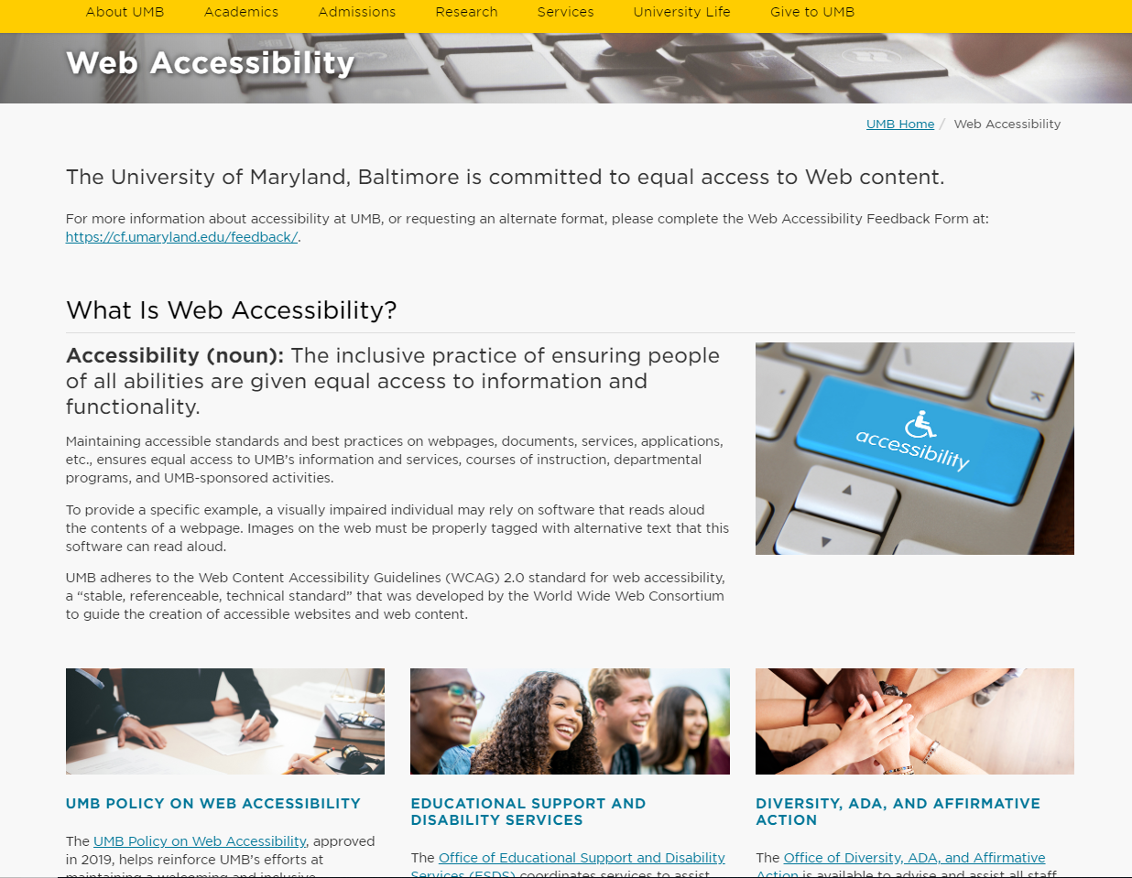

Slide 22
How to Support students with LD and ADHD in Graduate School?
Provide advance information about course expectations and requirements - this includes early distribution of syllabi, assignments, and readings, and PPTs/lecture materials
Provide structure that more clearly distinguishes main and supporting ideas and shows the relationship of parts of a whole; ex. lecture objectives will assist with studying.
It is helpful to outline the class sessions and have recordings and notes available on the web
Provide students with feedback on their performance so that they can modify their learning strategies
Notes:
Fall 2019 statistic- At our institution, 43% of students registered at ESDS were either diagnosed with a learning disability and/or ADHD (Here are some techniques
Example- car navigation. Giving students all the information in a clear and/or multiple ways, removes barriers from getting to point A to point B (understanding and synthesizing the content to be successful as a professional).

Slide 23
Communicating with the Student
Respect Confidentiality
Do not ask about ADA diagnosis
  Work collaboratively with student
  How can I help you learn best in this course?
Stay in role as educator- refer student to ESDS consultations or counseling center if needed
Need some consultation around a specific situation?
  Contact ESDS office
Notes:
Here are some techniques faculty can utilize to help facilitate an open conversation:
Respect Confidentiality: Many students with disabilities are hesitant to let others know about their disability. Faculty members need to respect the student’s privacy when providing accommodations. This means that faculty members should not discuss disability-related matters with the student when other students are present unless the student approves.
Work Collaboratively with the Student: the faculty member and the student have the same end goal; to provide the student with a sound learning experience as a part of their graduate study. Additionally, the student would be the expert on how he/she best learns and works with their disability. Therefore, it is advised to speak openly about how you can best accommodate the student and work collaboratively to come up with alternative when needed.
Refer student for Coaching if needed: if you think a student is struggling academically or feeling overwhelmed, they may benefit from academic coaching offered by ESESDS. You may suggest to the student to make an appointment with ESESDS to discuss his/her challenges and work with a coach to create a strategy to achieve their goals.
Faculty Training and Consultation: for specific assistance with working with students with disabilities, faculty members are encouraged to contact ESESDS for training or consultation. Please contact your ESESDS provider.

Slide 24
Disability is Diversity:
Campus-wide Considerations
Mention the ADA and accommodations information:
  On admissions webpages
  At orientation- ESDS will travel and talk!
  At workshops and programs; on flyers add: If you are in need of an accommodation, please contact us at: x@umaryland.edu.
Use similar language to how the student choses to Identify or Person-first language (Student with a disability)
Discuss in course content; not using deficit perspective

Slide 25
How to be an Ally to Students with Disabilities
Syllabus
  Put Disability statement
  Provide a grievance policy
  Place to provide feedback anonymously
Consider your Teaching Style
  Please use the microphone, show captions on any video-clips
  Talking too fast; reading aloud what is on the PPT slide
  Put objectives for each lecture
  Multiple modes of content delivery (oral and written); Use the notes sections of PPTs to put in content you would include in the lecture; provide all students with PPTs prior to class.
Consider the student as your partner in the learning process
  Avoid making assumptions of their abilities
  Ask for input or feedback
Notes:
**This does not only help students with disabilities, but also, students with English as their second language, international students, and potentially all students. Goal is to have the students learn the material and be successful professionally.

Slide 26
Additional Accessibility Considerations
Questions one may ask regarding a service animal:
  Is the dog a service animal required because of a disability?
  What work or task has the dog been trained to perform?

Slide 27
Helpful Resources
DOJ Website - http://www.ada.gov/
AHEAD - https://www.ahead.org/
ADA National Network
https://adata.org/learn-about-ada
Universal Design http://www.udluniverse.com/
DO-IT - https://www.washington.edu/doit/
Disability Studies
http:/www.missouristate.edu/disability/117153.htm
Pepnet - http://www.pepnet.org/
Notes:
DOJ: Laws and statues
AHEAD (Association of Higher Education and Disability): Professional membership organization for individuals involved in the development of policy and in the provision of quality services to meet the needs of persons with disabilities involved in all areas of higher education.
ADA National Network: Provides guidance and training on the ADA
UDL Universe: First link is to UDL Universe, A Comprehensive Universal Design for Learning Faculty Development Guide. The second is to a great annotated list on the AHEAD resources page.
Disability Studies: Begin looking at disability as a part of diversity and value it as an integral part of life. First link is to the Society for Disability Studies and a the second link goes to a comprehensive list from Missouri State that is provided to faculty.
DO-IT: Disabilities, Opportunities, Internetworking and Technology: From University of Washington. Promotes the success of individuals with disabilities in postsecondary education and careers, using technology as an empowering tool. Specifically look into the faculty room.
Pepnet: Their mission is to increase the educational, career and lifetime choices available to individuals who are deaf or hard of hearing. Their site offers great resources for faculty and staff, training opportunities (e.g. note taker training).

Slide 28
Hear from the Students’ Perspective
ESDS Student Panel:
March 12, 2020 at 12 pm- 1 pm
SMC Room 351
Join in on the discussion of inclusion and accessibility. Current UMB students with disabilities will share their stories, discuss issues impacting students with disabilities both in and out of the classroom, and ways to promote acceptance and empowerment. Lunch will be provided.

Slide 29
Contact Information
Deborah Levi, LCSW-C, MA
dlevi@umaryland.edu
410-706-7505
Notes:
Stop Recording…then, ask for questions

