Slide 1



The Geriatric Assessment Interdisciplinary Team (GAIT) Project
AHEC West
Central Maryland AHEC
Eastern Shore AHEC

Slide 2
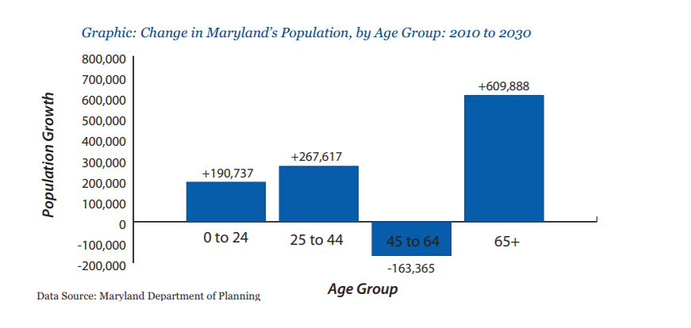
Funded by the Geriatrics & Gerontology Education and Research (GGEAR) program at University of Maryland, Baltimore Graduate School
GGEAR AND Its Purpose…
University-based program facilitating interprofessional educational, research, and service activities in the field of aging in partnership with campus affiliates and agencies & organizations serving Maryland’s older adults and their caregivers
Promote an age-educated workforce with the knowledge and tools to meet the needs and wants of our growing population of older adults

Slide 3
Sampling of GGEAR Activities
Guest lecture courses across USM to stimulate interest in geriatric health & social service careers
Partnership with the Center on Research on Aging to support interprofessional research opportunities among UMB faculty & students
Serves on advisory boards (campus, state, national); collaborate with state and local agencies serving older adults in task forces; educational planning committees specific to older adults and their caregivers
Partner with faculty to integrate aging content into existing courses/programs, cultivate programs that complement curriculum and allow students to learn and work collaboratively in interprofessional settings
On-Campus Interprofessional Case Conferences
Clinical Training Program at local LTC sites
GAIT Program (open to all USM health & social science students; coordinated by AHEC West, ESAHEC, Central MD AHEC)
Supports educational outreach programs for healthcare profession students, practitioners, and the community throughout the state of Maryland
Caregiver Conferences in Southern MD, Howard Co
AHEC West, ESAHEC, Central MD AHEC

Slide 4
Connecting USM students to Geriatric Care in Rural and Underserved Sites
Central Maryland AHEC
Baltimore City,
Carroll, Harford, Howard, Baltimore, Anne Arundel,
Prince George’s counties
AHEC
West
UMB
School of Medicine
PROGRAM OFFICE
3.
Garrett , Allegany Washington, Frederick Counties
Allegany
Washington
Allegany
Allegany
Washington
Washington
Carroll
Cecil
Cecil
Garrett
Harford
Cecil
Garrett
Garrett
Harford
Frederick
Baltimore
Baltimore
Eastern Shore
AHEC
1.
Baltimore
City
Balt.
Howard
Balt.
Kent
Kent
Howard
City
Kent
Caroline, Cecil, Dorchester, Kent, Queen Anne’s, Talbot, Somerset, Wicomico and Worcester Counties
Montgomery
Anne
Anne
Queen
Arundel
Queen
Arundel
Anne’s
Anne’s
Car
Car
-
oline
-
oline
Talbot
Caroline
Prince
2.
Prince
Talbot
George’s
Talbot
George’s
Charles
Cal
-
Charles
vert
Calvert
Dorchester
Dorchester
Dorchester
Wicomico
Wicomico
St. Mary’s
Wicomico
St. Mary’s
Worcester
Worcester
2.
Somerset
Worcester
4.
Somerset
Southern Maryland Clinical SITE
AHEC Centers
1.
AHEC West
St. Mary’s County
2.
Eastern Shore AHEC
3.
Central Maryland AHEC
4.
Southern Maryland Clinical Site

Slide 5
Maryland AHEC Programs
Clinical Education
AHEC Scholars
Continuing Education
Learning Resources
Health Career Pipeline Programs
Community Partnerships
CHW Training Programs
Interprofessional Education for USM students
(GAIT) GERIATRIC ASSESSMENT INTERDISCIPLINARY TEAM

Slide 6
What is GAIT…
Unique NO COST interprofessional learning experience open to health and social service students attending USM institutions
Learning Outcomes
Increase sensitivity to challenges of later life and needs of older adults
Demonstrate understanding of comprehensive geriatric assessments (CGA)
Appreciate the value of interprofessional collaboration in providing quality person-centered geriatric care
Recognize career opportunities in geriatrics and gerontology
Identify resources to improve care in rural/underserved regions
Hosted by various health and community-based care settings throughout Maryland

Slide 7
Sampling of Recent GAIT Experiences…
TOPIC | SITE | COUNTY
Function & Independence = Quality of Life | Heron Point of Chestertown | Kent
Rehabilitation of the Amputee | Chesapeake Rehabilitation Hospital | Wicomico
NICHE- Nurses Improving Care for Health System Elders | Atlantic General Hospital | Worcester
Dementia Care | Chesapeake Woods | Dorchester
Maintaining Social Connections for Healthy Aging: HEARING for HEALTH | Homewood at Williamsport – Independent Living | Washington
Supporting Staying at Home: Accurate Assessment critical to Effective Care in ADS | Diakon Adult Medical Day Services | Washington
PREVENTING READMISSION: Geriatric Rehabilitation to Safe Discharge | WMHS - Comprehensive Inpatient Rehabilitation Unit | Allegany
Living in the Community with Dignity & Purpose: Partnering with Caregivers to Maximize Independence | Daybreak Adult Day Services | Frederick
ALL-INCLUSIVE CARE FOR OLDER ADULTS Supporting Living in the Community | ELDERPLUS Johns Hopkins Bayview | Baltimore City
COMMUNITY BASED HOSPICE CARE In a Rural Community | Hospice of Garrett County | Garrett

Slide 8
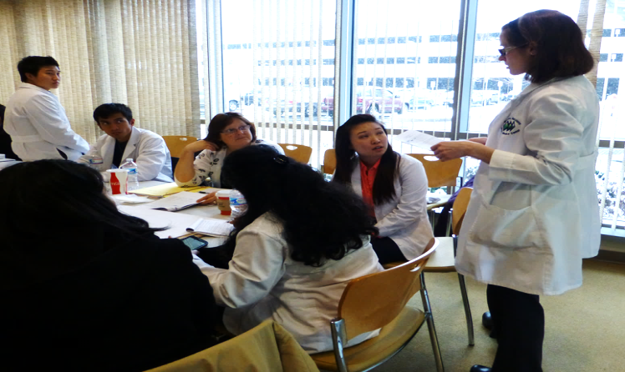
What to Expect…
Simulation activities to raise awareness of changes associated with aging
Team-building activities focused on
Principles of CGA
Effective person-centered communication
Principles of interdisciplinary collaboration
Site activities
Tour
Focus topic presentation
Team-based activities
Chart Reviews & Observations
Interviews with older adults, family and/or staff
Interdisciplinary Team Planning
Presentation to Group and Host Site Staff

Slide 9
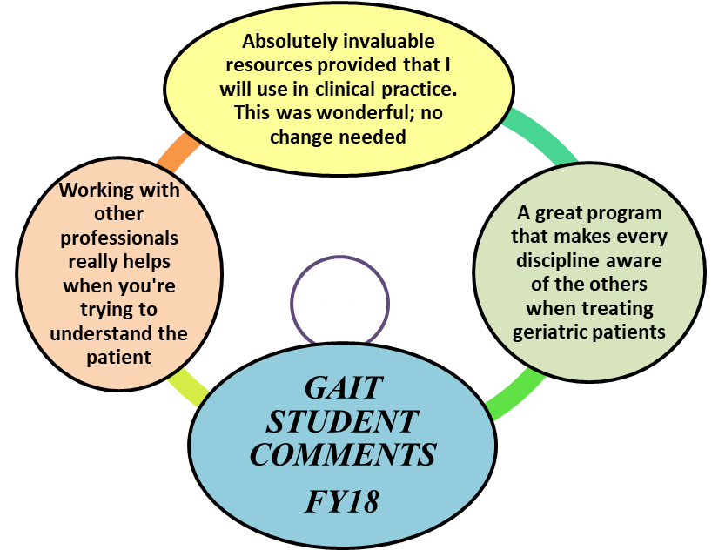
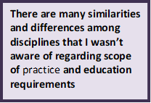
Student Reflections…

Slide 10
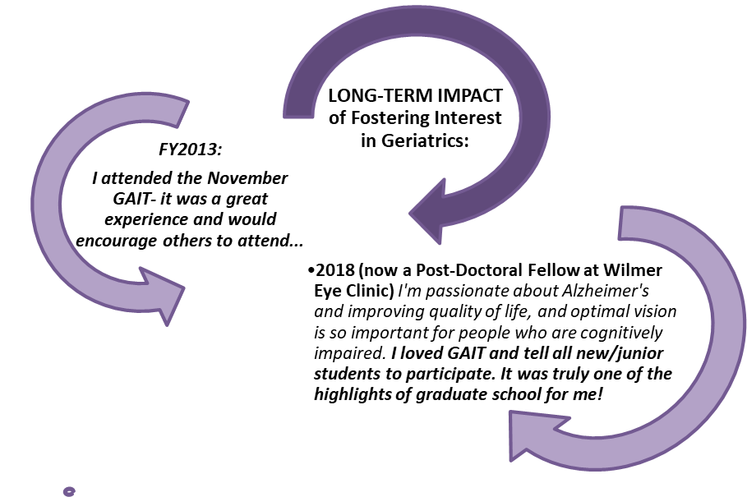
GAIT Impact…

Slide 11

GAIT Registration…
Check with your adviser at the start of each semester or the program calendar found on the GGEAR website (www.umaryland.edu/gerontology) for offerings and locations
Register online for the GAIT(s) that best fit your schedule
Check your email for confirmation and instructions
PLEASE contact the GAIT Coordinator
immediately if your plans to attend change!

Slide 12
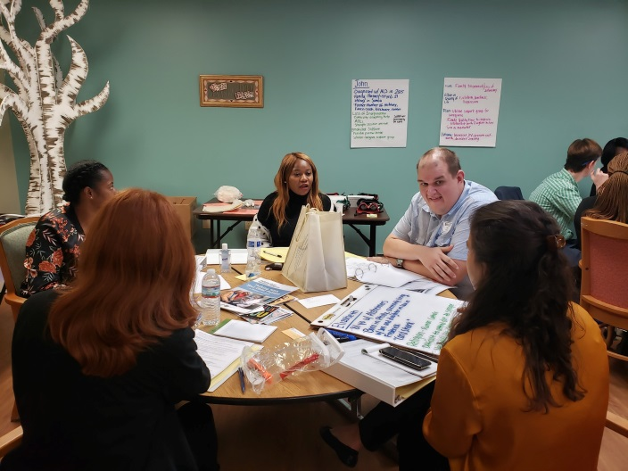
Contact Information...
Central Maryland Locations (www.centralmarylandahec.org)
GAIT Contact: Meredith Hochman (meredithhochman@centralmarylandahec.org)
Eastern Shore Locations (https://www.esahec.org/gait)
GAIT Contact: Pam Allen (pallen@esahec.org)
Western Maryland Locations (https://ahecwest.org/geriatric-programs/)
GAIT Contact: Joy Taylor (jtaylor@ahecwest.org)
General Information about GAIT or GGEAR
Diane Martin, Ph.D., director
410-706-4327 or diane.martin@umaryland.edu
www.umaryland.edu/gerontology

